Slide 1
The Post-IPocalypse Internet
Geoff Huston
APNIC

Slide 2
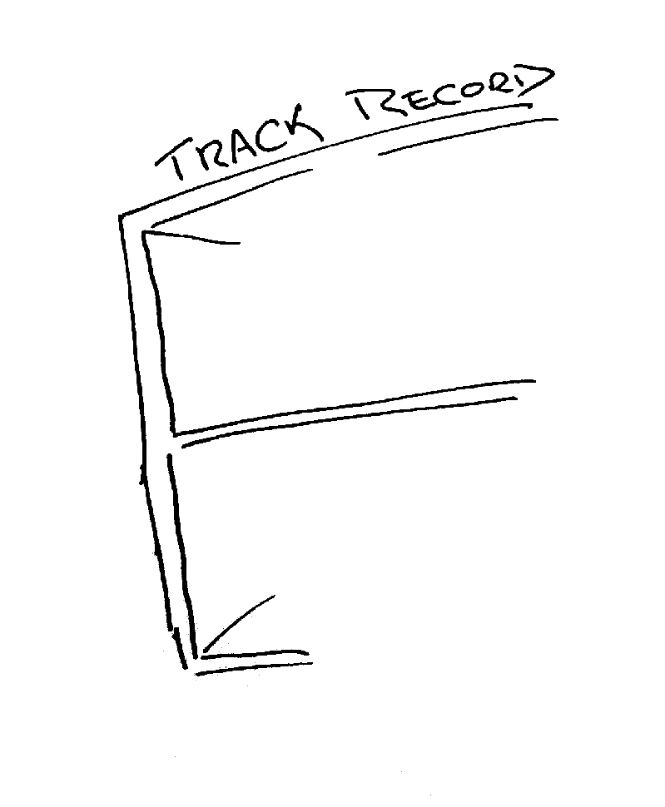
The mainstream telecommunications industry has a rich history

Slide 3


The mainstream telecommunications industry has a rich history
…of making very poor
technology choices

Slide 4


The mainstream telecommunications industry has a rich history
…of making very poor
technology guesses
and regularly being
taken by
surprise!

Slide 5
The Internet...
Has been a runaway success that has transformed not just the telecommunications sector, but entire social structures are being altered by the Internet!
And now we’ve used up most of the Internet’s 32bit address pool

Slide 6
The Internet...
Has been a runaway success that has transformed not just the telecommunications sector, but entire social structures are being altered by the Internet!
And now we’ve used up most of the Internet’s 32bit address pool
This is should not be news – we’ve known about
this looming IPocalypse for the past twenty years!

Slide 7
IETF Meeting – August 1990

Slide 8
IETF Meeting – August 1990

Slide 9
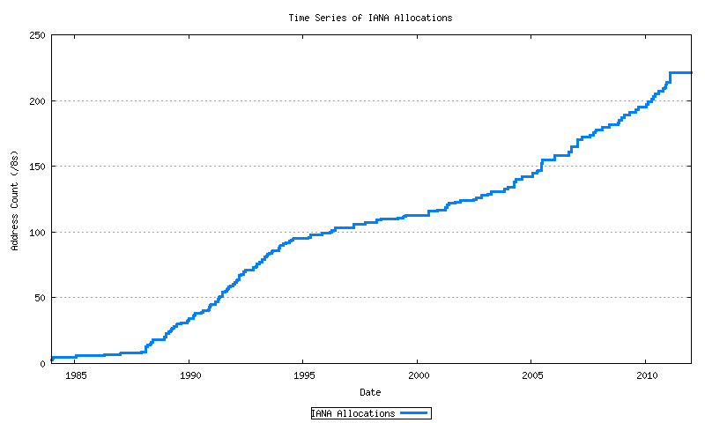
IPv4 Address Allocations
Class B Nets
A&R networks
NSFNET

Slide 10
What did we do back in 1992?
We bought some time by removing the CLASS A, B, C address structure from IP addresses

Slide 11
The CIDR Fix
Class-full
A&R networks
CIDR
NSFNET

Slide 12
What else did we do back in 1992?
And we started working on a new Internet Protocol – to become IPv6 - to replace IPv4
We left the task of transition until after we had figured out what this new protocol would look like

Slide 13
zzzzzz
For a while this did not look to be an urgent problem...

Slide 14
CIDR worked!
Class-full
CIDR
A&R networks
NSFNET

Slide 15
Meanwhile, we continued to build (IPv4) networks
Mobiles
Broadband
Boom & Bust
CIDR
A&R networks
NSFNET

Slide 16
The rude awakening
Until all of a sudden the IPv4 address piggy bank was looking extremely empty...

Slide 17
IPv4 Address Allocations
Exhaustion!
Mobiles
Broadband
Boom & Bust
CIDR
A&R networks
NSFNET

Slide 18
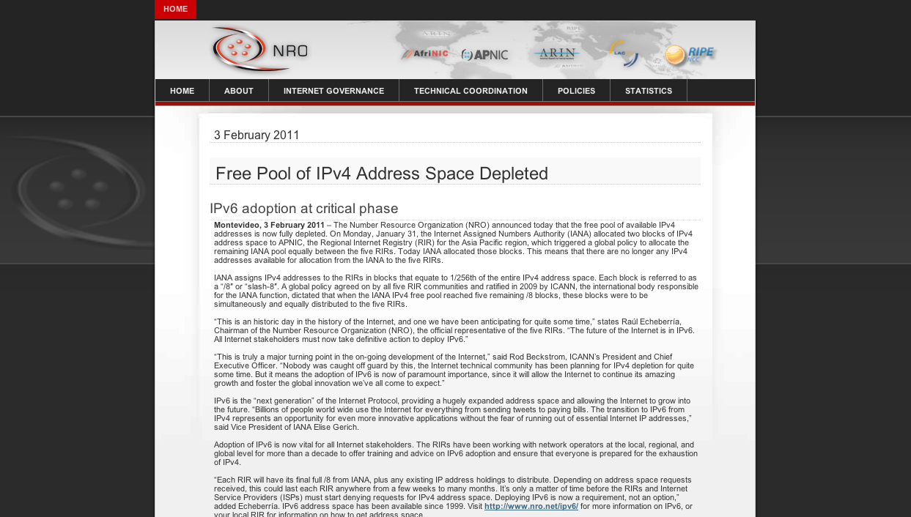
Ooops!

Slide 19
The rude awakening
Until all of a sudden the IPv4 address piggy bank was looking extremely empty...
And transition to IPv6 is suddenly a very important topic!

Slide 20
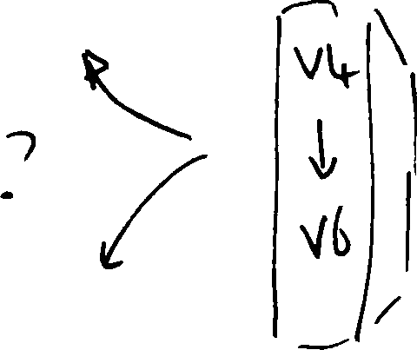
So, how are we going with the IPv4 to IPv6 transition?

Slide 21
Do we really need to worry about this?

Slide 22
Do we really need to worry about this?
Surely IPv6 will just happen – its just a matter
of waiting for the pressure of Ipv4 address
exhaustion to get to sufficient levels of intensity.

Slide 23
Do we really need to worry about this?
Surely IPv6 will just happen – its just a matter
of waiting for the pressure of Ipv4 address
exhaustion to get to sufficient levels of intensity.
Or maybe not – let’s look a bit closer at the situation ...

Slide 24
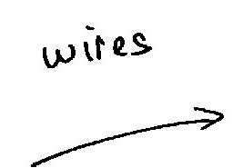
The “inevitability” of technological evolution

Slide 25
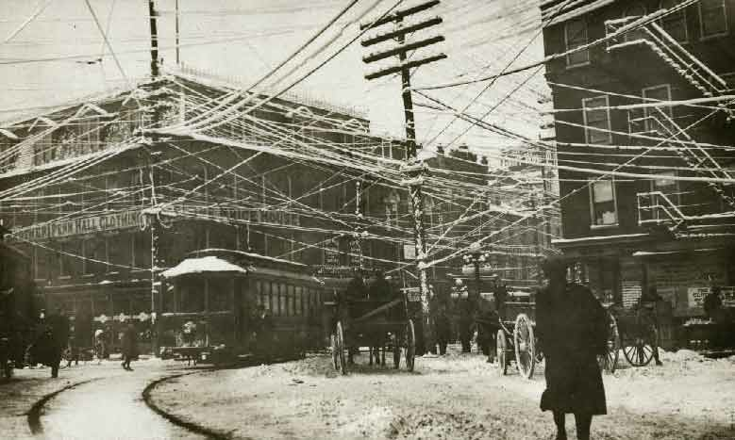

Slide 26

The “inevitability” of technological evolution

Slide 28
Well what did you expect? They are VIRTUAL circuits, so a picture was always going to be a challenge!

Slide 29

The “inevitability” of technological evolution

Slide 30
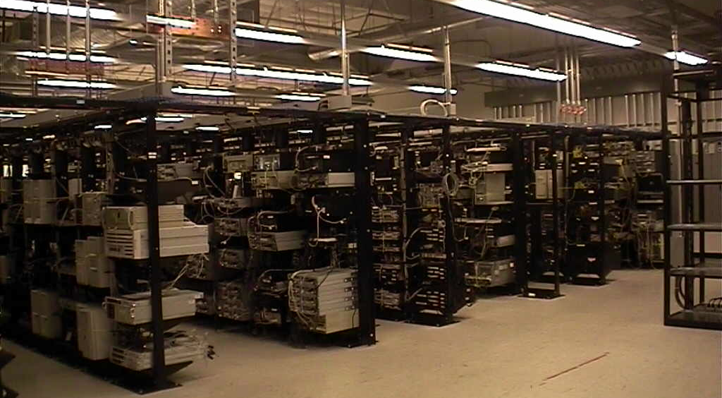

Slide 31
The “inevitability” of technological evolution
Each time we shifted the technology base of the network, the cost efficiencies of the “new” technology in effect motivated the shift from the older technology to the new

Slide 32
The “inevitability” of technological evolution
Now lets look at something a little more topical to today!

Slide 33

The “inevitability” of technological evolution?

Slide 34

The “inevitability” of technological evolution?

Slide 35


The challenge often lies in managing the transition from one technology to another

Slide 36
Option 1: Flag Day!
We all agree to turn off IPv4 and turn on IPv6 EVERYWHERE
All at the same time! All over the Internet!

Slide 37
Option 1: Flag Day!
We’re just too big!
We all agree to turn off IPv4 and turn on IPv6 EVERYWHERE
All at the same time! All over the Internet!

Slide 38
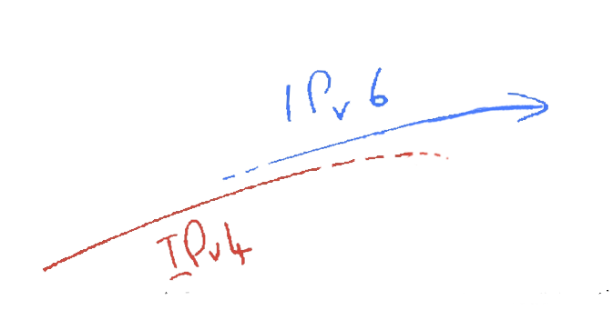
Option 2: Parallel Transition!
We start to slide in IPv6 in parallel with Ipv4
Then we gradually phase out IPv6

Slide 39
Option 2: Parallel Transition!
Size of the Internet
IPv6 Deployment
IPv6 Transition – Dual Stack
IPv4 Pool Size
Time
For this to work we have to start early and finish BEFORE IPv4 address pool exhaustion

Slide 40
Option 2: Parallel Transition!
We’re just too late!
We start to slide in IPv6 in parallel with Ipv4
Then we gradually phase out IPv6
The small print: It’s incredibly difficult for markets to plan without clear price signals, and we never managed to price future scarcity into the Internet model. Our chosen address distribution model was one that deliberately avoided any form of price-based market signaling. We sort of hoped that operators would price future risk. We were very wrong!

Slide 41
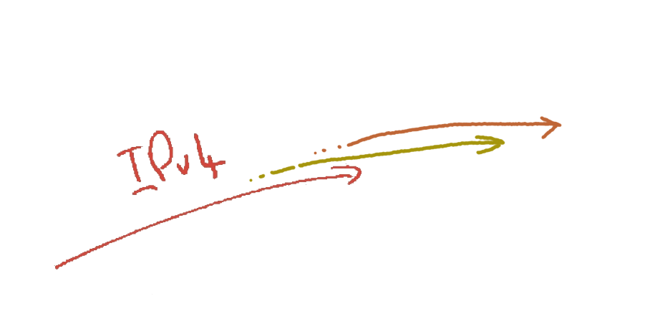
Hybrid IPv4
+ALGs
+CGNs
IPv4
The increasing scarcity of Ipv4 will force carriage providers to add address sharing mechanisms into the IPv4 network

Slide 42

To get from “here” to “there” requires an excursion through an environment of CGNs, CDNs, ALGs and similar middleware ‘solutions’ to IPv4 address exhaustion
Option 3: Hybrid Transition
IPv6
CGNs
IPv4
ALGs
CDNs

Slide 43
But will this be merely a temporary phase of transition?
IPv6
CGNs
IPv4
ALGs
CDNs
Transition requires the network owner to undertake capital investment in network service infrastructure to support IPv4 address sharing/rationing.

Slide 44
But will this be merely a temporary phase of transition?
IPv6
CGNs
IPv4
ALGs
CDNs
Transition requires the network owner to undertake capital investment in network service infrastructure to support IPv4 address sharing/rationing.
What lengths will the network owner then go to to protect the value of this additional investment by locking itself into this “transitional” service model for an extended/indefinite period?

Slide 45

The challenge often lies in managing the transition from one technology to another
IPv6
CGNs
IPv4
ALGs
CDNs
The risk in this transition phase is that the Internet carriage provider heads off in a completely different direction!

Slide 46
How can we “manage” this transition?

Slide 47
How can we “manage” this transition?
To ensure that the industry maintains a collective focus on IPv6 as the objective of this exercise!

Slide 48
How can we “manage” this transition?
To ensure that the industry maintains a collective focus on IPv6 as the objective of this exercise!
And to ensure that we do not get distracted by attempting to optimize what were intended to be temporary measures

Slide 49
How can we “manage” this transition?
This was always going to be a very hard question to try and answer!

Slide 50
How can we “manage” this transition?
The data on IPv6 uptake so far suggests that we are still not managing this at all well.

Slide 51
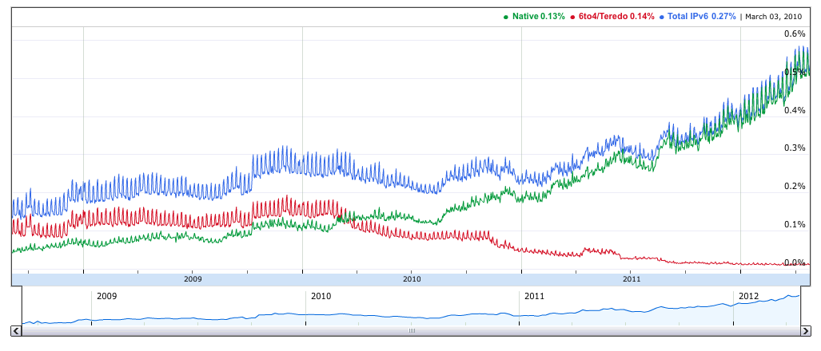
IPv6 capability, as seen by Google
In April 2012 only 0.5% of users access Google’s dual stack
services using IPv6
http://www.google.com/intl/en/ipv6/statistics/

Slide 52
Packet Counting...
Some 50% of the Internet’s transit ISPs support IPv6 transit
Some 50% of the Internet’s host devices have an active IPv6 stack
  and the rest run Windows XP!
But only 0.5% of the Internet actually uses IPv6!
  and the problem appears to lie in the last mile access infrastructure!

Slide 53
How can we “manage” this transition?
And the data on IPv6 uptake so far suggests that we are still not managing this at all well.
Progress at the customer edge of the network with IPv6 access is glacial.

Slide 54
The IPv6 Transition Plan - V2.0
Size of the Internet
IPv6 Deployment?
IPv6 Transition – Dual Stack
IPv4 Pool Size
???
2006
2008
2010
2012
2014
Date

Slide 55
What’s gone wrong?
It seems that we’ve managed to achieve only 2 out of 3 necessary prerequisites for IPv6 deployment
And the third area, the last mile access infrastructure, is once more proving to be very challenging

Slide 56
What’s gone wrong?
It seems that we’ve managed to achieve only 2 out of 3 necessary prerequisites for IPv6 deployment
To support further growth the access industry has to purchase Ipv4 addresses, deploy (and fund) IPv4 address extension mechanisms, in addition to funding an IPv6 deployment program

Slide 57
What’s gone wrong?
It seems that we’ve managed to achieve only 2 out of 3 necessary prerequisites for IPv6 deployment
To support further growth the access industry has to purchase Ipv4 addresses, deploy (and fund) IPv4 address extension mechanisms, in addition to funding an IPv6 deployment program
  Why has the access service sector been disinterested in any meaningful levels of IPv6 deployment so far?

Slide 58
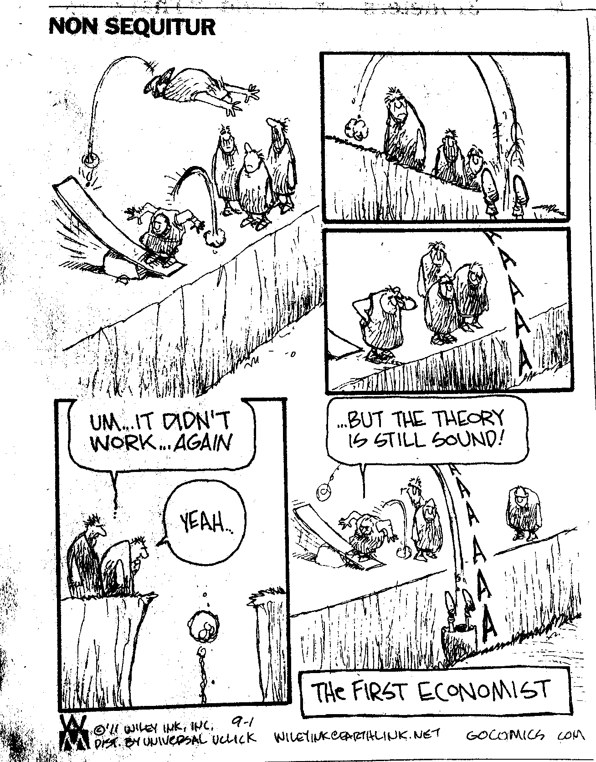
Economics!

Slide 59
Economics!
The Internet’s last mile access is mired in commodity utility economics. Relentless competition has resulted in a sector where margins are thin. A move to IPv6 represents expenditure without immediate revenue gain. This is classic case of economic dislocation in an unbundled industry, where expenditure in one sector:
-carriage- yields benefits in another sector: -content-

Slide 60
How can we “manage” this transition?
This was always going to be a very hard question to try and answer!
And at the moment we seem to be making the task even harder, not easier, by adding even more challenges into the path we need to follow!

Slide 61
Challenges:
This is a deregulated and highly
competitive environment

Slide 62

Challenges:
This is a deregulated and highly
competitive environment
It is NOT a case of a single
“either/or” decision
?
IPv6
IPv4 &
CGNs

Slide 63

Challenges:
This is a deregulated and highly
competitive environment
There are many different players
Each with their own perspective
?
?
?
?
?
?
?
?
?
?
?
?
?
?
?
?
?
?
?
?
?

Slide 64

Challenges:
This is a deregulated and highly
competitive environment
There are many different players
Each with their own perspective
?
And all potential approaches will be explored at
the same time!

Slide 65
Challenges:
This is a deregulated and highly
competitive environment
There is no plan!

Slide 66
Challenges:
This is a deregulated and highly
competitive environment
There is no plan, just the interplay of
various market pressures

Slide 67
Challenges:
This is a deregulated and highly
competitive environment
There is no plan, just the interplay of
various market pressures
2. Varying IPv4 Address Exhaustion Timelines

Slide 68
IPv4 Address Exhaustion – APNIC

Slide 69
Remaining IPv4 Address
Pools–All RIRs

Slide 70
Address Exhaustion Projections

Slide 71
Exhaustion Predictions
RIR | Predicted Exhaustion Date * | Remaining Address Pool (1 May 2012)
APNIC | 19 April 2011 (actual) | 1.16 /8s (0.3 /8s rsvd)
RIPE NCC | 13 August 2012 | 2.32 /8s
ARIN | 20 June 2013 | 5.08 /8s
LACNIC | 20 January 2014 | 3.65 /8s
AFRINIC | 4 November 2014 | 4.34 /8s
* Here “exhaustion” is defined as the point when the RIR’s remaining pool falls to 1 /8

Slide 72
So what?

Slide 73
Reality Acceptance

Slide 74
Reality Acceptance
Or not

Slide 75
Reality Acceptance
Or not
Is IPv4 address exhaustion a “here and now”
problem or a “some time in the future”
problem?

Slide 76
Reality Acceptance
Or not
Is IPv4 address exhaustion a “here and now”
problem or a “some time in the future”
problem?
Well, that depends on where you happen to be! If it hasn’t happened to you yet, then denial is still an option!

Slide 77
Reality Acceptance
Or not
Is IPv4 address exhaustion a “here and now”
problem or a “some time in the future”
problem?
It’s not happening until its happening to me!

Slide 78
Challenges:
This is a deregulated and highly
competitive environment
There is no plan, just the interplay of
various market pressures
2. Varying IPv4 Address Exhaustion Timelines
There is a credibility problem!

Slide 79
Challenges:
This is a deregulated and highly
competitive environment
There is no plan, just the interplay of
various market pressures
2. Varying IPv4 Address Exhaustion Timelines
There is a credibility problem: This
industry has a hard time believing
reality over its own mythology

Slide 80
Challenges:
This is a deregulated and highly
competitive environment
There is no plan, just the interplay of
various market pressures
2. Varying IPv4 Address Exhaustion Timelines
There is a credibility problem: This
industry has a hard time believing
reality over its own mythology
3. Regional Diversity

Slide 81
Today
IPv6
RIPE NCC
APNIC
IPv4
ARIN
CGNs
LACNIC
AFRINIC
ALGs
CDNs

Slide 82
Late 2012
IPv6
RIPE NCC
ARIN
CGNs
LACNIC
APNIC
IPv4
AFRINIC
ALGs
CDNs

Slide 83
2013
IPv6
RIPE NCC
ARIN
CGNs
LACNIC
IPv4
AFRINIC
ALGs
CDNs
APNIC

Slide 84
By 2013 it is possible that different regions of the world will be experiencing very different market pressures for the provision of Internet services, due to differing transitional pressures from IPv4 exhaustion

Slide 85
By 2013 it is possible that different regions of the world will be experiencing very different market pressures for the provision of Internet services, due to differing transitional pressures from IPv4 exhaustion
What’s the level of risk that the differing environments of transition lead to significantly different outcomes in each region?

Slide 86
By 2013 it is possible that different regions of the world will be experiencing very different market pressures for the provision of Internet services, due to differing transitional pressures from IPv4 exhaustion
Will we continue to maintain coherency of a single Internet through this transition?
What’s the level of risk that the differing environments of transition lead to significantly different outcomes in each region?

Slide 87
The Myth of the Long Term Plan

Slide 88
The Myth of the Long Term Plan
“Transition will take many years...
5 years, maybe 10 years, maybe longer”

Slide 89
The Myth of the Long Term Plan
“Transition will take many years...
5 years, maybe 10 years, maybe longer”
Are we still firmly committed to the plans we had 5 years ago?

Slide 90
The Myth of the Long Term Plan
“Transition will take many years...
5 years, maybe 10 years, maybe longer”
Are we still firmly committed to the plans we had 5 years ago? How about our 10 year old plans?

Slide 91
The Myth of the Long Term Plan
“Transition will take many years...
5 years, maybe 10 years, maybe longer”
The longer the period of transition, the higher the risk of completely losing the plot and heading into other directions!

Slide 92
IPv6
20xx?
S. America
N. America
Africa
IPv4
Europe / Mid East
Asia

Slide 93
Challenges:
This is a deregulated and highly
competitive environment
There is no plan, just the interplay of
various market pressures
2. Varying IPv4 Address Exhaustion Timelines
There is a credibility problem: This
industry has a hard time believing
reality over its own mythology
3. Regional Diversity
One network is not an assured outcome!

Slide 94
Challenges:
This is a deregulated and highly
competitive environment
There is no plan, just the interplay of
various market pressures
2. Varying IPv4 Address Exhaustion Timelines
There is a credibility problem: This
industry has a hard time believing
reality over its own mythology
3. Regional Diversity
One network is not an assured outcome:
Market pressures during an extended
transition may push the Internet along
different paths in each region

Slide 95
  If IPv6 is what we are after as an open and accessible platform for further network growth and innovation then the public interest in a continuing open and accessible network needs to be expressed within the dynamics of market pressures.
  Today’s question is:
  How can we do this?

Slide 96
How can we help the Internet through this transition?

Slide 97
How can we help the Internet through this transition?
Or at least, how can we avoid making it any worse than it is now?

Slide 99
Yes, that was intentionally left blank!
I really don’t know what will work.
And as far as I can see, nor does anyone else!

Slide 100
But even though I don’t have an answer here, I have some thoughts to offer about this issue of pulling the Internet though this transition

Slide 101
Three thoughts...
!
!
!

Slide 102
Firstly
If we want one working Internet at the end of all this, then keep an eye on the larger picture
  Think about what is our common interest here
  and try to find ways for local interests to converge with our common interest in a single cohesive network that remains open, neutral, and accessible

Slide 103
Secondly
Addresses should be used in working networks, not hoarded
  Scarcity generates pain and uncertainty
  Hoarding exacerbates scarcity in both its intensity and duration
  Extended scarcity prolongs the pain and increases the unpredictability of the entire transition process
  Closed or opaque address markets create asymmetric information that encourages speculation and hoarding, further exacerbating the problem

Slide 104
Finally...
Bring it on! A rapid onset of exhaustion and a rapid transition represents the best chance of achieving an IPv6 network as an outcome
  The more time we spend investing time, money and effort in deploying IPv4 address extension mechanisms, the greater the pain to our customers, and the higher the risk that we will lose track of the intended temporary nature of transition and the greater the chances that we will forget about IPv6 as the objective!
  The risk here is no less than the future of open networking and open content - if we get this wrong we will recreate the old stifling vertically bundled carriage monopolies of the telephone era!
  And at that point we’ve lost everything!

Slide 105
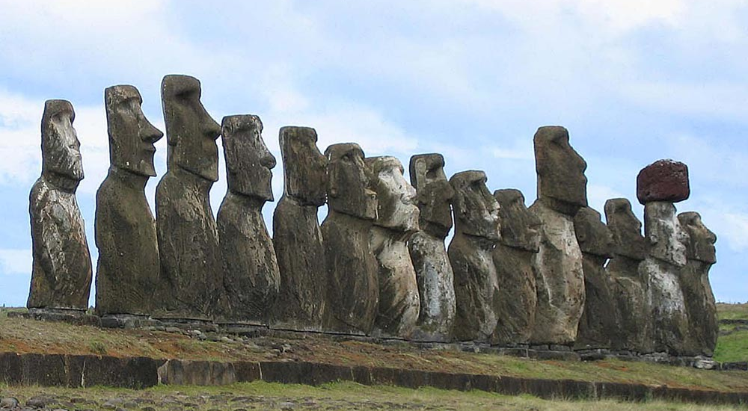

Slide 106
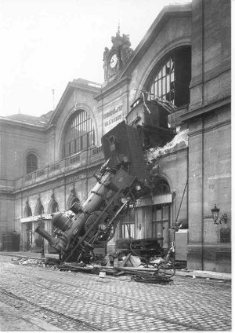
Thank You!

