Slide 1
The Resolvers We Use
Geoff Huston
APNIC

Slide 2
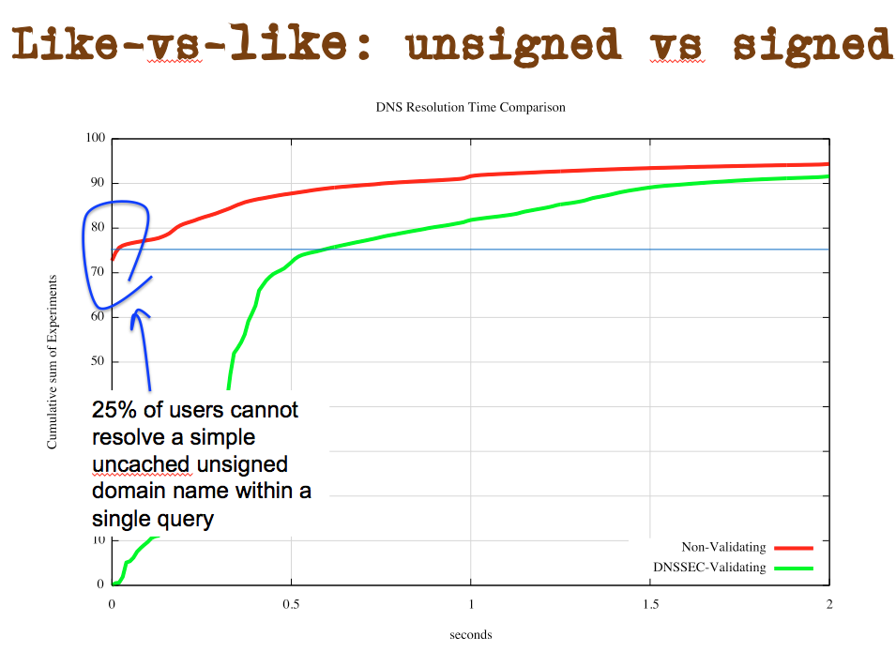
One of those wtf moments…
This figure was produced as part of some related work that was measuring the additional time penalty that would apply when the name being resolved was signed using DNSSEC.
But the surprising observation here is that for 25% of the world’s users a simple uncached DNS name is not resolved in a single query
Equally surprising, some 6% of Internet users use resolvers that take more than 2 seconds to complete the resolution function
6% of users take more than 2 seconds to complete a simple resolution task

Slide 3
One of those wtf moments…
This figure was produced as part of some related work that was measuring the additional time penalty that would apply when the name being resolved was signed using DNSSEC.
But the surprising observation here is that for 25% of the world’s users a simple uncached DNS name is not resolved in a single query
Equally surprising, some 6% of Internet users use resolvers that take more than 2 seconds to complete the resolution function
6% of users take more than 2 seconds to complete a simple resolution task
Why is DNS resolution performance so bad for so many users?

Slide 4
And that leads to…
What we think about how the DNS works and how folk use the DNS is not well aligned
We all think we understand how DNS resolution works in terms of the interchange of DNS protocol elements
But the performance of DNS name resolution depends on a number of additional factors, both in terms of the users’ choice of resolvers and the name admin’s choice of authoritative servers
So let’s look at the resolvers that users use…

Slide 5
Aside: Why is DNS resolution data of interest?
Almost everything we do on the Internet starts with a DNS name resolution operation
DNS resolver query logs contain a rich vein of real time information about what users do, and can be analyzed to infer information about the users themselves through the names that their applications resolve
The DNS resolution data contains indirect pointers that can be used to derive aspects of users’ demographics, preferences, purchases, etc

Slide 6
Aside: Information Leakage
To what extent is this DNS resolution data stream “leaked” outward?
Across network boundaries?
Across national boundaries?
This second form of information leakage is “interesting”
While many national regimes include regulations concerning personally identifying data, its not clear if these regulations extend these same protections to aliens who are not citizens of the country where the information is held

Slide 7
Measuring the Internet via its Users
At APNIC we’ve been using online ads to measure the user’s view of the Internet for some years
We ask users to fetch a unique URL
This involves a DNS resolution and a HTTP GET to our servers
So we collect sets of DNS queries and WEB queries
And we can put them together
To see
how we are doing with the IPv6 transition
where DNSSEC validation is being used
And similar

Slide 8
Users and Resolvers
The data set also allows us to match
the IP address of the resolver that queries the authoritative name server (the “visible resolver”)
to
the IP address of the client agent that retrieves the URL

Slide 9
Some Numbers
Using data collected across 2014 (Jan-Dec):
104,986,719 individual sample points
404,705 unique resolver IP addresses
This “raw” data is skewed to the ad placement algorithms we used, so we then re-weighted the raw numbers in each country to align to the relativities of the Internet user population in each country. This provides us with a view that does not over-represent certain countries in the data

Slide 10
Top 25 Resolvers
Rank Resolver Use %
1 74.125.189.20 962,729 0.42%
2 74.125.189.16 961,207 0.42%
3 74.125.189.23 960,124 0.42%
4 74.125.189.17 959,964 0.42%
5 74.125.189.21 959,915 0.42%
6 74.125.189.19 959,060 0.42%
7 74.125.189.18 958,675 0.42%
8 74.125.189.22 958,597 0.42%
9 74.125.41.81 879,019 0.39%
10 74.125.41.82 877,909 0.39%
11 74.125.41.84 876,049 0.39%
12 74.125.41.83 875,978 0.39%
13 74.125.41.80 875,355 0.39%
14 74.125.41.16 862,749 0.38%
15 74.125.41.17 862,407 0.38%
16 74.125.41.18 861,868 0.38%
17 74.125.41.20 861,713 0.38%
18 74.125.41.19 861,538 0.38%
19 74.125.16.82 731,702 0.32%
20 74.125.16.81 730,670 0.32%
21 74.125.16.84 730,328 0.32%
22 74.125.16.80 730,098 0.32%
23 74.125.16.83 729,540 0.32%
24 74.125.41.145 669,941 0.30%
25 74.125.41.147 669,081 0.29%

Slide 11
Top 25 Resolvers
Rank Resolver Use %
1 74.125.189.20 962,729 0.42%
2 74.125.189.16 961,207 0.42%
3 74.125.189.23 960,124 0.42%
4 74.125.189.17 959,964 0.42%
5 74.125.189.21 959,915 0.42%
6 74.125.189.19 959,060 0.42%
7 74.125.189.18 958,675 0.42%
8 74.125.189.22 958,597 0.42%
9 74.125.41.81 879,019 0.39%
10 74.125.41.82 877,909 0.39%
11 74.125.41.84 876,049 0.39%
12 74.125.41.83 875,978 0.39%
13 74.125.41.80 875,355 0.39%
14 74.125.41.16 862,749 0.38%
15 74.125.41.17 862,407 0.38%
16 74.125.41.18 861,868 0.38%
17 74.125.41.20 861,713 0.38%
18 74.125.41.19 861,538 0.38%
19 74.125.16.82 731,702 0.32%
20 74.125.16.81 730,670 0.32%
21 74.125.16.84 730,328 0.32%
22 74.125.16.80 730,098 0.32%
23 74.125.16.83 729,540 0.32%
24 74.125.41.145 669,941 0.30%
25 74.125.41.147 669,081 0.29%
This list looks pretty strange!

Slide 12
Top Resolvers
Rank Resolver Use % Origin AS
1 74.125.189.20 962,729 0.42% 15169 - Google
2 74.125.189.16 961,207 0.42% 15169 - Google
3 74.125.189.23 960,124 0.42% 15169 - Google
4 74.125.189.17 959,964 0.42% 15169 - Google
5 74.125.189.21 959,915 0.42% 15169 - Google
6 74.125.189.19 959,060 0.42% 15169 - Google
7 74.125.189.18 958,675 0.42% 15169 - Google
8 74.125.189.22 958,597 0.42% 15169 - Google
9 74.125.41.81 879,019 0.39% 15169 - Google
10 74.125.41.82 877,909 0.39% 15169 - Google
11 74.125.41.84 876,049 0.39% 15169 - Google
12 74.125.41.83 875,978 0.39% 15169 - Google
13 74.125.41.80 875,355 0.39% 15169 - Google
14 74.125.41.16 862,749 0.38% 15169 - Google
15 74.125.41.17 862,407 0.38% 15169 - Google
16 74.125.41.18 861,868 0.38% 15169 - Google
17 74.125.41.20 861,713 0.38% 15169 - Google
18 74.125.41.19 861,538 0.38% 15169 - Google
19 74.125.16.82 731,702 0.32% 15169 - Google
20 74.125.16.81 730,670 0.32% 15169 - Google
21 74.125.16.84 730,328 0.32% 15169 - Google
22 74.125.16.80 730,098 0.32% 15169 - Google
23 74.125.16.83 729,540 0.32% 15169 - Google
24 74.125.41.145 669,941 0.30% 15169 - Google
25 74.125.41.147 669,081 0.29% 15169 - Google
When we add origin AS it gets a little clearer
These resolvers are part of Google’s Public DNS resolver
farms that support 8.8.8.8 and 8.8.4.4 – they are the fetch slaves
So we need a different counting approach -- what if we group all resolvers by their AS?

Slide 13
Top Resolvers by AS
Rank AS Count Share Cumulative AS Name
1 15169 77,752,963 34.24% 34.24% GOOGLE - Google Inc.,US
2 4134 7,515,050 3.31% 37.55% CHINANET-BACKBONE No.31,Jin-rong Street,CN
3 3462 5,651,005 2.49% 40.04% HINET Data Communication Business Group,TW
4 3356 5,544,822 2.44% 42.48% LEVEL3 - Level 3 Communications, Inc.,US
5 6147 5,123,169 2.26% 44.74% Telefonica del Peru S.A.A.,PE
6 16880 4,120,210 1.81% 46.55% AS2-TRENDMICRO-COM - TREND MICRO INCORPORATED,US
7 8151 4,090,436 1.80% 48.35% Uninet S.A. de C.V.,MX
8 7470 3,388,845 1.49% 49.85% TRUEINTERNET-AS-AP TRUE INTERNET Co.,Ltd.,TH
9 4837 3,150,429 1.39% 51.23% CHINA169-BACKBONE CNCGROUP China169 Backbone,CN
10 9121 2,958,671 1.30% 52.54% TTNET Turk Telekomunikasyon Anonim Sirketi,TR
11 7922 2,808,303 1.24% 53.77% COMCAST-7922 - Comcast Cable Communications, Inc.,US
12 9299 2,719,648 1.20% 54.97% IPG-AS-AP Philippine Long Distance Telephone Company,PH
13 4766 2,595,704 1.14% 56.11% KIXS-AS-KR Korea Telecom,KR
14 45758 2,408,824 1.06% 57.17% TRIPLETNET-AS-AP TripleT Bangkok,TH
15 36692 2,075,246 0.91% 58.09% OPENDNS - OpenDNS, LLC,US
16 9318 1,839,866 0.81% 58.90% HANARO-AS Hanaro Telecom Inc.,KR
17 8048 1,740,434 0.77% 59.67% CANTV Servicios, Venezuela,VE
18 3786 1,675,723 0.74% 60.40% LGDACOM LG DACOM Corporation,KR
19 9737 1,662,131 0.73% 61.14% TOTNET-TH-AS-AP TOT Public Company Limited,TH
20 13489 1,634,966 0.72% 61.86% EPM Telecomunicaciones S.A. E.S.P.,CO
21 17974 1,554,658 0.68% 62.54% TELKOMNET-AS2-AP PT Telekomunikasi Indonesia,ID
22 7643 1,487,808 0.66% 63.20% VNPT-AS-VN Vietnam Posts and Telecommunications,VN
23 7303 1,414,687 0.62% 63.82% Telecom Argentina S.A.,AR
24 19994 1,357,249 0.60% 64.42% RACKSPACE - Rackspace Hosting,US
25 8708 1,272,774 0.56% 64.98% RCS-RDS RCS & RDS SA,RO

Slide 14
Top Resolvers by AS
Rank AS Count Share Cumulative AS Name
1 15169 77,752,963 34.24% 34.24% GOOGLE - Google Inc.,US
2 4134 7,515,050 3.31% 37.55% CHINANET-BACKBONE No.31,Jin-rong Street,CN
3 3462 5,651,005 2.49% 40.04% HINET Data Communication Business Group,TW
4 3356 5,544,822 2.44% 42.48% LEVEL3 - Level 3 Communications, Inc.,US
5 6147 5,123,169 2.26% 44.74% Telefonica del Peru S.A.A.,PE
6 16880 4,120,210 1.81% 46.55% AS2-TRENDMICRO-COM - TREND MICRO INCORPORATED,US
7 8151 4,090,436 1.80% 48.35% Uninet S.A. de C.V.,MX
8 7470 3,388,845 1.49% 49.85% TRUEINTERNET-AS-AP TRUE INTERNET Co.,Ltd.,TH
9 4837 3,150,429 1.39% 51.23% CHINA169-BACKBONE CNCGROUP China169 Backbone,CN
10 9121 2,958,671 1.30% 52.54% TTNET Turk Telekomunikasyon Anonim Sirketi,TR
11 7922 2,808,303 1.24% 53.77% COMCAST-7922 - Comcast Cable Communications, Inc.,US
12 9299 2,719,648 1.20% 54.97% IPG-AS-AP Philippine Long Distance Telephone Company,PH
13 4766 2,595,704 1.14% 56.11% KIXS-AS-KR Korea Telecom,KR
14 45758 2,408,824 1.06% 57.17% TRIPLETNET-AS-AP TripleT Bangkok,TH
15 36692 2,075,246 0.91% 58.09% OPENDNS - OpenDNS, LLC,US
16 9318 1,839,866 0.81% 58.90% HANARO-AS Hanaro Telecom Inc.,KR
17 8048 1,740,434 0.77% 59.67% CANTV Servicios, Venezuela,VE
18 3786 1,675,723 0.74% 60.40% LGDACOM LG DACOM Corporation,KR
19 9737 1,662,131 0.73% 61.14% TOTNET-TH-AS-AP TOT Public Company Limited,TH
20 13489 1,634,966 0.72% 61.86% EPM Telecomunicaciones S.A. E.S.P.,CO
21 17974 1,554,658 0.68% 62.54% TELKOMNET-AS2-AP PT Telekomunikasi Indonesia,ID
22 7643 1,487,808 0.66% 63.20% VNPT-AS-VN Vietnam Posts and Telecommunications,VN
23 7303 1,414,687 0.62% 63.82% Telecom Argentina S.A.,AR
24 19994 1,357,249 0.60% 64.42% RACKSPACE - Rackspace Hosting,US
25 8708 1,272,774 0.56% 64.98% RCS-RDS RCS & RDS SA,RO
This list still looks pretty strange!
The problem is that resolver farms amplify their
presence in this list because they splay multiple
Instances of the same query across slave resolvers
Can we compensate for this?

Slide 15
Top Resolvers by AS – Filtered
Rank AS Use AS Name
1 15169 9.91% GOOGLE - Google Inc.,US
2 4134 9.53% CHINANET-BACKBONE No.31,Jin-rong Street,CN
3 4837 5.95% CHINA169-BACKBONE CNCGROUP China169 Backbone,CN
4 7922 1.67% COMCAST-7922 - Comcast Cable Communications, Inc.,US
5 36692 1.32% OPENDNS - OpenDNS, LLC,US
6 8151 1.27% Uninet S.A. de C.V.,MX
7 9829 1.17% BSNL-NIB National Internet Backbone,IN
8 4713 1.13% OCN NTT Communications Corporation,JP
9 3320 1.02% DTAG Deutsche Telekom AG,DE
10 10753 0.93% LVLT-10753 - Level 3 Communications, Inc.,US
11 4812 0.92% CHINANET-SH-AP China Telecom (Group),CN
12 4813 0.90% BACKBONE-GUANGDONG-AP China Telecom(Group),CN
13 4766 0.86% KIXS-AS-KR Korea Telecom,KR
14 28573 0.84% NET Servicos de Comunicatio S.A.,BR
15 4808 0.76% CHINA169-BJ CNCGROUP IP network China169 Beijing Province Network,CN
16 24560 0.75% AIRTELBROADBAND-AS-AP Bharti Airtel Ltd., Telemedia Services,IN
17 3215 0.72% AS3215 Orange S.A.,FR
18 701 0.71% UUNET - MCI Communications Services, Inc. d/b/a Verizon Business,US
19 9121 0.64% TTNET Turk Telekomunikasyon Anonim Sirketi,TR
20 8452 0.63% TE-AS TE-AS,EG
21 9394 0.62% CTTNET China TieTong Telecommunications Corporation,CN
22 9808 0.60% CMNET-GD Guangdong Mobile Communication Co.Ltd.,CN
23 6713 0.57% IAM-AS,MA
24 6830 0.56% LGI-UPC Liberty Global Operations B.V.,EU
25 18881 0.55% Global Village Telecom,BR

Slide 16
Who’s Resolving “Locally” and Who’s Not?
Let’s filter this data by removing all entries where the user and the visible resolver are in the same network (same AS)
Which non-local resolvers are being used?

Slide 17
Non-Local (AS) Resolution: Top Resolvers (by AS)
Rank AS Use AS Name
1 15169 2,494,244 36.87% GOOGLE - Google Inc.,US
2 36692 332,762 4.92% OPENDNS - OpenDNS, LLC,US
3 10753 233,568 3.45% LVLT-10753 - Level 3 Communications, Inc.,US
4 4813 227,137 3.36% BACKBONE-GUANGDONG-AP China Telecom(Group),CN
5 7132 126,454 1.87% SBIS-AS - AT&T Internet Services,US
6 6713 116,586 1.72% IAM-AS,MA
7 4134 104,840 1.55% CHINANET-BACKBONE No.31,Jin-rong Street,CN
8 18209 86,197 1.27% BEAMTELE-AS-AP Beam Telecom Pvt Ltd,IN
9 4837 75,780 1.12% CHINA169-BACKBONE CNCGROUP China169 Backbone,CN
10 4808 75,497 1.12% China169 China Unicom Beijing Province Network,CN
11 18101 73,760 1.09% Reliance Communications Ltd.DAKC MUMBAI,IN
12 20746 68,061 1.01% ASN-IDC Telecomitalia s.p.a.,IT
13 3786 65,025 0.96% LGDACOM LG DACOM Corporation,KR
14 9394 64,963 0.96% CTTNET China TieTong Telecommunications Corporation,CN
15 7843 55,329 0.82% TWCABLE-BACKBONE - Time Warner Cable Internet LLC,US
16 17621 54,542 0.81% CNCGROUP-SH China Unicom Shanghai network,CN
17 17816 52,618 0.78% China Unicom China169 Guangdong province,CN
18 7643 48,236 0.71% VNPT-AS-VN Vietnam Posts and Telecommunications (VNPT),VN
19 5713 46,887 0.69% SAIX-NET,ZA
20 23724 42,281 0.62% CHINANET-IDC-BJ-AP IDC, China Telecommunications Corporation,CN
21 3356 40,161 0.59% LEVEL3 - Level 3 Communications, Inc.,US
22 7470 39,916 0.59% TRUEINTERNET-AS-AP TRUE INTERNET Co.,Ltd.,TH
23 2914 36,238 0.54% NTT-COMMUNICATIONS-2914 - NTT America, Inc.,US
24 58466 35,730 0.53% CT-GUANGZHOU-IDC CHINANET Guangdong province network,CN
25 4835 34,897 0.52% CHINANET-IDC-SN China Telecom (Group),CN
Total: 27% of total end users

Slide 18
Who’s using “Foreign” Resolvers?
Let’s apply a further filter and look only at those instances where the IP address of the end users and that of the resolvers that they are using are geo-located in different countries

Slide 19
Foreign (CC) Resolution: Top Resolvers by AS
Rank AS Use AS Name
1 15169 2,501,732 67.00% GOOGLE - Google Inc.,US
2 36692 280,737 7.52% OPENDNS - OpenDNS, LLC,US
3 10753 205,897 5.51% LVLT-10753 - Level 3 Communications, Inc.,US
4 6830 67,353 1.80% LGI-UPC Liberty Global Operations B.V.,AT
5 3356 30,737 0.82% LEVEL3 - Level 3 Communications, Inc.,US
6 2914 28,814 0.77% NTT-COMMUNICATIONS-2914 - NTT America, Inc.,US
7 1273 26,120 0.70% CW Cable and Wireless Worldwide plc,GB
8 9050 23,194 0.62% RTD ROMTELECOM S.A,RO
9 174 18,097 0.48% COGENT-174 - Cogent Communications,US
10 198605 16,564 0.44% AVAST-AS-DC AVAST Software a.s.,CZ
11 30689 16,483 0.44% FLOW-NET - FLOW,JM
12 3257 15,298 0.41% TINET-BACKBONE Tinet SpA,DE
13 29791 14,078 0.38% VOXEL-DOT-NET - Voxel Dot Net, Inc.,US
14 13238 12,961 0.35% YANDEX Yandex LLC,RU
15 35838 10,761 0.29% CCANET CCANet Limited,GB
16 35074 10,591 0.28% COBRANET-AS Cobranet Limited,LB
17 42523 10,575 0.28% PLATINIUM-AS Platinium Star TV SRL,RO
18 13210 9,878 0.26% ASE ACADEMIA DE STUDII ECONOMICE,RO
19 36351 9,748 0.26% SOFTLAYER - SoftLayer Technologies Inc.,US
20 6939 9,221 0.25% HURRICANE - Hurricane Electric, Inc.,US
21 37204 8,897 0.24% TELONE,ZW
22 3462 8,761 0.23% HINET Data Communication Business Group,TW
23 13127 7,710 0.21% VERSATEL Tele 2 Nederland B.V.,NL
24 30607 7,137 0.19% 302-DIRECT-MEDIA-ASN - 302 Direct Media LLC,US
25 6663 6,813 0.18% TTI-NET Euroweb Romania SA,RO
Total: 15% of total end users

Slide 20
Countries with users that have the lowest foreign resolution counts
CC % Foreign Domestic Country
KR 1.52 6,922 448,705 Republic of Korea
UY 2.96 571 18,715 Uruguay
CN 3.29 19,3273 5,673,988 China
PF 3.35 50 1,460 French Polynesia
LT 3.56 743 20,179 Lithuania
JP 3.68 40,465 1,058,919 Japan
QA 3.82 675 17,009 Qatar
HR 4.22 1,140 25,851 Croatia
FR 4.30 23,787 528,936 France
MN 4.53 180 3,797 Mongolia
FI 4.62 2,450 50,550 Finland
MT 4.64 148 3,061 Malta
GR 4.67 2,942 60,038 Greece
NZ 4.75 1,933 38,791 New Zealand
FM 4.83 12 247 Micronesia (Federated States of)
AE 4.96 4,061 77,743 United Arab Emirates
MD 5.04 722 13,627 Republic of Moldova
GE 5.12 762 14,133 Georgia
PT 5.13 3,297 60,940 Portugal
CL 5.38 5,498 96,718 Chile
PE 5.55 6,782 115,421 Peru
GY 5.60 153 2,583 Guyana
FO 5.61 24 412 Faroe Islands
SR 5.65 108 1,807 Suriname
SA 5.68 8,771 145,574 Saudi Arabia
EE 5.95 638 10,104 Estonia
BE 6.19 6,178 93,695 Belgium
IL 6.58 3,912 55,516 Israel
VE 7.23 9,909 127,117 Venezuela

Slide 21
Countries with highest foreign resolution counts
CC % Foreign Domestic Country
MQ 100.00 1,837 0 Martinique
DZ 98.91 61,171 673 Algeria
LR 98.56 1,443 21 Liberia
GF 98.07 781 15 French Guiana
AF 96.85 16,807 546 Afghanistan
BF 95.27 5,537 274 Burkina Faso
SO 94.66 1,422 80 Somalia
DJ 94.40 646 38 Djibouti
RE 93.38 3,153 223 Reunion
TD 91.00 2,542 251 Chad
GQ 90.19 897 97 Equatorial Guinea
CD 88.12 8,152 1,098 Democratic Republic of the Congo
IM 86.96 375 56 Isle of Man
GN 86.47 1,503 235 Guinea
SV 84.94 11,266 1,997 El Salvador
IR 84.88 154,305 27,487 Iran (Islamic Republic of)
ZW 78.64 20,042 5,444 Zimbabwe
CG 78.44 2,620 720 Congo
BN 77.37 2,023 591 Brunei Darussalam
SL 72.02 445 172 Sierra Leone
VN 68.04 243,186 114,206 Vietnam
NI 67.30 4,858 2,360 Nicaragua
NG 61.17 345,177 219,107 Nigeria
BZ 60.39 425 279 Belize
ZM 59.45 11,444 7,805 Zambia
NE 56.22 1,514 1,179 Niger
CY 55.27 3,992 3,231 Cyprus
SY 54.53 29,657 24,734 Syrian Arab Republic
BI 54.21 702 593 Burundi

Slide 22
Mapping the resolver spread
For each country can we show the distribution of the resolvers used by users located within that country?

Slide 23
Mapping Foreign Resolution- US
6.46% use PK resolvers
% of foreign name resolution per country
US: 2,813,576 samples, 345,087 foreign resolution instances
0.07%
% of foreign name resolution per country

Slide 24
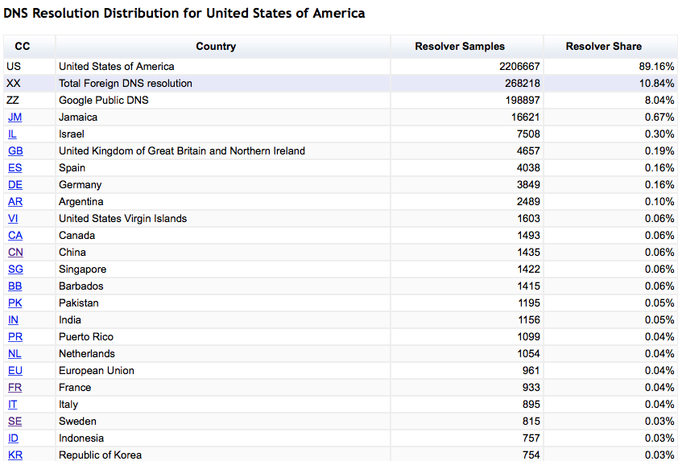
Mapping Foreign Resolution- US
6.46% use PK resolvers
% of foreign name resolution per country
US: 2,813,576 samples, 345,087 foreign resolution instances

Slide 25
Mapping Foreign Resolution- CA
0.02%
% of foreign name resolution per country

Slide 26
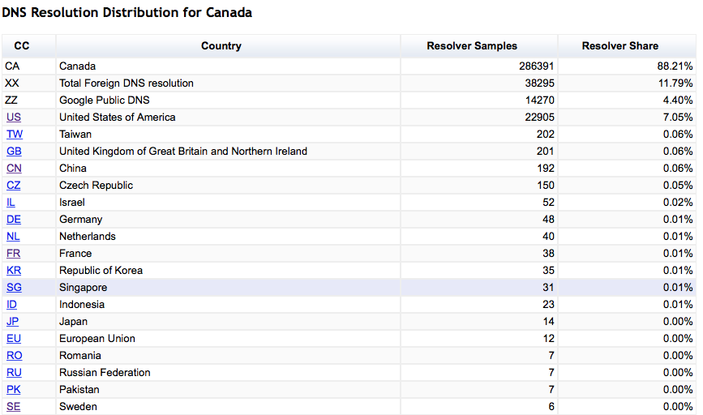
Mapping Foreign Resolution- CA
0.02%
% of foreign name resolution per country

Slide 27
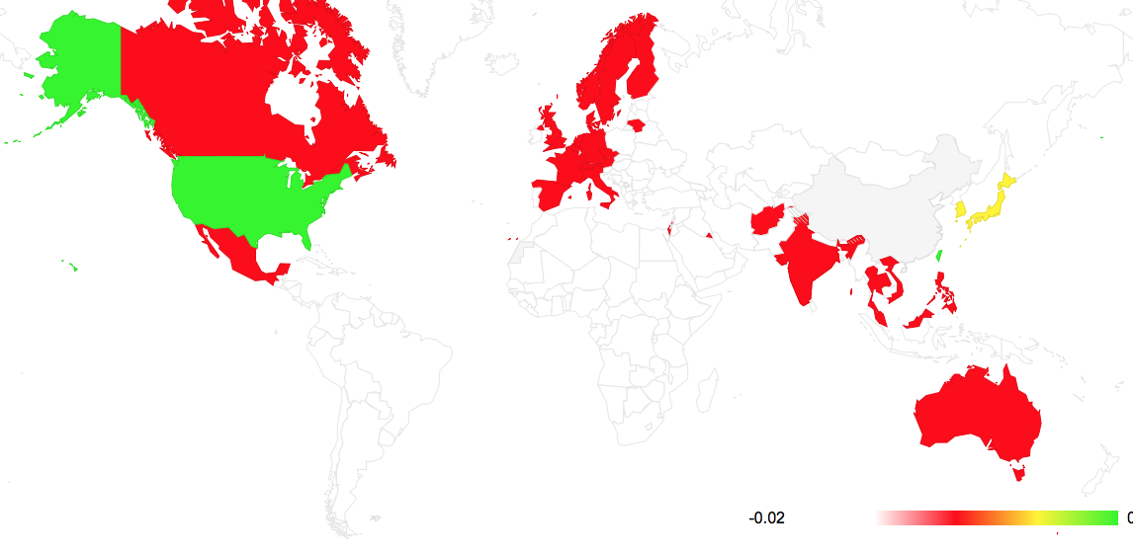
Mapping Foreign Resolution - CN
0.07%
% of foreign name resolution per country

Slide 28
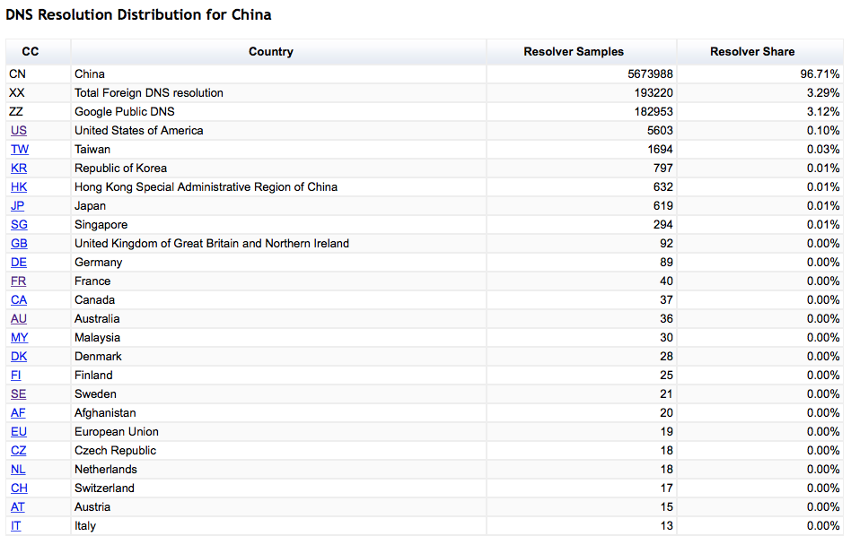
Mapping Foreign Resolution - CN
0.07%
% of foreign name resolution per country

Slide 29
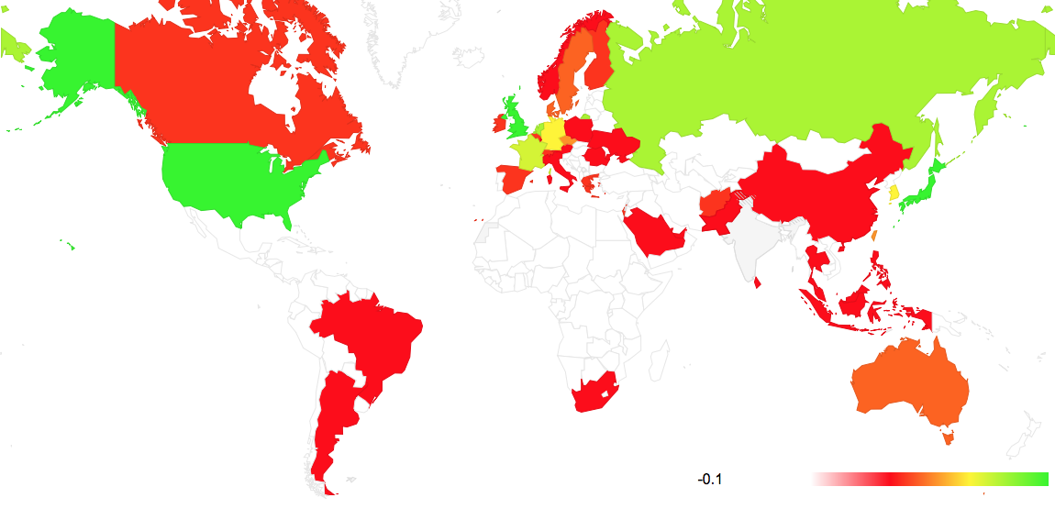
Mapping Foreign Resolution - IN
0.1%
% of foreign name resolution per country

Slide 30
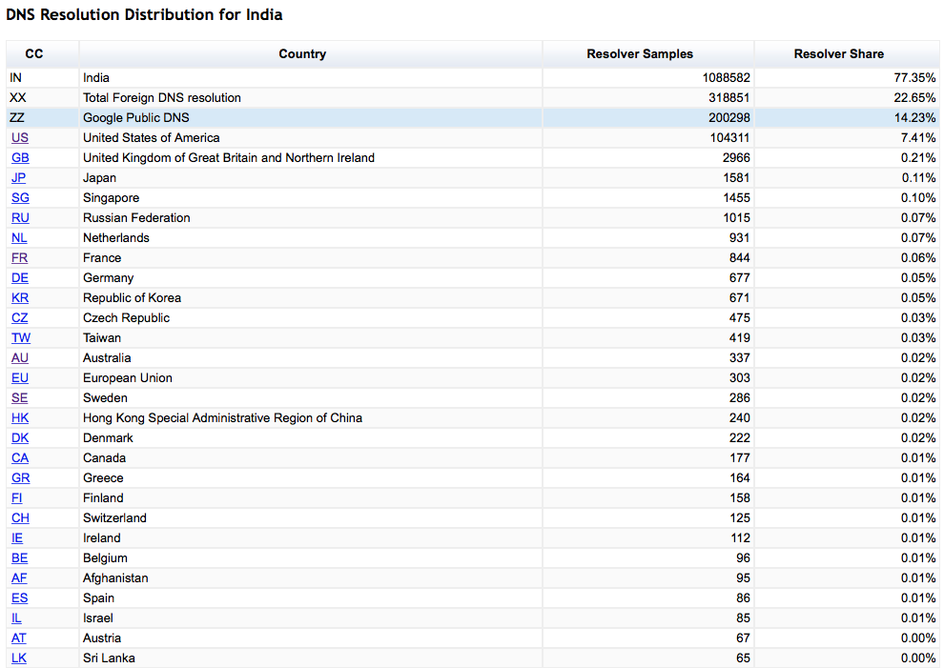
Mapping Foreign Resolution - IN
0.1%
% of foreign name resolution per country

Slide 31
What About Google’s Public DNS?
% of users who have their queries resolved by Google’s PDNS service

Slide 32
What About Google’s Public DNS?
Aside - This jump in the use of Google’s service from ~12% to 20% of the world’s users in earl;y November 2014 is a surprise. These additional queries have Checking Disabled. It’s as if some popular app has decided not to trust the local environment and perform resolution within the app itself.
% of users who have their queries resolved by Google’s PDNS service

Slide 33
Where is Google’s Public DNS used?

Slide 34
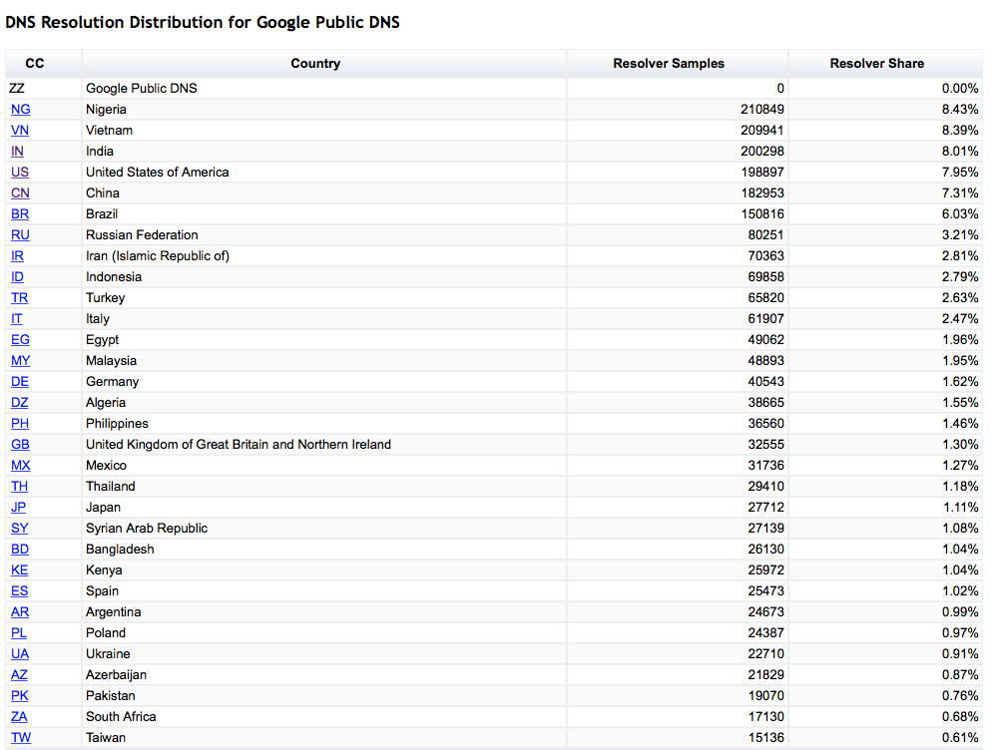
Where is Google’s Public DNS used?

Slide 35
Which Countries make extensive use of Google’s PDNS?
% of users who direct queries to Google

Slide 36
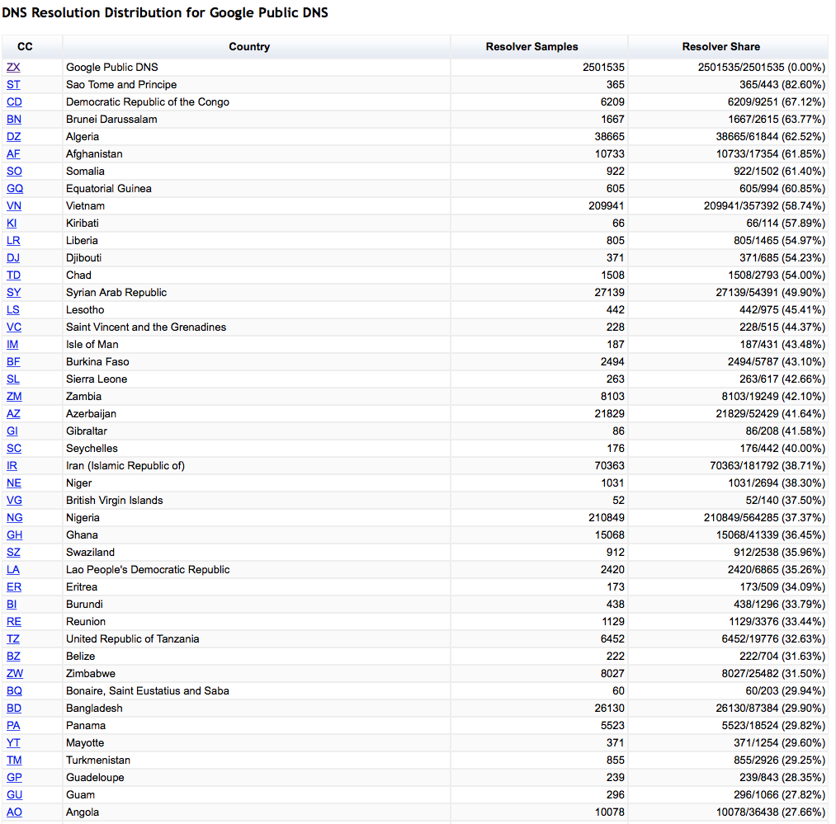
Which Countries make extensive use of Google’s PDNS?
% of users who direct queries to Google

Slide 37
Why is this happening?
At lot of this story is Google’s Public DNS, which now has a “market share” of more than 10 % of the Internet’s user population
User’s efforts to circumvent content control via national DNS filtering measures
Also there is Users’ efforts to circumvent DNS-based geo-loc content access controls (think Netflix)
3rd party DNS query monitoring/stalking (yes, there is some of this going on, but that’s a lightning talk for another time!)
Virus contamination of the host (yes, captured systems often show a redirected DNS config)
<insert your favourite theory here>

Slide 38
Where is the DNS heading?
Is the DNS under pressure to aggregate to ever larger resolvers and server farms?
What is the economic model of name resolution in a highly aggregated environment? Will resolver operators turn to data mining of queries to generate revenue streams?
Is it possible to reduce the information exposure while still using common resolver caches?
What is the nature of the trade-off between resolution performance and information leakage in DNS resolution?

Slide 39
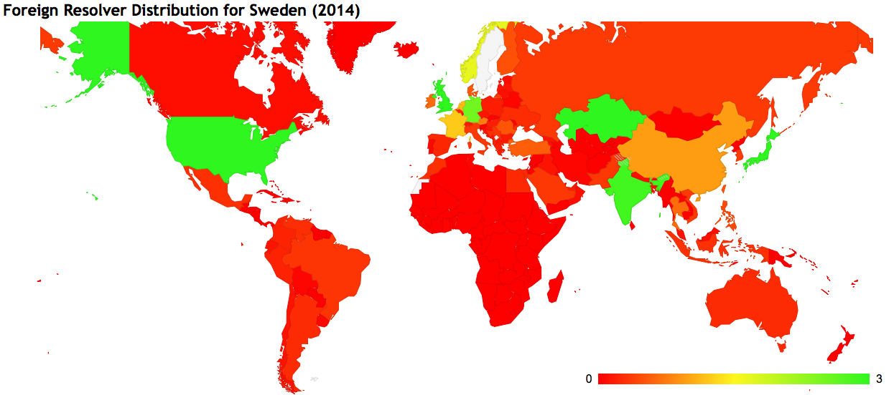
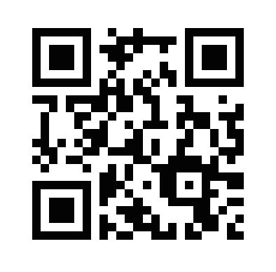
If you want to play with these maps, here’s a (temporary) URL:
http://bit.ly/13oU09X
% of foreign name resolution per country

Slide 40
Thanks!

