Slide 1
May 2015 Update on Measuring IPv6
Geoff Huston, George Michaelson
APNIC Labs
March 2015

Slide 2
IPv6: How Many Can?
http://stats.labs.apnic.net/ipv6/XA

Slide 3
IPv6: How Many Can?
Weekend numbers are 0.4% higher then weekday numbers
0.2% of users prefer to use V4 in dual stack scenarios

Slide 4
IPv6: How Many Can?
IPv6 use in 2015 has been relatively static
IPv6 use has doubled across 2014

Slide 5
Forward Guesstimates
Best Case: IPv6 uptake doubles every year:
2019
(though it has to be observed that the first four months of 2015 are tracking nowhere near a constant doubling rate, so this looks like a stretch objective!)
Worst Case: IPv6 additional uptake constant at a further 2% every year:
2067
(this is insane! If the transition takes longer than 10 more years from now then IPv6 is looking more and more like a discarded hIstorical objective )

Slide 6
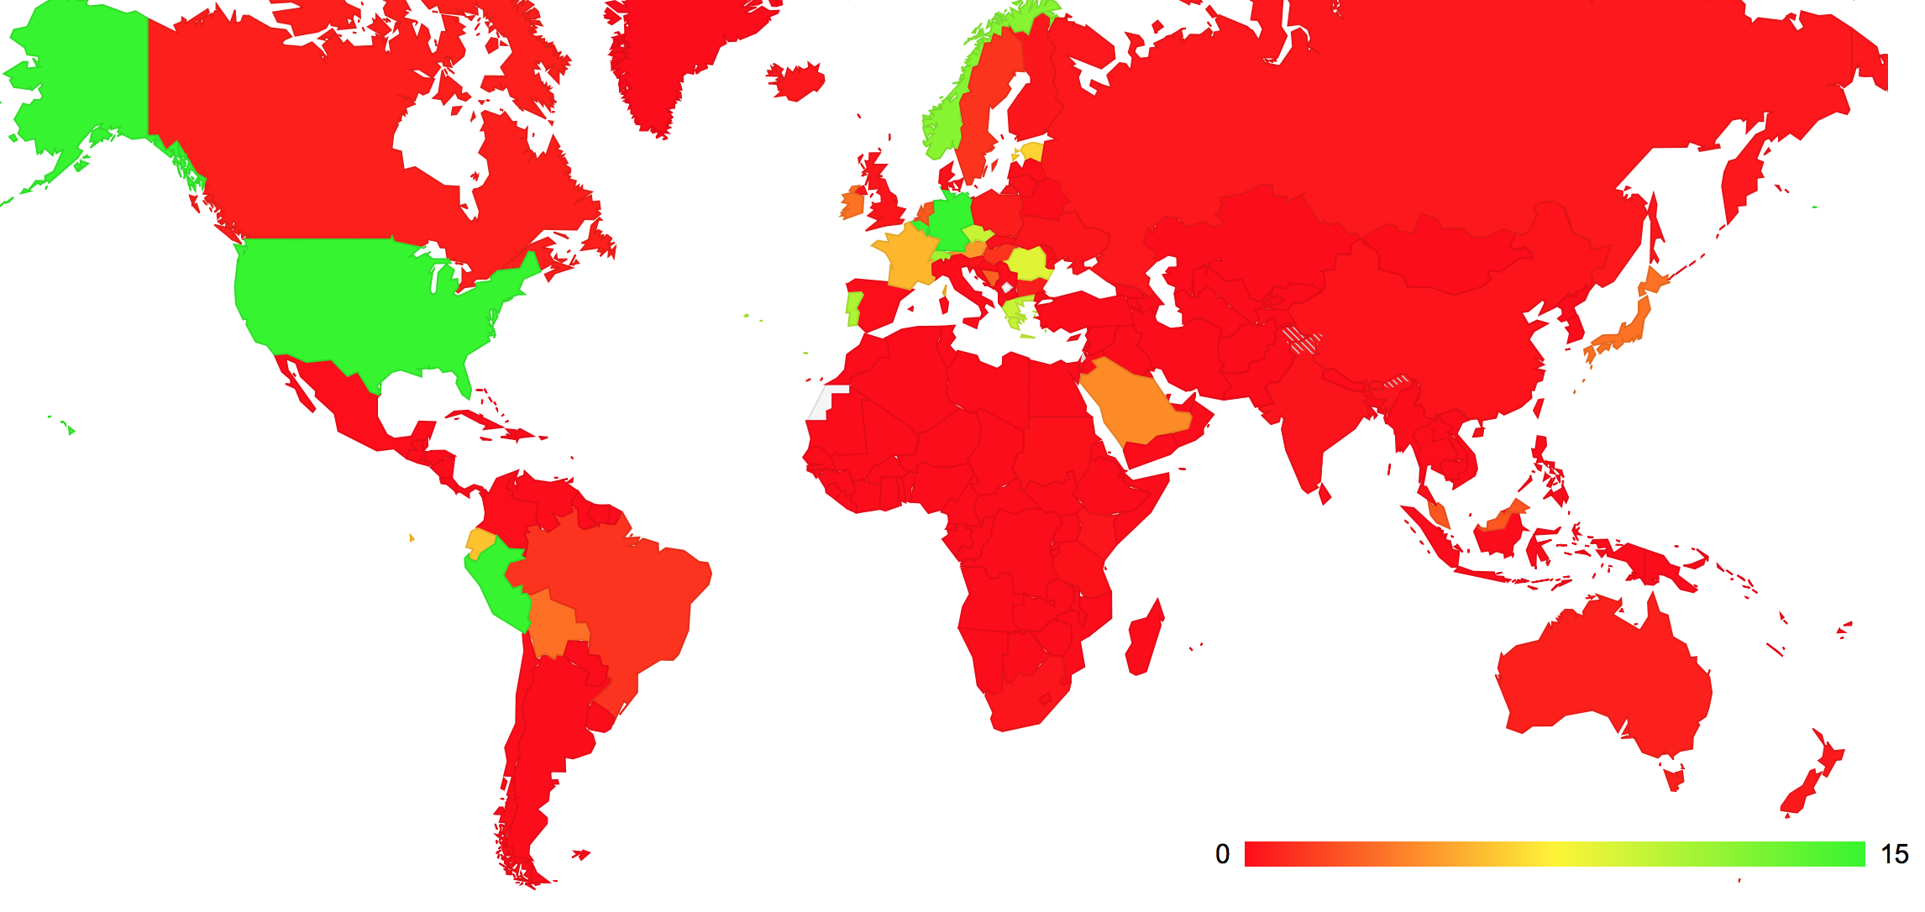
IPv6: Who Can?
IPv6 use by Country – May 2015

Slide 7
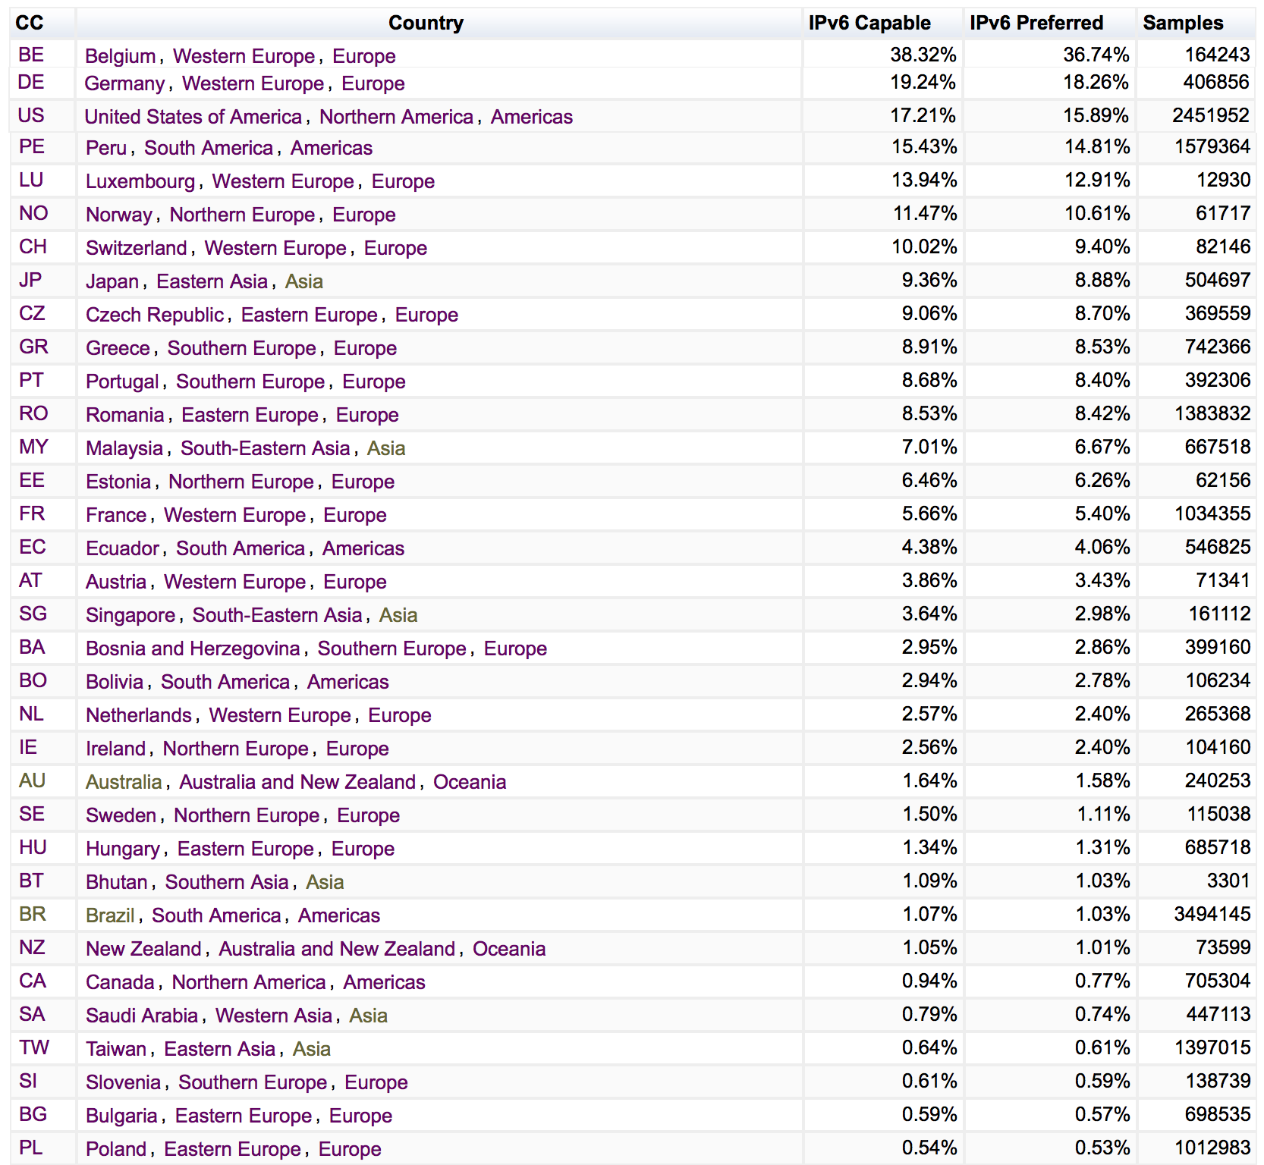
IPv6: Who Can?
World Average

Slide 8
The Local View: NL

Slide 9
The Country View for the US

Slide 10
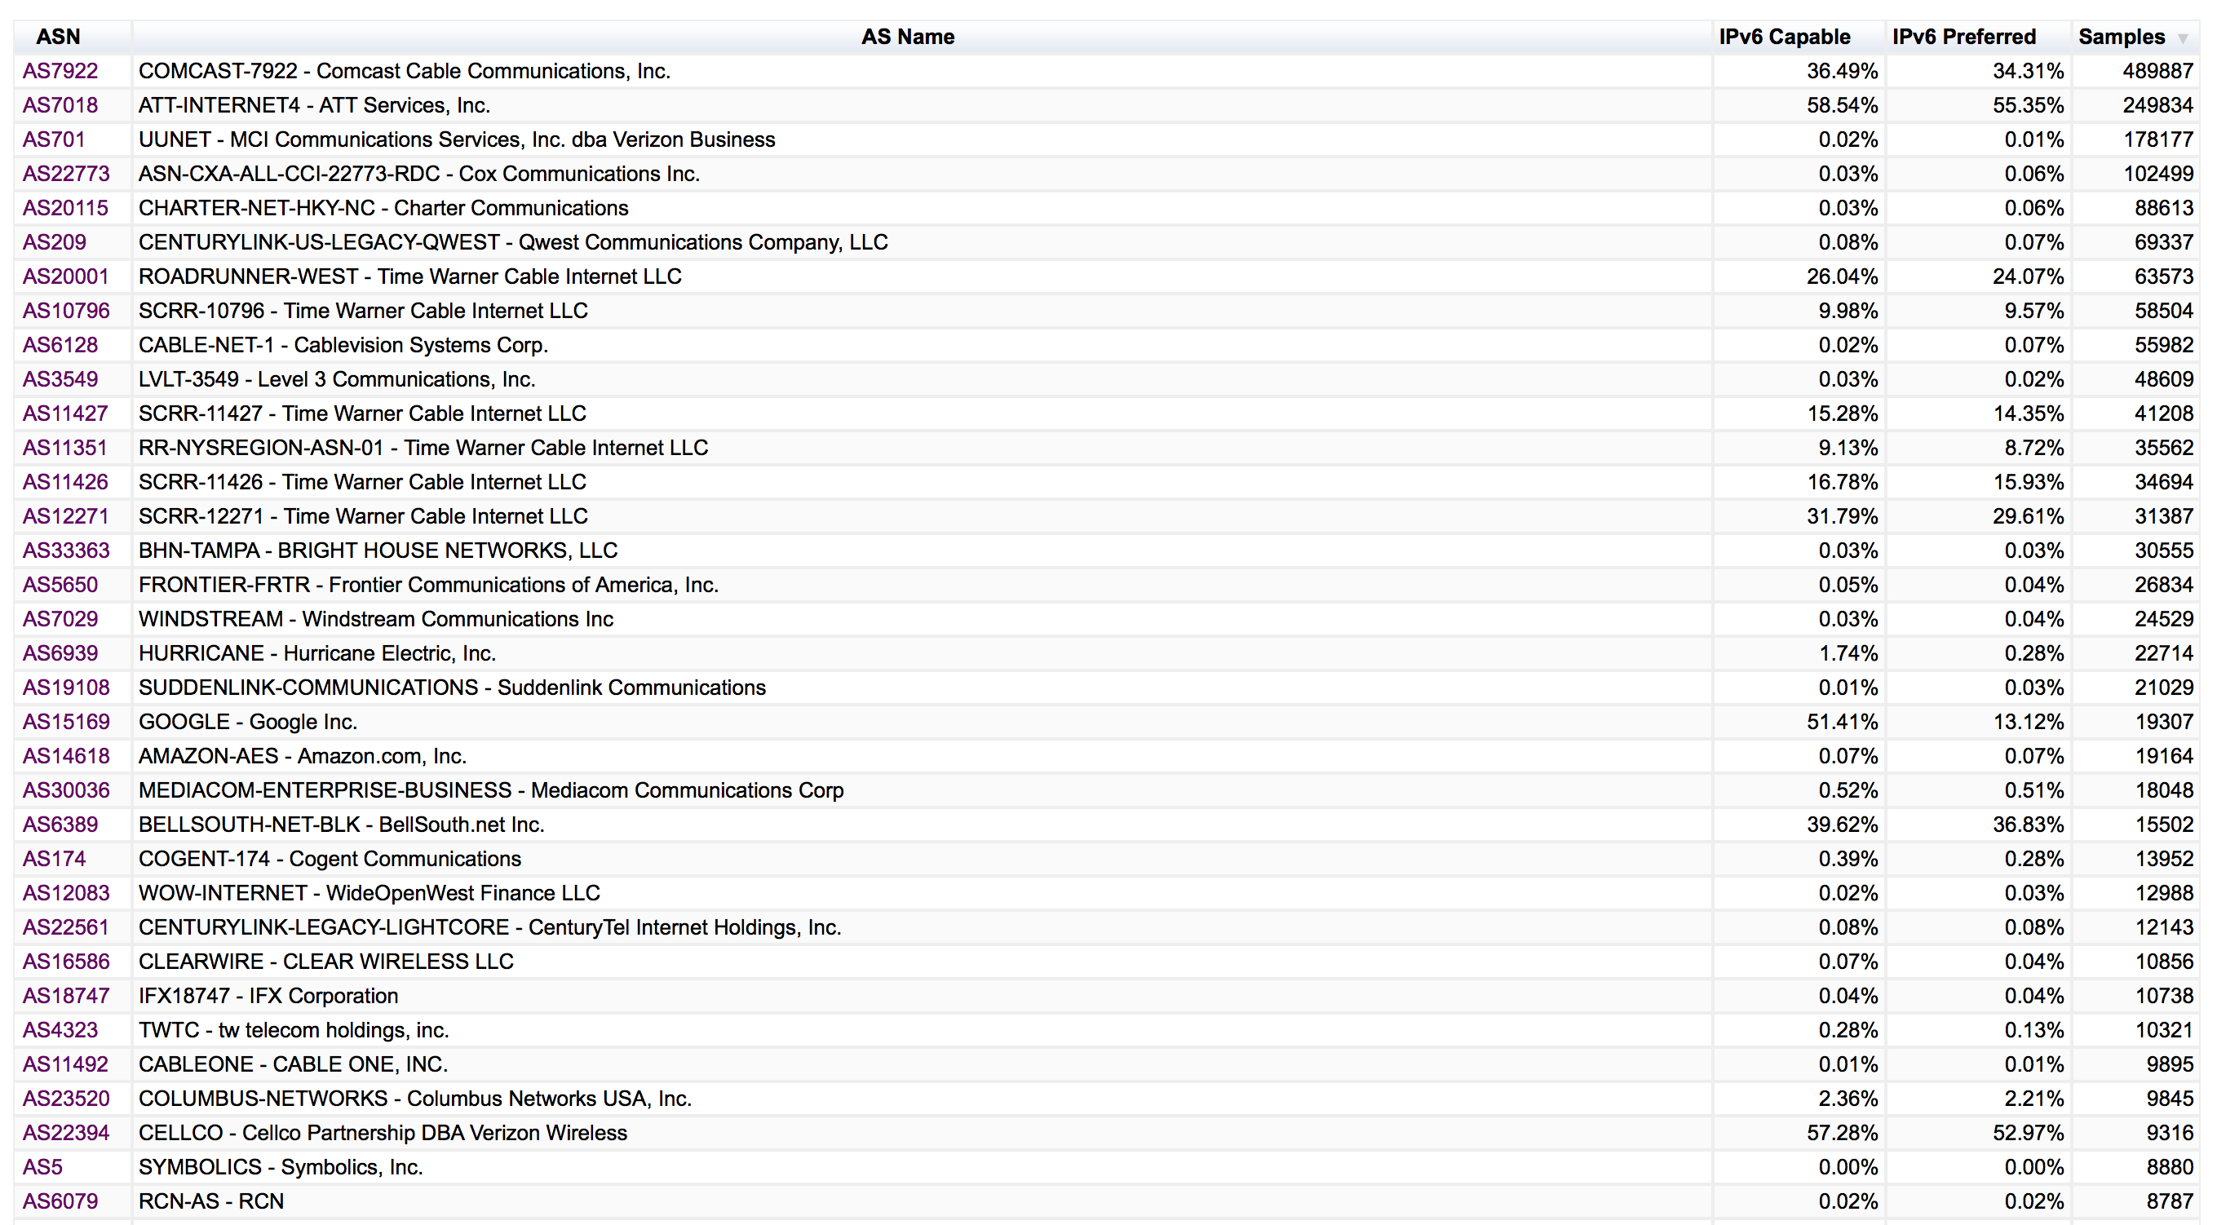
The Country View for the US
7 providers in the US are supporting the majority of IPv6 use in the country.
This is not an unusual scenario

Slide 11
Concentration of IPv6
Does this concentration of effort hold for the rest of the world?
How many IPv6-enabled ISPs serve the majority of the world’s IPv6 user population?

Slide 12
The Internet’s IPv6 Top 30
Here we’ve combined estimates of the Internet user population per country (ITU data) with estimates of market share of each provider (APNIC data) with the observations of the percent of users in each AS that appears to be IPv6 capacle – this gives an estimate of the number of IPv6 users behind each provider

Slide 13
The Internet’s IPv6 Top 30

Slide 14
The Internet’s IPv6 Top 30

Slide 15
The Internet’s IPv6 Top 30
It’s a very uneven takeup of IPv6 – 94% of the world’s IPv6 users sit behind just 30 ISPs

Slide 16
Some Observations
If you allow the customer to own and maintain their own CPE then the CPE upgrade path is a critical issue – old CPE drags the IPv6 numbers down
Mobile providers should see higher penetration numbers … but legacy handsets seem to pull the numbers down
There are some high penetration numbers on “greenfield” deployments, but its rare to see:
49,AS16591,"GOOGLE-FIBER - Google Fiber Inc.",US,155096,87.3%

Slide 17
The Internet’s 30 Largest ISPs

Slide 18
Some Further Observations
IPv6 support is still very patchy:
While most of the V6 activity in terms of user counts is confined to 30 ISPs, just 5 of the top 30 largest ISPs have any significant IPv6 deployments
The Internet is heavily skewed
The 30 largest ISPs service 42% of the entire Internet user population
If these 30 providers were to achieve an average 50% IPv6 uptake in their customer base, then the total IPv6 capability level across the entire Internet would be 20% today, rather than 3.6%

Slide 19
Maybe there’s more to it…
A number of these largest ISPs operate in the developing world
With a tendency to be late adopters so as to reduce capital risk for their enterprise
So can we look at the “value” of an ISP’s customers?
One possible approach is to multiply the estimated user population by the per capita GDP in that country
Perhaps this ranking exposes those ISPs who can afford to deploy V6, but so far have not moved

Slide 20
“Net User Value”
Lets multiply the estimated user population of each network by the GDP per capita
30 providers (by AS) account for 43% of the estimated “value” base of of the Internet
Just 6 of these providers have significant IPv6 deployment programs
One view is that if/when all of these 30 ISPs complete a large scale IPv6 deployment, then they would exert a very strong “pull through” effect on the entire Internet because these most valuable ISPs tend to have the greatest “influencer” ability on the ISP space

Slide 21
The Internet’s 30 Most Valuable ISPs

Slide 22
Maybe IPv6 is further ahead than we thought…
The 30 largest IPv6 providers account for 94% of the total IPv6 user population
These same 30 providers also encompass 28% of the total “user value” of the Internet

Slide 23
The Net Value View of IPv6

Slide 24
The “Net User Value” view of the IPv6 Internet

Slide 25
IPv6 Today…
Is being used by some 4% of the world’s users
Is being actively deployed in significant volumes in 20 countries
30 ISPs serve the bulk of the V6 user population
These providers represent 28% of the “net user value” of the Internet
Their IPv6 users represent 7% of the total “net user value” of the Internet

Slide 26
Thanks!

