Slide 1
Why Dane?
Geoff Huston
Chief Scientist, APNIC

Slide 2
Security on the Internet
How do you know that you are going to where you thought you were going to?

Slide 3
Security on the Internet
How do you know that you are going to where you thought you were going to?
My Bank’s web site
Or at least I think its my
bank because it looks a bit
familiar and there is a
green icon of a lock
So it HAS to be my
bank – hasn’t it?

Slide 4
Connection Steps
Client:
DNS Query:
www.commbank.com.au?
DNS Response:
104.97.235.12
TCP Session:
TCP Connect 104.97.235.12, port 443

Slide 5
Hang on…
$ dig -x 104.97.235.12 +short
a104-97-235-12.deploy.static.akamaitechnologies.com.
That’s not an IP addresses that was allocated to the Commonwealth Bank!
The Commonwealth Bank of Australia has 140.168.0.0 - 140.168.255.255 and 203.17.185.0 - 203.17.185.255
So why should my browser trust that 104.97.235.12 is really the “proper” web site for the Commonwealth Bank of Australia and not some dastardly evil scam?
How can my browser tell the difference between an intended truth and a lie?

Slide 6
TLS Connections
https://rhsecurity.wordpress.com/tag/tls/

Slide 7
TLS Connections
How does the client
“recognise” this certificate
as valid?
https://rhsecurity.wordpress.com/tag/tls/

Slide 8
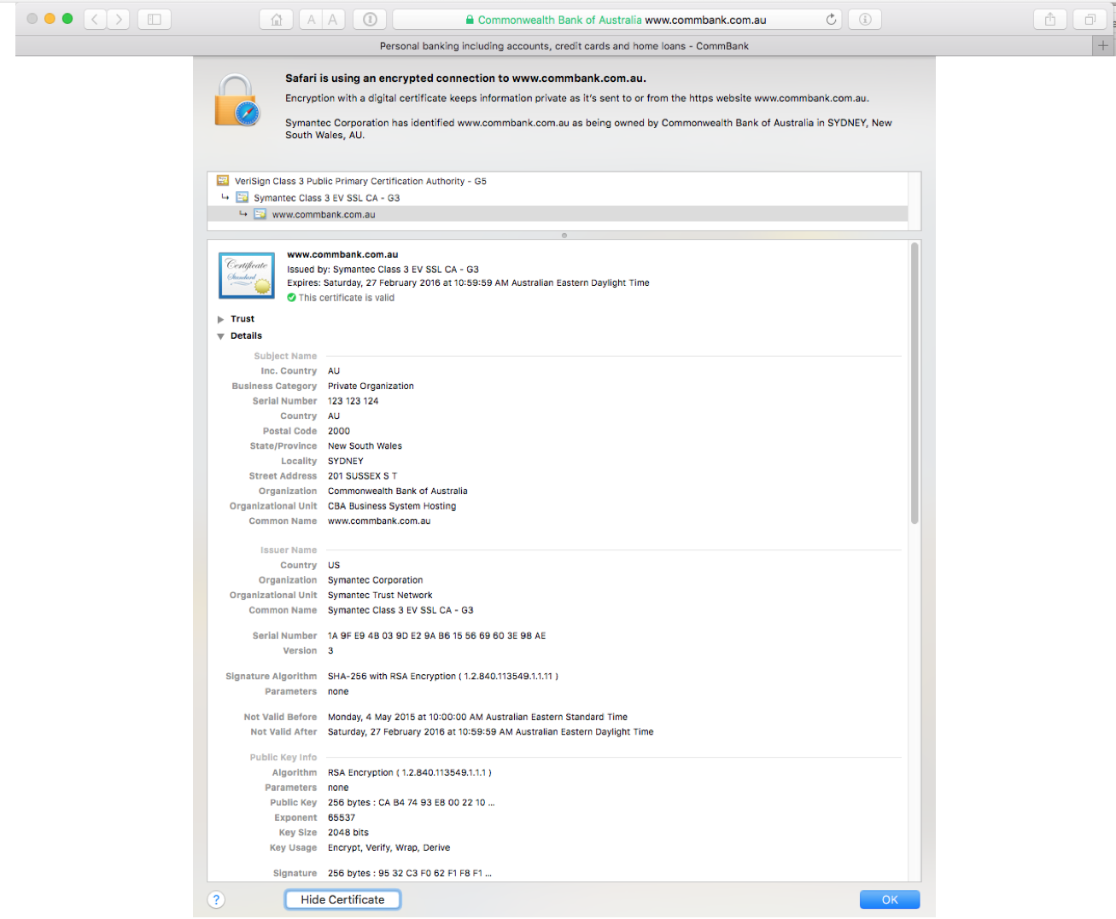

Slide 9
How did my browser know that this is a valid cert?

Slide 10
Domain Name Certification
The Commonwealth Bank of Australia has generated a key pair
And they passed a Certificate Signing Request to a company called “Symantec” (together with money)
Symantec is willing to vouch (in a certificate) that the entity who goes by the domain name of www.commbank.com.au also has a certain public key value (partly because it got paid to do this!)
So if I can associate this public key with a connection then I have a high degree of confidence that I’ve connected to the “real” www.commbank.com.au, as long as I am also prepared to trust Symantec, and their certificate issuance processes, and that the certificates that they issue are always genuine

Slide 11
Domain Name Certification
The Commonwealth Bank of Australia has generated a key pair
And they passed a Certificate Signing Request to a company called “Symantec” (together with money)
Symantec is willing to vouch (in a certificate) that the entity who goes by the domain name of www.commbank.com.au also has a certain public key value (partly because it got paid to do this!)
So if I can associate this public key with a connection then I have a high degree of confidence that I’ve connected to the “real” www.commbank.com.au, as long as I am also prepared to trust Symantec, and their certificate issuance processes, and that the certificates that they issue are always genuine
Why should I trust them?

Slide 12
Local Trust
The cert I’m being asked to trust was issued by a certification authority that my browser already trusts – so I trust that cert!

Slide 13
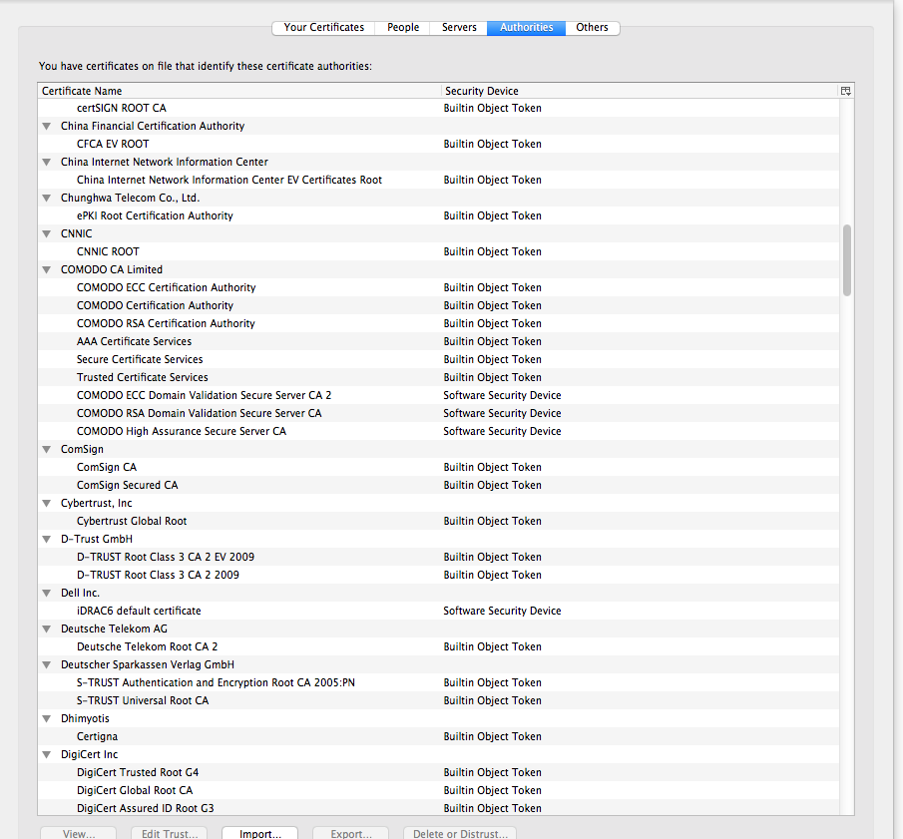
Local Trust or Local Credulity*?
That’s a big list of people to
Trust
Are they all trustable?
*

Slide 14
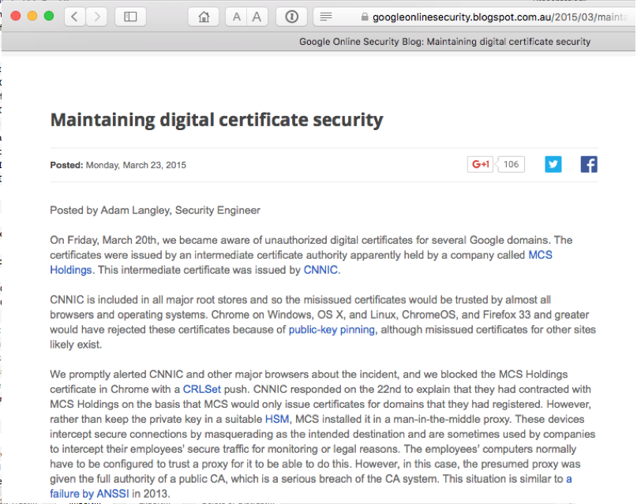
Local Credulity
That’s a big list of people to
Trust
Are they all trustable?
Evidently Not!

Slide 15
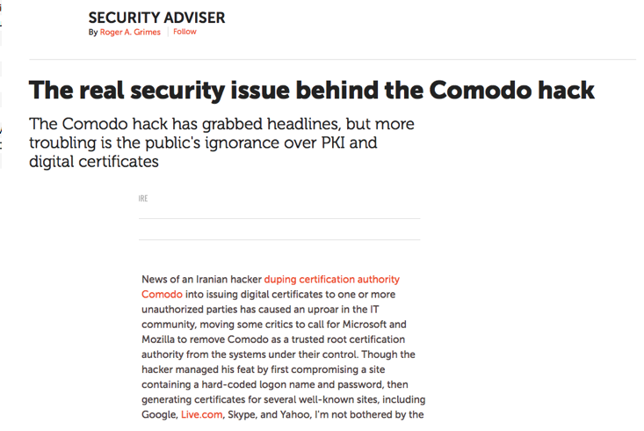
Local Credulity
That’s a big list of people to
Trust
Are they all trustable?
Evidently Not!

Slide 16
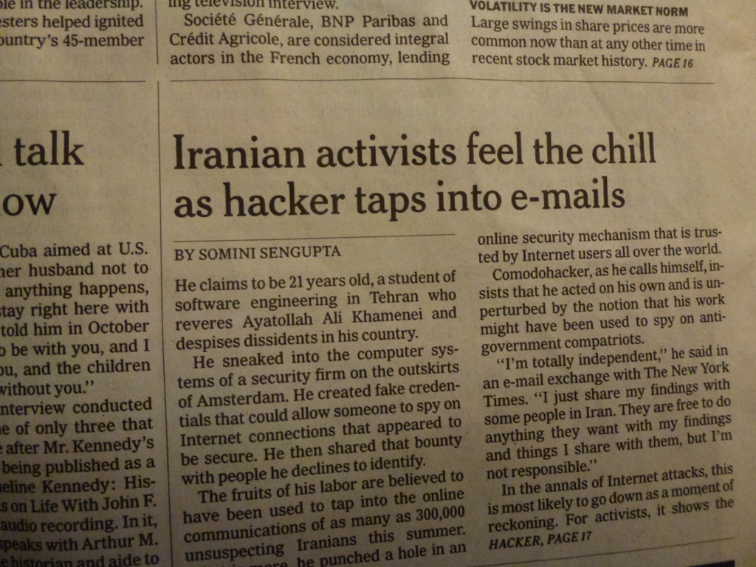
With unpleasant consequences when it all goes wrong
International Herald Tribune
Sep 13, 2011 Front Page

Slide 17
What’s going wrong here?
The TLS handshake cannot specify WHICH CA should be used to validate the digital certificate
That means that your browser may allow ANY CA to be used to validate a certificate

Slide 18
What’s going wrong here?
The TLS handshake cannot specify WHICH CA should be used to validate the digital certificate
That means that your browser may allow ANY CA to be used to validate a certificate
WOW! That’s awesomely bad!

Slide 19
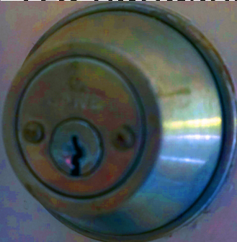
What’s going wrong here?
The TLS handshake cannot specify WHICH CA should be used to validate the digital certificate
That means that your browser may allow ANY CA to be used to validate a certificate
Here’s a lock – it might be the lock on your front door for all I know.
The lock might LOOK secure, but don’t worry – literally ANY key can open it!
WOW! That’s awesomely bad!

Slide 20
What’s going wrong here?
There is no incentive for quality in the CA marketplace
Why pay more for any certificate when the entire CA structure is only as strong as the weakest CA
And you browser trusts a LOT of CAs!
About 60 – 100 CA’s
About 1,500 Subordinate RA’s
Operated by 650 different organisations
See the EFF SSL observatory http://www.eff.org/files/DefconSSLiverse.pdf

Slide 21
In a commercial environment
Where CA’s compete with each other for market share
And quality offers no protection
Than what ‘wins’ in the market?
Sustainable
?
Resilient
Secure
Privacy
Trusted

Slide 22
In a commercial environment
Where CA’s compete with each other for market share
And quality offers no protection
Than what ‘wins’ in the market?
Sustainable
Resilient
Cheap!
Secure
Privacy
Trusted

Slide 23
Where now?
Option A: Take all the money out of the system!
www.letsencrypt.org

Slide 24
Where now?
Option A: Take all the money out of the system!
Will the automation of the Cert Issuance coupled with a totally free service make the overall environment more or less secure?
We’re probably going to find out real soon!
www.letsencrypt.org

Slide 25
Where now?
Option B: White Listing and Pinning with HSTS
https://code.google.com/p/chromium/codesearch#chromium/src/net/http/transport_security_state_static.json

Slide 26
Where now?
Option B: White Listing and Pinning with HSTS
https://code.google.com/p/chromium/codesearch#chromium/src/net/http/transport_security_state_static.json
Its not a totally insane idea -- until you realise that it appears to be completely unscaleable!

Slide 27
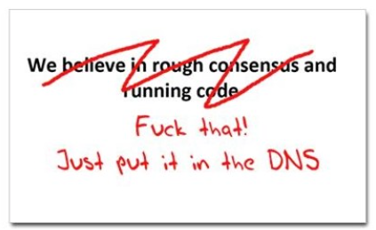
Where now?
Option C: Use the DNS!
cafepress.com/nxdomain

Slide 28
Seriously … just use the DNS Luke!*
Where better to find out the public key associated with a DNS name than to look it up in the DNS?
* Ok, that was a cheap shot – my apologies to the Star Wars franchise!

Slide 29
Seriously
Where better to find out the public key associated with a DNS name than to look it up in the DNS?
Why not query the DNS for the HSTS record (pinning record)?

Slide 30
Seriously
Where better to find out the public key associated with a DNS name than to look it up in the DNS?
Why not query the DNS for the HSTS record?
Why not query the DNS for the issuer CA?

Slide 31
Seriously
Where better to find out the public key associated with a DNS name than to look it up in the DNS?
Why not query the DNS for the HSTS record?
Why not query the DNS for the issuer CA?
Why not query the DNS for the hash of the domain name cert?

Slide 32
Seriously
Where better to find out the public key associated with a DNS name than to look it up in the DNS?
Why not query the DNS for the HSTS record?
Why not query the DNS for the issuer CA?
Why not query the DNS for the hash of the domain name cert?
Why not query the DNS for the hash of the domain name subject public key info?

Slide 33
Seriously
Where better to find out the public key associated with a DNS name than to look it up in the DNS?
Why not query the DNS for the HSTS record?
Why not query the DNS for the issuer CA?
Why not query the DNS for the hash of the domain name cert?
Why not query the DNS for the hash of the domain name subject public key info?
Who needs CA’s anyway?

Slide 34
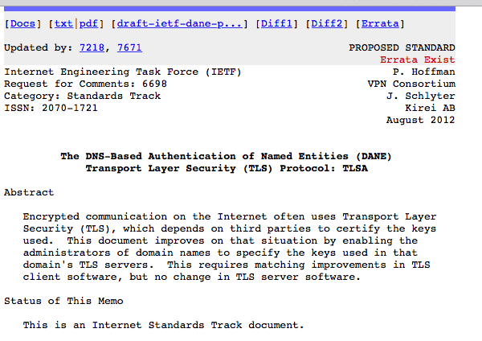
DANE
Using the DNS to associated domain name public key certificates with domain name

Slide 35
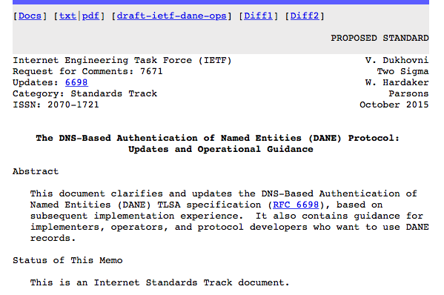
DANE
Using the DNS to associated domain name public key certificates with domain name

Slide 36
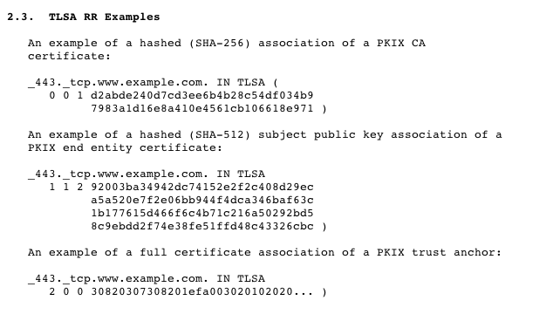
DANE
TLSA RR
CA Cert Hash
EE Cert Hash
Trust Anchor

Slide 37
TLS with DANE
Client receives server cert in Server Hello
Client lookups the DNS for the TLSA Resource Record of the domain name
Client validates the presented certificate against the TLSA RR
Client performs Client Key exchange

Slide 38
TLS Connections
DNS Name
TLSA query
Cert
https://rhsecurity.wordpress.com/tag/tls/

Slide 39
Just one problem…
The DNS is full of liars and lies!
And this can compromise the integrity of public key information embedded in the DNS
Unless we fix the DNS we are no better off than before with these TLSA records!

Slide 40
Just one response…
We need to allow users to validate DNS responses for themselves
And for this we need a Secure DNS framework
Which we have – and its called DNSSEC!

Slide 41
DNSSEC Interlocking Signatures
. (root)
. Key-Signing Key – signs over
. Zone-Signing Key – signs over
DS for .com (Key-Signing Key)
.com
.com Key-Signing Key – signs over
.com Zone-Signing Key – signs over
DS for example .com (Key-Signing Key)
.example.com
example.com Key-Signing Key – signs over
example.com Zone-Signing Key – signs over
www.example.com
www.example.com

Slide 42
DNSSEC Interlocking Signatures
. (root)
. Key-Signing Key – signs over
. Zone-Signing Key – signs over
DS for .com (Key-Signing Key)
.com
.com Key-Signing Key – signs over
.com Zone-Signing Key – signs over
DS for example .com (Key-Signing Key)
.example.com
example.com Key-Signing Key – signs over
example.com Zone-Signing Key – signs over
www.example.com
www.example.com IN A 192.0.1

Slide 43
DNSSEC Interlocking Signatures
Is the KSK for . valid?
. (root)
. Key-Signing Key – signs over
Is the ZSK for . valid?
. Zone-Signing Key – signs over
Is this DS equal to the hash of the KSK?
Is the signature for this record valid?
DS for .com (Key-Signing Key)
.com
Is the KSK for .com valid?
.com Key-Signing Key – signs over
.com Zone-Signing Key – signs over
Is the ZSK for .com valid?
DS for example .com (Key-Signing Key)
Is this DS equal to the hash of the KSK?
Is the signature for this record valid?
.example.com
example.com Key-Signing Key – signs over
Is the KSK for example.com valid?
example.com Zone-Signing Key – signs over
Is the ZSK for example.com valid?
www.example.com
Is the signature for this record valid?
www.example.com IN A 192.0.1

Slide 44
DNSSEC Interlocking Signatures
Is the KSK for . valid?
. (root)
As long as you have a valid local trust anchor for the root zone then you can validate a signed DNS response by constructing this backward path to the local root trust anchor
Is the ZSK for . valid?
. Key-Signing Key – signs over
. Zone-Signing Key – signs over
Is this DS equal to the hash of the KSK?
Is the signature for this record valid?
DS for .com (Key-Signing Key)
.com
Is the KSK for .com valid?
.com Key-Signing Key – signs over
.com Zone-Signing Key – signs over
Is the ZSK for .com valid?
DS for example .com (Key-Signing Key)
Is this DS equal to the hash of the KSK?
Is the signature for this record valid?
.example.com
example.com Key-Signing Key – signs over
Is the KSK for example.com valid?
example.com Zone-Signing Key – signs over
Is the ZSK for example.com valid?
www.example.com
Is the signature for this record valid?
www.example.com IN A 192.0.1

Slide 45
DANE + DNSSEC
Query the DNS for the TLSA record of the domain name and ask for the DNSSEC signature to be included in the response
Validate the signature to ensure that you have an unbroken signature chain to the root trust point
At this point you can accept the TLSA record as the authentic record, and set up a TLS session based on this data

Slide 46
So we need DNSSEC as well as DANE…
How much DNSSEC Validation is out there?

Slide 47
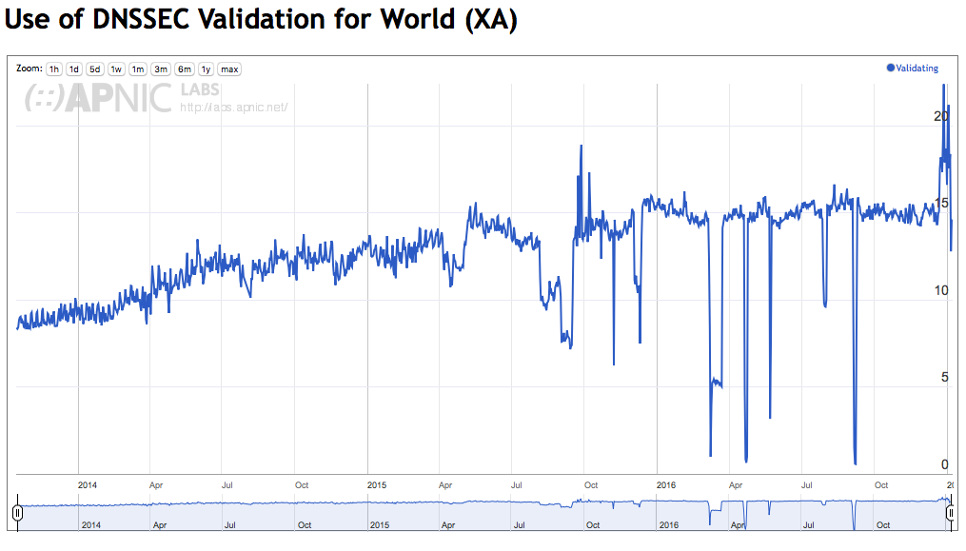
Do we do DNSSEC Validation?
stats.labs.apnic.net/dnssec/XA

Slide 48
Or…

Slide 49
Look! No DNS!
Server packages server cert, TLSA record and the DNSSEC credential chain in a single bundle
Client receives bundle in Server Hello
Client performs validation of TLSA Resource Record using the supplied DNSEC signatures plus the local DNS Root Trust Anchor without performing any DNS queries
Client validates the presented certificate against the TLSA RR
Client performs Client Key exchange

Slide 50
Where now?
Browser vendors appear to be dragging the chain on DANE support
DANE exists today as plug-ins rather than a core functionality
Cynically, one could observe that fast but insecure is the browser vendors’ current preference!

Slide 51
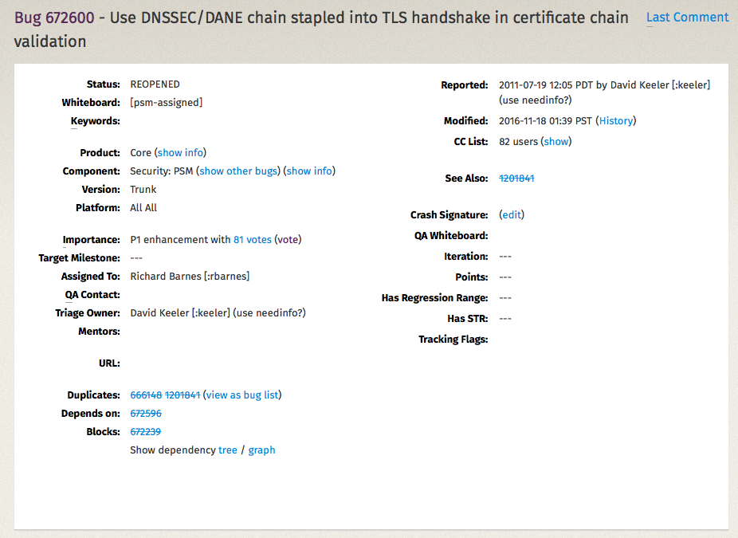
Maybe this will change
Mozilla Bug Report 672600

Slide 52
Where now?
We could do a far better job at Internet Security:
Publishing DNSSEC-signed zones
Publishing DANE TLSA records
Using DNSSEC-validating resolution
Using TLSA records to guide Key Exchange for TLS

Slide 53
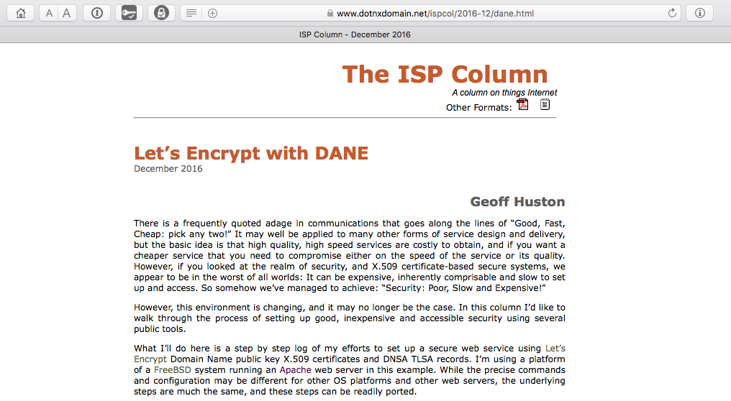
Let’s Do it!
What Let’s Encrypt and DNSSEC offers is robust, affordable, accessible security without the current overheads of high priced vanity CA offerings

Slide 54
That’s it!
Questions?

