Slide 1
Forensic Tracing in the Internet: An Update
Geoff Huston Chief Scientist
APNIC

Slide 2
The story so far…
The status of the transition to IPv6 is not going according to the original plan:
We have exhausted the remaining pools of IPv4 addresses in all regions except Africa - this was never meant to have happened
We we meant to have IPv6 fully deployed by now
What we are seeing is the pervasive use of Carrier Grade NATs as a means of extending the useable life of the IPv4 Internet
Around 10% of users use both IPv6 and IPv4 – the other 90% are IPv4 only
It appears that most IPv4 use today uses NATs in the path
This has some major implications for LEA functions, principally in traceback and metadata record keeping

Slide 3
Traceback – Version 1
Lets start by looking way back to the Internet of the 1980’s
A: 192.0.2.1
Internet
Ftp Server
Ftp Server Log
ftpserver.net 192.0.2.1 [31/Aug/2013:00:00:08 +0000]
$ whois 192.0.2.1
NetRange: 192.0.2.0 - 192.0.2.255
NetName: TEST-NET-1
Contact: User Contact Details
There was a rudimentary whois service and it listed all end users!

Slide 4
Assumptions:
Each end site used a stable IP address range
Each address range was recorded in a registry, together with the end user data
Each end device was manually configured with a stable IP address
Traceback was keyed from the IP address

Slide 5
Assumptions:
Each end site used a stable IP address range
Each address range was recorded in a registry, together with the end user data
Each end device was manually configured with a stable IP address
Traceback is keyed from the IP address
This model largely fell into disuse in the 1990’s
It was replaced by a combination of provider-address blocks, dynamic addressing to end users (AAA tools) and CPE NATs

Slide 6
+ NATs
A: 10.0.0.1
192.0.2.1
ISP
B: 10.0.0.2
CPE NAT/
DHCP Server
C: 10.0.0.3

Slide 7
Traceback – Version 2
ISP RADIUS Log
15/Aug/2013:18:01:02: user XXX IP: 192.0.2.1
A: 10.0.0.1
ISP
192.0.2.1
Web Server
CPE NAT/
DHCP Server
Web Server Log
webserver.net 192.0.2.1 [31/Aug/2013:00:00:08 +0000] "GET /1x1.png HTTP/1.1" 200
$ whois 192.0.2.1
NetRange: 192.0.2.0 - 192.0.2.255
CIDR: 192.0.2.0/24
OriginAS:
NetName: TEST-NET-1
NetHandle: NET-192-0-2-0-1
Parent: NET-192-0-0-0-0
NetType: IANA Special Use

Slide 8
Assumptions
The ISP operates an address pool
Each end site is dynamically assigned a single IP address upon login (AAA)
The site is dynamically addressed using a private address range and a DHCP server
The single public address is shared by the private devices through a CPE NAT

Slide 9
Changes
Traceback to an end site is keyed by an IP address and a date/time
Requires access to WHOIS records to identify the ISP and the ISP’s AAA logs to identify the end site
No traceback to an individual device – the trace stops at the edge NAT

Slide 10
IPv4 Address Exhaustion
What have ISP’s done in response?
It’s still not viable to switch over to all-IPv6 yet
The supply of further IPv4 addresses to fuel service platform growth has dried up
How do ISPs continue to offer IPv4 services to customers in the interim?
By sharing addresses across customers

Slide 11
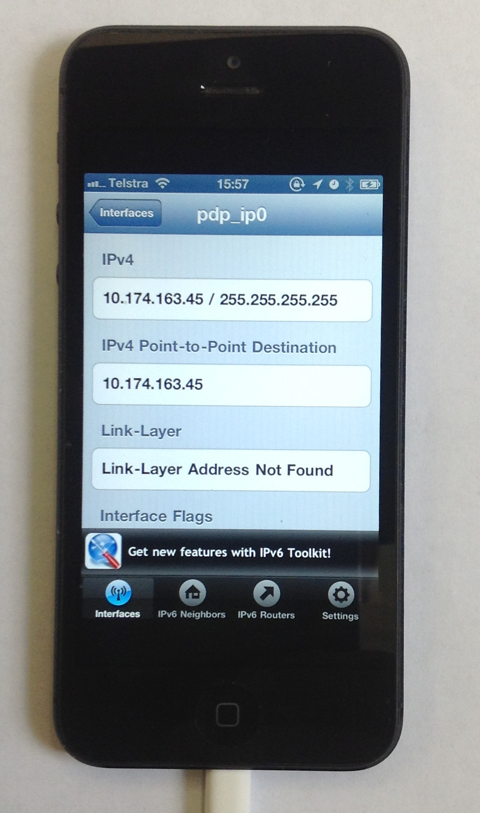
Carrier Grade NATs
By sharing public IPv4 addresses across multiple customers!

Slide 12
Traceback – Version 3
ISP RADIUS Log
15/Aug/2013:18:01:02: user XXX IP: 172.16.5.6:34000-40000
ISP CGN
A: 10.0.0.1
192.0.2.0/24
172.16.5.6
Internet
B: 10.0.0.2
CPE NAT/
DHCP Server
Web Server
C: 10.0.0.3
ISP CGN Log
Web Server Log
31/Aug/2013:00:00:02
172.16.5.6:34233 128.66.0.0:80 -> 192.0.2.1:45800 128.66.0.0:80
webserver.net [192.0.2.1]::45800 [31/Aug/2013:00:00:08
+0000] "GET /1x1.png HTTP/1.1" 200
$ whois 192.0.2.1
NetRange: 192.0.2.0 - 192.0.2.255
CIDR: 192.0.2.0/24
OriginAS:
NetName: TEST-NET-1
NetHandle: NET-192-0-2-0-1
Parent: NET-192-0-0-0-0
NetType: IANA Special Use

Slide 13
Assumptions
The ISP operates a public address pool and a private address pool
The access into the public address pool is via an ISP-operated NAT (CGN)
Each end site is dynamically assigned a single private IP address upon login (AAA)
The site is dynamically addressed using a private address range and a DHCP server
The single public address is shared by the private devices through a CPE NAT

Slide 14
Assumptions
Traceback to an end site is keyed by a source IP address and a source port address, and a date/time
Requires access to
WHOIS records to identify the ISP,
The ISP’s CGN logs to identify the ISP’s private address and
The ISP’s AAA logs to identify the end site

Slide 15
ISP CGN Logging
CGN bindings are formed for EVERY unique TCP and UDP session
That can be a LOT of data to retain…
http://www.nanog.org/meetings/nanog54/presentations/Tuesday/GrundemannLT.pdf

Slide 16
It could be better than this…
Use Port Blocks per customer
or
Use a mix of Port Blocks and Shared Port Pool overflow
and
Compress the log data (which will reduce storage but may increase search overhead)

Slide 17
Or it could be worse…

Slide 18
We are going to see a LOT of transition middleware being deployed!

Slide 19
We are going to see a LOT of transition middleware being deployed!
And we are going to see a significant diversity in what that transition middleware does

Slide 20
What does this mean for Forensic tracing?
LEAs have traditionally focused on the NETWORK as the point of interception and tracing
They are used to a consistent model to trace activity:
get an IP address and a time range
trace back based on these two values to uncover a set of network transactions

Slide 21
What does this mean for Forensic tracing?
In a world of densely deployed CGNs and ALGs the IP address loses coherent meaning in terms of end party identification.

Slide 22
What does this mean for Forensic tracing?
And instead of shifting to a single “new” model of IP address use, we are going to see widespread diversity in the use of transition mechanisms and NATs in carrier networks
Which implies that there will no longer be a useful single model of how to perform traceback on the network
Or even a single coherent model of “what is an IP address” in the network

Slide 23
Variants of NAT CGN Technologies
Address Compression
Ratio
10:1
100:1
1,000:1
>>10,000:1
Variant:
CGN with per user port blocks
CGN with per user port blocks + pooled overflow
CGN with pooled ports
CGN with 5-tuple binding maps
The same public address and port is used
simultaneously by multiple different internal
users
Customer A
Source: 192.0.2.1:1234
Dest: 128.66.0.0:80
ISP
Internet
Customer B
CGN
Source: 192.0.2.1:1234
Dest: 128.66.2.2:80

Slide 24
Adding IPv6 to the CGN Mix
The space is not exclusively an IPv4 space.
While CGNs using all-IPv4 technologies are common today, we are also looking at how to use CGN variants with a mix of IPv6 and IPv4
For example: Dual-Stack Light connects IPv4 end users to the IPv4 Internet across an IPv6 ISP infrastructure.
We see many more variants of ISP’s address transforming middleware when they IPv6 into the mix

Slide 25
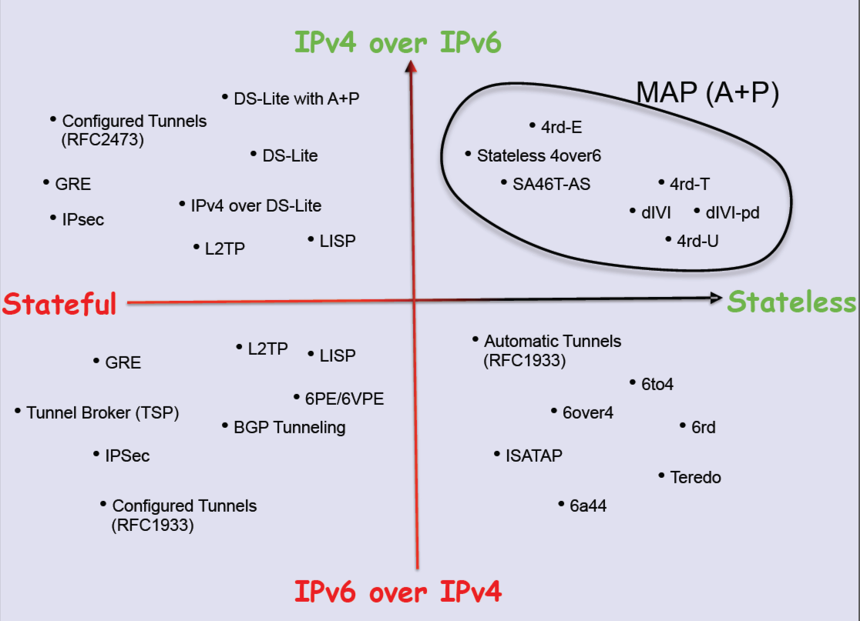
++IPv6: Transition Technologies
Randy Bush, APPRICOT 2012: http://meetings.apnic.net/__data/assets/pdf_file/0016/45241/120229.apops-v4-life-extension.pdf

Slide 26
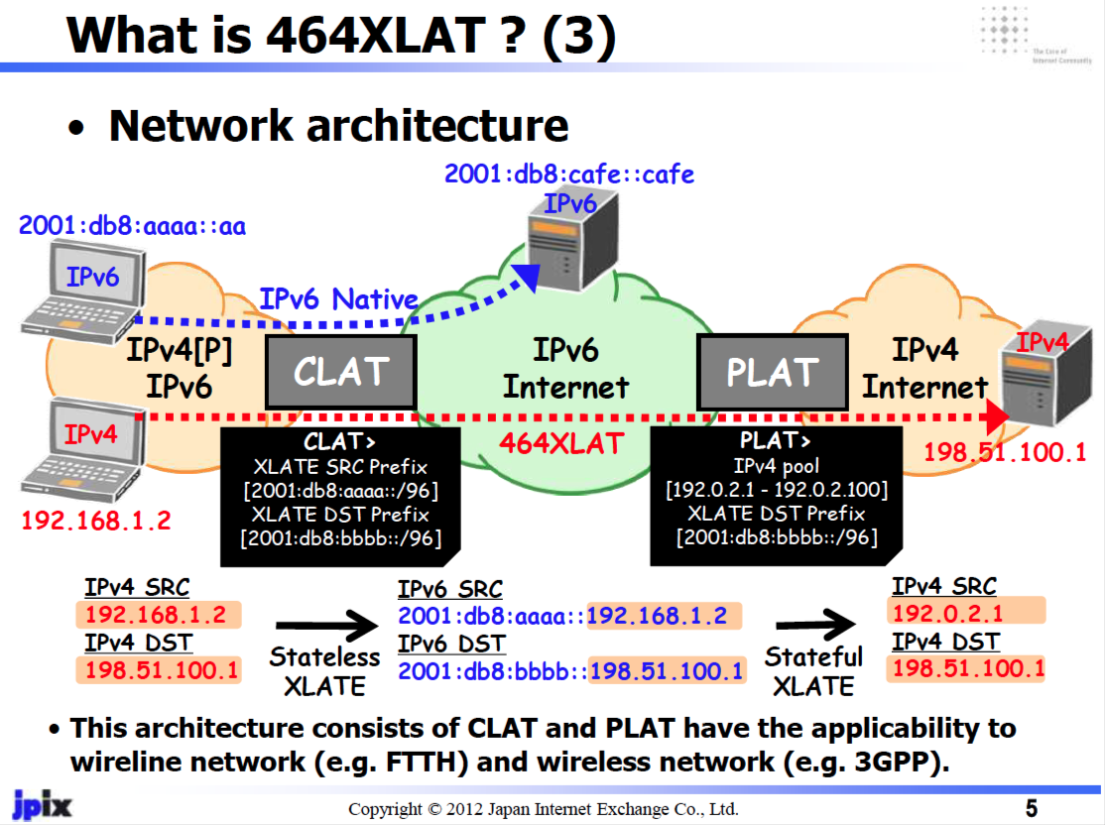
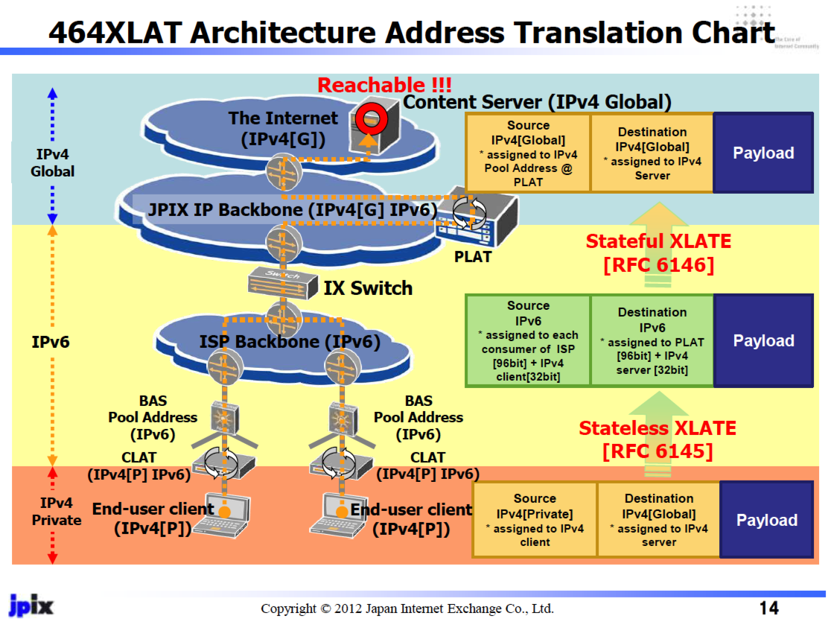
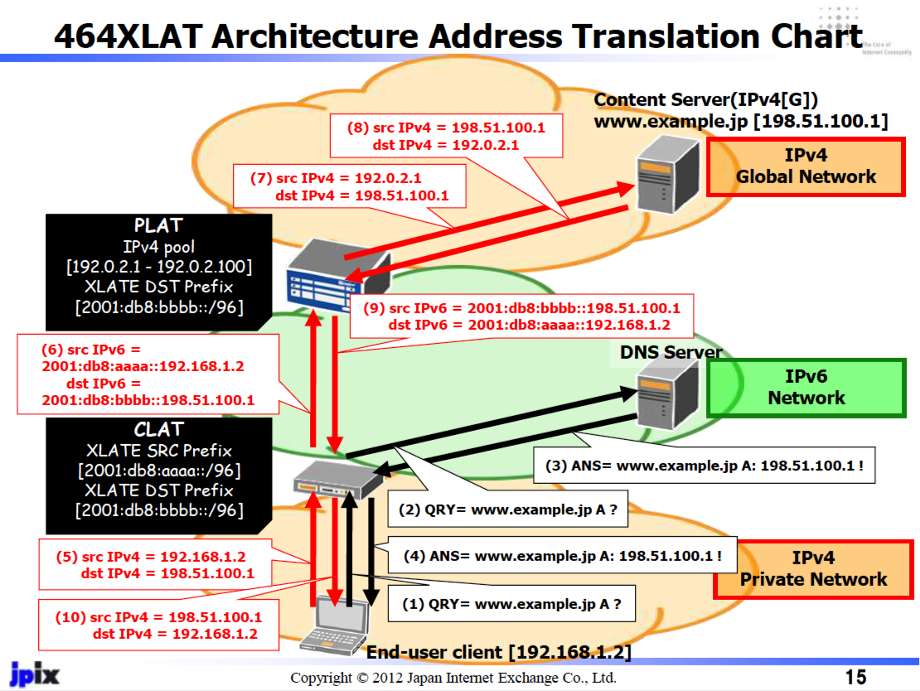
Transition Technologies Example: 464XLAT
Masataka Mawatari, Apricot 2012, http://meetings.apnic.net/__data/assets/pdf_file/0020/45542/jpix_464xlat_apricot2012_for_web.pdf

Slide 27
What does this mean for Forensic tracing?
There is no single consistent model of how an IP network manages IPv4 and IPv6 addresses
There is no fixed relationship between IPv4 and IPv6 addresses
What you see in terms of network trace information is strongly dependent on where the trace data is collected

Slide 28
What does this mean for LEAs?
What’s the likely response from LEAs and regulators?
One likely response is to augment the record keeping rules for ISPs

Slide 29
What does this mean for ISPs and LEAs?
But what are the new record keeping rules?
In order to map a “external” IP address and time to a subscriber as part of a traceback exercise then:
for every active middleware element you now need to hold the precise time and the precise transforms that were applied to a packet flow
and you need to be able to cross-match these records accurately

Slide 30
What does this mean for ISPs and LEAs?
But what are the new record keeping rules?
In order to map a “external” IP address and time to a subscriber as part of a traceback exercise then:
for every active middleware element you now need to hold the precise time and the precise transforms that were applied to a packet flow
and you need to be able to cross-match these records accurately
Degree of difficulty: approaching 10/10 !

Slide 31
What does this mean for ISPs and LEAs?
How many different sets of record keeping rules are required for each CGN / dual stack transition model being used?
And are these record keeping practices affordable?
(granularity of the records is shifting from “session” records to “transition” and even individual packet records in this diverse model)
Are they even practical within today’s technology capability?
Is this scaleable?
Is it even useful any more?

Slide 32
Making it hard...
The V6 transition was challenging enough
The combination of V4 exhaustion and V6 transition is far harder
The combination of varying exhaustion times, widespread confusion, diverse agendas, diverse pressures, V4 exhaustion and V6 transition is now amazingly challenging

Slide 33
Making it very hard...
The problem we are facing is that we are heading away from a single service architecture in our IP networks
Different providers are seeing different pressures and opportunities, and are using different technology solutions in their networks
And the longer we sit in this “exhaustion + transitioning” world, the greater the diversity and internal complexity of service networks that will be deployed

Slide 34
Does it ever get easier?
Is there light at the end of this tunnel?

Slide 35
That was then
The material so far refers to the Internet of late 2013
Three years later, has it got any easier?
Or has it just got harder?

Slide 36
Sessions are the Key
We assumed that there is a “session” that maps between a service and a client, and this session is visible in some manner to the network
The forensic task was to take a partial record of a “session” and identify the other party to the session by using ancilliary information (whois registries, web logs, metadata data sets, etc)
But maybe the entire concept of a “session” no longer exists! Do we still use “sessions” in applications?
What is changing?

Slide 37
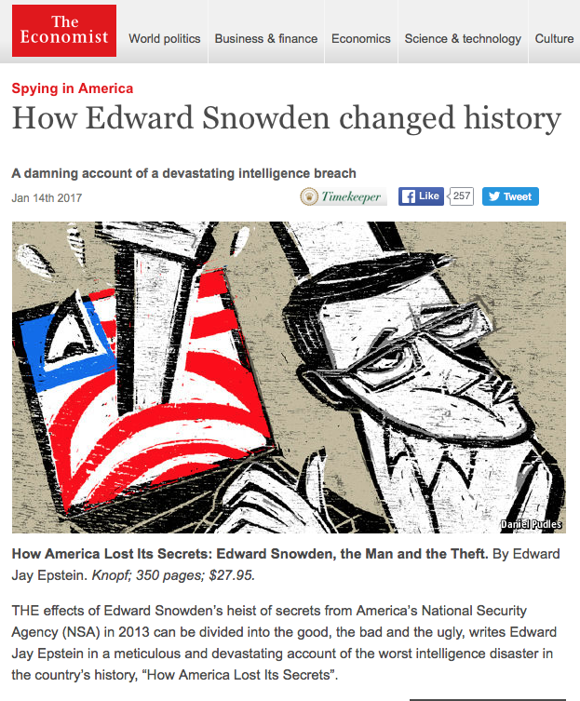

Slide 38
The new Paranoid Internet Service Architecture
The entire concept of open network transactions is now over
We are shifting into an environment where user information is deliberately withheld from the network, withheld from the platform and even withheld from other applications
We circulate large self-contained applications that attempt to insulate themselves completely from the host platform
Application Service Providers see the platform provider as representing a competitive interest in the user, and they want to prevent information leakage from their application to the platform
Application Service Providers see other applications as as representing a competitive interest in the user, and they want to prevent information leakage from their application to other applications in the same platform

Slide 39
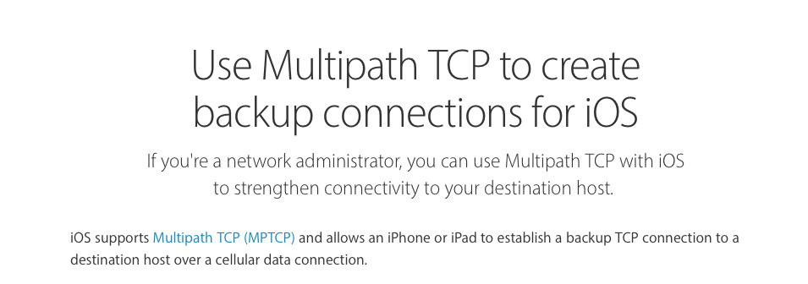
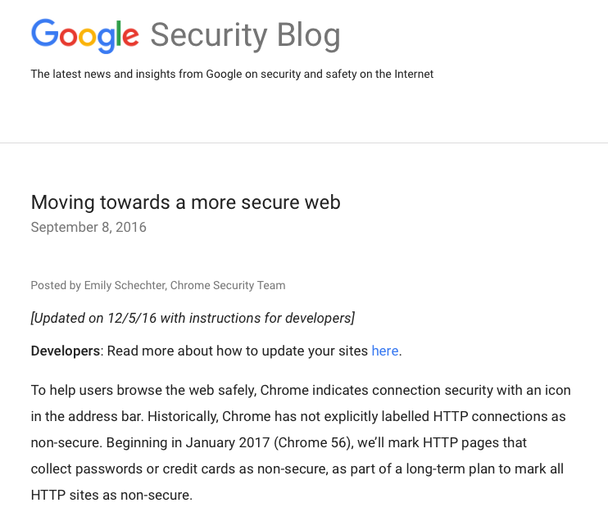
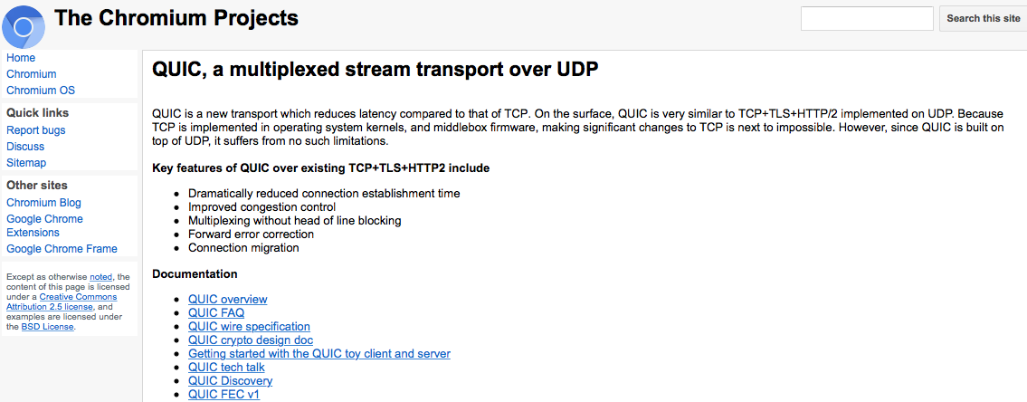

Slide 40
These technologies are already deployed, and enjoy significant use in today’s network
They break down the concept of a “session” and splay the encrypted traffic across multiple networks, and even multiple protocols
They use opportunistic encryption to limit third party access to information about users’ actions
The result is that only the endpoints see the entirety of a session, while individual networks see disparate fragments of pseudo-sessions

Slide 41
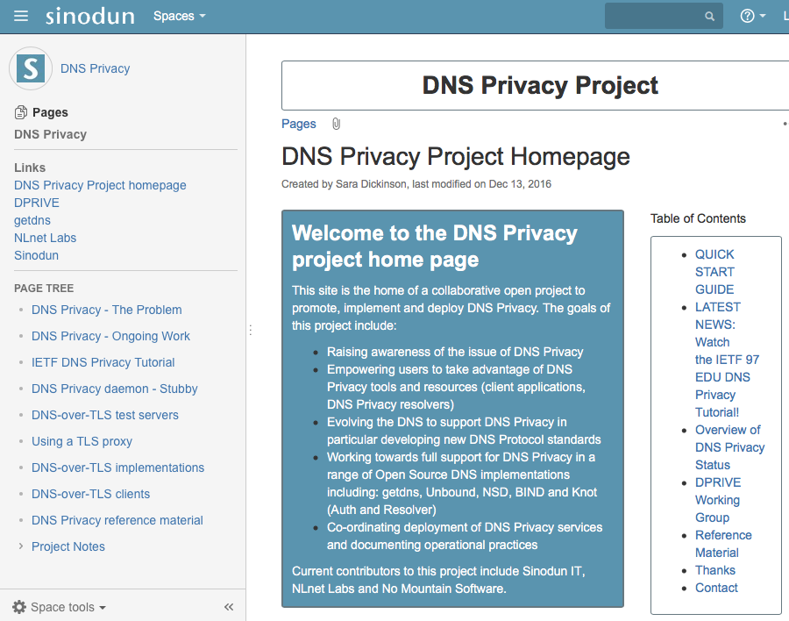
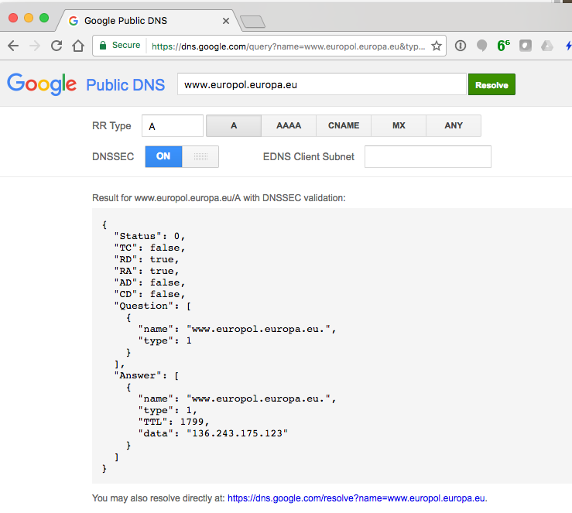
Even the DNS is going “dark!”

Slide 42
The Bottom Line
It’s no longer just an issue with IPv4 and NATs and a visible reluctance to shift to IPv6
Networks, platforms and applications now regard each other with mutual suspicion
Platforms seek to hide users’ activities from the network
Applications seek to hide their information from the platform and from other applications
The DNS is sealing itself into private tunnels that resist external examination, intervention and intervention
“Sessions” are being deconstructed into opaque fragments
Opportunistic encryption is being applied ubiquitously

Slide 43
Its not just “the IPv6 transition” any more
These are not just temporary steps to make IPv4 last longer for the transition to IPv6
Even if we complete the transition to an all-IPv6 Internet, this paranoia, complexity and deliberate obfuscation will not go away
This is now the Internet we have to live with

Slide 44
We are never coming back from here – this is the new “ground state” for the Internet!

Slide 45
Does it ever get easier?
Is there light at the end of this tunnel?

Slide 46
No!

Slide 47
Thank You!
Me: gih@apnic.net

