Slide 1
IPv6: Are we really ready to turn off IPv4?
Geoff Huston
APNIC

Slide 2
The IPv6 Timeline…
1999 - RIR Allocations of Unicast IPv6 start
2003 - Dual Stack Transition underway
1993 - Next Generation IP work in the IETF
1996 - 6Bone Testbed (1996 – 2006)
1989- Forecasts of IPv4 Address Exhaustion
IPv4 Address Exhaustion
1995 IPv6 Spec (RFC1883)
2010
2020
1990
2000

Slide 3
The IPv6 Timeline…
1999 - RIR Allocations of Unicast IPv6 start
2003 - Dual Stack Transition underway
1993 - Next Generation IP work in the IETF
1996 - 6Bone Testbed (1996 – 2006)
Yes, we’ve been working on this for close to 30 years!
1989- Forecasts of IPv4 Address Exhaustion
IPv4 Address Exhaustion
1995 IPv6 Spec (RFC1883)
2010
2020
1990
2000

Slide 4
In-situ transition…

Slide 5
In-situ transition…
Phase 1 – Early Deployment
IPv4 Internet
Edge Dual -Stack Networks
IPv6 networks interconnect by
IPv6-over-IPv4 tunnels

Slide 6
In-situ transition…
Phase 2 – Dual Stack Deployment
Transit Dual-Stack
Networks
Edge Dual-Stack
Networks
IPv6 networks interconnect by
Dual Stack transit paths

Slide 7
In-situ transition…
Phase 3 – IPv4 Sunset
IPv6 Internet
Edge Dual Stack Networks
IPv4 networks interconnect by
IPv4-over-IPv6 tunnels

Slide 8
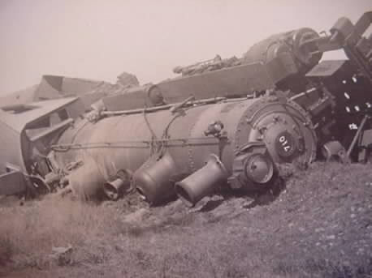
In-situ transition…
We’re pretty lousy at following plans!
Size of the Internet
Dual Stack Transition
IPv6 Deployment
IPv4 Pool Size

Slide 9
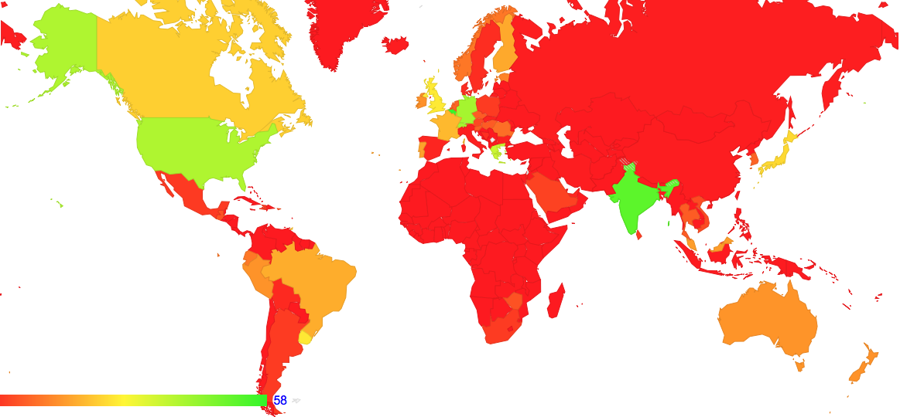
The Map of IPv6 penetration – November 2017

Slide 10
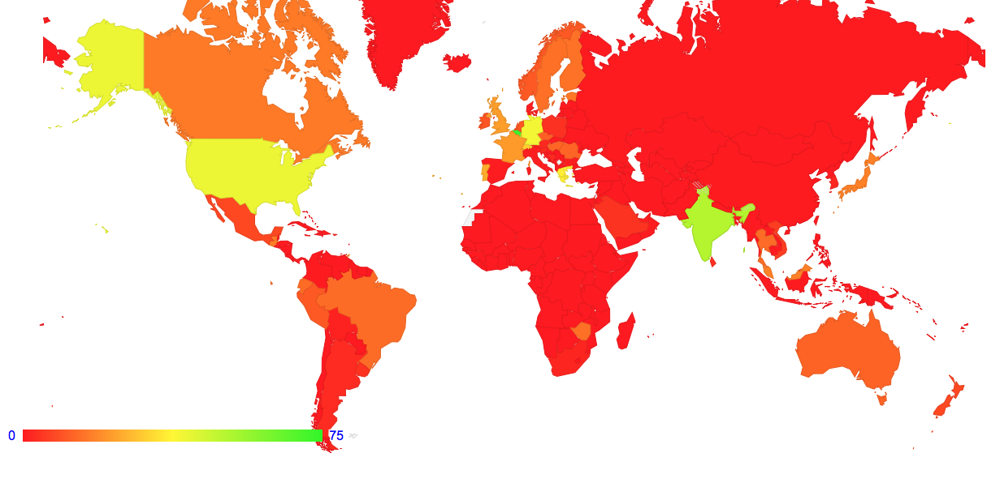
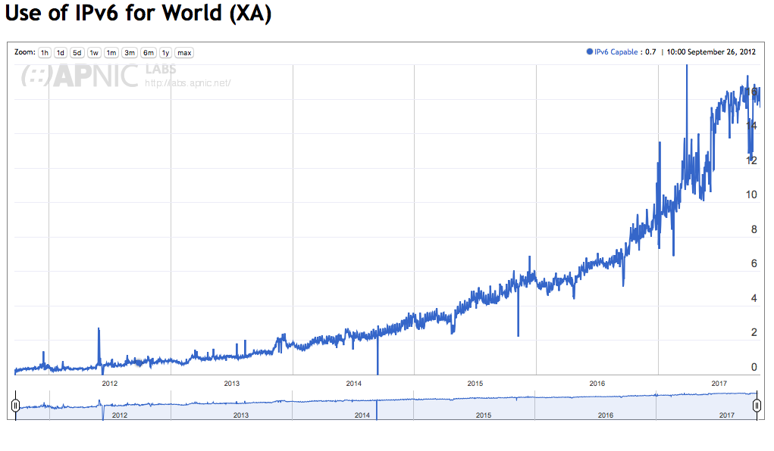
The Map of IPv6 penetration – November 2017

Slide 11
We’re stuck in Phase 2
Some 15% - 20% of Internet users have IPv6 capability
In the IoT world the IPv6 numbers appear to be far lower than this
Most new IP deployments use IPv6+ (NATTED) IPv4
IPv4-only Legacy networks are being (gradually) migrated to dual stack

Slide 12
We’re stuck in Phase 2
Some 15% - 20% of Internet users have IPv6 capability
In the IoT world the IPv6 numbers appear to be far lower than this
Most new IP deployments use IPv6+ (NATTED) IPv4
IPv4-only Legacy networks are being (gradually) migrated to dual stack
The current situation is that the universal “glue” of the Internet remains IPv4, while IPv6 is still an optional feature!

Slide 13
Today
We appear to be in the middle of the transition!
Dual Stack networks cannot drop support for IPv4 as long as significant services and user populations do not support IPv6

Slide 14
Today
We appear to be in the middle of the transition!
Dual Stack networks cannot drop support for IPv4 as long as significant services and user populations do not support IPv6 – and we can’t tell when that may change
Nobody is really in a position to deploy a robust at-scale ipv6-only network service today, even if they wanted to!
And we are not even sure if we can!

Slide 15
Today
We appear to be in the middle of the transition!
Dual Stack networks cannot drop support for IPv4 as long as significant services and user populations do not support IPv6 – and we can’t tell when that may change
Nobody is really in a position to deploy a robust at-scale ipv6-only network service today, even if they wanted to!
And we are not even sure if we can!

Slide 16
The Issue
We cannot run Dual-Stack services indefinitely
At some point we need to support networks that only have IPv6
Is that viable?

Slide 17
In other words…
What do we rely on today in IPv4 that does not appear to have a clear working counterpart in IPv6?

Slide 18
In other words…
What do we rely on today in IPv4 that does not appear to have a clear working counterpart in IPv6?
If the answer is “nothing” then we are done!
But if there is an issue here, then we should be working on it!

Slide 19
IPv6: What changed?
IPv4 Header
Version
IHL
Type of Service
Total Length
Identification
Flags
Fragment Offset
Time To Live
Protocol
Header Checksum
Source Address
Destination Address
Options
Padding
IPv6 Header
Version
Class
Flow
Payload Length
Next Header
Hop Limit
Source Address
Destination Address

Slide 20
IPv6: What changed?
Type of Service is changed to Traffic Class
Flow Label Added
Options and Protocol fields replaced by Extension Headers
32 bit Fragmentation Control were pushed into an Extension Header
Checksum becomes a media layer function

Slide 21
IPv6: What changed?
Type of Service is changed to Traffic Class
Flow Label Added
Options and Protocol fields replaced by Extension Headers
32 bit Fragmentation Control were pushed into an Extension Header
Checksum becomes a media layer function

Slide 22
IPv6: What changed?
Type of Service is changed to Traffic Class
The only substantive changes with IPv6 are:
- the handling of fragmentation via Extension Headers
- cementing the Don’t’Fragment bit to ON for routers
Flow Label Added
Options and Protocol fields replaced by Extension Headers
32 bit Fragmentation Control were pushed into an Extension Header
Checksum becomes a media layer function

Slide 23
IPv6: What changed?
IPv4 “Forward Fragmentation”
IPv4 header
2
IPv4 header
1
TCP/UDP header
TCP/UDP header
Payload
Payload
IPv4 Router

Slide 24
IPv6: What changed?
IPv4 “Forward Fragmentation”
IPv4 header
2
IPv4 header
1
TCP/UDP header
TCP/UDP header
Payload
Payload
Source
IPv4 Router
IPv6 header
TCP/UDP xtn header
IPv6 “Source Fragmentation”
1
Payload
IPv6 Router
Source
ICMPv6 PTB
IPv6 header
2
TCP/UDP xtn header
Payload
IPv6 header
Fragmentation xtn header
3
TCP/UDP xtn header
Payload

Slide 25
ICMPv6 and Anycast
Anycast Constellation
Sender Instance
Sender Instance
Client
Sender Instance
Sender Instance
Sender Instance
It is not obvious (or even assured) that every router on the path from an anycast instance to a client host will necessarily be part of the same anycast instance “cloud”
The implication is that in anycast, the reverse ICMPv6 PTB messages will not necessarily head back to the original sender!

Slide 26
New Dependencies
For IP fragmentation to work in IPv6 then:
- all ICMPv6 messages have to be passed backwards from the interior
of the network to the sender
- IPv6 packets containing a IPv6 Fragmentation Extension
header should not be dropped

Slide 27
Processing incoming ICMPv6 messages
Only the sending host now has control of fragmentation – this is a new twist
A received ICMPv6 message needs to alter the sender’s state to that destination
For TCP, if the ICMP payload contains the TCP header, then you can pass this to the TCP control block. TCP can alter the session MSS and resend the dropped data
For UDP – um, err, um well

Slide 28
Processing incoming ICMPv6 messages
Only the sending host now has control of fragmentation – this is a new twist
A received ICMPv6 message needs to alter the sender’s state to that destination
For TCP, if the ICMP payload contains the TCP header, then you can pass this to the TCP control block. TCP can alter the session MSS and resend the dropped data
For UDP – um, err, um well
Maybe you should store the revised path MTU in a host forwarding table cache for a while
If you ever need to send another UDP packet to this host you can use this cache entry to guide your fragmentation behaviour

Slide 29
IPv6 and Fragmentation
The theory is that TCP in IPv6 should never send a fragmented packet - TCP should use the session MSS as a guide to packet sizes and segment the stream according to the session MSS
However, UDP cannot avoid fragmentation - large payloads in UDP simply need to be fragmented to fit within the path MTU
Fragmentation in IPv6 uses the same control fields as IPv4 – a packet identifier, a fragmentation offset and a More Frags flag
BUT they are located in an inserted “shim” that sits between the IPv6 packet header and the UDP transport header - this is an instance of the IPv6 “Extension Header”

Slide 30
IPv6 Fragmentation Extension Header Handling
The extension header sits between the IPv6 packet header and the upper level protocol header for the leading fragged packet, and sits between the header and the trailing payload frags for the trailing packets
Practically, this means that transport-protocol aware packet processors/switches need to decode the extension header chain, if its present, which can consume additional cycles to process/switch a packet – and the additional time is not predictable. For trailing frags there is no transport header!
Or the unit can simply discard all Ipv6 packets that contain extension headers!
Which is what a lot of transport protocol sensitive IPv6 deployed switching equipment actually does (e.g. load balancers!)
IPv6 header
Fragmentation xtn header
TCP/UDP xtn header
Payload

Slide 31
IPv6 Fragmentation Extension Header Handling
There is a lot of “drop” behaviour in the IPv6 Internet for Fragmentation Extension headers
RFC7872 – recorded drop rates of 30% - 40%
This experiment sent fragmented packets towards well-known servers and observed whether the server received and reconstructed the fragmented packet
But sending fragmented queries to servers is not all that common – the reverse situation of big responses is more common
So what about sending fragmented packets BACK from servers – what’s the drop rate of the reverse case?

Slide 32
IPv6 Fragmentation Extension Header Handling
We used an ad-based measurement system, using a custom packet fragmentation wrangler as a front end to a DNS and Web server to test IPv6 fragmentation behaviour
DNS Resolver
IPv6 DNS Server
IPv6 ‘Fragmenter’
DNS Goo
IPv6 NGINX Server
Client

Slide 33
IPv6 Fragmentation Extension Header Handling
We used an ad-based measurement system, using a custom packet fragmentation wrangler as a front end to a DNS and Web server to test IPv6 fragmentation behaviour
We use a technique of “glueless” delegation and fragmentation of the NS query response to allow us to detect if the DNS resolver received the fragmented response
DNS Resolver
DNS Resolver
IPv6 DNS Server
IPv6 ‘Fragmenter’
DNS Goo
IPv6 NGINX Server
Client
Client
We track TCP ACKs at the server to see if the client received the fragmented TCP response

Slide 34
IPv6 Fragmentation Extension Header Handling
Our Experiments were run across some 40M individual sample points in August 2017:
37% of end users who used IPv6-capable DNS resolvers could not receive a fragmented IPv6 DNS response

Slide 35
IPv6 Fragmentation Extension Header Handling
Our Experiments were run across some 40M individual sample points in August 2017:
37% of end users who used IPv6-capable DNS resolvers could not receive a fragmented IPv6 DNS response
20% of IPv6-capable end users could not receive a fragmented IPv6 packet

Slide 36
IPv6 Fragmentation is very unreliable
Why don’t we see this unreliability in today’s IPv6 networks affecting user transactions?

Slide 37
IPv6 Fragmentation is very unreliable
Why don’t we see this unreliability in today’s IPv6 networks affecting user transactions?
Because IPv4 papers over the problem!

Slide 38
IPv6 Fragmentation is very unreliable
Why don’t we see this unreliability in today’s IPv6 networks affecting user transactions?
Because IPv4 papers over the problem!
In a Dual-Stack environment there is always the option to flip to use IPv4 if you are stuck with Ipv6.
The DNS does this, and Happy Eyeballs does this
So there are few user-visible problems in a dual stack environment
This means that there is no urgent imperative to correct these underlying problems in deployed IPv6 networks

Slide 39
IPv6 Fragmentation is very unreliable
Why don’t we see this unreliability in today’s IPv6 networks affecting user transactions?
Because IPv4 papers over the problem!
In a Dual-Stack environment there is always the option to flip to use IPv4 if you are stuck with Ipv6.
The DNS does this, and Happy Eyeballs does this
So there are few user-visible problems in a dual stack environment
This means that there is no urgent imperative to correct these underlying problems in deployed IPv6 networks
There is little in the way of practical incentives to fix this today!

Slide 40
Living without IPv6 Fragmentation
If we apparently don’t want to fix this, can we live with it?
We are living with it in a Dual Stack world, because IPv4 just makes it all better!
But what happens when there is no IPv4 left?

Slide 41
Living without IPv6 Fragmentation
If we apparently don’t want to fix this, can we live with it?
We are living with it in a Dual Stack world, because IPv4 just makes it all better!
But what happens when there is no IPv4 left?
We have to avoid IPv6 Fragmentation!
TCP can work as long as IPv6 sessions use conservative MSS sizes
UDP can work as long as UDP packet sizes are capped so as to avoid fragmentation

Slide 42
Living without IPv6 Fragmentation
We have to avoid IPv6 Fragmentation!
TCP can work as long as IPv6 sessions use conservative MSS sizes
UDP can work as long as UDP packet sizes are capped so as to avoid fragmentation
Who needs to use large UDP packets anyway?

Slide 43
Living without IPv6 Fragmentation
We have to avoid IPv6 Fragmentation!
TCP can work as long as IPv6 sessions use conservative MSS sizes
UDP can work as long as UDP packet sizes are capped so as to avoid fragmentation
Who needs to use large UDP packets anyway?
DNSSEC!

Slide 44
What can we do about it?
A. Get all the deployed routers and switches to deliver ICMPv6 packets and accept packets with IPv6 Fragmentation Headers

Slide 45
What can we do about it?
B. Get all the deployed routers and switches to alter the way IPv6 manages packet fragmentation

Slide 46
What can we do about it?
C. Move the DNS off UDP

Slide 47
Pick one?
All of these options have a certain level of pain, cost and potential inconvenience
Its hard to work out what is the best course of action, but it seems like a lot of extra effort if we take on all three at once!

Slide 48
For TCP …
Working around this issue in TCP can be as simple as a very careful selection of a default IPv6 TCP MSS
Large enough enough to offer a tolerable data carriage efficiency
Small enough to avoid Path MTU issues
And perhaps you might want to to support TCP path MTU discovery (RFC 4281)

Slide 49
For TCP …
But you have to take into account the observation that Path MTU discovery without reliable ICMPv6 signaling takes a number of Round Trip Times (delay)
And time is something no application designer has enough of to waste on probing path characteristics
So choose your TCP MSS very carefully
Hint: Smaller TCP MSS sizes are Better in IPv6!

Slide 50
For UDP …
Working around this issue can be challenging with UDP
ICMPv6 Packet Too Big filtering causes silence
Fragment drop is silent drop
Which means that protocols need to understand timeouts
An effort to work around this necessarily involves application-level adaptation to pass large responses without relying on UDP packet fragmentation

Slide 51
If we can’t fix IPv6
And we can’t fix end-to-end transport
Then all that’s left is to look at the application protocol and see if we can re-define the protocol behaviour in a way eliminates fragmentation behaviour

Slide 52
“Old Style” DNS
The original DNS protocol had this behaviour
If the DNS payload was <= 512 bytes send the answer over UDP
Otherwise send as much as will fit in 512 bytes set the truncate bit
The receiver is meant to re-query using TCP upon receipt of a truncated response
Why did we change this behaviour?
Because we thought that fragmentation was “safe” and TCP was too costly
So we added Extension options for DNS to signal it was OK to send large fragmented UDP responses
But its not OK

Slide 53
Large DNS Responses and IPv6
Change the protocol behaviour?
Shift Additional Records into additional explicit UDP query/response transactions rather than bloating the original DNS response
Perform UDP MTU discovery using EDNS(0) UDP Buffer Size variations as a probe
Add a truncated minimal UDP response to trail a fragmented response (ATR)
Change the transport?
DNS over TCP by default
DNS over TLS over TCP by default
DNS over QUIC
Devise some new DNS framing protocol that uses multiple packets instead of fragmentation

Slide 54
Where now?
We have a decent idea of the problem space we need to resolve
We’d prefer a plan that allows each of us to work independently rather than a large scale orchestrated common change
We’re not sure we can clean up all the ICMPv6 filters and EH packet droppers in the IPv6 network
And it sure seems a bit late in the day to contemplate IPv6 protocol changes
Which means that we are probably looking at working around the problem by changing the behaviour of applications

Slide 55
What do the RFC’s say?

Slide 56
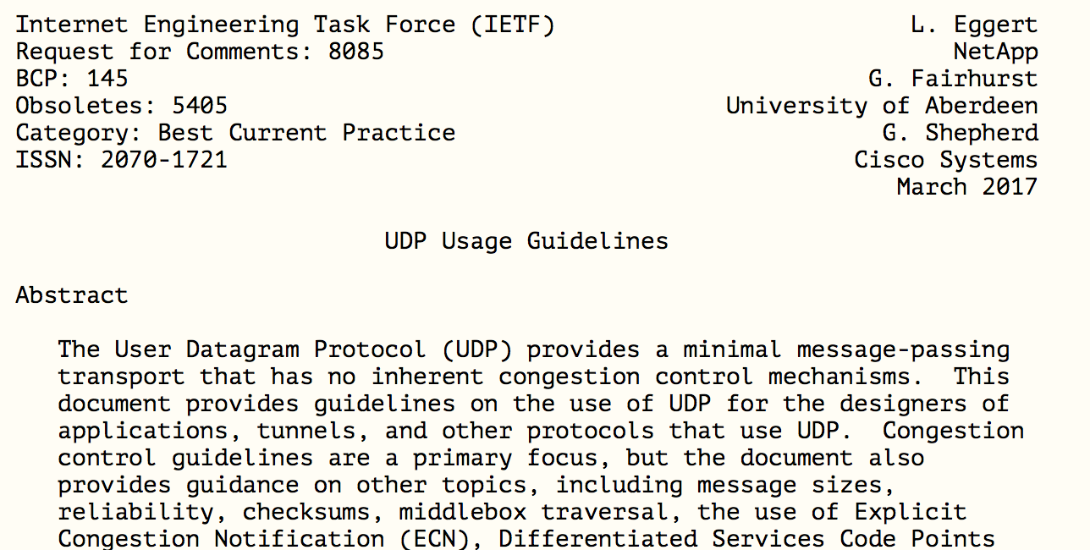
What do the RFC’s say?

Slide 57
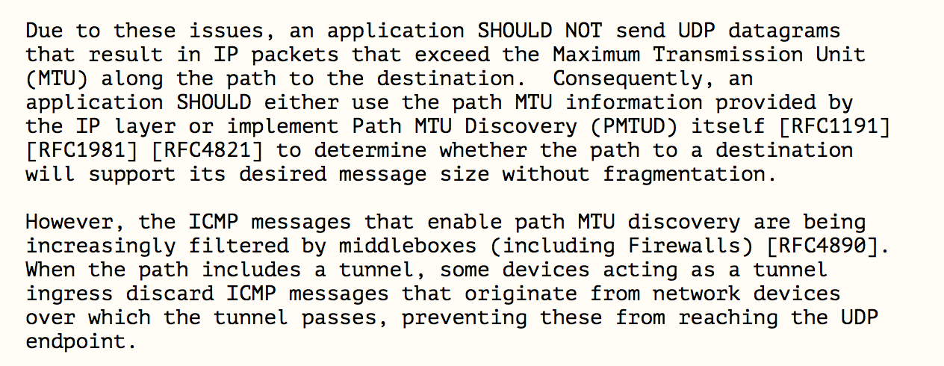
What do the RFC’s say?

Slide 58
What do the RFC’s say?

Slide 59
What do the RFC’s say?
This BCP is saying that using EDNS(0) in the DNS to signal the capability of accepting large fragmented DNS responses was unwise, and if a host/application does know the path MTU, it should truncate at UDP at 1280 octets (and IPv4 should truncate at 512 octets!)

Slide 60
But would that be enough?
Is the root cause problem with the way our IPv6 networks handle Fragmented IPv6 packets?
Or with the way our IPv6 networks handle IPv6 packets with Extension Headers?
The data presented here suggests that EH drop could be the underlying significant issue here
Perhaps we might want to think about advice to host stacks and applications to avoid EH altogether!
Including fragmentation!

Slide 61
What was the question again?
Oh yes, that’s right:
“Are we ready for an IPv6-only Internet?”
It appears that the answer is “no, not if we want the DNS to work!”

Slide 62
What was the question again?
Oh yes, that’s right:
“Are we ready for an IPv6-only Internet?”
It appears that the answer is “no, not if we want the DNS to work!”
IPv6 Grade: B-
It’s close, but more effort is needed if you want to properly finish this work!

Slide 63
Thanks!

