Slide 1
TCP and BBR
Geoff Huston
APNIC

Slide 2
The IP Architecture
At its heart IP is a datagram network architecture
  Individual IP packets may be lost, re-ordered, re-timed and even fragmented

Slide 3
The IP Architecture
At its heart IP is a datagram network architecture
  Individual IP packets may be lost, re-ordered, re-timed and even fragmented
!!!
!!!

Slide 4
The IP Architecture
At its heart IP is a datagram network architecture
  Individual IP packets may be lost, re-ordered, re-timed and even fragmented

Slide 5
TCP
The Transmission Control Protocol is an END-TO-END protocol that creates a reliable stream protocol from the underlying IP datagram device
TCP uses a sliding window flow control protocol to manage the data flow
Data stream
ACKed Data
unacknowledged Data
unsent Data
window

Slide 6
TCP Sliding Window
Each ACK advertises the sequence number of the last “good” received byte and the available buffer size in the receiver
The sender can send up to a window size of data before pausing for a window update
Data stream
ACKed Data
unacknowledged Data
unsent Data
W=s ACK=n
n
window
s

Slide 7
Sliding Window protocols tend to be “bursty”
Send a window of data
Wait for acks to advertise re-opened window
Send a window of data
Sending rate
1 RTT
time

Slide 8
Flow Control
While TCP could send up to one window of data into the network as fast as it can, it is possible/likely that this would flood the network and generate packet loss
The question is then how to regulate TCP’s sending behaviour so that it sends as much data as it can while avoiding network packet loss
So lets look at networks…

Slide 9
Network Considerations
Networks routers are constructed of links and routers
Links are a constant delay lossless pipe
Routers are a buffered switch
  Buffers within the router constrain the total amount of data that can be held in the network
Input Buffers
Switch
Output Buffers

Slide 10
Queue Formation in Network Buffers

Slide 11
Buffer Considerations
Buffers play the role of multiplexing adaptors
  If two packets arrive at the same instant, one packet is queued in a buffer while the other is being services
Buffers also play the role of rate adaptation
  But only from fast to slow, and only in a limited role!

Slide 12
Buffer Considerations
When the queue fills then incoming packets are dropped – so larger buffers are better to reduce the incidence of queue drop!
When packets spend time in the queue it adds to the additional time this packets spends in transit (this delay variation is called jitter) – too much imposed jitter is bad, so smaller queues are better!
A reasonable rule of thumb for IP routers is to use a buffer size equal to the delay bandwidth product of the next hop link

Slide 13
TCP Design Objectives
To maintain an average flow which is Efficient and Fair
Efficient:
  Minimise packet loss
  Minimise packet re-ordering
  Do not leave unused path bandwidth on the table!
Fair:
  Do not crowd out other TCP sessions
  Over time, take an average 1/N of the path capacity when there are N other TCP sessions sharing the same path

Slide 14
It’s a Flow Control process
Think of this as a multi-flow fluid dynamics problem
Each flow has to gently exert pressure on the other flows to signal them to provide a fair share of the network, and be responsive to the pressure from all other flows

Slide 15
How can we achieve this?

Slide 16
A few more observations about TCP
TCP is an ACK Pacing protocol
Data sending rate is matched to the ACK arrival rate

Slide 17
A few more observations about TCP
TCP is an ACK Pacing protocol
  Each received ACK tells the sender how many bytes of data were received by the remote receiver – which is the same as the number of bytes that left the network
  If a sender paces its data to ensure that the same number of bytes enters the network, then it will maintain a steady rate of network “pressure” assuming a constant capacity network path
  If the sender sends more data into the network than is spanned by the ACK then it increases its data rate and its network pressure
  Similarly if it sends less than the ACK span then it decrease its sending rate and its network pressure

Slide 18
A few more observations about TCP
ACK pacing protocols relate to a past network state, not necessarily the current network state
  The ACK signal shows the rate of data that left the network at the receiver that occurred at ½ RTT back in time
  So if there is data loss, the ACK signal of that loss is already ½ RTT old!
    So TCP should react quickly to ‘bad’ news
  If there is no data loss, that is also old news
    So TCP should react conservatively to ‘good’ news

Slide 19
“Classic TCP” – TCP Reno
Additive Increase Multiplicative Decrease (AIMD)
  While there is no packet loss, increase the sending rate by One Segment (MSS) each RTT interval
  If there is packet loss decrease the sending rate by 50% each RTT Interval
Start Up
  Each RTT interval, double the sending rate
  We call this “slow start” – probably because its anything but slow!!!

Slide 20
Idealised TCP Reno
Notification of Packet Loss via Duplicate ACKs causes RENO to halve its sending rate
Slow Start
Rate Doubles
each RTT
Interval
Congestion Avoidance
Rate increases by 1 MSS per RTT
Rate halves on Packet Loss
Time

Slide 21
TCP RENO and Idealized Queue Behaviour
Total Queue Capacity
(Onset of Packet Loss)
Network Buffers Fill
Link Capacity Capacity
(Onset of Queuing)
Network Buffers Drain

Slide 22
Reno is “coarse”
TCP Reno tries to oscillate between sending rates R and 2 x R that span the link capacity
It increases its sending rate slowly so it’s really lousy when trying to run at very high speed over long delay networks
It over-corrects on loss and leaves available path capacity idle
  10Gbps rates over 100ms RTT demands a packet loss rate of less than 0.000003%
  A more common average 1% loss rate over a 100ms RTT maxes AIMD to 3Mbps

Slide 23
Reno is too “coarse”
Could we make TCP faster and more efficient by changing the way in which the sending rate is inflated?

Slide 24
Refinements to TCP
There have been many efforts to alter TCP’s flow control algorithm to improve on RENO
In a loss-based control system the essential parameters are the manner of rate increase and the manner of loss-based decrease
  For example:
    MulTCP behaves as it it were N simultaneous TCP sessions: i.e. increase by N segments each RTT and rate drop by 1/N upon packet loss
What about varying the manner of rate increase?

Slide 25


CUBIC
CUBIC is designed to be useful for high speed sessions while still being ‘fair’ to other sessions and also efficient even at lower speeds
Rather than probe in a linear manner for the sending rate that triggers packet loss, CUBIC uses a non-linear (cubic) search algorithm
C is a scaling factor
ß is the window deflation factor,
t is the time since the most recent window deflation
W_{max} is the window size prior to the window deflation

Slide 26
Idealized CUBIC operation
Link capacity

Slide 27
CUBIC and Queue formation

Slide 28
CUBIC
Can react quickly to available capacity in the network
Tends to sit for extended periods in the phase of queue formation
Can react efficiently to long fat pipes and rapidly scale up the sending rate
Can operate in a manner that tends to exacerbate ‘buffer bloat’ conditions

Slide 29
Can we do better?
Lets look at the model of the network once more
There are three ‘states’ of flow management in this network:
  Under-Utilised – where the flow rate is below the link capacity and no queues form
  Over-Utilised – where the flow rate is greater that the link capacity and queues form
  Saturated – where the queue is filled and packet loss occurs
Loss-based control systems probe upward to the saturation point, and back off to what they guess is the under-utilised state in order to the let the queues drain
But the optimal operational point for the flow is at the state change from Under to Over utilised

Slide 30
RTT and Delivery Rate with Queuing
Under-Utilised
Over-Utilised
Saturated

Slide 31
How to detect the onset of queuing?
By carefully measuring the Round Trip Time!

Slide 32
BBR Design Principles
Probe the path capacity intermittently
Probe the path capacity by increasing the sending rate for a short interval:
  If the RTT of the probe equals the RTT of the previous state then there is available path bandwidth that could be utilised
  If the RTT of the probe rises then the path is likely to be at the onset of queuing and no further path bandwidth is available
Do not alter the path bandwidth estimate in response to packet loss
Pace the sending packets to avoid the need for network buffer rate adaptation

Slide 33
BBR
Maintain a long term stable estimate of path RTT and a shorter updated estimate of the bottleneck capacity of the path
Probe these estimates regularly, but not continuously
  Maintain the sending rate at this estimated bottleneck capacity rate for 6 RTT intervals
  For the next RTT, raise the sending rate by 25% and sample the RTT
  If the RTT increased across this probe, then for the next RTT drop the sending rate by 25%
  Otherwise assume this is the new bottleneck bandwidth

Slide 34
Idealised BBR profile

Slide 35
Idealised BBR profile
I’m not sure I have the queue size profile right in this simulation

Slide 36
BBR Politeness?
BBR will probably not constantly pull back when simultaneous loss-based protocols exert pressure on the path’s queues
BBR tries to make minimal demands on the queue size, and does not rely on a large dynamic range of queue occupancy during a flow

Slide 37
From Theory to Practice
Lets use BBR in the wild
I’m using iperf3 on Linux platforms (Linode)
  The platforms are dedicated to these tests
It’s the Internet
  The networks paths vary between tests
  The cross traffic is highly variable
  No measurement is repeatable to a fine level of detail
These are long pipes
  Which is probably the opposite scenario of the target deployment environment of BBR

Slide 38
Cubic vs BBR over a 12ms RTT 10G circuit

Slide 39
Wow!
That was BRUTAL!
As soon as BBR started up it collided with CUBIC, and BBR startup placed pressure on CUBIC such that CUBIC’s congestion window was reduced close to zero
At this stage CUBIC’s efforts to restart its congestion window appear to collide with BBR’s congestion control model, so CUBIC remains suppressed
  The inference is that BBR appears to be operating in steady state with a relatively full network queue in order to crowd out CUBIC

Slide 40
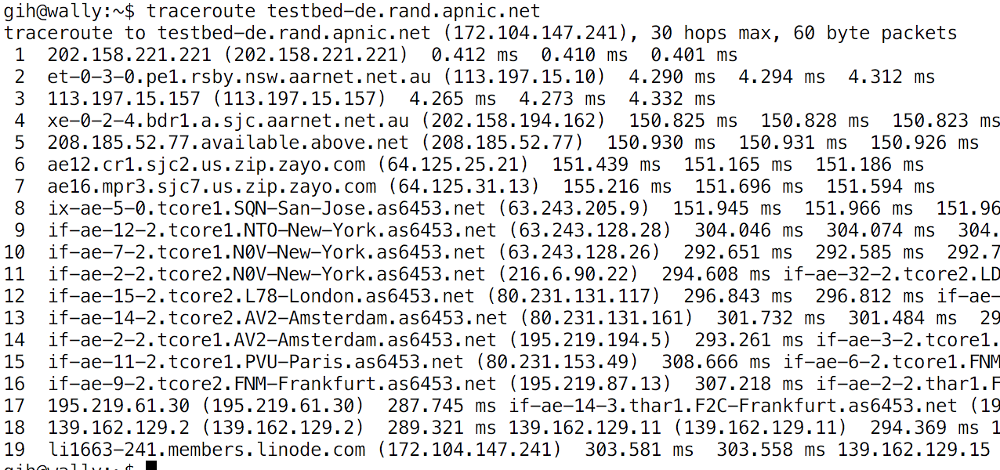
BBR vs Cubic – second attempt
Same two endpoints, same network path across the public Internet
Using a long delay path AU to Germany via the US

Slide 41
BBR vs Cubic
The Internet is capable of offering a 400Mbps capacity path on demand!
In this case BBR is apparently operating with filled queues, and this crowds out CUBIC
BBR does not compete well with itself, and the two sessions oscillate in getting the majority share of available path capacity
BBR (1) starts
Cubic starts
BBR (2) starts
Cubic ends
BBR(2) ends

Slide 42
BBR vs Cubic
Using a shorter (200ms) creates an entirely different profile
Its possible to drive the network harder, and NNR is pulling some 700Mbps in capacity
Cubic is still completely crowded out of the picture!
Interestingly in this case two BBR sessions share the capacity very effectively
BBR (1) starts
Cubic starts
BBR (2) starts
Cubic ends
BBR(2) ends

Slide 43
So what can we say about BBR?
It’s “interesting” in so many ways:
  It’s a move away from the more common loss-based flow control protocols
  It looks likeit will operate very efficiently in a high-speed small-buffer world
    High speed small buffer chips are way cheaper, but loss-based TCP reacts really badly to small buffers by capping its flow rate
  It also looks as if it will operate efficiently in rate policed environments
  Unlike AIMD systems, it will scale from Kbps to Gbps over long delay paths very efficiently
  It resists the conventional network-based traffic control mechanisms

Slide 44
Why use BBR?
Because it achieves!

Slide 45
Why not use BBR?
Because it over achieves!
The classic question for many Internet technologies is scaling – “what if everyone does it?”
  BBR is not a scalable approach
  It works so well for the user while it is used by just a few users, some of the time
  But when it is active, BBR has the ability to slaughter concurrent loss-based flows
  Which sends all the wrong signals to the TCP ecosystem
    The loss-based flows convert to BBR to compete on equal terms
    The network is then a BBR vs BBR environment, which is highly unstable
    And we all loose!

Slide 46
While we are bad-mouthing BBR…
Its really unfair in the (loss-based) Internet environment
  Its like driving a rocket-propelled bulldozer down the freeway!
Its unstable, in that it appears to react quite radically to small variations in the path characteristics
It spends 75% of its time flying “blind” with respect to its sending rate
BBR’s RTT estimates are too susceptible to admit the onset of queueing, and maintains a (too) high sending rate in the face of large scale congestion loss.

Slide 47
Is this BBR experiment a failure?
Is it just too ‘greedy’ and too ‘insensitive’ to other flows to be allowed out on the Internet to play?
  Many networks have been provisioned as a response to the aggregate behaviours of loss-based TCP congestion control
  BBR changes all those assumptions, and could potentially push many networks into sustained instability
  We cannot use the conventional network control mechanisms to regulate BBR flows
    Selective packet drop just wont create back pressure on the flow

Slide 48
Where now?
BBR 2.0!
  Alter BBR’s ‘sensitivity’ to loss rates, so that it does not persist with an internal bandwidth delay product (BDP) that exceeds the uncongested BDP
    This measure would moderate BBR 1.0’s ability to operate for extended periods with very high loss levels
  Improve the dynamic sharing fairness by moderating the BDP by using an estimated ‘fair’ proportion of the path BDP
  Alter the +/- 25% probe factors dynamically (i.e. allow this to be less than 25% overload)

Slide 49
That’s it!
Questions?

