Slide 1
DNSSEC, the DNS and Internet Security
Geoff Huston
Chief Scientist, APNIC
April 2019

Slide 2
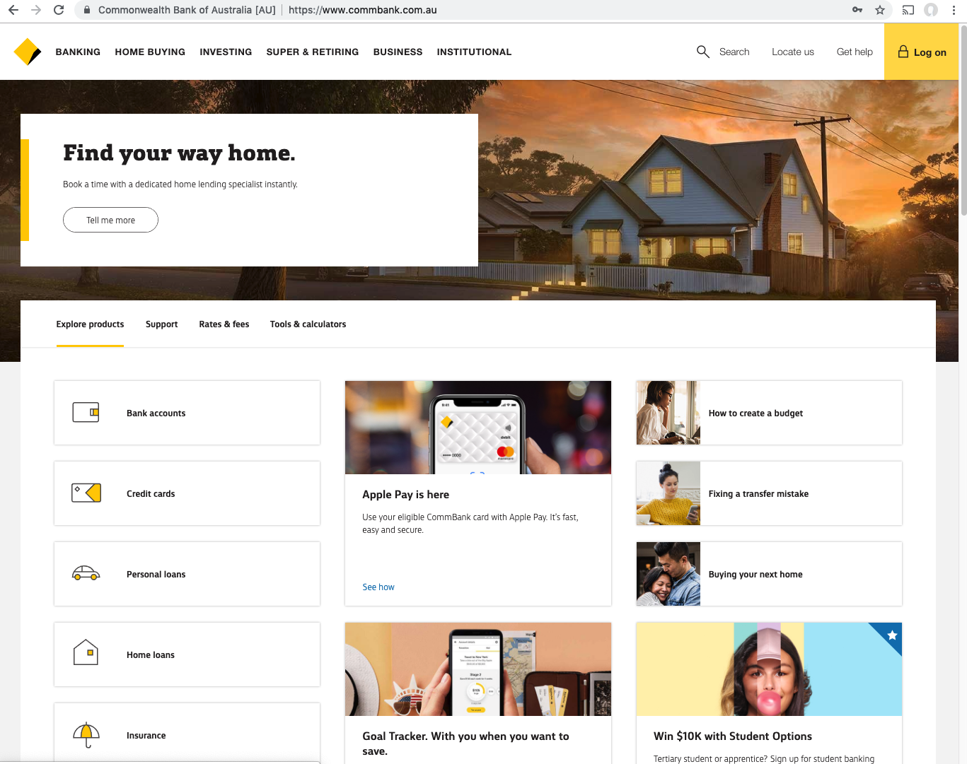
Security on the Internet
How do you know that you are going to where you thought you were going to?
My bank

Slide 3
Security on the Internet
How do you know that you are going to where you thought you were going to?
My bank
I hope!

Slide 4
Security on the Internet
How do you know that you are going to where you thought you were going to?
Or at least I think it’s my bank because it looks a bit familiar and there is a totally reassuring green icon of a lock
So it HAS to be my bank – hasn’t it?

Slide 5
Connection Steps
Client:
DNS Query:
www.commbank.com.au?
DNS Response:
23.77.145.19
TCP Session:
TCP Connect 23.77.145.19, port 443

Slide 6
Hang on…
$ dig -x 23.77.145.19 +short
a23-77-145-19.deploy.static.akamaitechnologies.com.
That’s not an IP addresses that was allocated to the Commonwealth Bank!

Slide 7
Hang on…
$ dig -x 23.77.145.19 +short
a23-77-145-19.deploy.static.akamaitechnologies.com.
That’s not an IP addresses that was allocated to the Commonwealth Bank!
The Commonwealth Bank of Australia has 140.168.0.0 - 140.168.255.255 and 203.17.185.0 - 203.17.185.255
So why should my browser trust that 23.77.145.19 is really the “proper” web site for the Commonwealth Bank of Australia and not some dastardly evil scam?

Slide 8
Hang on…
$ dig -x 23.77.145.19 +short
a23-77-145-19.deploy.static.akamaitechnologies.com.
That’s not an IP addresses that was allocated to the Commonwealth Bank!
The Commonwealth Bank of Australia has 140.168.0.0 - 140.168.255.255 and 203.17.185.0 - 203.17.185.255
So why should my browser trust that 23.77.145.19 is really the “proper” web site for the Commonwealth Bank of Australia and not some dastardly evil scam?
How can my browser tell the difference between an intended truth and a lie?

Slide 9
TCP Port 443 Transport Layer Security (TLS) Connections
https://rhsecurity.wordpress.com/tag/tls/

Slide 10
TCP Port 443 Transport Layer Security (TLS) Connections
How does the client
“recognise” this certificate
as valid?
https://rhsecurity.wordpress.com/tag/tls/

Slide 11
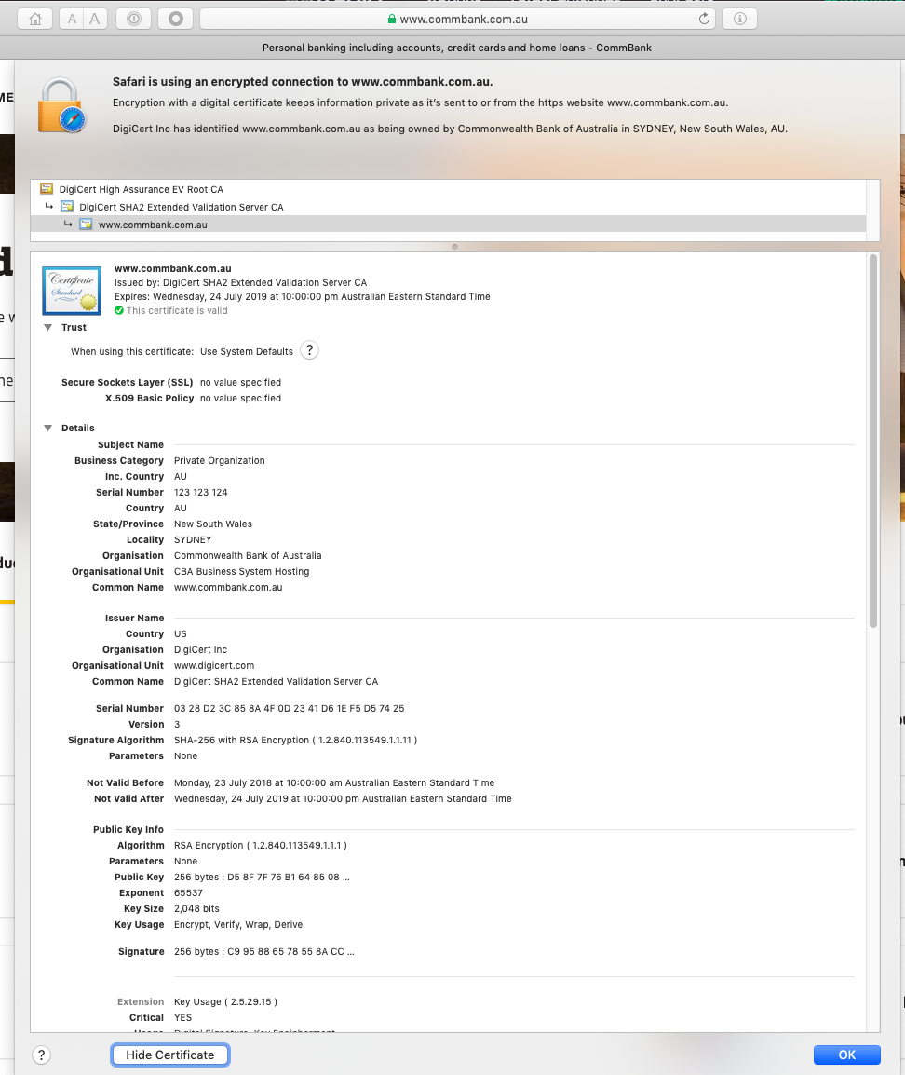
The Server’s Certificate

Slide 12
The Server’s Certificate
How did my browser know that this is a valid cert?

Slide 13
Domain Name Certification
The Commonwealth Bank of Australia has generated a key pair
And they passed a Certificate Signing Request to a company called “Digicert” (together with money)
Digicert is willing to vouch (in a certificate) that the entity who administers the domain name www.commbank.com.au also has a certain public key value (partly because it got paid to do this!)
So if I can associate this public key with a connection then I have a high degree of confidence that I’ve connected to the “real” www.commbank.com.au
as long as I am also prepared to trust Digicert, and their certificate issuance processes, and that the certificates that they issue are always genuine

Slide 14
Domain Name Certification
The Commonwealth Bank of Australia has generated a key pair
And they passed a Certificate Signing Request to a company called “Digicert” (together with money)
Digicert is willing to vouch (in a certificate) that the entity who administers the domain name www.commbank.com.au also has a certain public key value (partly because it got paid to do this!)
So if I can associate this public key with a connection then I have a high degree of confidence that I’ve connected to the “real” www.commbank.com.au
as long as I am also prepared to trust Digicert, and their certificate issuance processes, and that the certificates that they issue are always genuine
Why should I trust them?

Slide 15
Digicert
Is this the sign of a conscientious CA?

Slide 16
Local Trust
The cert I’m being asked to trust was issued by a certification authority that my browser already trusts – so I trust that cert!

Slide 17
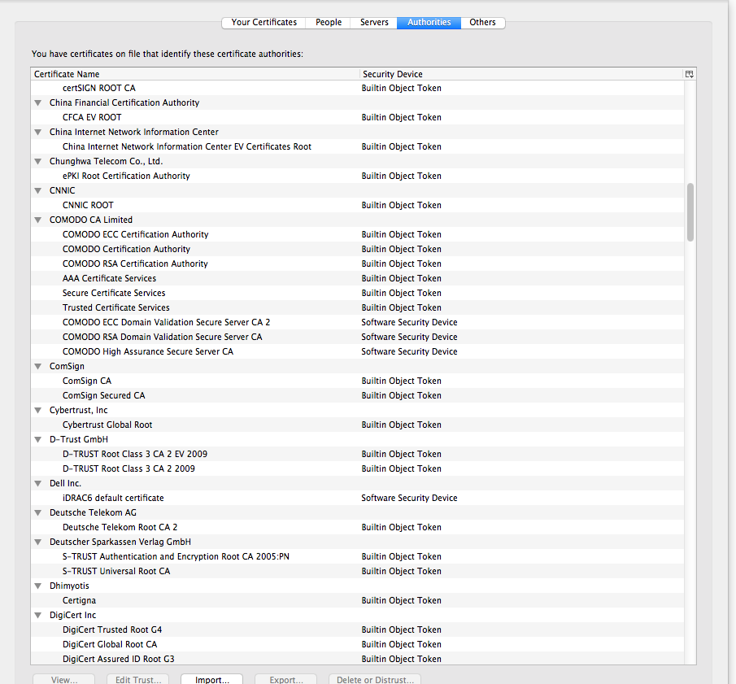
Local Trust or Local Credulity*?
That’s a big list of people to
Trust
Are they all trustable?
*

Slide 18
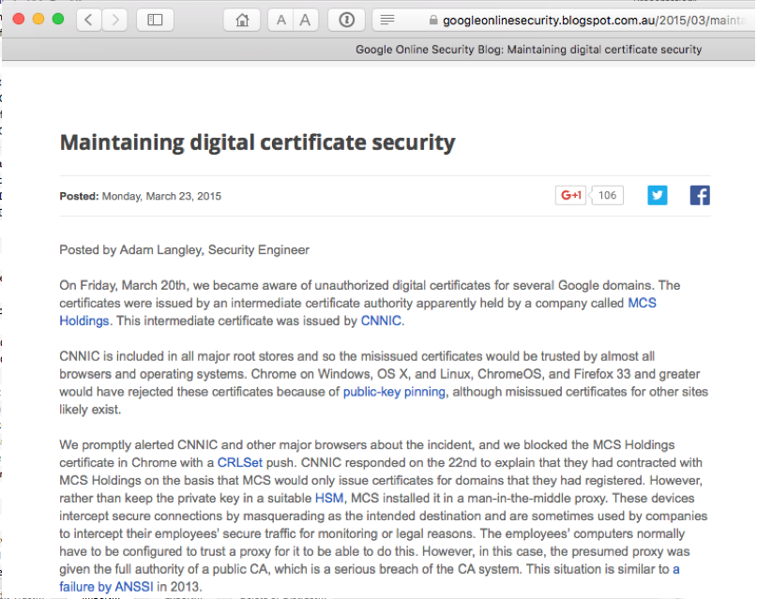
Local Credulity
That’s a big list of people to
Trust
Are they all trustable?
Evidently Not!

Slide 19
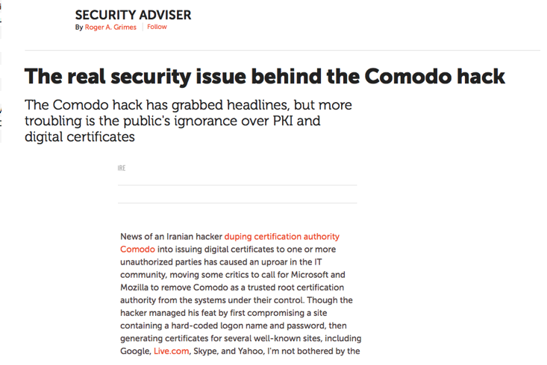
Local Credulity
That’s a big list of people to
Trust
Are they all trustable?
Evidently Not!

Slide 20
Credulity
So I don’t really have a say at all as to what I trust
For my Chrome browser “the Google team” makes that decision on my behalf
For my Mac “the Apple team” determine what I trust
For my Windows platform I trust what Microsoft trusts
Are you feeling better about all this now?

Slide 21
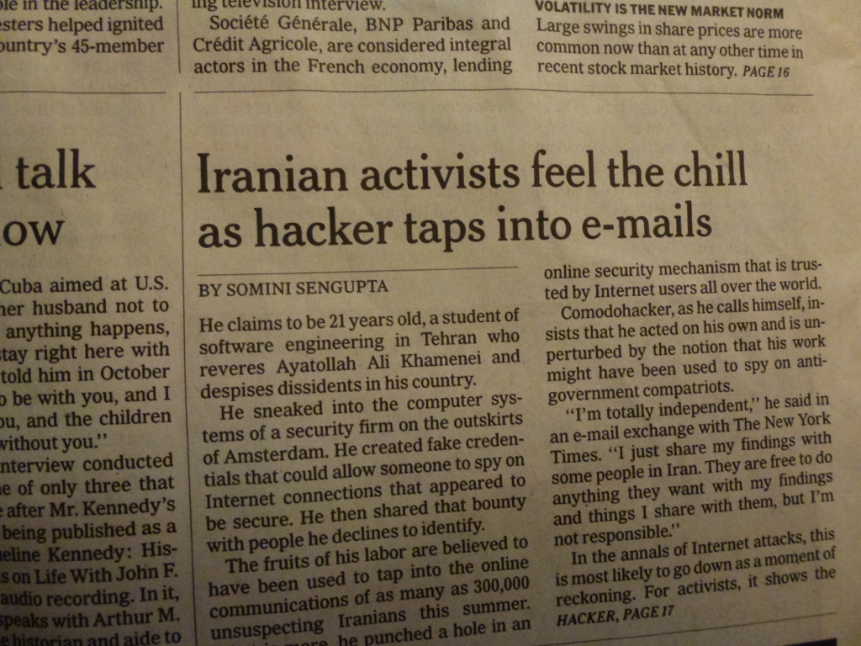
With unpleasant consequences when it all goes wrong
International Herald Tribune
Sep 13, 2011 Front Page

Slide 22
What’s going wrong here?
The TLS handshake cannot specify WHICH CA should be used to validate the digital certificate
That means that your browser may allow ANY CA to be used to validate a certificate

Slide 23
What’s going wrong here?
The TLS handshake cannot specify WHICH CA should be used to validate the digital certificate
That means that your browser may allow ANY CA to be used to validate a certificate
WOW! That’s awesomely bad!

Slide 24
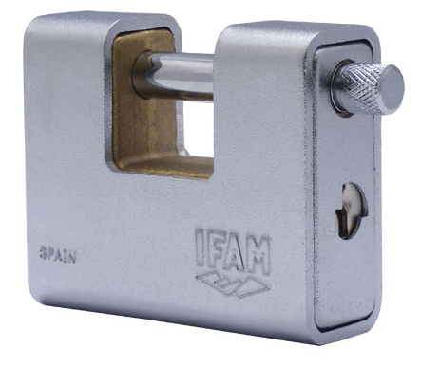
What’s going wrong here?
The TLS handshake cannot specify WHICH CA should be used to validate the digital certificate
That means that your browser may allow ANY CA to be used to validate a certificate
Here’s a lock – it might be the lock on your front door for all I know.
The lock might LOOK secure, but don’t worry – literally ANY key can open it!

Slide 25
What’s going wrong here?
There is no incentive for quality in the CA marketplace
Why pay more for any certificate when the entire CA structure is only as strong as the weakest CA
And you browser trusts a LOT of CAs!
About 60 – 100 CA’s
About 1,500 Subordinate RA’s
Operated by 650 different organisations
See the EFF SSL observatory http://www.eff.org/files/DefconSSLiverse.pdf

Slide 26
In a Commercial Environment
Where CA’s compete with each other for market share
And quality offers no protection
Than what ‘wins’ in the market?
Sustainable
?
Resilient
Secure
Privacy
Trusted

Slide 27
In a Commercial Environment
Where CA’s compete with each other for market share
And quality offers no protection
Than what ‘wins’ in the market?
Sustainable
Resilient
Cheap!
Secure
Privacy
Trusted

Slide 28
Cheap Won!
www.letsencrypt.org

Slide 29
Cheap Won!
Will the automation of the Cert Issuance coupled with a totally free service make the overall environment more or less secure?
Well, we now know the answer!
www.letsencrypt.org

Slide 30
What’s the problem
If ANY CA can issue a valid certificate for ANY Domain Name then the system is compromised:
No matter who I choose to be my CA, any CA can issue a certificate for my Domain Name
The system is only as strong as the weakest link
So maybe we need to ‘pin’ a domain name to a given CA

Slide 31
CA Pinning
Chrome and in-code pinning
HPKP
CAA
Certificate Transparency Logs
Like the IPv6 transition, we have devised numerous approaches to this problem

Slide 32
CA Pinning
Chrome and in-code pinning
HPKP
CAA
Certificate Transparency Logs
Doesn’t scale
Like the IPv6 transition, we have devised numerous approaches to this problem
But none of them are terribly effective!
TOFU is useless
Rogue CAs are not stopped
Too little, too slowly

Slide 33
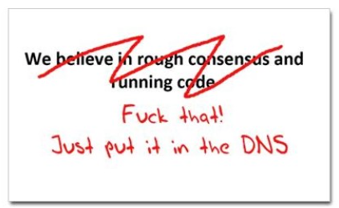
Where now?
Use the DNS?
cafepress.com/nxdomain

Slide 34
Seriously … just use the DNS Luke!*
Where better to find out the public key associated with a DNS name than to look it up in the DNS?
* Ok, that was a cheap shot – my apologies to the Star Wars franchise!

Slide 35
Seriously
Where better to find out the public key associated with a DNS name than to look it up in the DNS?
Why not query the DNS for the issuer CA?
or
Why not query the DNS for the hash of the domain name cert?
or
Why not query the DNS for the hash of the domain name subject public key info?

Slide 36
Seriously
Where better to find out the public key associated with a DNS name than to look it up in the DNS?
Why not query the DNS for the issuer CA?
or
Why not query the DNS for the hash of the domain name cert?
or
Why not query the DNS for the hash of the domain name subject public key info?
Who needs CA’s anyway?

Slide 37
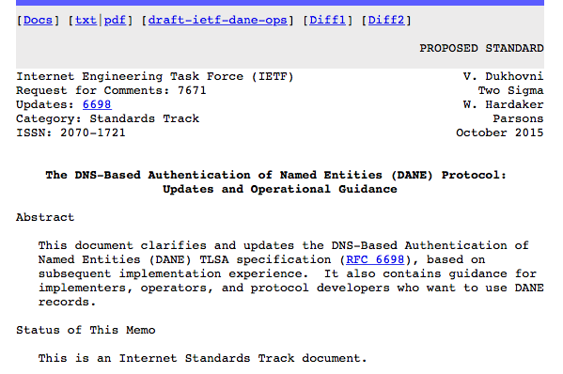
DANE
Using the DNS to associated domain name public key certificates with domain name

Slide 38
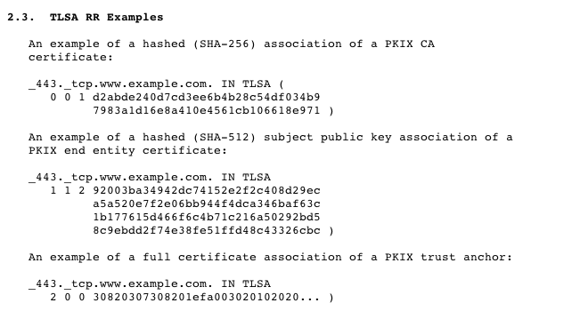
DANE
TLSA RR
CA Cert Hash
EE Cert Hash
Trust Anchor

Slide 39
TLS with DANE
Client receives server cert in Server Hello
Client lookups the DNS for the TLSA Resource Record of the domain name
Client validates the presented certificate against the TLSA RR
Client performs Client Key exchange

Slide 40
TLS Connections
DNS Name
TLSA query
Cert
https://rhsecurity.wordpress.com/tag/tls/

Slide 41
Just one problem…
The DNS is full of liars and lies!
And this can compromise the integrity of public key information embedded in the DNS
Unless we fix the DNS we are no better off than before with these TLSA records!

Slide 42
Just one answer…
We need to allow users to validate DNS responses for themselves
And for this we need a Secure DNS framework
Which we have – and its called DNSSEC!
We need to allow users to validate DNS responses for themselves
And for this we need a Secure DNS framework
Which we have – and its called DNSSEC!

Slide 43
DNSSEC Interlocking Signatures
. (root)
. Key-Signing Key – signs over
. Zone-Signing Key – signs over
DS for .com (Key-Signing Key)
.com
.com Key-Signing Key – signs over
.com Zone-Signing Key – signs over
DS for example .com (Key-Signing Key)
.example.com
example.com Key-Signing Key – signs over
example.com Zone-Signing Key – signs over
www.example.com
www.example.com IN A 192.0.1

Slide 44
DNSSEC Interlocking Signatures
Is the KSK for . valid?
. (root)
. Key-Signing Key – signs over
Is the ZSK for . valid?
. Zone-Signing Key – signs over
Is this DS equal to the hash of the KSK?
Is the signature for this record valid?
DS for .com (Key-Signing Key)
.com
Is the KSK for .com valid?
.com Key-Signing Key – signs over
.com Zone-Signing Key – signs over
Is the ZSK for .com valid?
DS for example .com (Key-Signing Key)
Is this DS equal to the hash of the KSK?
Is the signature for this record valid?
.example.com
example.com Key-Signing Key – signs over
Is the KSK for example.com valid?
example.com Zone-Signing Key – signs over
Is the ZSK for example.com valid?
www.example.com
Is the signature for this record valid?
www.example.com IN A 192.0.1

Slide 45
DNSSEC Interlocking Signatures
Is the KSK for . valid?
. (root)
As long as you have a valid local trust anchor for the root zone then you can validate a signed DNS response by constructing this backward path to the DNS trust anchor
Is the ZSK for . valid?
. Key-Signing Key – signs over
. Zone-Signing Key – signs over
Is this DS equal to the hash of the KSK?
Is the signature for this record valid?
DS for .com (Key-Signing Key)
.com
Is the KSK for .com valid?
.com Key-Signing Key – signs over
.com Zone-Signing Key – signs over
Is the ZSK for .com valid?
DS for example .com (Key-Signing Key)
Is this DS equal to the hash of the KSK?
Is the signature for this record valid?
.example.com
example.com Key-Signing Key – signs over
Is the KSK for example.com valid?
example.com Zone-Signing Key – signs over
Is the ZSK for example.com valid?
www.example.com
Is the signature for this record valid?
www.example.com IN A 192.0.1

Slide 46
DANE + DNSSEC
Query the DNS for the TLSA record of the domain name and ask for the DNSSEC signature to be included in the response
Validate the signature to ensure that you have an unbroken signature chain to the root trust point
At this point you can accept the TLSA record as the authentic record, and set up a TLS session based on this data

Slide 47
Alternatively - Look! No DNS!
The Server packages server cert, TLSA record and the DNSSEC credential chain in a single bundle for TLS
Client receives bundle in TLS Server Hello
Client performs validation of TLSA Resource Record using the supplied DNSEC signatures plus the local DNS Root Trust Anchor without performing any DNS queries
Client validates the presented certificate against the TLSA RR
Client performs Client Key exchange

Slide 48
Why DNSSEC?
DNSSEC was devised in response to the possibility of cache poisoning attacks on the DNS (the so-called “Kaminsky attack”)
but the combination of randomized source ports, free Domain name certificates and the use of TLS made that problem go away!
But a reliable and trustable DNS can be very useful for the larger issue of Internet Security
DNSSEC provides us with such a tool for the DNS

Slide 49
Next Steps
Security for the Internet is an ongoing task
We know the current WebPKI is hopelessly compromised, and adversaries have been successful in mounting attacks on Internet infrastructure
The approach of placing Domain Name Keys in a DNSSEC-secured DNS record seems to hold considerable promise to improve the integrity of Domain Name Keys
But it’s still a work-in-progress, not a completed solution

Slide 50
Some Practical Suggestions
Some things you can do today:
Use a Name registrar that at a minimum uses multi-factor authentication and Registry Lock
Sign your DNS name with DNSSEC
Obtain Domain Name certificates
Use TLS and DKIM in all your services
Turn on DNSSEC Validation in your DNS resolvers

Slide 51
Some Practical Suggestions
Some things you can do today:
Use a Name registrar that at a minimum uses multi-factor authentication and Registry Lock
Because if I can take over your name registration then
I can create the potential to assume control over
your online services
So your name registration credentials needs to be more than a simple password and an email address if the name is important to you and your users

Slide 52
Some Practical Suggestions
Some things you can do today:
Use a Name registrar that at a minimum uses multi-factor authentication and Registry Lock
Sign your DNS name with DNSSEC
I can now place information in the DNS that clients
can trust as being my information

Slide 53
Some Practical Suggestions
Some things you can do today:
Use a Name registrar that at a minimum uses multi-factor authentication and Registry Lock
Sign your DNS name with DNSSEC
Obtain Domain Name certificates
Lets Encrypt is effective - use it!

Slide 54
Some Practical Suggestions
Some things you can do today:
Use a Name registrar that at a minimum uses multi-factor authentication and Registry Lock
Sign your DNS name with DNSSEC
Obtain Domain Name certificates
Use TLS and DKIM in all your services
Passing data over the Internet in the clear is so
Irresponsible these days!

Slide 55
Some Practical Suggestions
Some things you can do today:
Use a Name registrar that at a minimum uses multi-factor authentication and Registry Lock
Sign your DNS name with DNSSEC
Obtain Domain Name certificates
Use TLS and DKIM in all your services
Turn on DNSSEC Validation in your DNS resolvers
Don’t accept signed DNS responses that cannot be validated

Slide 56
Some Practical Suggestions
Some things you can do today:
Use a Name registrar that at a minimum uses multi-factor authentication and Registry Lock
Sign your DNS name with DNSSEC
Obtain Domain Name certificates
Use TLS and DKIM in all your services
Turn on DNSSEC Validation in your DNS resolvers

Slide 57
That’s it!

