Slide 1
Detecting BGP Anomalies
Geoff Huston
APNIC

Slide 2
BGP Anomaly Detection
The objective of an BGP anomaly detector is to process BGP updates and automatically detect “anomalies” where the prefix or the path does not appear to be aligned to “normal” routing behaviours
The challenge is to train an automated system to generate a useful model of “normal” and “anomalous” classification of BGP updates

Slide 3
Approaches to Anomaly Detection
I - Rule-based systems
Have network operators describe their routing policies
Trigger notification on detected exceptions
For example:
AS131072
Originates:
192.0.2.0/24
2001:DB8::/32
Provider AS
AS4608
DownstreamAS:
Nil
BGP updates:
matches the rule set
BGP4MP|1566349266|A|192.0.2.0/24|4608 4777 131072|IGP|
BGP4MP|1566349266|A|192.0.2.128/25|4608 4777|IGP
does not matches rule set

Slide 4
Approaches to Anomaly Detection
II – Machine Based Learning
Feed updates into a parameter generator
Perform n-dimensional cluster analysis on the data set
Identify outliers as potential anomalies
Outliers?

Slide 5
Approaches to Anomaly Detection
III – Heuristics
Feed updates into an analyser
Generate a n-dimensional ‘score’ for the update
Use thresholds to pick out out candidate anomalies
Which is the focus of this project…

Slide 6
BGP is a Chatty Protocol
It’s a distance vector protocol
Which means that it converges through exhaustion via progressive refinement, not through direct computation (as is the case with SPF protocols)
Which also implies that there are transient states that are not stable
Which implies that when we look for anomalies in BGP updates there is a huge amount of BGP chaff to work through!

Slide 7
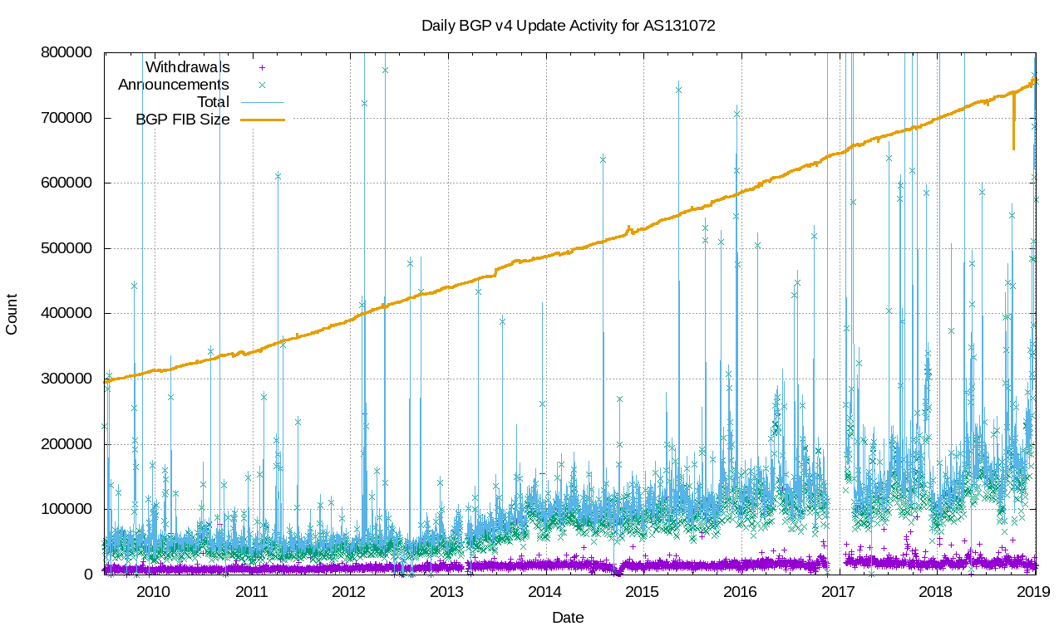
BGP Update Profile

Slide 8
BGP Update Profile
Over 10 years the number of prefixes has more than doubled
Number of prefix updates was stable for 4 years, then has been rising slowly
Number of prefix withdrawals has been steady

Slide 9
BGP Update Profile
A conventional default-free IPv4 eBGP session at the edge of the Internet will process some 150,000 – 200,000 prefix announcements per day
And some 10,000 prefix withdrawals per day
This is a relatively stable profile for BGP

Slide 10
BGP Update Profile
It is useful to understand how much of this protocol traffic is a by product of the operation of the protocol, how much is realignment of the network topology and how much is “new” reachability information
So lets count the daily number of prefixes in the eBGP RIB and the daily count of previously unseen prefixes

Slide 11
BGP Prefix Updates – IPv4
There are some 200-300 ”new” prefixes per day in the IPv4 BGP RIB

Slide 12
BGP Prefix Updates – IPv6
There are some 5-10 ”new” prefixes per day in the IPv6 BGP RIB

Slide 13
BGP AS Adjacency Updates - IPv4
There are up to 100 ”new” AS Adjacencies per day in the IPv4 BGP RIB

Slide 14
BGP AS Adjacency Updates – V6
There are up to 30 ”new” AS Adjacencies per day in the IPv4 BGP RIB

Slide 15
BGP Updates and Information Content
BGP updates tend to repeat previous information most of the time
The “new” information content volume in BGP updates is relatively small, and is scale free
(The rate of growth is not directly related to the size of the network)
If we use “new” information as a trigger point to look for unusual BGP activity we might have a useful way to filter BGP updates

Slide 16
BGP Update Processing
For each Prefix, load the prefix into an aggregate and more specific context tree
For each AS Path, analyse the AS ordered adjacencies and infer the provider / peer / customer relationship
Geolocate the prefix and the originating AS
Check the ROA status
Check the IRR material for this prefix
Now apply an anomaly “interest” level calculation on announcement and withdrawal

Slide 17
What is “interesting” in BGP Updates?
AS paths that contain “valleys”
AS paths that contain ASes in “unusual” places
Previously unseen prefixes
Previously unseen ASes
Prefixes that are more specifics or aggregates where the origin ASs are different
Prefixes where the geolocation of the more specifics are different
Prefixes where the geolocation of the prefix and the Originating AS are different
Short lived prefixes

Slide 18
Interest and Intent Filtering
RPKI can be interpreted as a strong statement of routing intent
IRR data can also be interpreted as intent, although without the same level of clarity of intent
More specific floods is “interesting”

Slide 19
This Project
Yet another BGP Anomaly detector
Why another?
Open source code base (C )
Generic design that can cope with feeds from one or more BGP speakers
Intended to use plug in filter sets, to allow both specific rule applications and more general anomaly detection

Slide 20
Overall Architecture
RPKI Filter
IRR Filter
AS valley Filter
Rule Filter
Input module
RIB Model
Anomalous update feed
Classifier

Slide 21
Reporting
How should the tool report?
JSON feed
Web Archive
Linked into RIPEStat
Other report formats?

Slide 22
Current Status
Flikr: P.A.H. http://bit.ly/320TEF4

Slide 23
Interested in this work?
You can play too:
Pass an eBGP feed to a detector
Take a copy of the code and apply it to your own BGP feeds?
Subscribing to a BGP anomaly feed service using your rule set
Interested in subscribing to a general BGP anomaly feed

Slide 24
APNIC’s Role
We share an interest in a secure and stable routing system
We’d like to help operators by informing them of the status of routing stability
We are interested in trying to measure the incidence of BGP anomalies over time to inform the community about the severity and incidence of these anomalies

