Slide 1
The End of Days
Geoff Huston
APNIC Labs

Slide 2
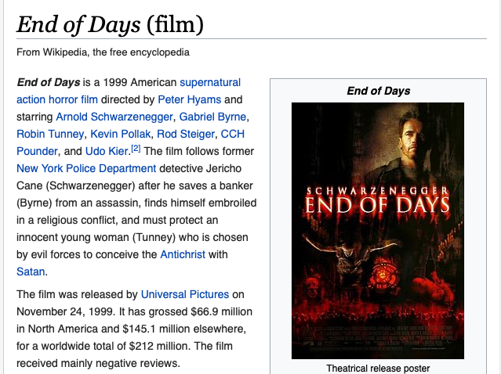

Slide 3
No, not THAT “End of Days”!
Let’s look at the end of IPv4 address allocation in the APNIC Registry

Slide 4
The End of the IPv4 Pool in the APNIC Registry
January 27th 2020
APNIC Address Pool: 890,748,672 /32s (or 53.1 /8s)
Assigned: 883,440,640 (99.18%)
Available: 2,884,608 ( 0.32%)
Reserved: 4,423,424 ( 0.50%)

Slide 5
I – Available Pool Consumption

Slide 6
Available Pool 2011 - 2020
Final IANA /8 allocations
Last /8 policy activated
IANA redistribution of returned legacy addresses

Slide 7
Consumption – 2011 - 2020

Slide 8
Consumption Projections

Slide 9
When?
900 days
31 October 2021
400 days
9 October 2022
90 days
23 February 2023

Slide 10
II – APNIC Reservations

Slide 11
APNIC Reserved Address Pool Size
4,423,424 /32s

Slide 12
APNIC Reserved Address Age
Looks at the start date for each currently reserved prefix to find when it was first marked “reserved”
Public records go back to the start of 2010 for APNIC

Slide 13
APNIC Reserved Address Age
More than one half the current reserved addresses have been marked as reserved since the start of the published reserved pool by APNIC
1M addresses removed from reserved pool
In October 2015

Slide 14
Reservations 2014 - 2020
Since 2017 the number of reserved address prefixes is growing by some 200 per year
Pool Size
Daily Activity

Slide 15
Reservations 2014 - 2020

Slide 16
Reservations and UnReservations
“long term” pool of some 4M addresses
Short term recent growth by some 100K /32s per year net
Pool Size
Daily Activity

Slide 17
Reservations and UnReservations

Slide 18
Reserved Addresses
What is the story here?
What is a reasonable expectation of ‘release’ from reserved status?
  Of the 1,399 address prefixes marked as “reserved” in the past 24 months the average (*) period of reservation is 26 months
  The prefix-size weighted reservation average period is 40 months
* This does not include the 2.2M addresses (300 prefixes) that have been marked as reserved before 2011

Slide 19
Assumptions for Reserved Addresses
The experience since 2017 points to a small number larger old blocks being removed from the reserved pool and a larger number of smaller blocks being listed as ‘Reserved’
The ‘Reserved’ listing lasts on average for two years for recent reservations
Unless release this 3.6M address pool of “old” reservation blocks, recovery of reservations will have little impact on the IPv4 address pool

Slide 20
Advertising APNIC Reserved Prefixes
In the APNIC Registry 1,501 prefix blocks are marked as reserved
34 of these blocks contain advertised prefixes
  These blocks advertise 14,336 addresses
The remaining 1,467 reserved blocks are not visible in the BGP routing table
  These unadvertised blocks contain 4,414,9766 addresses

Slide 21
Advertising APNIC Reserved Prefixes
57% of all reserved addresses have not been seen in logs of advertised addresses since 1997
90% of all reserved addresses have not been seen in logs of advertised addresses for the past 2 years

Slide 22
III - Advertised and Unadvertised Addresses

Slide 23
Advertised Addresses
768,477,696 addresses
advertised from a total
pool of 883,441,664
addresses

Slide 24
Unadvertised Addresses
114,963,968 addresses
not advertised from a total
pool of 883,441,664
addresses

Slide 25
APNIC Unadvertised Address Ratio
114,963,968 addresses
are unadvertised from a total pool of 883,441,664
addresses
That’s 13% of the assigned address pool

Slide 26
Unadvertised Address Age Profile
Lets take the entire sequence of BGP dumps in Route Views archive from 1997 onward, using one dump per day
Parse each dump file (8,000 of them!) and assemble the “last seen” date for every /24 in the IPv4 address space that is ‘visible

Slide 27
Unadvertised Address Age Profile
78,046,208 addresses (68%) of all unadvertised addresses have been seen in the routing table at some point in the past
This is the cumulative profile of ages since these prefixes were last seen
36,852,224 (32%) have not been observed in the routing table since 1997 (the start of the Route Views archive)

Slide 28
Unadvertised Address Registration Age Profile
114,963,968 addresses
not advertised from a total
pool of 883,441,664
addresses
This plot shows the age profile of these unadvertised addresses using the APNIC Registration date
90% of these addresses were assigned prior to 2012

Slide 29
Unadvertised Address Age Profile
This plot combines the registration and last seen profiles
Some 58% of unadvertised addresses are “older” than 8 years
Some 30% of unadvertised addresses are “older” than 22 years

Slide 30
Where are these Unadvertised Allocated Addresses?

Slide 31
Observations
It would be useful to understand the conditions or caveats that apply to the pool of reserved addresses, particularly the large pool of ‘old’ reservations
  Releasing this reserved address pool of 4.4 M addresses would extend the availability of the IPv4 address pool by a further 3 years at current address consumption rates
The unadavertised allocated address pool (115M) is far larger than the reserved pool (4.4M)
  One line of thought is that a rising market price for IPv4 addresses would release these addresses for reuse through the transfer market

Slide 32
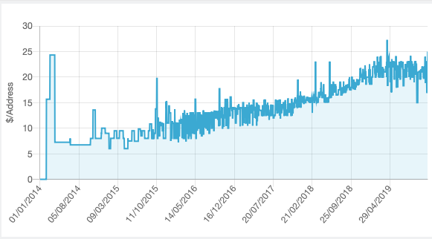
Market Signals
https://lassekarstensen.wordpress.com/2019/01/03/some-ipv4-address-price-forecasting/
http://ipv4marketgroup.com/ipv4-price-trends/

Slide 33
Observations
It would be useful to understand the conditions or caveats that apply to the pool of reserved addresses, particularly the large pool of ‘old’ reservations
  Releasing this reserved address pool of 4.4 M addresses would extend the availability of the IPv4 address pool by a further 3 years at current address consumption rates
The unadavertised allocated address pool (115M) is far larger than the reserved pool (4.4M)
  One line of thought is that a rising market price for IPv4 addresses would release these addresses for reuse through the transfer market
  It may be the case that up to 30M addresses in the registry are buried in legacy records and have never been advertised since the late 90’s and current market prices may not flush them out

Slide 34
Questions?

