Slide 1
How to measure a million end users
be www.google.net
Or
Get your code run on millions of machines

Slide 2
Placement
At low CPM, the advertising network needs to present unique, new eyeballs to harvest impressions and take your money.
Therefore, a ‘good’ advertising network provides fresh crop of unique clients per day
Pay for placement of ads, embed measurement in flashcode.
Result is lots of Unique IP addresses to measure.

Slide 3
What are we finding?
http://labs.apnic.net/ipv6_measurement
Breakdowns by ASN, Economy, Region, Organisation
125+ economies provide >200 samples/interval consistently in weeklies
150+ at monthlies.
2400 ASN provide graphable data
Over 35,000 ASN seen during the last year.

Slide 4
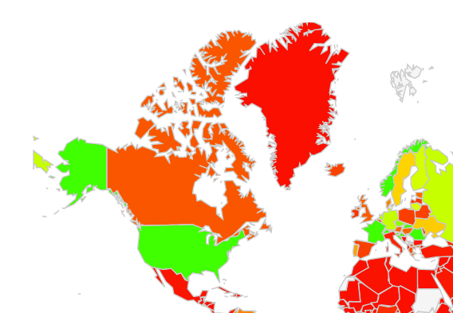
Google visualization API

Slide 5
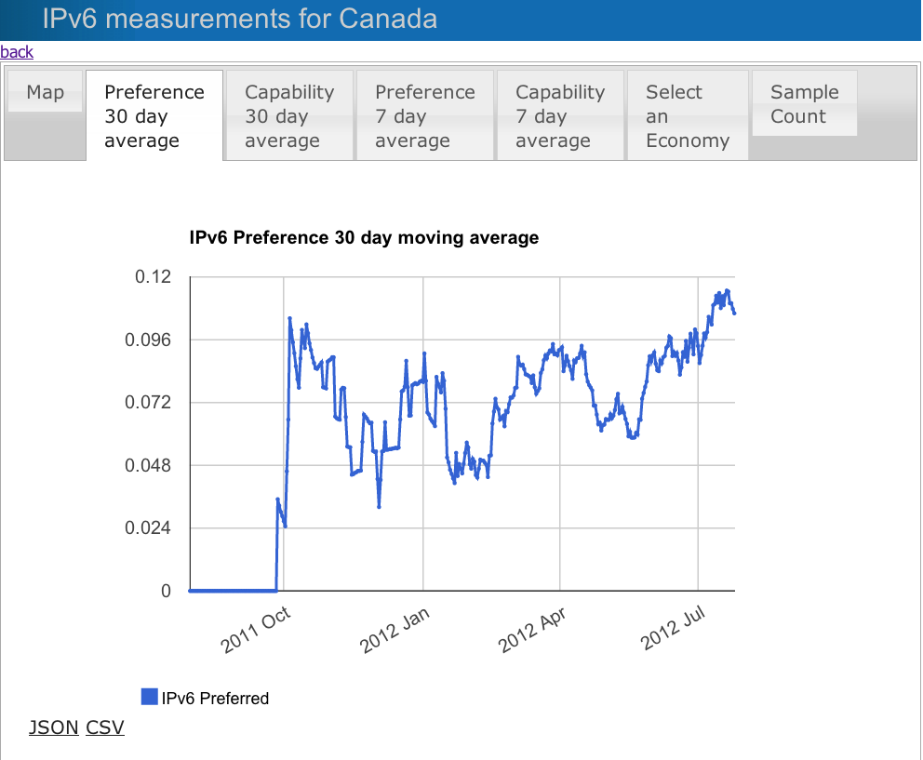
Google visualization API

Slide 6
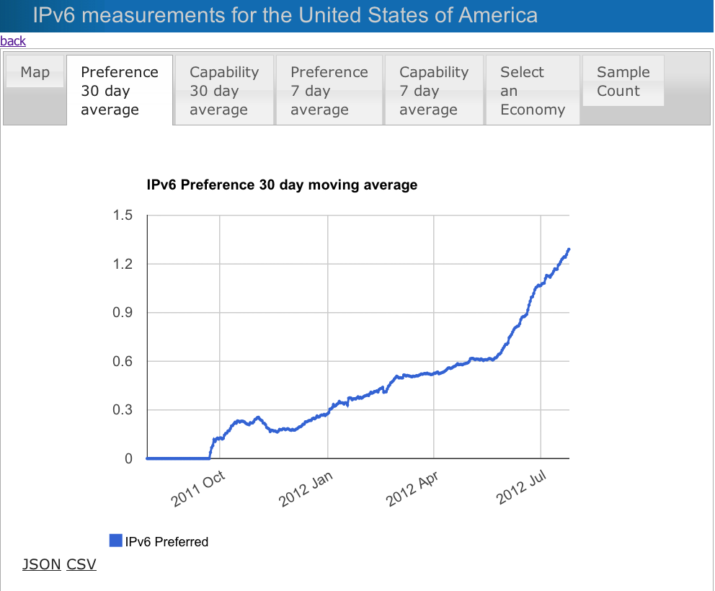
Google visualization API

Slide 7
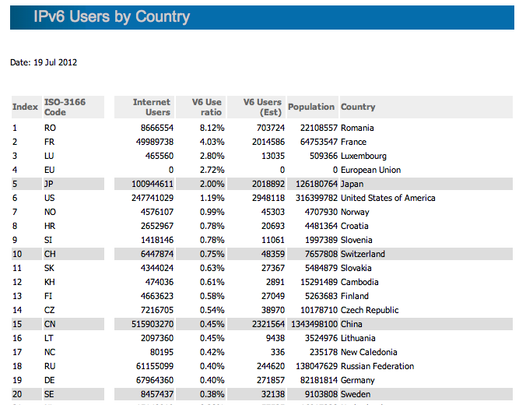
http://labs.apnic.net/dists/v6dcc.html

Slide 8
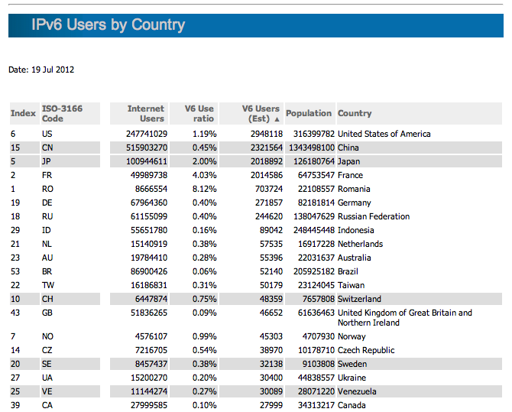
http://labs.apnic.net/dists/v6dcc.html

Slide 9
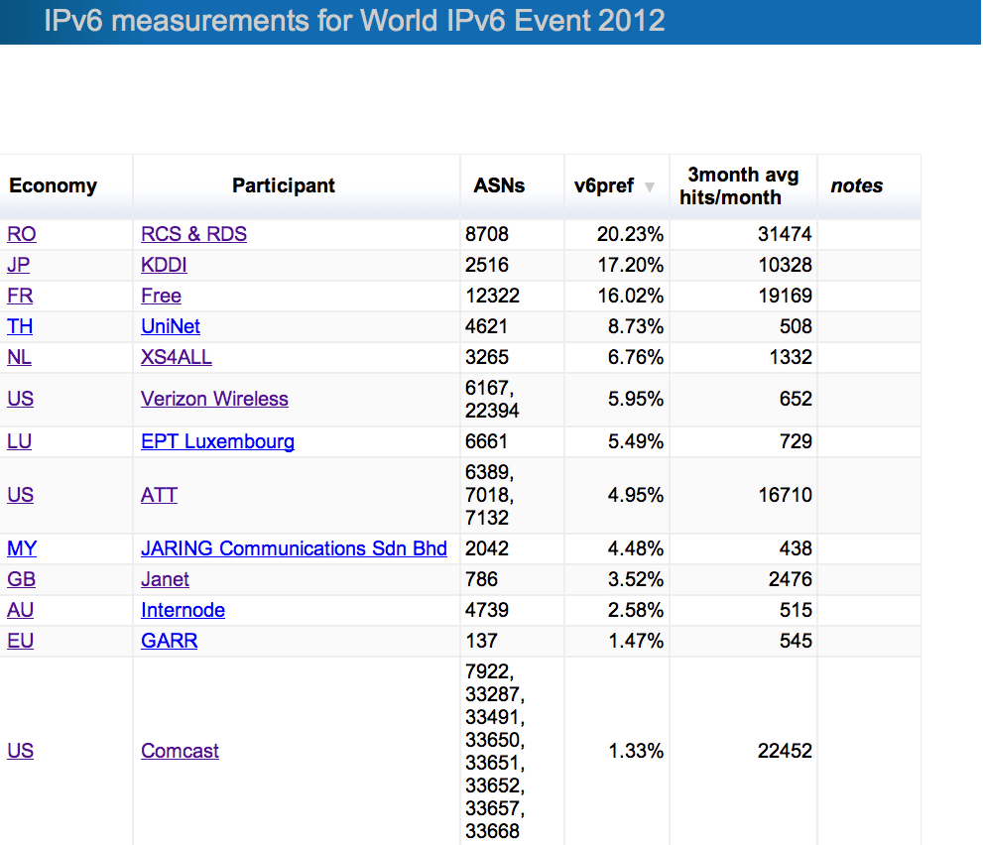
http://labs.apnic.net/ipv6-measurement/W6L

Slide 10
A word for our sponsors
Thanks to
the Internet Society
Google
ISC
RIPE NCC
For funding, platform support, collaboration
Don’t Click on the ad if you see it! (costs more)

