Slide 1
IPv4 Address Exhaustion: A Progress Report
Geoff Huston Chief Scientist
APNIC

Slide 2
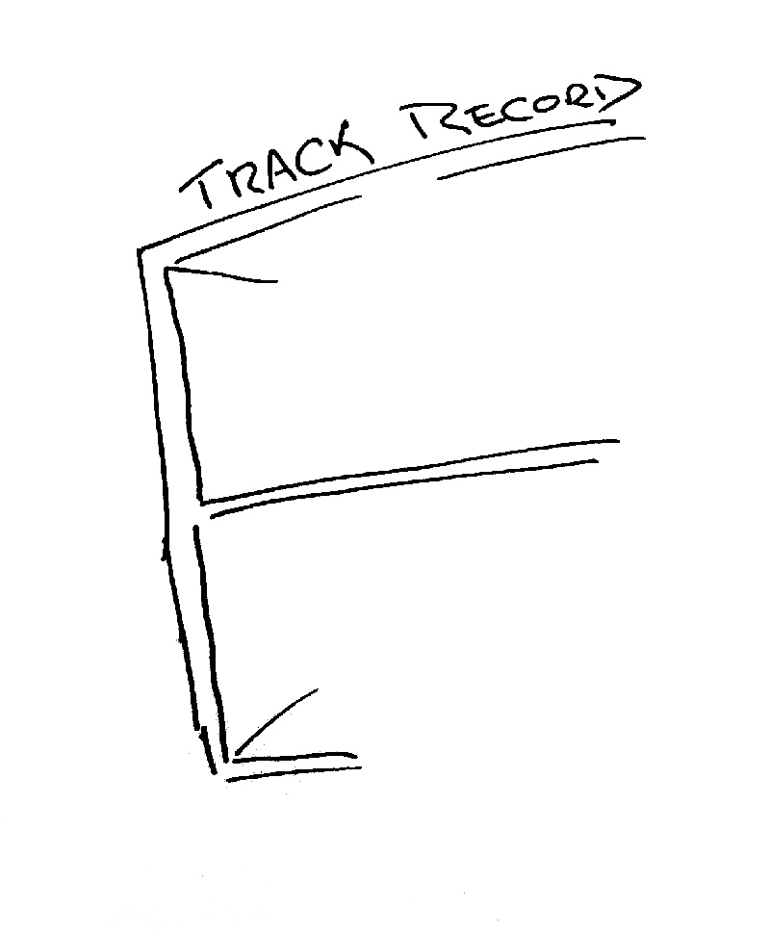
The mainstream telecommunications industry has a rich history

Slide 3
The mainstream telecommunications industry has a rich history
…of making very poor
technology choices

Slide 4
The mainstream telecommunications industry has a rich history
…of making very poor
technology guesses
and regularly being
taken by
surprise!

Slide 5
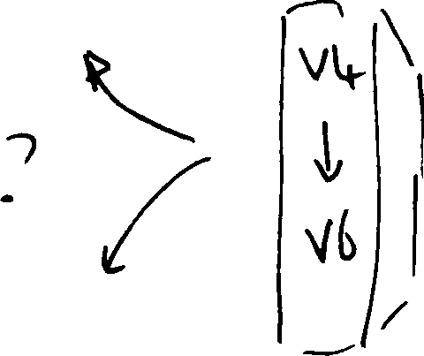
So, how are we going with the IPv4 to IPv6 transition?

Slide 6
Do we really need to worry about this?

Slide 7
Do we really need to worry about this?
Surely IPv6 will just happen – its just a matter
of waiting for the pressure of Ipv4 address
exhaustion to get to sufficient levels of intensity.

Slide 8
Do we really need to worry about this?
Surely IPv6 will just happen – its just a matter
of waiting for the pressure of Ipv4 address
exhaustion to get to sufficient levels of intensity.
Or maybe not – let’s look a bit closer at the situation

Slide 9
The “inevitability” of technological evolution

Slide 11
The “inevitability” of technological evolution

Slide 12
The “inevitability” of technological evolution

Slide 13
The “inevitability” of technological evolution?

Slide 14
The challenge often lies in managing the transition from one technology to another

Slide 15
To get from “here” to “there” requires an excursion through an environment of CGNs, CDNs, ALGs and similar middleware ‘solutions’ to IPv4 address exhaustion
The challenge often lies in managing the transition from one technology to another
IPv6
CGNs
IPv4
ALGs
CDNs

Slide 16
To get from “here” to “there” requires an excursion through an environment of CGNs, CDNs, ALGs and similar middleware ‘solutions’ to IPv4 address exhaustion
The challenge often lies in managing the transition from one technology to another
IPv6
Transition requires the network owner to undertake capital investment in network service infrastructure. What lengths will the network owner then go to to protect the value of this additional investment by locking itself into this “transitional” service model for an extended/indefinite period?
CGNs
IPv4
ALGs
CDNs

Slide 17
The challenge often lies in managing the transition from one technology to another
IPv6
CGNs
IPv4
ALGs
CDNs
The risk in this transition phase is that the Internet heads off in a completely different direction!

Slide 18
How can we “manage” this transition?

Slide 19
How can we “manage” this transition?
To ensure that the industry maintains collective focus on IPv6 as the objective of this exercise!

Slide 20
How can we “manage” this transition?
To ensure that the industry maintains collective focus on IPv6 as the objective of this exercise!
And to ensure that we do not get distracted by attempting to optimize what were intended to be temporary measures

Slide 21
Challenges:
This is a deregulated and highly
competitive environment

Slide 22
Challenges:
This is a deregulated and highly
competitive environment
It is NOT a case of a single
“either/or” decision
?

Slide 23
Challenges:
This is a deregulated and highly
competitive environment
There are many different players
Each with their own perspective
?
?
?
?
?
?
?
?
?
?
?
?
?
?
?
?
?
?
?
?
?

Slide 24
Challenges:
This is a deregulated and highly
competitive environment
There are many different players
Each with their own perspective
?
And all potential approaches will be explored!

Slide 25
Challenges:
This is a deregulated and highly
competitive environment
There is no plan, just the interplay of
various market pressures

Slide 26
Challenges:
This is a deregulated and highly
competitive environment
There is no plan, just the interplay of
various market pressures
2. Varying IPv4 Address Exhaustion Timelines

Slide 27
IPv4 Address Exhaustion – APNIC

Slide 28
Remaining IPv4 Address
Pools–All RIRs

Slide 29
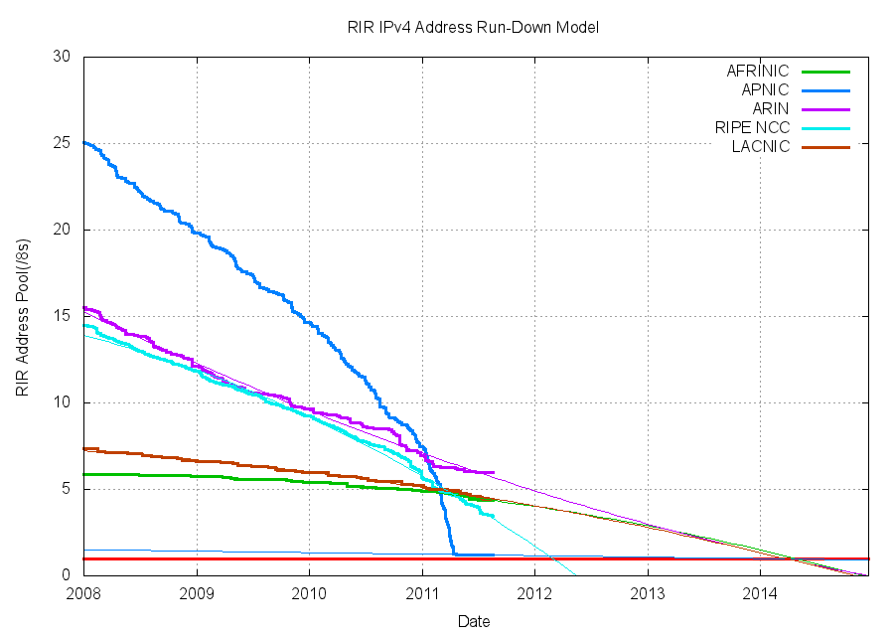
Address Exhaustion Projections

Slide 30
Exhaustion Predictions
RIR | Predicted Exhaustion Date * | Remaining Address Pool (19 Aug 2011)
APNIC | 19 April 2011 (actual) | 1.20 /8s (0.3 /8s rsvd)
RIPE NCC | 25 February 2012 | 3.47 /8s
LACNIC | 22 March 2014 | 4.43 /8s
ARIN | 23 March 2014 | 6.00 /8s
AFRINIC | 28 April 2014 | 4.38 /8s
* Here “exhaustion” is defined as the point when the RIR’s remaining pool falls to 1 /8

Slide 32
Address Exhaustion Projection
Post Feb-2011 Allocations in ARIN

Slide 33
Reality Acceptance

Slide 34
Reality Acceptance
Or not
Is IPv4 address exhaustion a “here and now”
problem or a “imminent future” problem?

Slide 35
Reality Acceptance
Or not
Is IPv4 address exhaustion a “here and now”
problem or a “imminent future” problem?
“It’s not happening until its happening to me!”

Slide 36
Challenges:
This is a deregulated and highly
competitive environment
There is no plan, just the interplay of
various market pressures
2. Varying IPv4 Address Exhaustion Timelines
Exhaustion is occurring variously over a
period of many years

Slide 37
Challenges:
This is a deregulated and highly
competitive environment
There is no plan, just the interplay of
various market pressures
2. Varying IPv4 Address Exhaustion Timelines
Exhaustion is occurring variously over a
period of many years
3. Regional Diversity

Slide 38
Today
IPv6
RIPE NCC
APNIC
IPv4
CGNs
LACNIC
ARIN
AFRINIC
ALGs
CDNs

Slide 39
Early 2012
IPv6
RIPE NCC
LACNIC
CGNs
ARIN
IPv4
APNIC
AFRINIC
ALGs
CDNs

Slide 40
2013
IPv6
LACNIC
RIPE NCC
ARIN
CGNs
IPv4
AFRINIC
ALGs
CDNs
APNIC

Slide 41
By 2013 it is possible that different regions will be experiencing very different market pressures for the provision of Internet services, due to differing transitional pressures from IPv4 exhaustion

Slide 42
By 2013 it is possible that different regions will be experiencing very different market pressures for the provision of Internet services, due to differing transitional pressures from IPv4 exhaustion
What’s the level of risk that the differing environments of transition lead to significantly different outcomes in each region?

Slide 43
By 2013 it is possible that different regions will be experiencing very different market pressures for the provision of Internet services, due to differing transitional pressures from IPv4 exhaustion
Will we continue to maintain coherency of a single Internet through this transition?
What’s the level of risk that the differing environments of transition lead to significantly different outcomes in each region?

Slide 44
The Myth of the Long Term Plan

Slide 45
The Myth of the Long Term Plan
“Transition will take many years...
5 years, maybe 10 years, maybe longer”

Slide 46
The Myth of the Long Term Plan
“Transition will take many years...
5 years, maybe 10 years, maybe longer”
Are we still firmly committed to the plans we had 5 years ago? How about our 10 year old plans?

Slide 47
The Myth of the Long Term Plan
“Transition will take many years...
5 years, maybe 10 years, maybe longer”
Are we still committed to the plans we had 5 years ago? How about our 10 year old plans?
The longer the period of transition, the higher the risk of losing the plot and heading into other directions

Slide 48
201x?
IPv6
ARIN
LACNIC
AFRINIC
CGNs
IPv4
RIPE NCC
ALGs
CDNs
APNIC

Slide 49
IPv6
20xx?
S. America
N. America
Africa
IPv4
Europe / Mid East
Asia

Slide 50
Challenges:
This is a deregulated and highly
competitive environment
There is no plan, just the interplay of
various market pressures
2. Varying IPv4 Address Exhaustion Timelines
Exhaustion is occurring variously over a
period of many years
3. Regional Diversity
Market pressures during an extended
transition may push the Internet along
different paths in each region

Slide 51
Can we help the Internet through this transition?

Slide 52
Can we help the Internet through this transition?
Or at least, how can we avoid making it any worse?

Slide 53
Three thoughts...
!
!
!

Slide 54
Three thoughts...
If we want one working Internet at the end of all this, then keep an eye on the larger picture
think about what is our common interest here
and try to find ways for local interests to converge with common interests

Slide 55
Three thoughts...
Addresses should be used in working networks, not hoarded
scarcity creates pain and uncertainty
extended scarcity prolongs the pain and increases the unpredictability of the entire transition process

Slide 56
Three thoughts...
A rapid transition represents the best chance of achieving an IPv6 network as an outcome
The more time we spend investing time, money and effort in deploying IPv4 address extension mechanisms, the higher the risk that we will lose track of the temporary nature of transition
If we are truly committed to achieving a single and coherent IPv6 Internet then perhaps its necessary to compress the timelines for transition, not extend them!

Slide 57
Thank You!

