Slide 1
Comparing IPv4 and IPv6 from the perspective of BGP dynamic activity
Geoff Huston
APNIC
February 2012

Slide 2
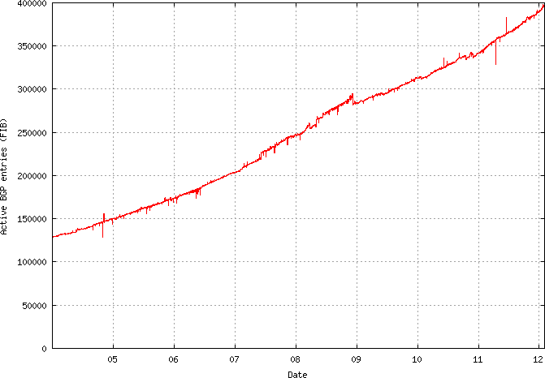
The IPv4 Table: 2004 - now

Slide 3
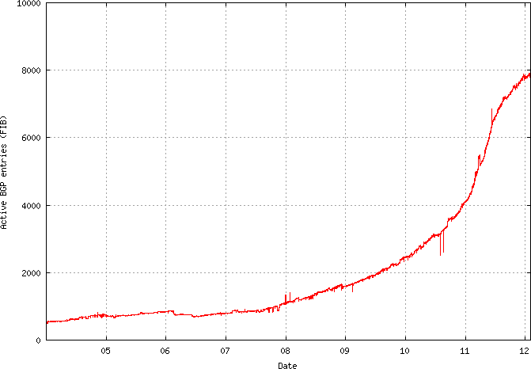
The IPv6 Table: 2004 - now

Slide 4
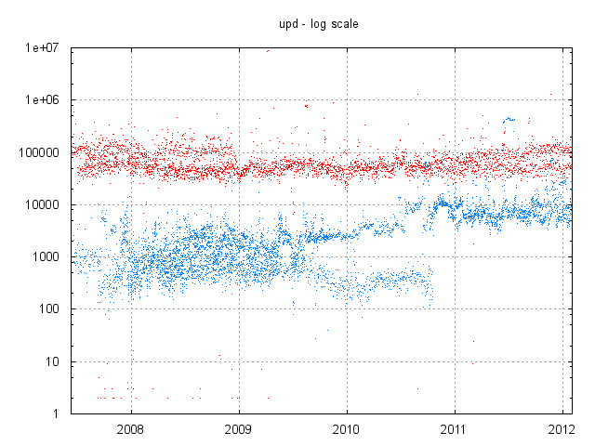
AS131072 – BGP Updates / day
V4 - ~100K updates/day
V6 - 1K rising to 10K
updates/day

Slide 5
That’s unexpected!
Most models of routing instability view instability as a probabilistic function relating to prefixes and ASs.
The corollary is that the greater the number of prefixes and ASs the greater the level of routing activity to maintain a coherent network topology
So why is IPv4’s update rate constant at ~100K updates across a period that has seen the IPv4 table grow from 125K to 400K entries?
And why is IPv6’s update rate growing at a similar rate to the size of the IPv6 table?

Slide 6
Prefixes vs Updates
The number of updates generated by a distance vector protocol increases with the distance between the “root cause” and the listening position
So instead of looking at the number of updates, lets look instead at the number of prefixes that are associated with a changed routing state each day

Slide 7
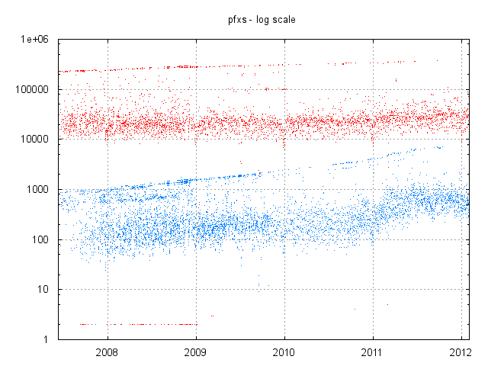
AS131072 – Unstable Prefixes /day
V4 - ~20K prefixes
V6 – 100 rising to 1K
prefixes

Slide 8
There are two curious aspects of this data:
1 - Is routing IPv4 really “scale free”?
2 - Why is IPv6 different?

Slide 9
1 - Is IPv4 BGP flat-lining?
Or is it just some strange anomaly in AS131072?
So I looked at the RIS and Route-View data sets

Slide 10
Daily Update rate for RIS peers – 2004 to 2011

Slide 11
Daily Update rate for Route Views peers – 2004 to 2011

Slide 12
Its not me!
Its not completely flat
But it’s everywhere
The long term growth rate of the dynamic activity of eBGP in IPv4 is far lower than the growth rate of the default-free routing table.

Slide 13
BGP Updates
There are two components to BGP update activity:
Convergence updates as BGP searches for a new stable “solution”
The update relating to the “primary” event
In an ever expanding network both BGP update components should be rising
But the total number of updates is not rising in IPv4

Slide 14
Convergence
BGP is a distance vector protocol
This implies that BGP may send a number of updates in a tight “cluster” before converging to the “best” path
This is clearly evident in withdrawals and convergence to (longer) secondary paths

Slide 15
For Example
Withdrawal at source at 08:00:00 03-Apr of 84.205.77.0/24 at MSK-IX, as observed at AS 2.0
Announced AS Path: <4777 2497 9002 12654>
Received update sequence:
08:02:22 03-Apr + <4777 2516 3549 3327 12976 20483 31323 12654>
08:02:51 03-Apr + <4777 2497 3549 3327 12976 20483 39792 8359 12654>
08:03:52 03-Apr + <4777 2516 3549 3327 12976 20483 39792 6939 16150 8359 12654>
08:04:28 03-Apr + <4777 2516 1239 3549 3327 12976 20483 39792 6939 16150 8359 12654>
08:04:52 03-Apr - <4777 2516 1239 3549 3327 12976 20483 39792 6939 16150 8359 12654>
1 withdrawal at source generated a convergence sequence of 5 events, spanning 150 seconds

Slide 16
Average Convergence Time for RIS peers – 2004 to 2011

Slide 17
Average Convergence Time for Route Views peers – 2004 to 2011

Slide 18
IPv4 Convergence Behaviour
IPv4 BGP convergence times and average convergence update counts have been constant for the past 7 years
This implies that a critical aspect of the network’s topology has also been held constant over the same period

Slide 19
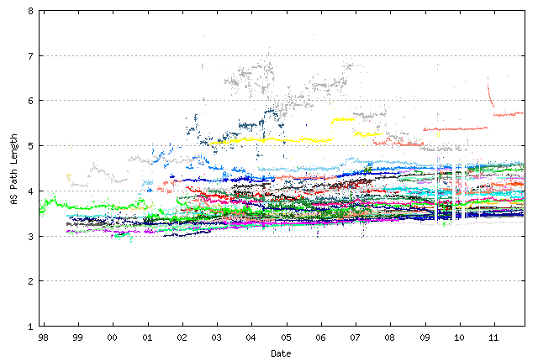
AS Path is Constant
The AS Path Length has been constant for many years, implying that the convergence effort has also remained constant
Per-peer average
AS Path Length as
Measured by Route-Views
Peers, 1998 - 2011

Slide 20
BGP Updates
There are two components to BGP update activity:
Convergence updates as BGP searches for a new stable “solution”
AS Path lengths have been steady as the Internet grows by increasing the density of interconnection, not by increasing average AS Path length
The update relating to the “primary” event

Slide 21
Unstable Prefixes
Are we seeing the same prefixes exhibiting instability multiple times per day, or different prefixes?
What’s the profile of instability from the perspective of individual prefixes?

Slide 22
Unstable Prefixes for RIS peers – 2004 to 2011

Slide 23
Unstable prefixes for Route Views peers – 2004 to 2011

Slide 24
Unstable Prefixes
Over the past 4 years the number of unstable prefixes lies between 20,000 – 50,000 prefixes per day
How “stable” is this set of unstable prefixes?
Are they the same prefixes?
Are they equally noisy?
What are the characteristics of this “noise”?

Slide 25
Prefix Instability Duration

Slide 26
Prefix Instability
Prefix Instability is generally short lived
90% of all prefixes are unstable for 2 days or less
6 prefixes are persistently unstable – these are beacon prefixes.
The distribution of the duration of prefix instability at a coarse level (per day) appears to be a power law distribution (see Zipfs’Law)

Slide 27
The Flat World of IPv4
The average number of convergence events appears to be basically flat for the past couple of years
The growth rate appears to be far lower than the growth rate of the routing table itself
The number of unstable prefixes per day is also relatively long term constant
but the individual prefixes themselves are unstable for 1 – 2 days on average

Slide 28
Why is BGP in IPv4 so Flat?
The convergence amplification factor is governed by the bounded diameter of the Internet
But why hasn’t the number of unstable prefixes grown in line with the growth in the table size? What is limiting this behaviour of the routing system? Why 20-50K unstable prefixes per day? Why not 100K? Or 5K? What is bounding this observed behaviour?

Slide 29
2 – Why is IPv6 Different?
Now lets return to the comparison of IPv4 and IPv6...

Slide 30
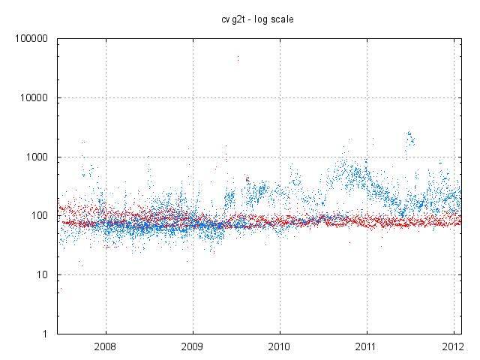
AS131072 – Average time to converge (secs)
Since mid 2009 AS131072 has been seeing dramatically higher average convergence times in IPv6

Slide 31
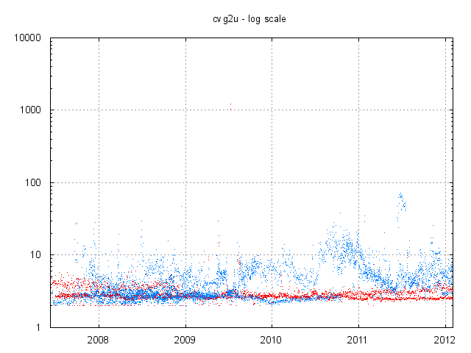
AS131072 – average number of updates to converge
Since mid 2009 AS131072 has been seeing the average number of updates per instability event rise to 2x – 10x the IPv4 rates

Slide 32
AS131072 Observations
The IPv4 network appears to exhibit scale-free properties:
while the number of advertised entries has triple from 125K to 400K, the number of updates, the number of unstable routes and the time to converge are all stable over the period
The IPv6 network appears to have scaling properties:
approx 10% of announced prefixes are unstable each day, and the time to converge is getting longer
Lets look at the RIPE NCC’s RIS data set, and the Route Views archive data set to see what other AS’s have observed over this period

Slide 33
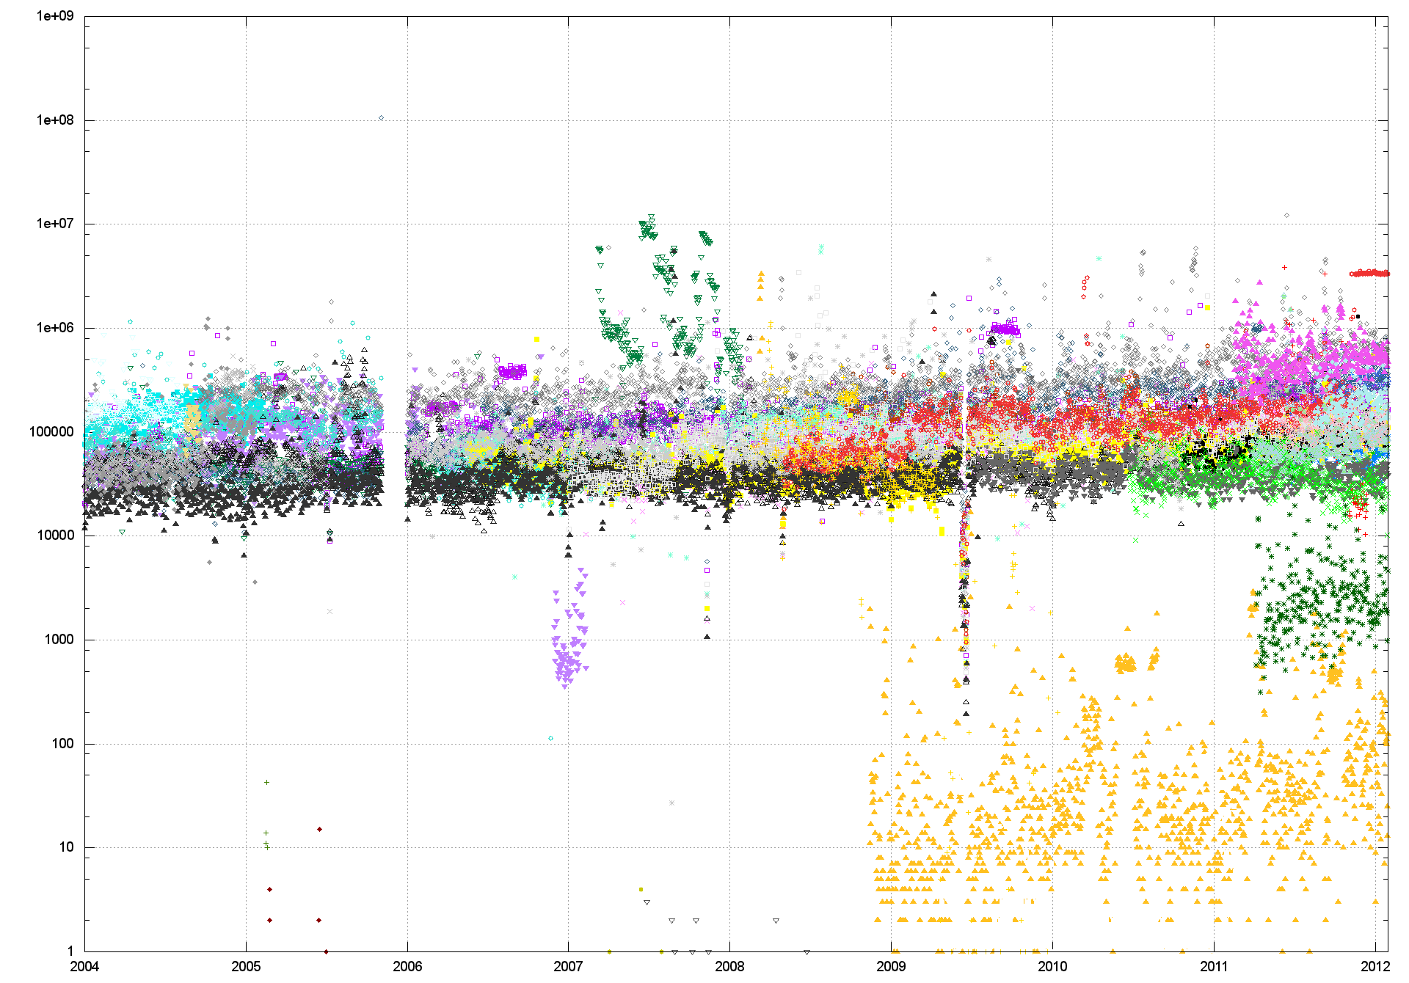
BGP IPv4 Updates / Day – RIS

Slide 34
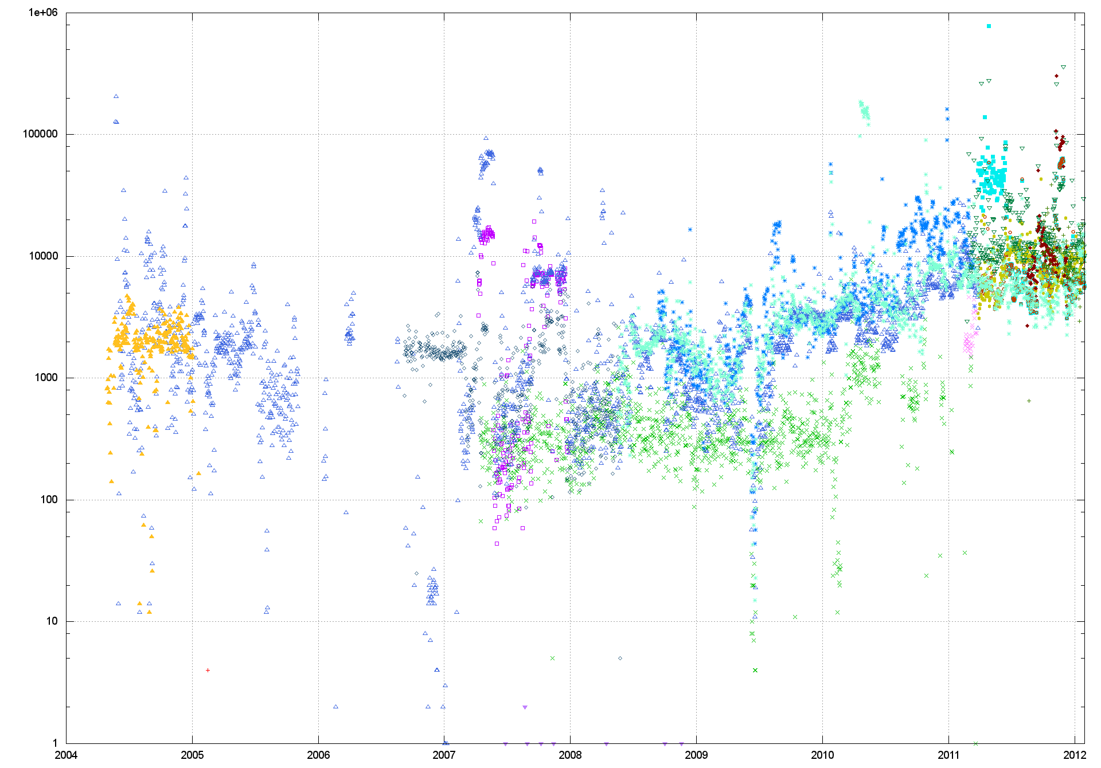
BGP IPv6 Updates / Day – RIS

Slide 35
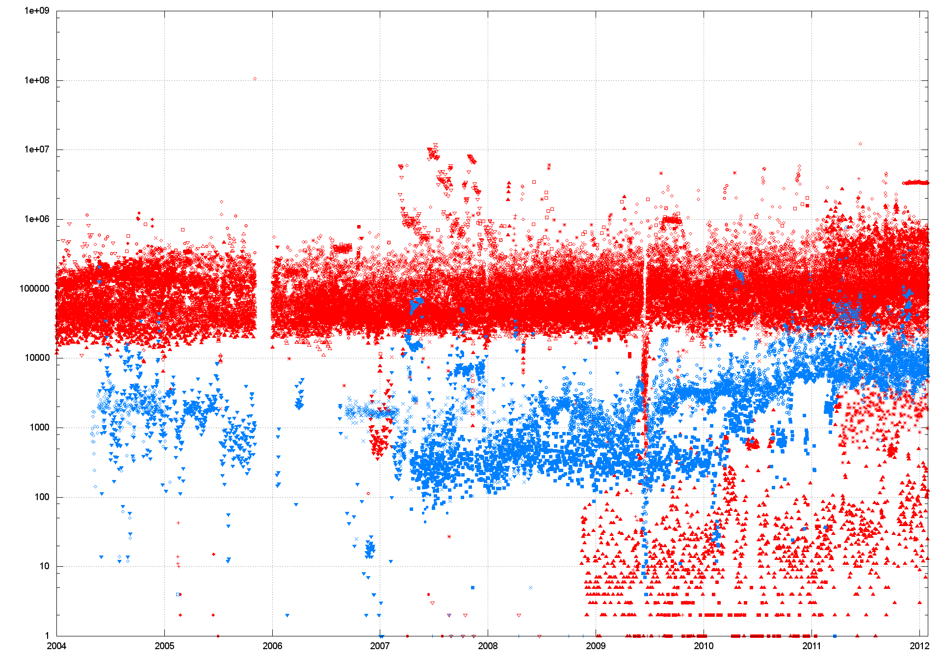
BGP Updates / Day – RIS
IPv4
IPv6

Slide 36
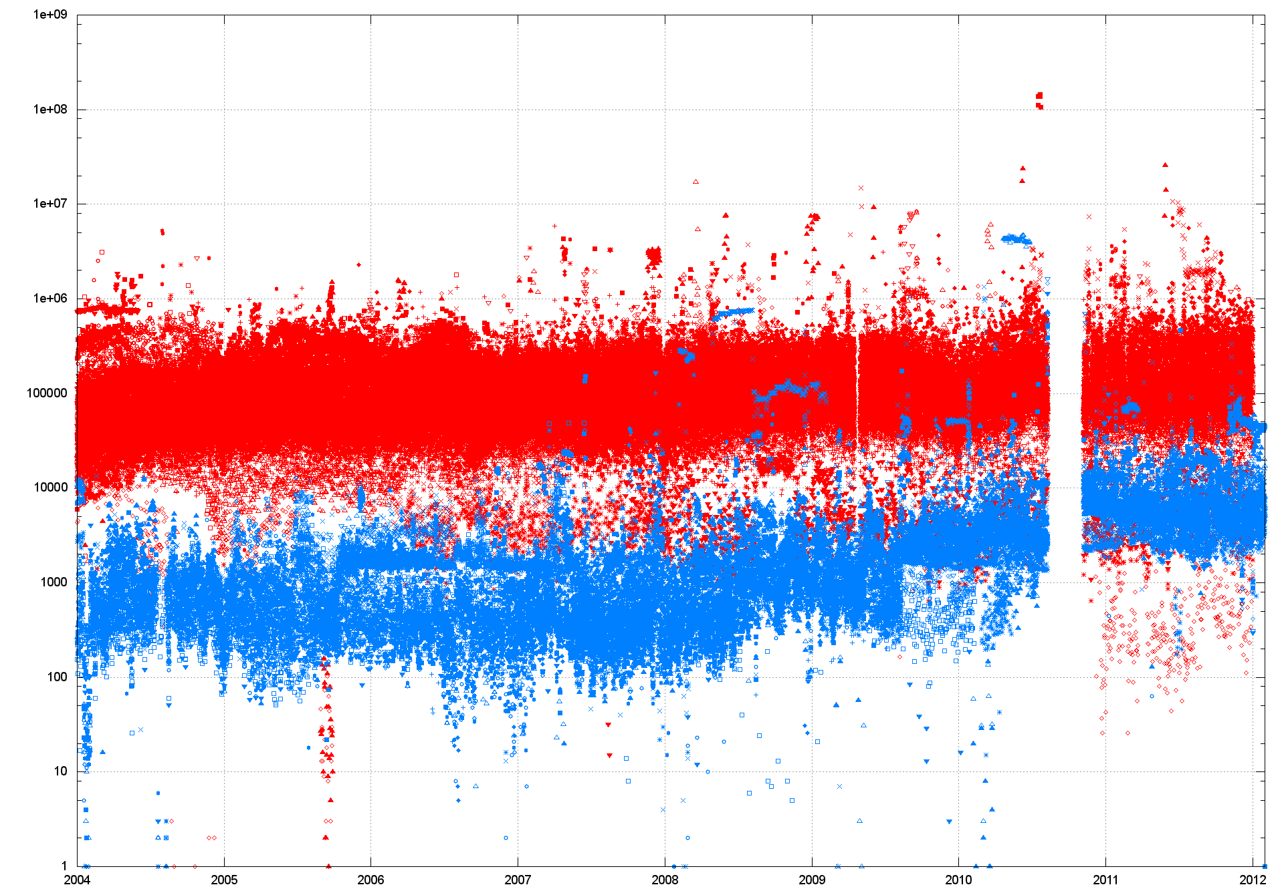
BGP Updates / Day – Route Views
IPv4
IPv6

Slide 37
It’s still not just me
A possible explanation was that AS131072 was seeing amplified IPv6 routing instability due to instability in its IPv6 routing
But we see the same behaviour across the larger set of IPv6 BGP peers
What about convergence behaviours in Ipv6?

Slide 38
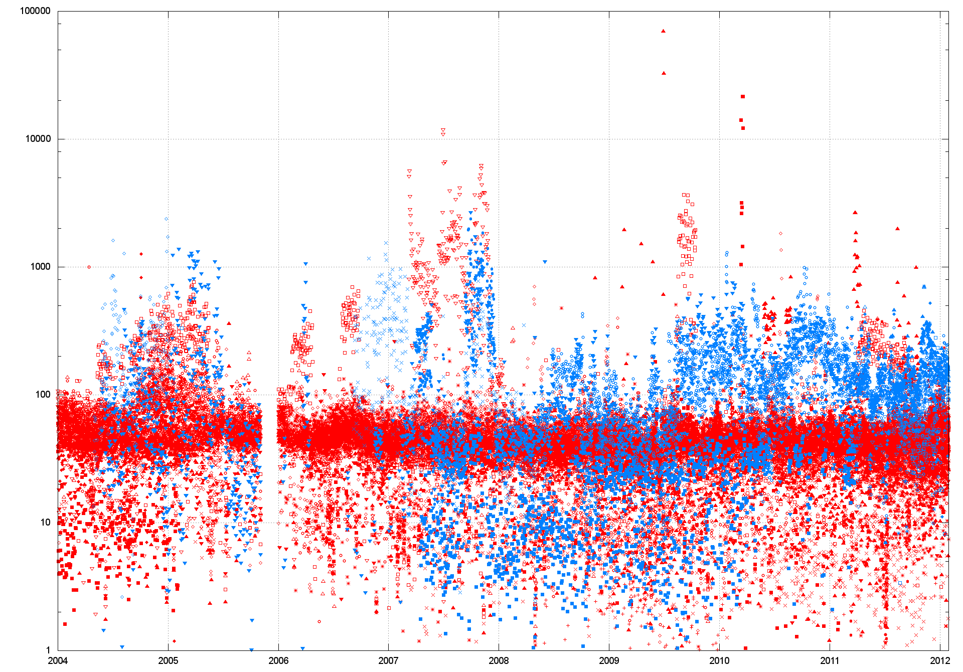
Average Convergence Time (RIS)

Slide 39
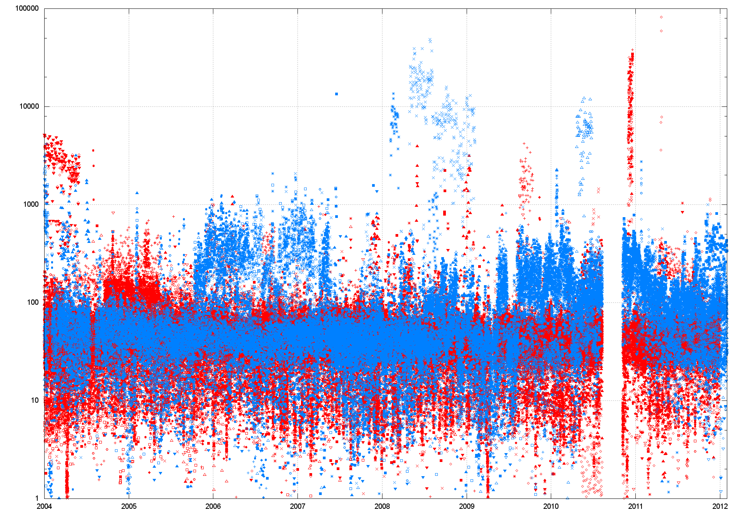
Average Convergence Time (R-V)

Slide 40
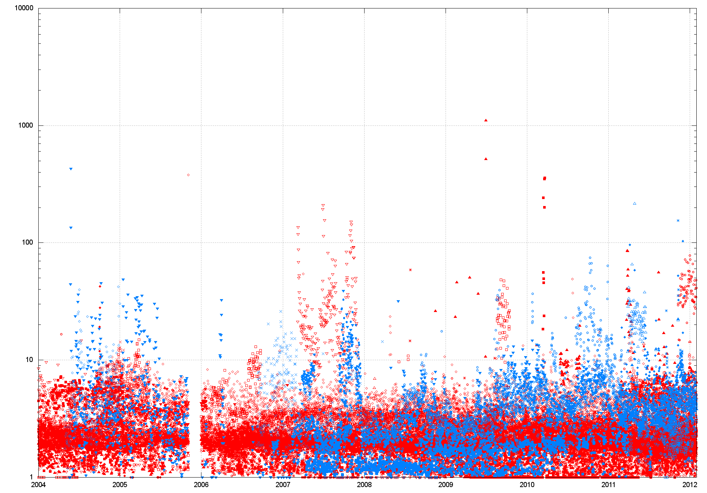
Average Convergence Updates (RIS)

Slide 41
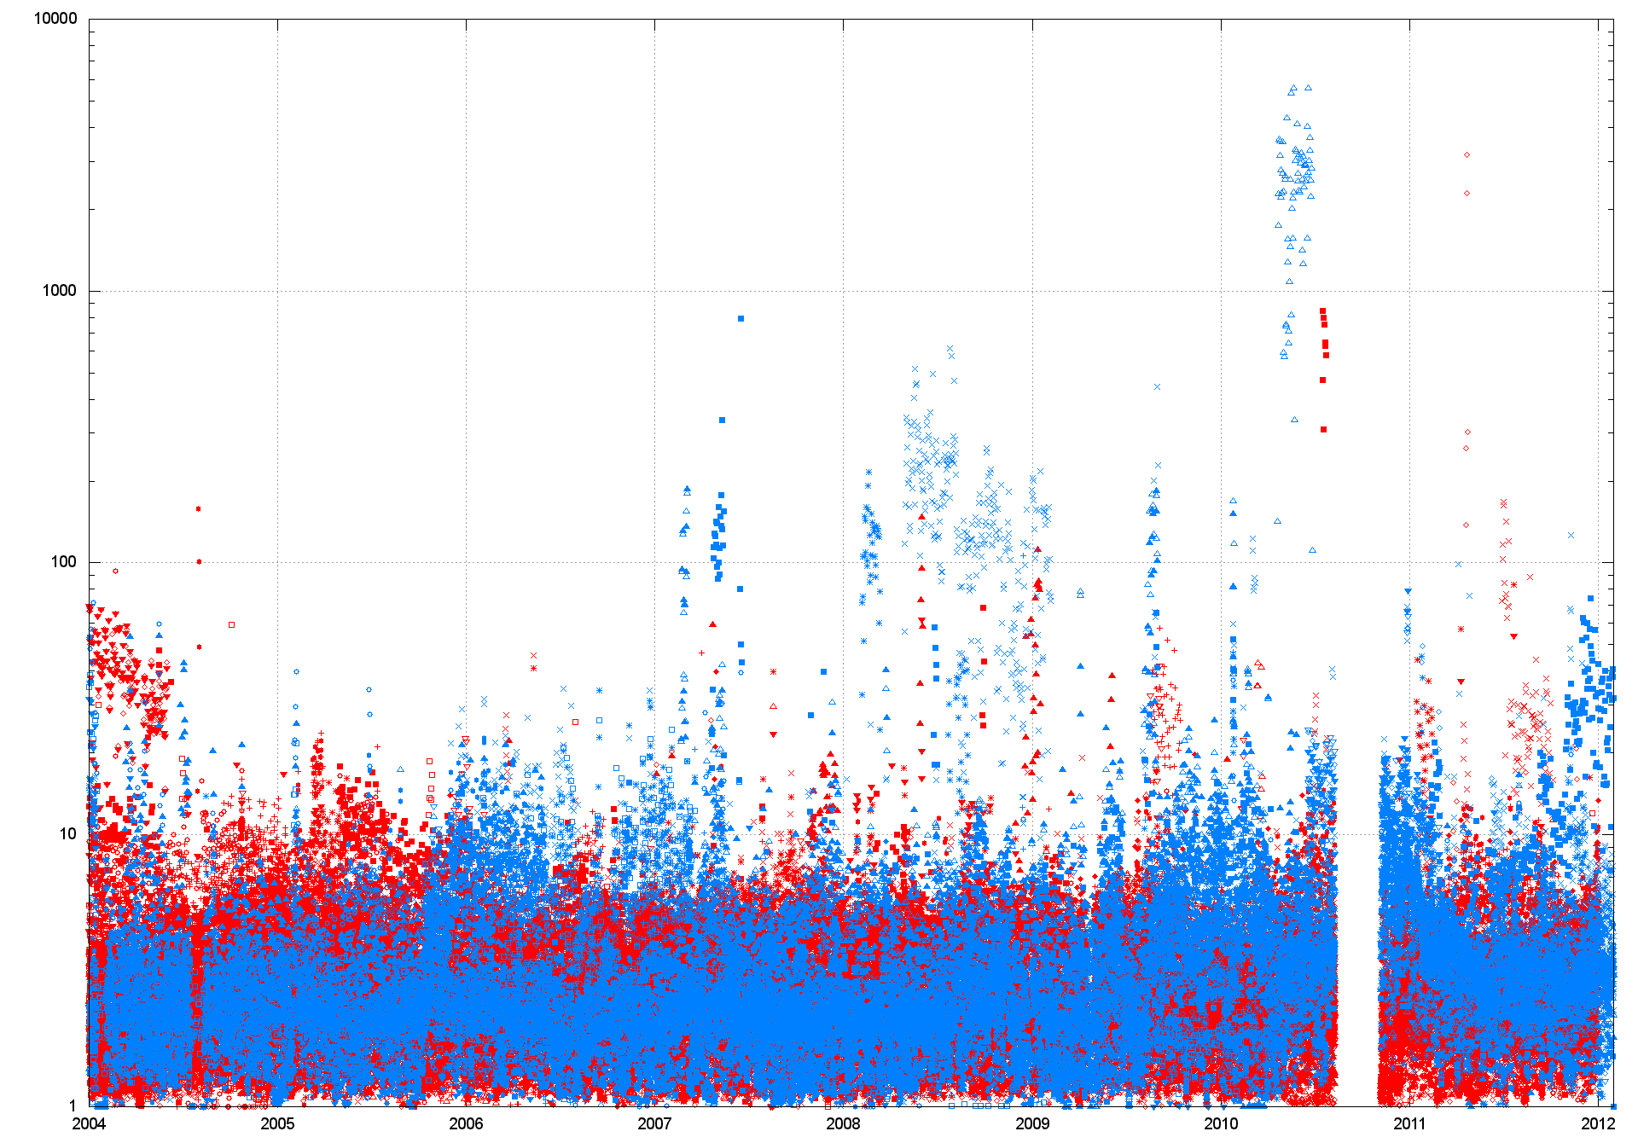
Average Convergence Updates (R-V)

Slide 42
IPv6 Instability
It appears that the level of instability in Ipv6 rose significantly for many IPv6 peers in mid 2009, and is only coming back down in recent months
Did the number of unstable prefixes rise at the same time?

Slide 43
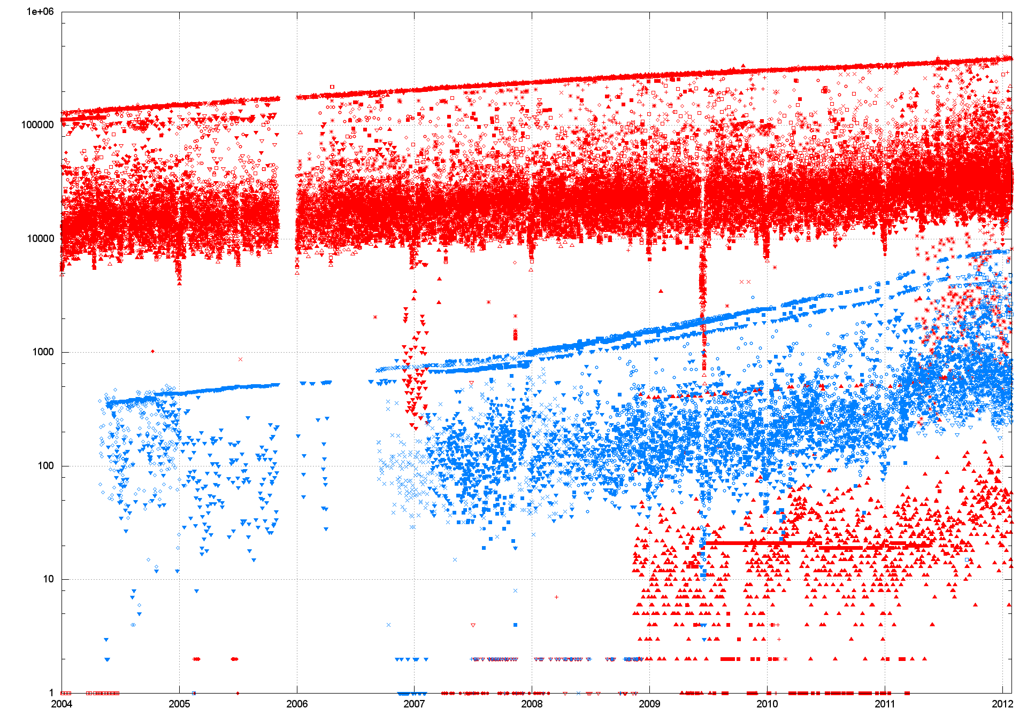
Unstable Prefixes (RIS)

Slide 44
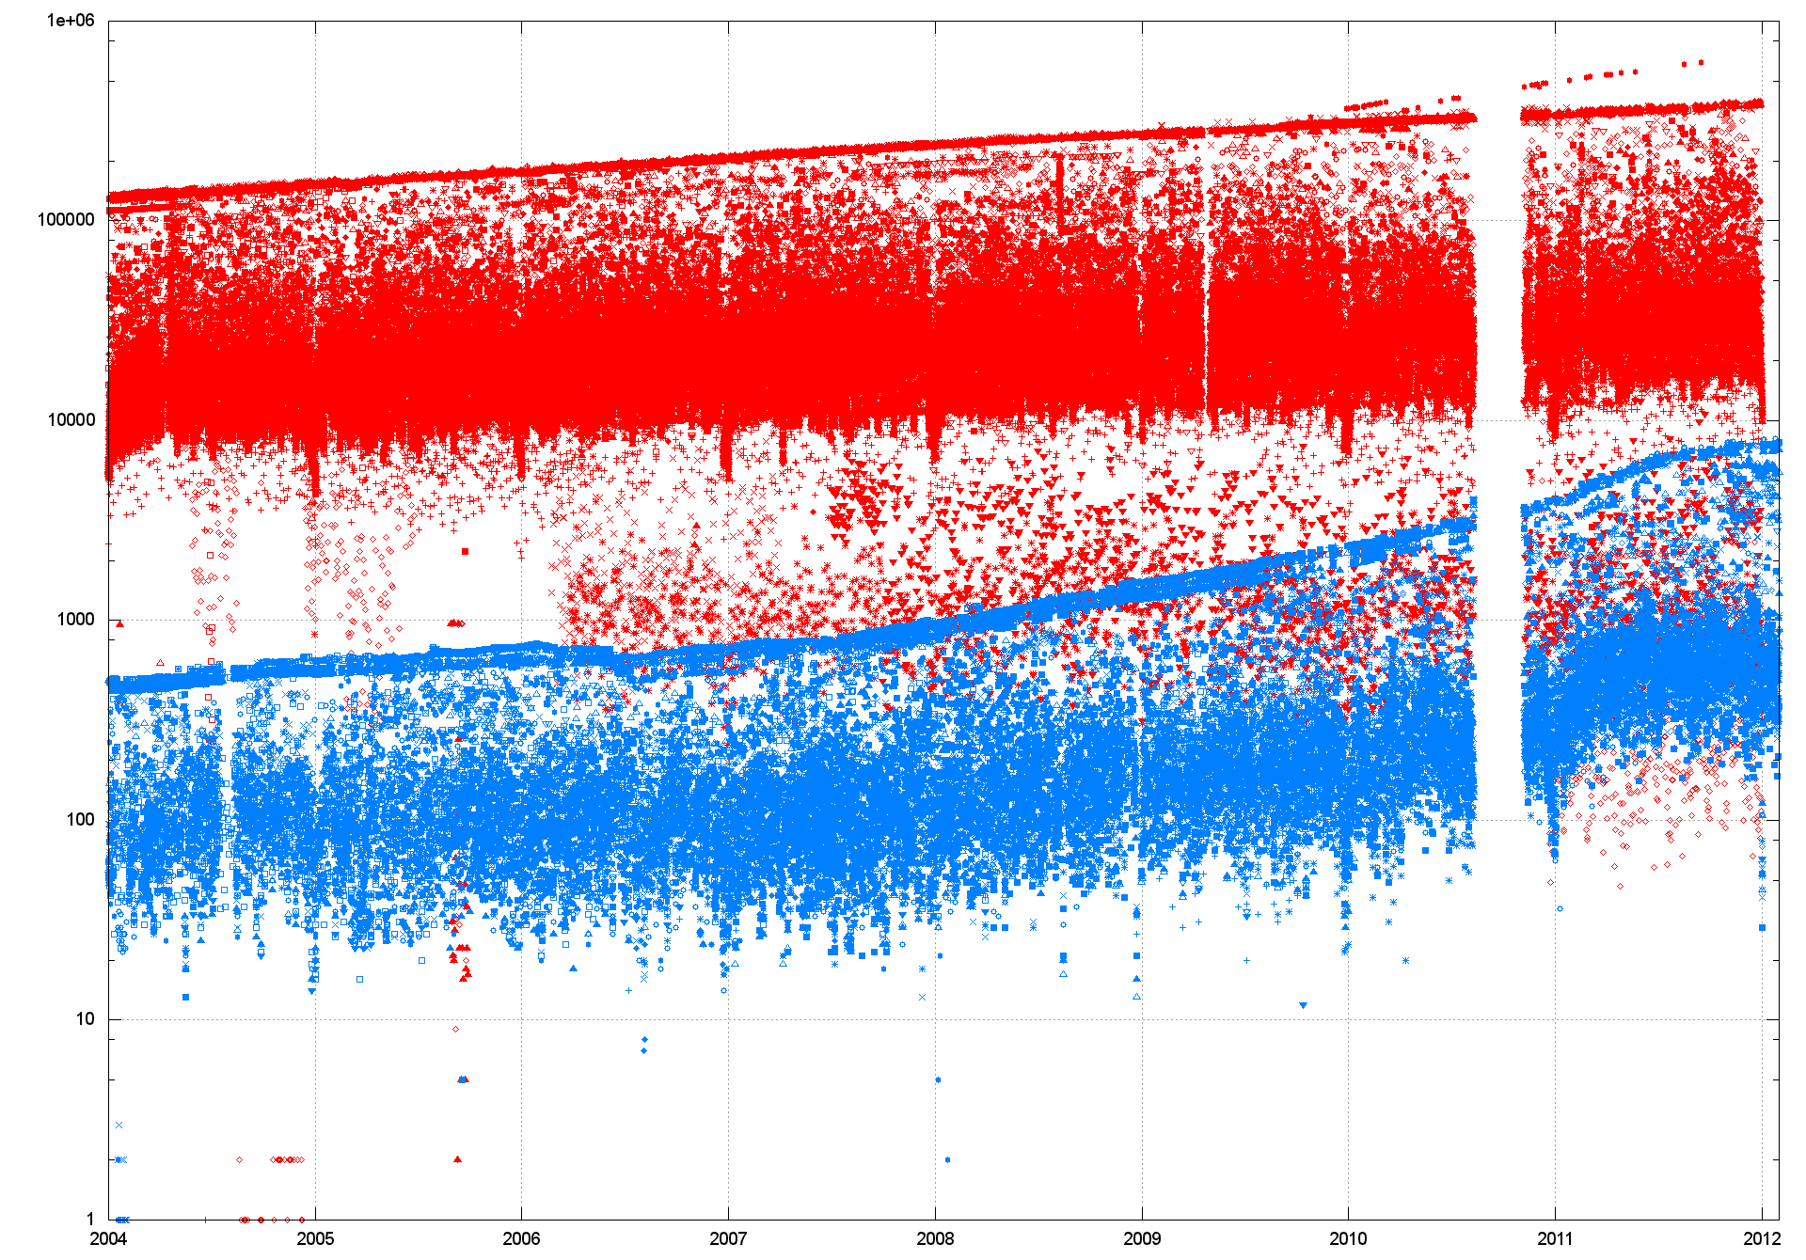
Unstable Prefixes (R-V)

Slide 45
Some observations
The per-AS views of the IPv6 network are more heterogeneous than the IPv4 network. Different AS’s see significantly different levels of instability and convergence behaviour in IPv6
The macroscopic properties of instability also differ. IPv6 prefix instability is running at 10% of prefixes. Over the same period network instability in IPv4 has dropped from 10% to 5% of advertised prefixes

Slide 46
And some questions
Are instability events in IPv4 and IPv6 linked, or are the dynamic routing behaviours in the two protocols entirely distinct?
Are there co-incident IPv4 and IPv6 instability events with the same origin AS or AS peering?
To what extent do IPv6 transit tunnels affect the stability of the IPv6 network? Is the higher variance of per-AS views attributable to the relative use of tunneled transit routes?
What other factors would drive up relative route instability in IPv6?

Slide 47
Your questions?

