Slide 1
The User Side of DNSSEC
Geoff Huston
APNIC

Slide 2
What is DNSSEC? (the ultra-short version)
DNSSEC adds Digital Signatures to DNS
  All DNS “data” is signed by the Zone Admin’s private key
  All DNS “gaps” are signed by the Zone key
  All DNS responses include the signature over the response data
This is a counter to various forms of DNS cache poisoning attacks, DNS MITM attacks and some other forms of attack on the integrity of the DNS
  (Other DNS vulnerabilities exist, so DNSSEC is not a panacea!)

Slide 3
Let’s look at USING DNSSEC…

Slide 4
Our Questions…
What proportion of the Internet’s users will perform DNSSEC validation if they are presented with a signed domain?
Where are these DNSSEC-validating users?
What is the performance overhead of serving signed names?

Slide 5
The Experiment
Each user is presented with three URLs to load:
the good (DNSSEC signed)
the bad (invalid DNSSEC signature)
the control (no DNSSEC at all)
We use an online ad system to deliver the test to a large pseudo-random set of clients

Slide 6
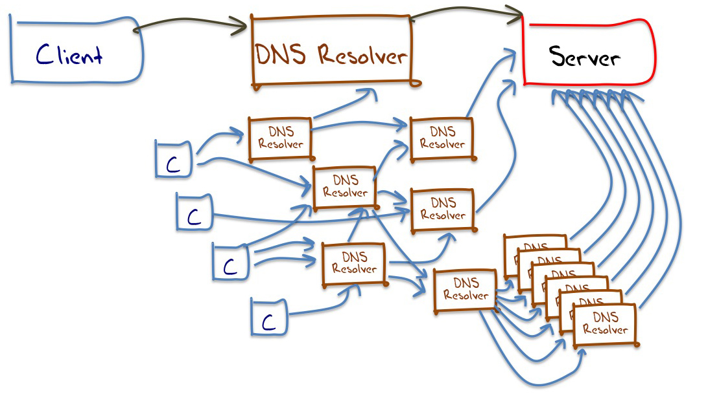
Understanding DNS Resolvers is “tricky”
A small sample of what appears to happen in DNS resolution

Slide 7
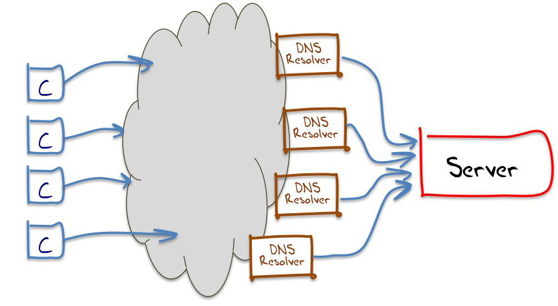
Understanding DNS Resolvers is “tricky”
The best model we can use for DNS resolution

Slide 8
This means…
That it is hard to talk about “all resolvers”
  We don’t know the ratio of the number of resolvers we cannot see compared to the resolvers we can see from the perspective of an authoritative name server
So it’s easier to talk about end clients, and whether these end clients use / don’t use a DNS resolution service that performs DNSSEC validation

Slide 9
The Results
Reported: 2,498,497 experiments that ran to “completion”
Web + DNS query log results for clients:
  Performed DNSSEC signature validation: 8.3%
  Fetched DNSSEC RRs but then retrieved the object anyway: 4.3%
  No DNSSEC; only fetched A RRs: 87.4%

Slide 10
Who uses DNSSEC? – The Top 20
Rank CC Count % D % x % A Country
1 SE 5,349 77.92 3.38 18.70 Sweden
2 SI 4,758 58.85 4.90 36.25 Slovenia
3 LU 652 43.87 6.90 49.23 Luxembourg
4 VN 26,665 38.28 4.04 57.69 Vietnam
5 FI 2,456 37.01 16.29 46.70 Finland
6 CZ 30,827 33.20 8.08 58.72 Czech Republic
7 CL 46,151 30.26 8.34 61.41 Chile
8 JM 1,545 28.22 3.11 68.67 Jamaica
9 IE 8,079 27.94 3.11 68.96 Ireland
10 BB 1,312 24.24 1.52 74.24 Barbados
11 ID 54,816 23.87 8.58 67.55 Indonesia
12 UA 26,399 21.65 12.75 65.60 Ukraine
13 ZA 2,969 21.15 9.36 69.48 South Africa
14 TR 49,498 18.06 2.10 79.84 Turkey
15 US 140,234 17.32 3.57 79.11 United States of America
16 EG 36,061 14.68 10.32 75.01 Egypt
17 GH 973 14.59 8.12 77.29 Ghana
18 AZ 7,409 14.55 30.34 55.11 Azerbaijan
19 BR 179,424 14.43 6.13 79.44 Brazil
20 PS 2,893 14.00 36.85 49.15 Occupied Palestinian Territory
% of clients who appear to use DNSSEC-validating resolvers
% of clients who use non-validating resolvers
% of clients who use a mix of DNSSEC-validating resolvers and non-validating resolvers
When we geo-locate clients to countries, what proportion of these clients: Perform DNSSEC validation? Retrieve some DNSSEC RRs? Do not retrieve any DNSSEC RRs?

Slide 11
Who uses DNSSEC? – The Top 20
Rank CC Count % D % x % A Country
1 SE 5,349 77.92 3.38 18.70 Sweden
2 SI 4,758 58.85 4.90 36.25 Slovenia
3 LU 652 43.87 6.90 49.23 Luxembourg
4 VN 26,665 38.28 4.04 57.69 Vietnam
5 FI 2,456 37.01 16.29 46.70 Finland
6 CZ 30,827 33.20 8.08 58.72 Czech Republic
7 CL 46,151 30.26 8.34 61.41 Chile
8 JM 1,545 28.22 3.11 68.67 Jamaica
9 IE 8,079 27.94 3.11 68.96 Ireland
10 BB 1,312 24.24 1.52 74.24 Barbados
11 ID 54,816 23.87 8.58 67.55 Indonesia
12 UA 26,399 21.65 12.75 65.60 Ukraine
13 ZA 2,969 21.15 9.36 69.48 South Africa
14 TR 49,498 18.06 2.10 79.84 Turkey
15 US 140,234 17.32 3.57 79.11 United States of America
16 EG 36,061 14.68 10.32 75.01 Egypt
17 GH 973 14.59 8.12 77.29 Ghana
18 AZ 7,409 14.55 30.34 55.11 Azerbaijan
19 BR 179,424 14.43 6.13 79.44 Brazil
20 PS 2,893 14.00 36.85 49.15 Occupied Palestinian Territory
When we geo-locate clients to countries, what proportion of these clients: Perform DNSSEC validation? Retrieve some DNSSEC RRs? Do not retrieve any DNSSEC RRs?

Slide 12
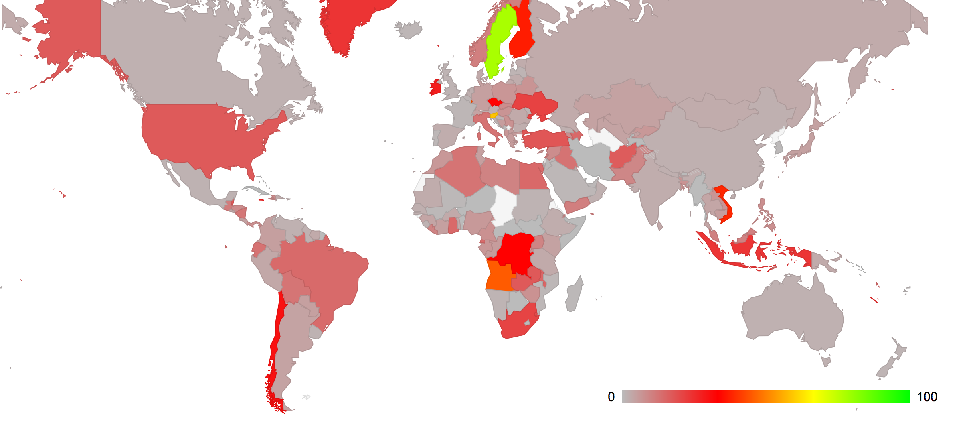
The Mapped view of DNSSEC Use
% of users who use DNSSEC-validating resolvers

Slide 13
Is Google’s P-DNS a Factor?
Rank CC Count % D %AG %SG %NG Country
1 SE 5,349 77.92 -> 1.78 0.19 98.03 Sweden
2 SI 4,758 58.85 -> 7.89 0.21 91.89 Slovenia
3 LU 652 43.87 -> 1.40 0.00 98.60 Luxembourg
4 VN 26,665 38.28 -> 96.66 2.25 1.09 Vietnam
5 FI 2,456 37.01 -> 2.64 0.33 97.03 Finland
6 CZ 30,827 33.20 -> 11.71 3.99 84.30 Czech Republic
7 CL 46,151 30.26 -> 3.62 0.45 95.92 Chile
8 JM 1,545 28.22 -> 91.74 0.69 7.57 Jamaica
9 IE 8,079 27.94 -> 12.18 0.93 86.89 Ireland
10 BB 1,312 24.24 -> 7.86 0.31 91.82 Barbados
11 ID 54,816 23.87 -> 68.36 12.63 19.01 Indonesia
12 UA 26,399 21.65 -> 19.84 2.15 78.01 Ukraine
13 ZA 2,969 21.15 -> 5.73 0.80 93.47 South Africa
14 TR 49,498 18.06 -> 93.25 3.33 3.41 Turkey
15 US 140,234 17.32 -> 7.28 0.73 91.98 United States
16 EG 36,061 14.68 -> 86.28 9.88 3.84 Egypt
17 GH 973 14.59 -> 59.86 14.08 26.06 Ghana
18 AZ 7,409 14.55 -> 71.24 26.72 2.04 Azerbaijan
19 BR 179,424 14.43 -> 50.31 7.08 42.61 Brazil
PS 2,893 14.00 -> 40.49 59.51 0.00 Occ. Palestine
% of validating clients who exclusively use Google’s P-DNS
% of clients who do not use Google’s P-DNS service
% of clients who use a mix of Google’s P-DNS and other resolvers
Of those clients who perform DNSSEC validation, what resolvers
are they using: All Google P-DNS, Some Google P-DNS? No Google P-DNS?

Slide 14
Is Google’s P-DNS a Factor?
Rank CC Count % D %AG %SG %NG Country
1 SE 5,349 77.92 -> 1.78 0.19 98.03 Sweden
2 SI 4,758 58.85 -> 7.89 0.21 91.89 Slovenia
3 LU 652 43.87 -> 1.40 0.00 98.60 Luxembourg
4 VN 26,665 38.28 -> 96.66 2.25 1.09 Vietnam
5 FI 2,456 37.01 -> 2.64 0.33 97.03 Finland
6 CZ 30,827 33.20 -> 11.71 3.99 84.30 Czech Republic
7 CL 46,151 30.26 -> 3.62 0.45 95.92 Chile
8 JM 1,545 28.22 -> 91.74 0.69 7.57 Jamaica
9 IE 8,079 27.94 -> 12.18 0.93 86.89 Ireland
10 BB 1,312 24.24 -> 7.86 0.31 91.82 Barbados
11 ID 54,816 23.87 -> 68.36 12.63 19.01 Indonesia
12 UA 26,399 21.65 -> 19.84 2.15 78.01 Ukraine
13 ZA 2,969 21.15 -> 5.73 0.80 93.47 South Africa
14 TR 49,498 18.06 -> 93.25 3.33 3.41 Turkey
15 US 140,234 17.32 -> 7.28 0.73 91.98 United States
16 EG 36,061 14.68 -> 86.28 9.88 3.84 Egypt
17 GH 973 14.59 -> 59.86 14.08 26.06 Ghana
18 AZ 7,409 14.55 -> 71.24 26.72 2.04 Azerbaijan
19 BR 179,424 14.43 -> 50.31 7.08 42.61 Brazil
PS 2,893 14.00 -> 40.49 59.51 0.00 Occ. Palestine
Of those clients who perform DNSSEC validation, what resolvers
are they using: All Google P-DNS, Some Google P-DNS? No Google P-DNS?

Slide 15
DNSSEC by Networks – the Top 25
Rank AS Count % D %x %A %G AS Name
1 AS39651 710 98.73 0.14 1.13 0.71 Com Hem, SE
2 AS27831 627 97.77 2.23 0.00 0.49 Colombia Movil,CO
3 AS12912 1,486 97.71 1.14 1.14 2.34 ERA Polska Telefonia, PL
4 AS34779 834 96.76 0.84 2.40 1.24 T-2 Slovenia, SI
5 AS29562 582 96.74 0.86 2.41 1.07 Kabel BW GmbH, DE
6 AS5603 1,372 96.72 0.87 2.41 0.53 Telekom Slovenije, SI
7 AS198471 730 96.44 1.10 2.47 99.86 Linkem spa, IT
8 AS719 583 96.05 0.69 3.26 1.07 Elisa Oyj, EU
9 AS5466 2,093 94.70 1.53 3.77 1.21 Eircom, IE
10 AS6849 4,596 92.43 2.15 5.42 3.55 UKRTELECOM, UA
11 AS3301 1,445 91.56 1.45 6.99 1.44 TeliaSonera, SE
12 AS5610 6,889 90.58 2.48 6.94 4.97 TO2 Telefonica Czech Rep., CZ
13 AS7922 24,129 89.57 2.07 8.36 1.09 Comcast Cable, US
14 AS22047 15,274 88.61 9.68 1.71 1.12 VTR BANDA ANCHA, CL
15 AS1257 795 86.29 1.38 12.33 1.60 TELE2, SE
16 AS38511 1,221 79.36 4.18 16.46 10.84 PT Remala Abadi, ID
17 AS2519 523 57.36 3.82 38.81 0.67 VECTANT, JP
18 AS1759 562 51.78 26.51 21.71 2.06 TeliaSonera, FI
19 AS2819 734 48.37 15.53 36.10 20.85 GTSCZ GTS Czech, CZ
20 AS45899 14,306 45.93 3.16 50.91 97.76 VNPT, VN
21 AS27738 950 45.79 40.11 14.11 4.60 Ecuadortelecom, EC
22 AS12301 6,885 42.96 3.59 53.45 5.71 Invitel Tavkozlesi HU
23 AS4230 1,327 37.91 17.48 44.61 59.44 EMBRATEL-EMPRESA, BR
24 AS34170 1,169 36.36 55.18 8.47 72.00 AZTELEKOM Azerbaijan Tele, AZ
25 AS7552 3,708 35.92 5.02 59.06 96.47 Vietel, VN
% of clients who appear to use DNSSEC-validating resolvers
% of validating clients who exclusively use Google’s P-DNS
% of clients who use a mix of DNSSEC-validating resolvers and non-validating resolvers
% of clients who use non-validating resolvers

Slide 16
DNSSEC by Networks – the Top 25
Rank AS Count % D %x %A %G AS Name
1 AS39651 710 98.73 0.14 1.13 0.71 Com Hem, SE
2 AS27831 627 97.77 2.23 0.00 0.49 Colombia Movil,CO
3 AS12912 1,486 97.71 1.14 1.14 2.34 ERA Polska Telefonia, PL
4 AS34779 834 96.76 0.84 2.40 1.24 T-2 Slovenia, SI
5 AS29562 582 96.74 0.86 2.41 1.07 Kabel BW GmbH, DE
6 AS5603 1,372 96.72 0.87 2.41 0.53 Telekom Slovenije, SI
7 AS198471 730 96.44 1.10 2.47 99.86 Linkem spa, IT
8 AS719 583 96.05 0.69 3.26 1.07 Elisa Oyj, EU
9 AS5466 2,093 94.70 1.53 3.77 1.21 Eircom, IE
10 AS6849 4,596 92.43 2.15 5.42 3.55 UKRTELECOM, UA
11 AS3301 1,445 91.56 1.45 6.99 1.44 TeliaSonera, SE
12 AS5610 6,889 90.58 2.48 6.94 4.97 TO2 Telefonica Czech Rep., CZ
13 AS7922 24,129 89.57 2.07 8.36 1.09 Comcast Cable, US
14 AS22047 15,274 88.61 9.68 1.71 1.12 VTR BANDA ANCHA, CL
15 AS1257 795 86.29 1.38 12.33 1.60 TELE2, SE
16 AS38511 1,221 79.36 4.18 16.46 10.84 PT Remala Abadi, ID
17 AS2519 523 57.36 3.82 38.81 0.67 VECTANT, JP
18 AS1759 562 51.78 26.51 21.71 2.06 TeliaSonera, FI
19 AS2819 734 48.37 15.53 36.10 20.85 GTSCZ GTS Czech, CZ
20 AS45899 14,306 45.93 3.16 50.91 97.76 VNPT, VN
21 AS27738 950 45.79 40.11 14.11 4.60 Ecuadortelecom, EC
22 AS12301 6,885 42.96 3.59 53.45 5.71 Invitel Tavkozlesi HU
23 AS4230 1,327 37.91 17.48 44.61 59.44 EMBRATEL-EMPRESA, BR
24 AS34170 1,169 36.36 55.18 8.47 72.00 AZTELEKOM Azerbaijan Tele, AZ
25 AS7552 3,708 35.92 5.02 59.06 96.47 Vietel, VN

Slide 17
DNS Performance
How can we measure the time taken to resolve each of the three domain name types (signed, unsigned, badly signed)?

Slide 18
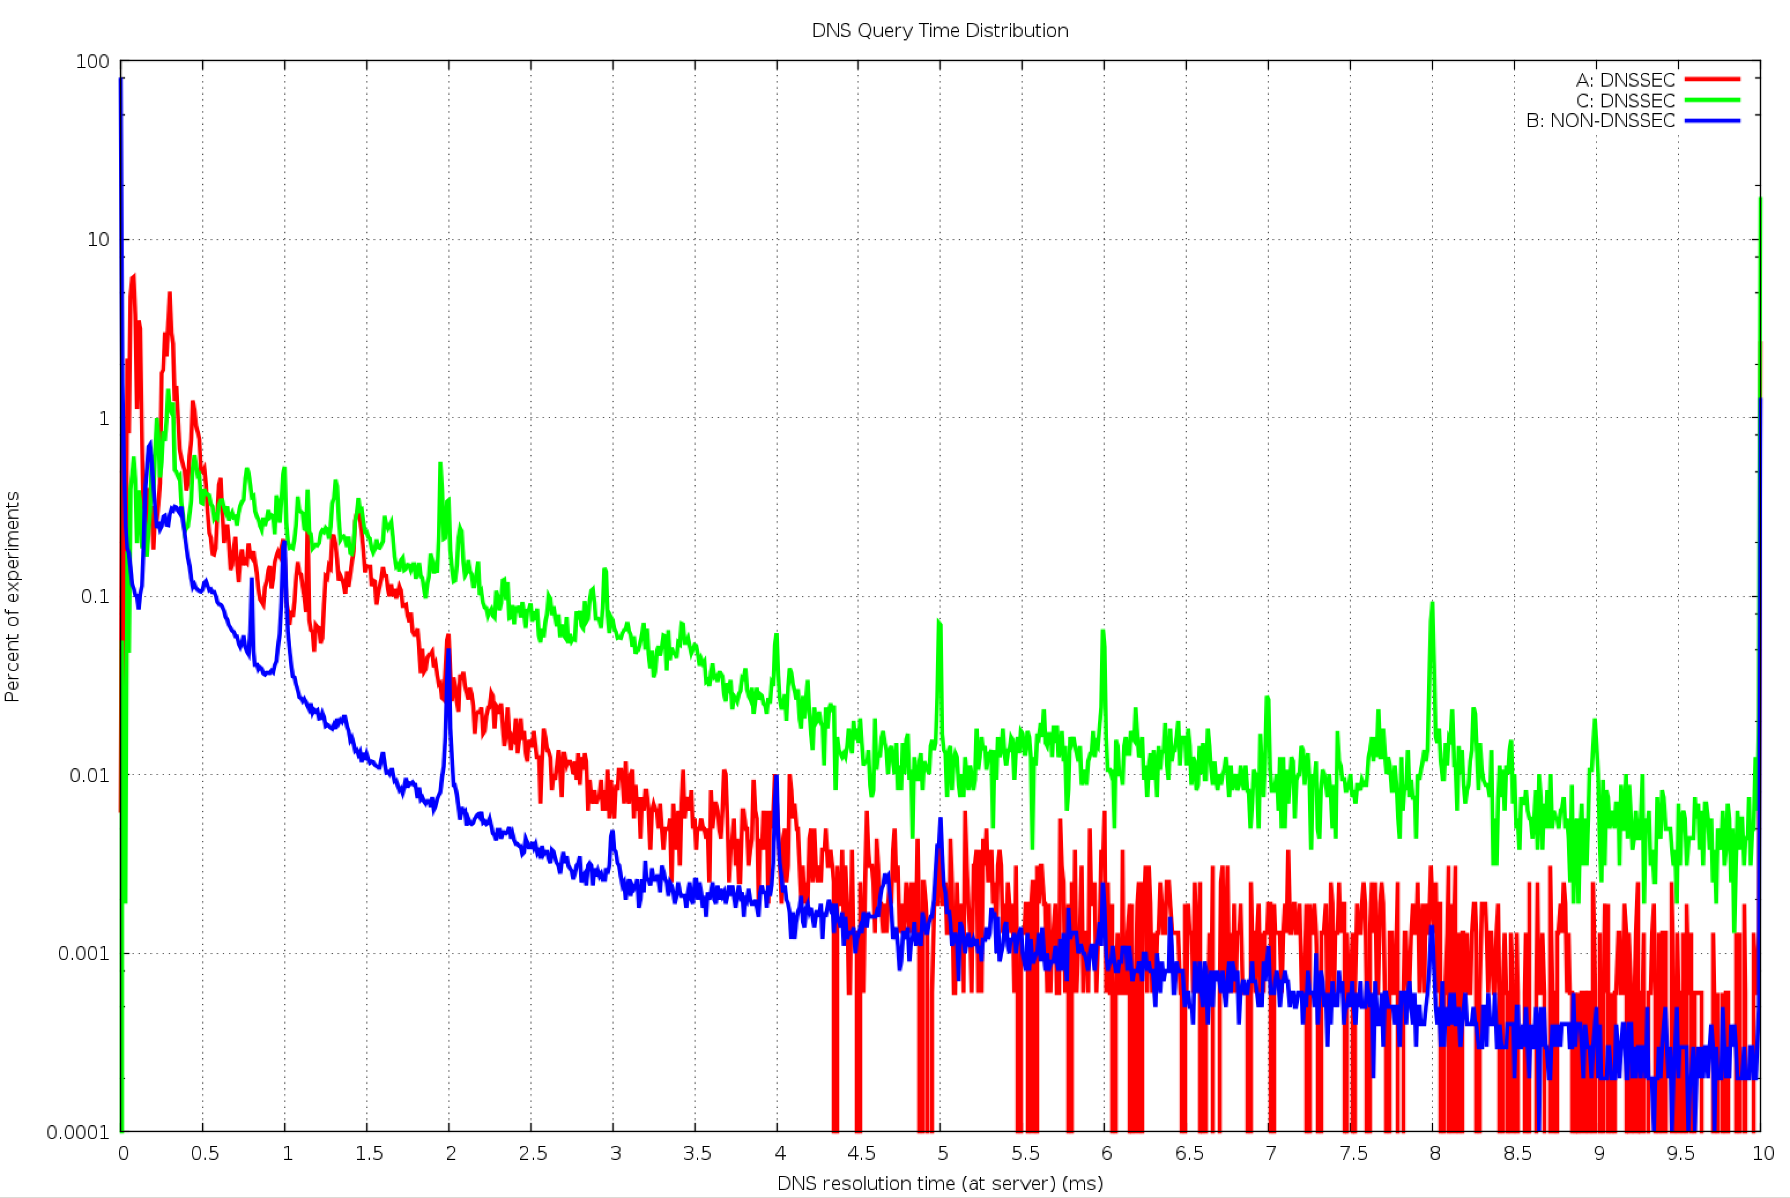
DNS Query Time

Slide 19
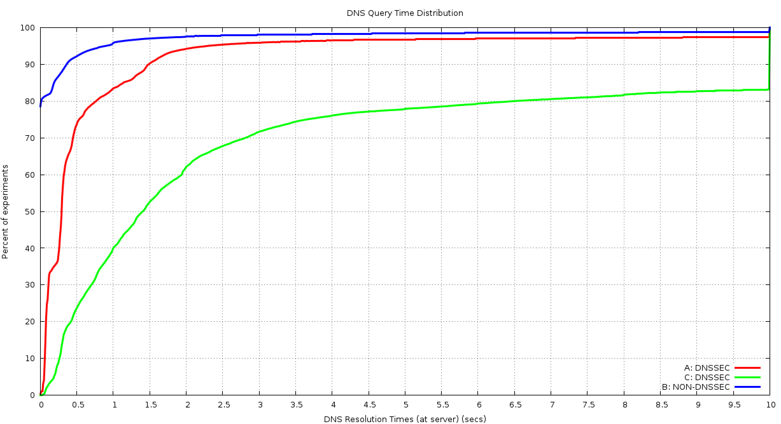
Cumulative Time Distribution

Slide 20
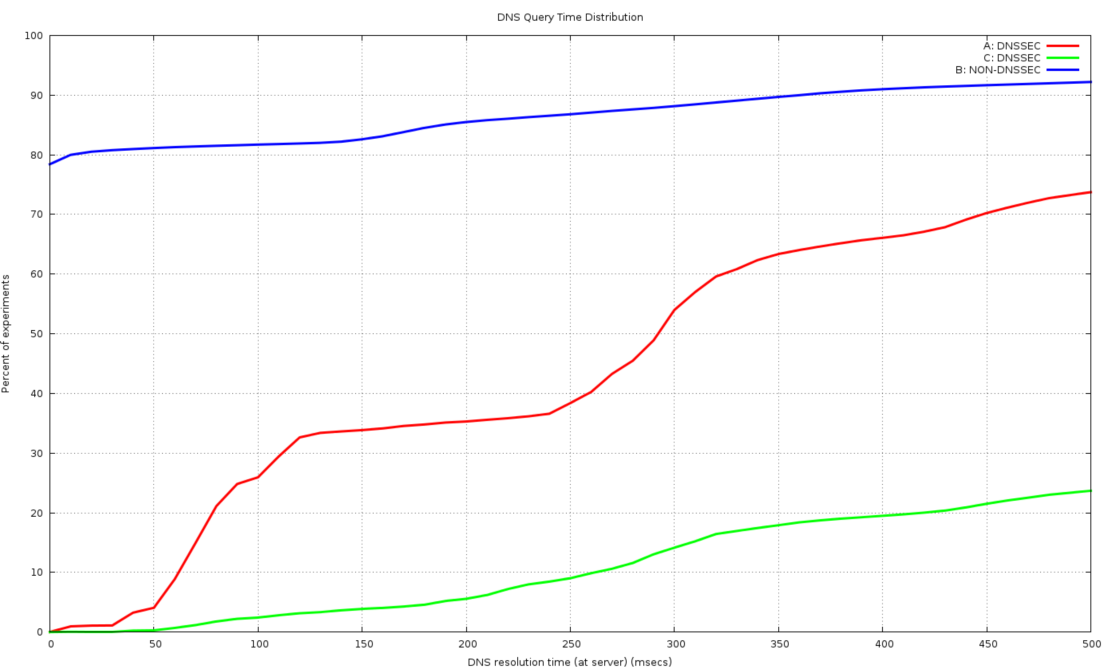
The first ½ second

Slide 21
What can we say?
DNS itself has its own performance issues
  20% of clients take 2 or more queries for a simple address query
  8% take longer than 500ms to complete the DNS query
DNSSEC takes longer
  Additional queries for DS and DNSKEY RRs
  At a minimum that’s 2 DNS query/answer intervals
    Because it appears that most resolvers serialise and perform resolution then validation
Badly-Signed DNSSEC takes even longer
  Resolvers try hard to find a good validation path
  And the SERVFAIL response causes clients to try subsequent resolvers in their list

Slide 22
At the other end…
Lets look at performance from the perspective of an Authoritative Name server who serves DNSSEC-signed domain names

Slide 23
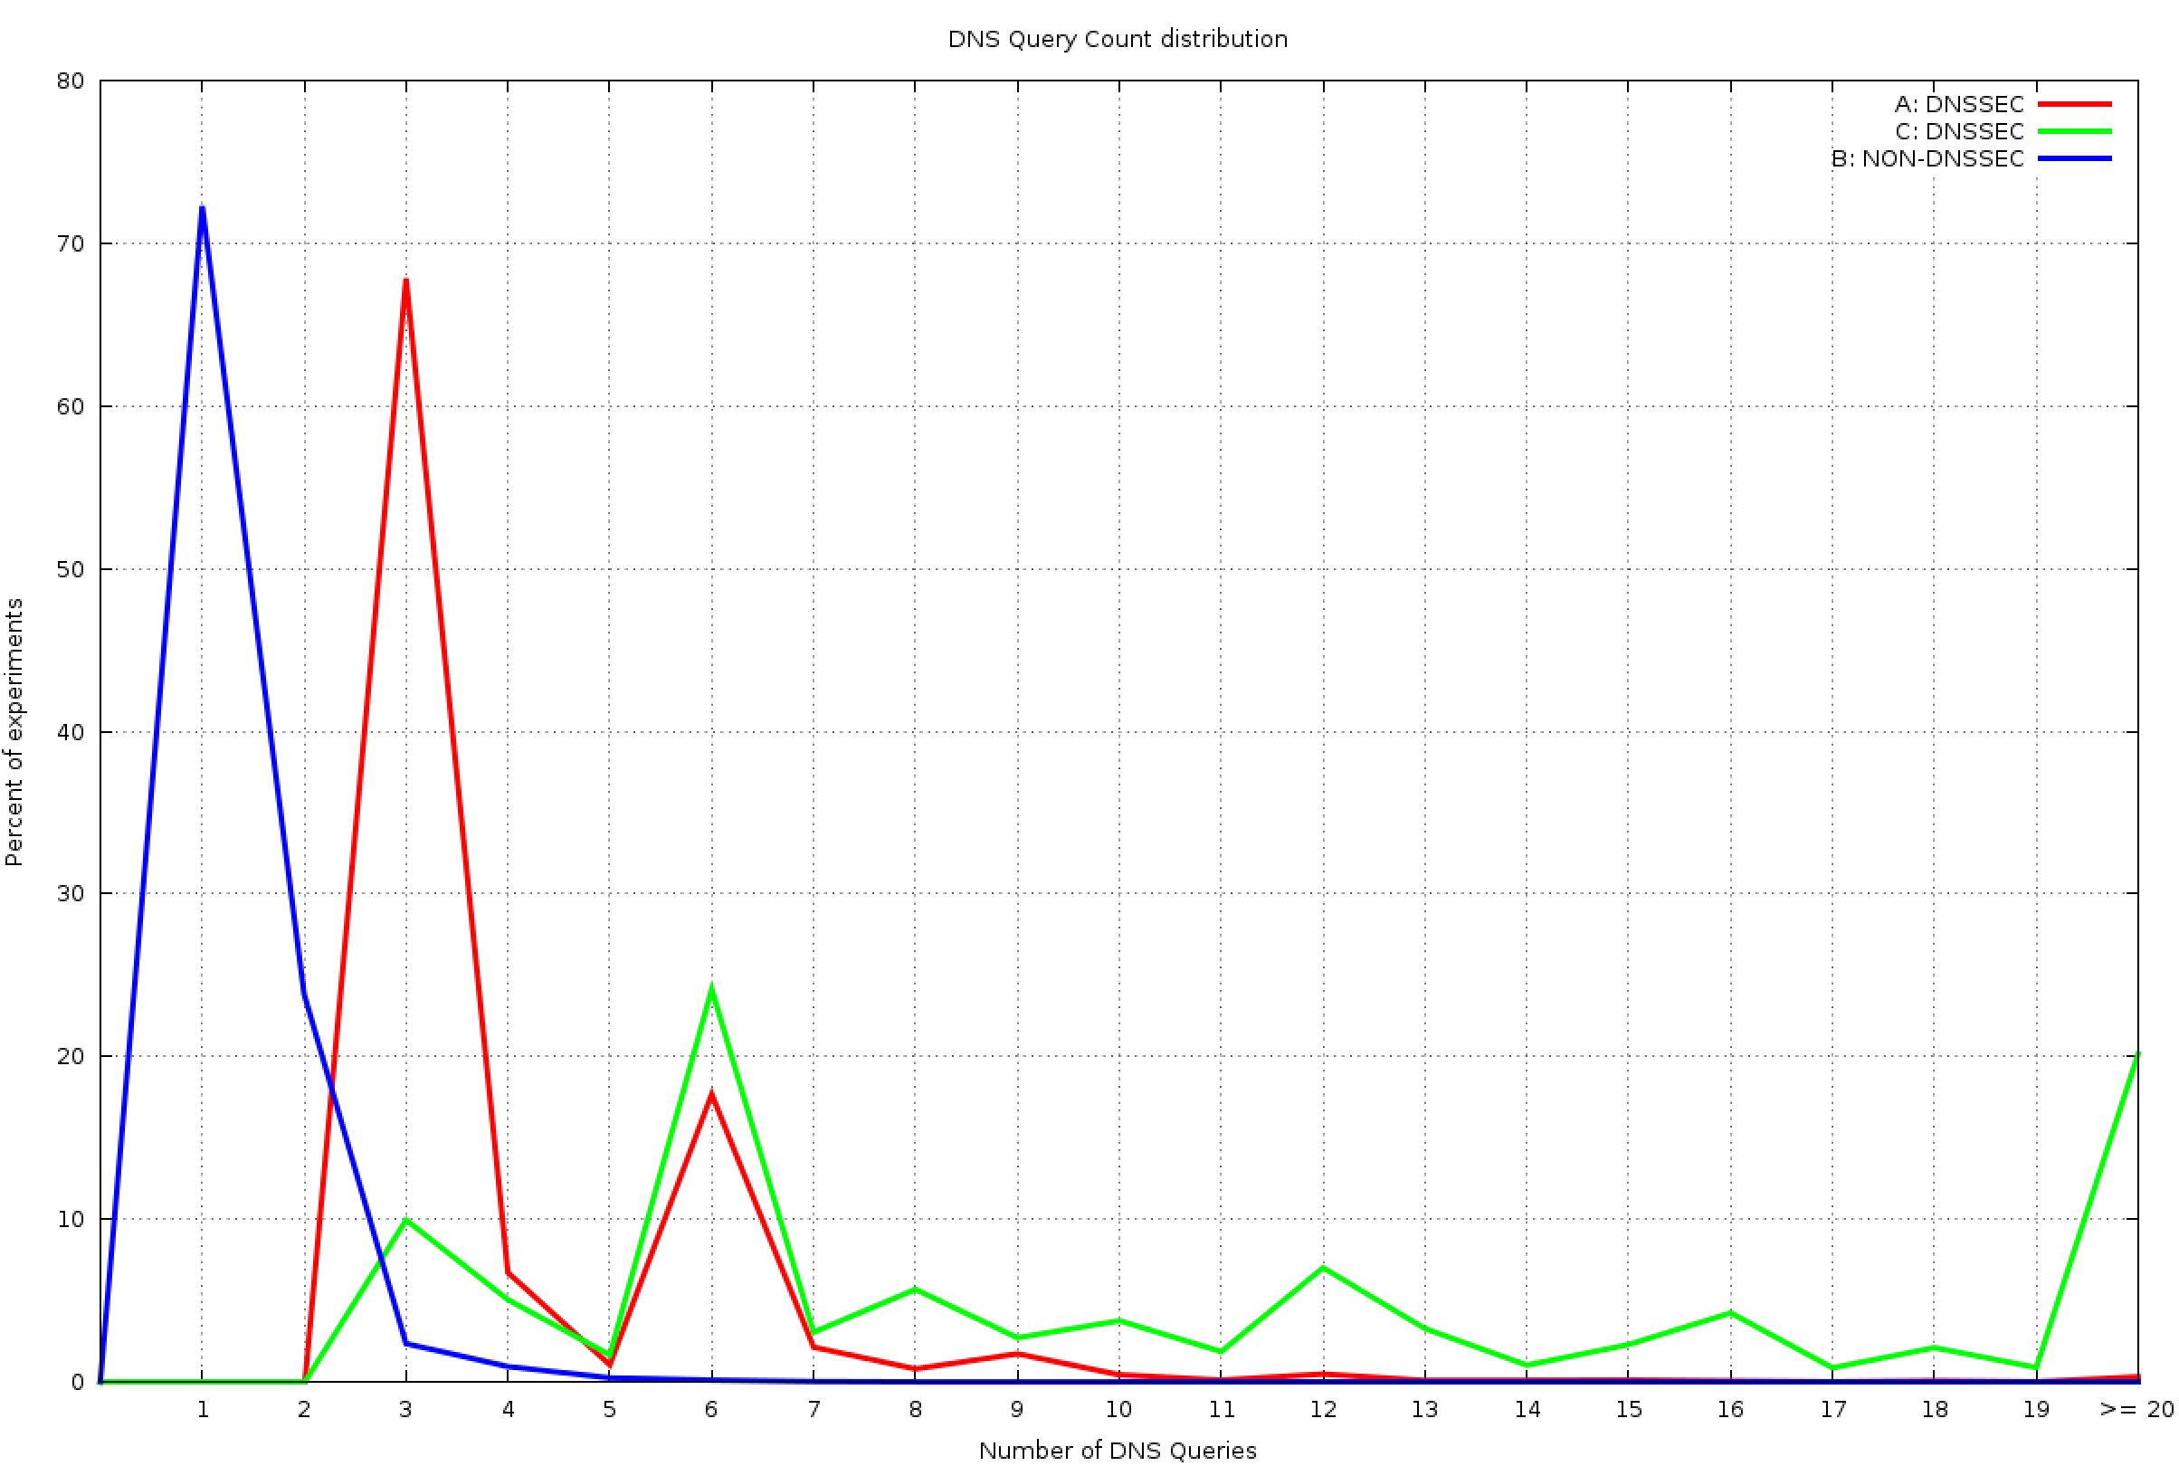
DNS Query count per Domain Name
No DNSSEC (control)
DNSSEC signed
DNSSEC signed – badly!

Slide 24
DNSSEC Performance
At the Authoritative Name Server:
Serving DNSSEC-signed zones = More Queries!
  The Authoritative server will now see additional queries for the DNSKEY and DS RRs for a zone, in addition to the A (and AAAA) queries
  2,637,091 launched experiments
    4,222,352 unsigned name queries
    7,394,794 signed name queries
    12,213,677 badly-signed name queries

Slide 25
What if everybody was doing it?
For the control name there are 1.6 queries per experiment
The total profile of queries for the control DNS name was:
    3.4M A queries
    0.4M AAAA queries
    0.4M Other (NS, MX, ANY, SOA, CNAME, TXT, A6) queries
For the signed name, only 12.6% of clients use DNSSEC-aware resolvers, so the theory (2 additional queries per name) says we will see 4.8M queries
But we saw 7.4M queries for the signed DNS Name
  If 12.6% of clients’ resolvers using DNSSEC generate an additional 3.1M queries for a signed domain name, what if every DNS resolver was DNSSEC aware?
  That would be 25M queries in the context of our experiment
A DNSSEC signed zone would see 6 times the query level of an unsigned zone if every resolver performed DNSSEC validation

Slide 26
Good vs Bad for Everyone
If 12.6% of clients performing some form of DNSSEC validation generate 12.2M queries for a badly-signed name, compared to the no-DNSSEC control level of 4.2M queries, what would be the query load if every resolver performed DNSSEC validation for the same badly signed domain?
  In our case that would be 63M queries
A badly-signed DNSSEC signed zone would see 15 times the query level of an unsigned zone if every resolver performed DNSSEC validation

Slide 27
Response Sizes
What about the relative traffic loads at the server?
In particular, what are the relative changes in the traffic profile for responses from the Authoritative Server?

Slide 28
DNS Response Sizes
Control (no DNSSEC)
Query: 124 octets
Response: 176 octets
DNSSEC-Signed
Query: (A Record) 124 octets
Response: 951 Octets
Query: (DNSKEY Record) 80 octets
Response: 342 Octets
Query: (DS Record) 80 octets
Response: 341 Octets
Total: Query: 284 octets
Total Response: 1634 octets
These are not constant sizes – the DNS packet sizes of responses relate to the particular name being resolver, the number of keys being used, and the key size
So these numbers are illustrative of what is going on, but particular cases will vary from these numbers

Slide 29
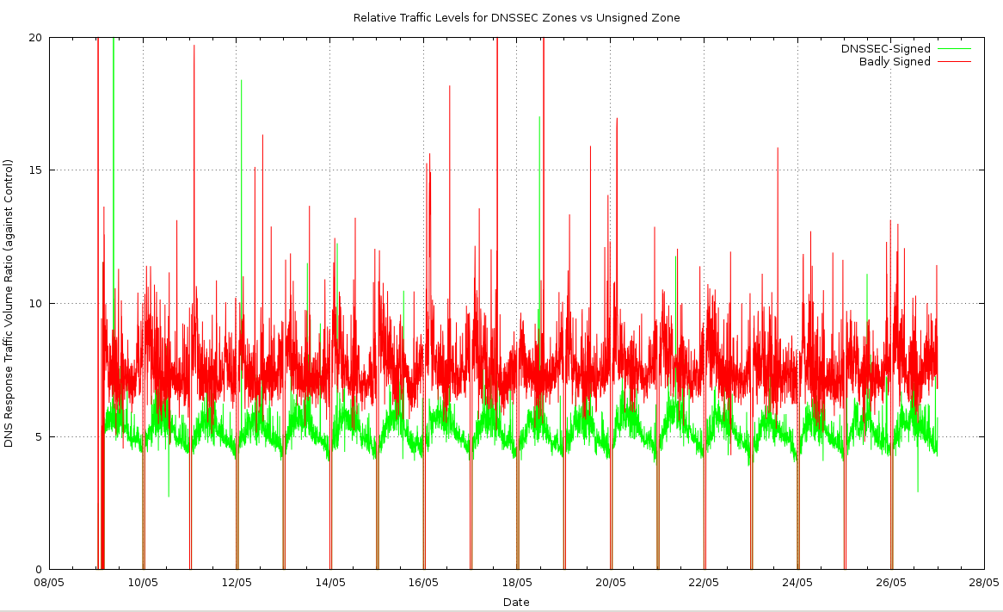
Measurement – Response Traffic Volume

Slide 30
Interpreting Traffic Data
The validly-signed domain name appears to generate 5x the traffic volume in responses as compared to the unsigned domain name
The badly-signed domain name appears to generate 7.5x the traffic volume in responses
What’s contributing to this?
  Setting the DNSSEC OK bit in a query to the signed zone raises the response size from 176 to 951 octets (80% of clients do this)
  Performing DNSSEC signature validation adds a minimum of a further 683 octets in DS and DNSKEY responses (12% of clients do this)

Slide 31
What if everybody was doing it?
If 12.6% of clients performing some form of DNSSEC validation for a signed zone generate around 5 times the traffic as compared to an unsigned zone, then what if every resolver performed DNSSEC validation?
An authoritative server for a DNSSEC signed zone would’ve seen 13 times the traffic level of an unsigned zone if every resolver performed DNSSEC validation
A badly-signed DNSSEC zone would seen 31 times the traffic level of an unsigned zone

Slide 32
DNSSEC means more Server capacity needed
Its probably a good idea to plan the serve the worst case: a badly signed zone
In which case you may want to consider provisioning the authoritative name servers with processing capacity to handle 15x the query load, and 30x the generated traffic load that you would need to serve an unsigned zone

Slide 33
It could be a lot better…
“Real” performance of DNSSEC could be a lot better than what we have observed here
We have deliberately negated any form of resolver caching
  Every client receives a “unique” signed URL, and therefore every DNS resolver has to to perform A, DS and DNSKEY fetches for the unique label
  The Ad placement technique constantly searches for “fresh eyeballs”, so caching is not as efficient as it could be
  Conventional DNS caching would dramatically change this picture
    Our 16 day experiment generated 12,748,834 queries
    A 7 day TTL would cut this to a (roughly estimated) 2M queries

Slide 34
And it could be (far) worse…
For the invalid DNSSEC case we deliberately limited the impact of invalidity on the server
  DNSSEC invalidity is not handled consistently by resolvers
  Some resolvers will perform an exhaustive check of all possible NS validation paths in the event of DNSSEC validation failure
  In this experiment we used a single NS record for the invalidly signed domains
  If we had chosen to use multiple nameservers, or used a deeper-signed label path, or both, on the invalid label, then the query load would’ve been (a lot?) higher
Resolver caching of invalidly signed data is also unclear – so a break in the DNSSEC validation material may also change the caching behaviour of resolvers, and increase load at the server

Slide 35
Something to think about
DNSSEC generates very large responses from very small queries
  Which makes it a highly effective DDOS amplifier
  Is relying on BCP38 going to work?
  Do we need to think about DNS over TCP again?
  How many resolvers/firewalls/other middleware stuff support using TCP for DNS?
  What’s the impact on the authoritative server load and caching recursive resolver load when moving from UDP to TCP?

Slide 36
Thanks!
Questions?

