Slide 1
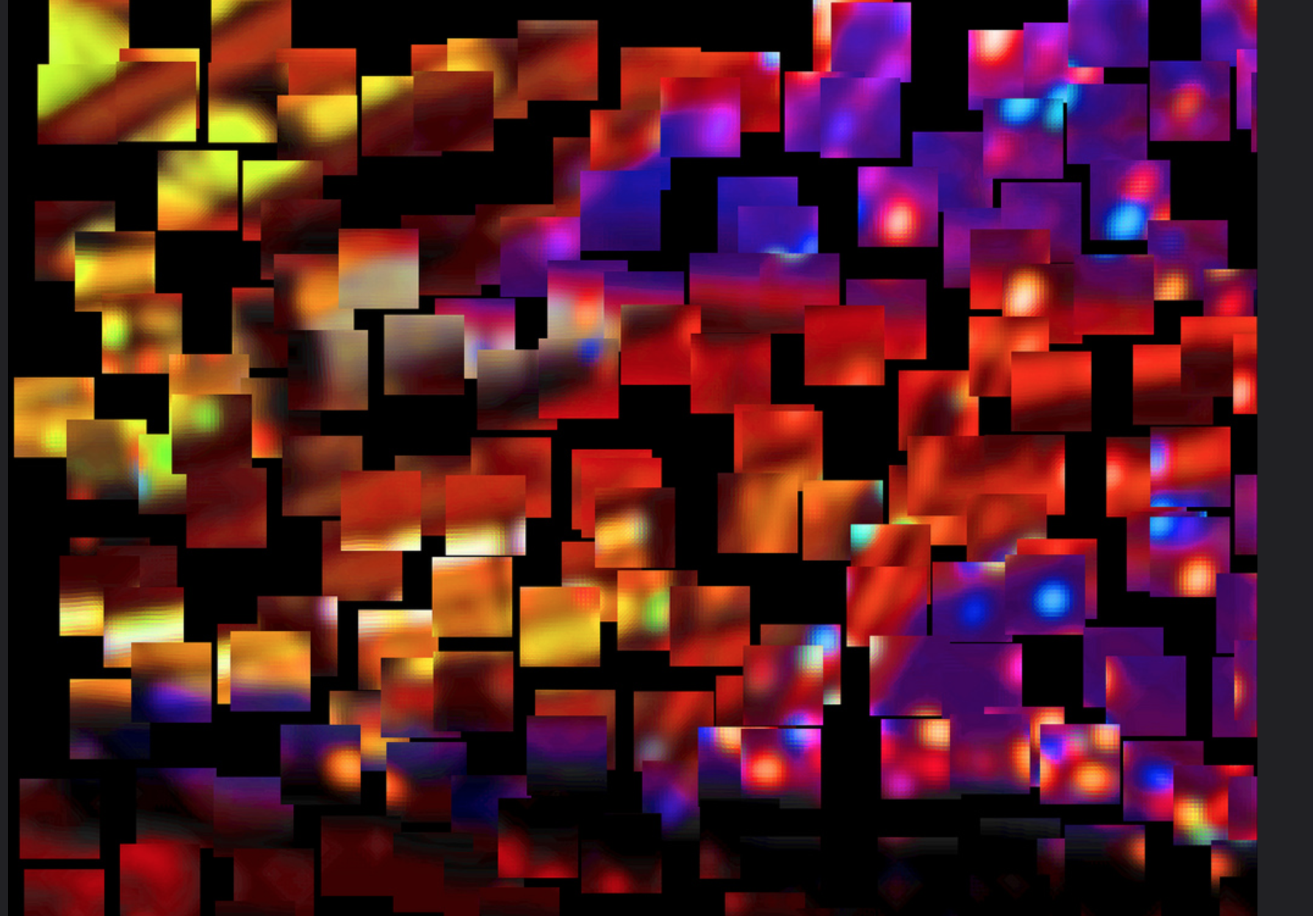
Fragmentation Considered Harmful?
Geoff Huston
APNIC

Slide 2
… “considered harmful”

Slide 3
What’s “Fragmentation” anyway?
Some time ago we used to refer to this as “Network Balkanisation”
It was a term used when talking about “alternate DNS roots” and other forms of of customised DNS name systems
These days I guess that “Network Fragmentation” is the politically correct term
And it can refer to a broad range of diversity, in name resolution, packet routing, security realms, application behaviour, character sets, and similar possibilities for differential outcomes
Although it still retains a flavour of enforcing geo-political boundaries and elimination cross-border dependencies

Slide 4
Its possible that the overt US control of the root zone of the DNS lies behind much of these reported Russian concerns – if .ru was arbitrarily removed from the DNS root zone then many communications within Russia, and external communications to and from Russia would be disrupted.
Could the Russians “isolate” Russia from the Internet? Probably. Syria, Egypt, and others have done so in the recent past. If you cut the wires then most communications just stop.
Could the Russians force continuity of connectivity in the face of external efforts to isolate Russia? What if .ru was expunged from the DNS? Could this be circumvented? The answer to that hypothetical question is far harder. “Probably not” is about the best answer today.

Slide 5
Why?
Why does the Internet have such a critical level of interdependence?
And why is this dependence asymmetric?
Is it even possible to conceive of an Internet as a loose coalition of national assets bound by selective bilateral arrangements and a loose regulatory binding structure managed through an international treaty structure?
Could we build an Internet as a collection of national fragments? Or are there some fundamental components in the Internet’s architecture that make this inconceivable?

Slide 6
The “Original” Internet Model
Network transactions are intentionally consistent:
https://www.mypage.com pulls down precisely the same content, no matter who requests the URL
We all use the same DNS data base
We all use the same resource object semantics
We all use the same protocols
We all use the same security framework
We all are connected to a common network

Slide 7
How was this consistency supported?
One DNS root hierarchy, and one name family
The unsuccessful “experiments” in alternate root zone files in the late 90’s were perhaps one of the earliest forms of network fragmentation
They reinforced the criticality of the single root zone as the glue of the Internet
End-to-end application behaviour
The absence of a requirement for active middleware allowed each client to directly interact with the intended server. As long as the server was consistent, then every client was handled consistently and the network played no active role.

Slide 8
So, is this the case today?
Is the Internet still “consistent”?

Slide 9
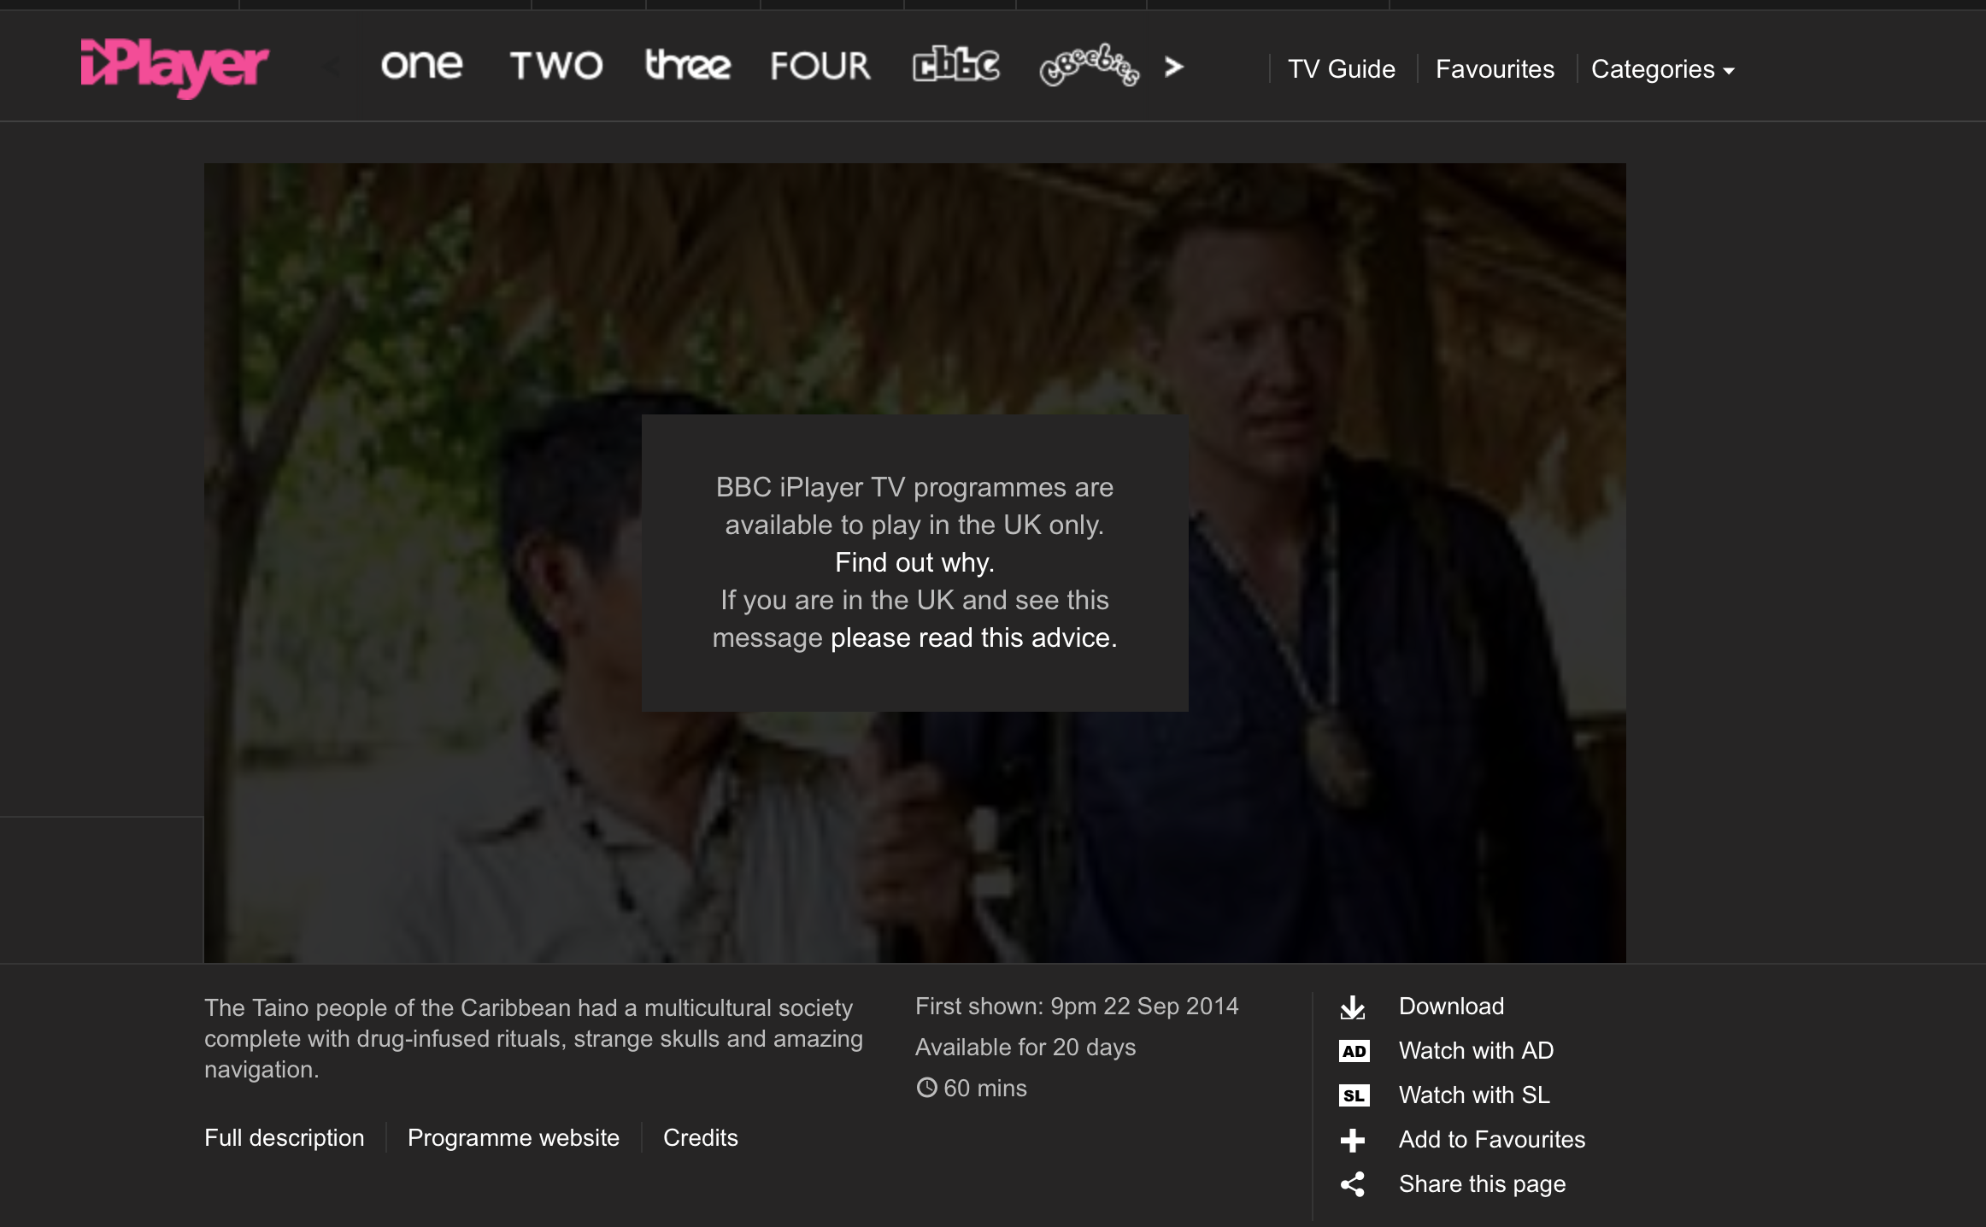
Geo-Located Content serving
Outside the UK
The assumed location of the end client (by source IP address) determines what content is passed back to the user
Inside the UK

Slide 10
Content De-Fragmentation
Sometimes the remedies for network fragmentation are regulatory, sometimes through voluntary adoption of common codes of operational practice and common technology standards, and sometimes remedies lie in the deliberate actions of users to circumvent the imposed fragmentation
“Every action has an equal and opposite reaction”

Slide 11
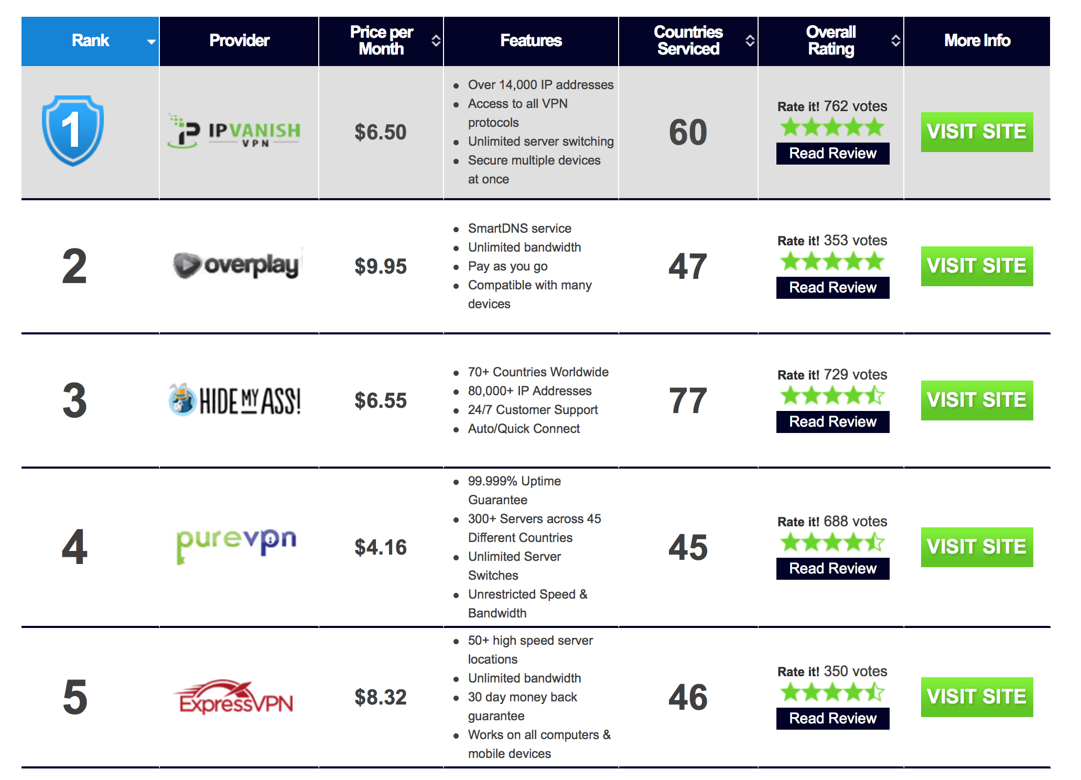
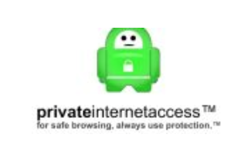
The Rise of the Retail VPN Provider
The VPN approach can be seen as a response to imposed content fragmentation, where the user’s assumed identity is translated to one
That can access the content
These VPNs conceal both the payload to the network, but also conceals the parties to a communication from the network and potentially from each other.
This is a case of the law of
unintended outcomes in action,
where encrypted tunnels have
passed over from limited
commercial use into popular
retail products. This has its own
Consequences not only for dis-intermediation in content
distribution, but for LEA and
national security functions

Slide 12
So, is this the case today?
Is the Internet still “consistent”?

Slide 13
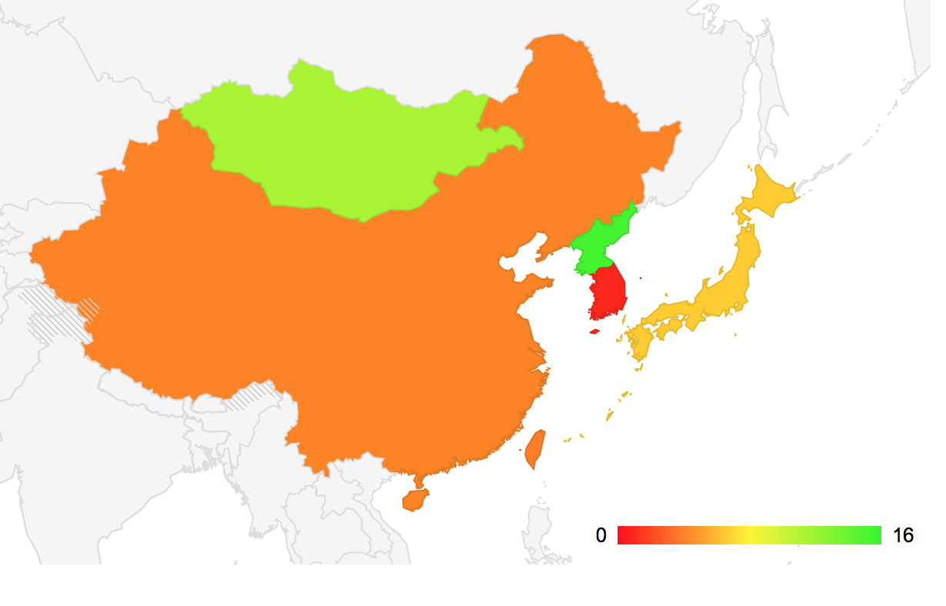
China, late 2013

Slide 14
Outside China Inside China
$ dig www.facebook.com
69.171.229.25
$ dig AAAA www.facebook.com
2a03:2880:10:6f08:face:b00c:0:1
$ dig www.facebook.com
1.1.1.1
$ dig AAAA www.facebook.com
2001:da8:112::21ae

Slide 15
Outside China Inside China
$ dig www.facebook.com
69.171.229.25
$ dig AAAA www.facebook.com
2a03:2880:10:6f08:face:b00c:0:1
$ dig www.facebook.com
1.1.1.1
$ dig AAAA www.facebook.com
2001:da8:112::21ae
In this case the DNS providing different answers depending on where
I was. Inside China I often received the address 1.1.1.1 in response
to my DNS query for the name “www.facebook.com”
When I used a VPN to jump outside of China, I received the “real” DNS answers

Slide 16
Outside Inside
NetRange: 69.171.224.0 - 69.171.255.255
CIDR: 69.171.224.0/19
OriginAS: AS32934
NetName: TFBNET3
NetHandle: NET-69-171-224-0-1
Parent: NET-69-0-0-0-0
NetType: Direct Assignment
RegDate: 2010-08-05
Updated: 2012-02-24
Ref: http://whois.arin.net/rest/net/NET-69-171-224-0-1
OrgName: Facebook, Inc.
OrgId: THEFA-3
Address: 1601 Willow Rd.
City: Menlo Park
StateProv: CA
PostalCode: 94025
Country: US
RegDate: 2004-08-11
Updated: 2012-04-17
Ref: http://whois.arin.net/rest/org/THEFA-3
OrgTechHandle: OPERA82-ARIN
OrgTechName: Operations
OrgTechPhone: +1-650-543-4800
OrgTechEmail: noc@fb.com
OrgTechRef: http://whois.arin.net/rest/poc/OPERA82-ARIN
OrgAbuseHandle: OPERA82-ARIN
OrgAbuseName: Operations
OrgAbusePhone: +1-650-543-4800
OrgAbuseEmail: noc@fb.com
OrgAbuseRef: http://whois.arin.net/rest/poc/OPERA82-ARIN
#
# ARIN WHOIS data and services are subject to the Terms of Use
# available at: https://www.arin.net/whois_tou.html
#
inetnum: 1.1.1.0 - 1.1.1.255
netname: Debogon-prefix
descr: APNIC Debogon Project
descr: APNIC Pty Ltd
country: AU
admin-c: AR302-AP
tech-c: AR302-AP
mnt-by: APNIC-HM
mnt-routes: MAINT-AU-APNIC-GM85-AP
mnt-irt: IRT-APNICRANDNET-AU
status: ASSIGNED PORTABLE
changed: hm-changed@apnic.net 20110922
source: APNIC
irt: IRT-APNICRANDNET-AU
address: PO Box 3646
address: South Brisbane, QLD 4101
address: Australia
e-mail: abuse@apnic.net
abuse-mailbox: abuse@apnic.net
admin-c: AR302-AP
tech-c: AR302-AP
mnt-by: MAINT-AU-APNIC-GM85-AP
changed: hm-changed@apnic.net 20110922
source: APNIC
role: APNIC RESEARCH

Slide 17
Outside Inside
NetRange: 69.171.224.0 - 69.171.255.255
CIDR: 69.171.224.0/19
OriginAS: AS32934
NetName: TFBNET3
NetHandle: NET-69-171-224-0-1
Parent: NET-69-0-0-0-0
NetType: Direct Assignment
RegDate: 2010-08-05
Updated: 2012-02-24
Ref: http://whois.arin.net/rest/net/NET-69-171-224-0-1
OrgName: Facebook, Inc.
OrgId: THEFA-3
Address: 1601 Willow Rd.
City: Menlo Park
StateProv: CA
PostalCode: 94025
Country: US
RegDate: 2004-08-11
Updated: 2012-04-17
Ref: http://whois.arin.net/rest/org/THEFA-3
OrgTechHandle: OPERA82-ARIN
OrgTechName: Operations
OrgTechPhone: +1-650-543-4800
OrgTechEmail: noc@fb.com
OrgTechRef: http://whois.arin.net/rest/poc/OPERA82-ARIN
OrgAbuseHandle: OPERA82-ARIN
OrgAbuseName: Operations
OrgAbusePhone: +1-650-543-4800
OrgAbuseEmail: noc@fb.com
OrgAbuseRef: http://whois.arin.net/rest/poc/OPERA82-ARIN
#
# ARIN WHOIS data and services are subject to the Terms of Use
# available at: https://www.arin.net/whois_tou.html
#
inetnum: 1.1.1.0 - 1.1.1.255
netname: Debogon-prefix
descr: APNIC Debogon Project
descr: APNIC Pty Ltd
country: AU
admin-c: AR302-AP
tech-c: AR302-AP
mnt-by: APNIC-HM
mnt-routes: MAINT-AU-APNIC-GM85-AP
mnt-irt: IRT-APNICRANDNET-AU
status: ASSIGNED PORTABLE
changed: hm-changed@apnic.net 20110922
source: APNIC
irt: IRT-APNICRANDNET-AU
address: PO Box 3646
address: South Brisbane, QLD 4101
address: Australia
e-mail: abuse@apnic.net
abuse-mailbox: abuse@apnic.net
admin-c: AR302-AP
tech-c: AR302-AP
mnt-by: MAINT-AU-APNIC-GM85-AP
changed: hm-changed@apnic.net 20110922
source: APNIC
role: APNIC RESEARCH
Facebook, INC
Not Facebook!

Slide 18
Outside Inside
So let’s focus on that inside address: 1.1.1.1
Is this the “real thing” or just a local route to some local black hole?
Let’s resume the Inside/Outside examination, but focus just on the address 1.1.1.1

Slide 19
Outside Inside
$ traceroute 1.1.1.1
traceroute to 1.1.1.1 (1.1.1.1), 64 hops max, 52 byte packets
1 202.158.221.221 (202.158.221.221) 0.266 ms 0.202 ms 0.194 ms
2 ge-4-0-0.bb1.b.cbr.aarnet.net.au (202.158.208.81) 0.491 ms 0.438 ms 0.424 ms
3 so-0-1-0.bb1.b.mel.aarnet.net.au (202.158.194.42) 8.001 ms 8.000 ms 7.992 ms
4 xe-0-0-0.pe1.a.mel.aarnet.net.au (202.158.200.12) 8.110 ms 8.088 ms 8.078 ms
5 gw1.xe-0-0-2.pe1.a.mel.aarnet.net.au (202.158.210.41) 12.165 ms 12.193 ms 12.159 ms
6 66.249.95.232 (66.249.95.232) 12.823 ms 13.254 ms
66.249.95.234 (66.249.95.234) 20.282 ms
7 209.85.249.52 (209.85.249.52) 134.637 ms 109.393 ms 109.426 ms
8 64.233.175.3 (64.233.175.3) 128.052 ms 113.782 ms
64.233.175.1 (64.233.175.1) 113.192 ms
9 209.85.255.34 (209.85.255.34) 114.562 ms
209.85.255.36 (209.85.255.36) 118.550 ms 133.640 ms
10 64.233.174.178 (64.233.174.178) 211.021 ms 211.275 ms 211.694 ms
11 72.14.239.82 (72.14.239.82) 263.661 ms 287.038 ms 264.518 ms
12 216.239.48.41 (216.239.48.41) 269.732 ms
72.14.239.65 (72.14.239.65) 270.545 ms
216.239.48.41 (216.239.48.41) 270.244 ms
13 72.14.235.11 (72.14.235.11) 279.278 ms 277.787 ms
66.249.95.230 (66.249.95.230) 277.315 ms
14 72.14.236.99 (72.14.236.99) 415.698 ms
72.14.236.147 (72.14.236.147) 278.543 ms
72.14.236.99 (72.14.236.99) 412.531 ms
15 209.85.252.47 (209.85.252.47) 256.836 ms
209.85.252.81 (209.85.252.81) 253.370 ms
209.85.252.47 (209.85.252.47) 254.984 ms
16 65.210.126.78 (65.210.126.78) 255.713 ms 253.913 ms 253.865 ms
$ traceroute 1.1.1.1
traceroute to 1.1.1.1 (1.1.1.1), 64 hops max, 52 byte packets
1 254 (220.247.145.254) 6.620 ms 1.774 ms 2.561 ms
2 * * *
3 192.168.9.5 (192.168.9.5) 6.718 ms 3.322 ms 5.324 ms
4 159.226.253.189 (159.226.253.189) 25.557 ms 26.145 ms 27.191 ms
5 8.130 (159.226.253.57) 26.059 ms 27.225 ms 25.889 ms
6 8.198 (159.226.253.50) 27.060 ms 29.788 ms 29.476 ms
7 8.192 (159.226.254.254) 64.767 ms 66.801 ms 66.768 ms
8 72.14.221.138 (72.14.221.138) 100.753 ms 105.117 ms 99.613 ms
9 209.85.241.56 (209.85.241.56) 101.914 ms
209.85.241.58 (209.85.241.58) 105.561 ms 101.748 ms
10 66.249.94.31 (66.249.94.31) 175.902 ms
66.249.94.123 (66.249.94.123) 149.653 ms
66.249.94.31 (66.249.94.31) 149.498 ms
11 64.233.175.3 (64.233.175.3) 150.364 ms
64.233.175.1 (64.233.175.1) 150.610 ms 147.552 ms
12 209.85.255.36 (209.85.255.36) 163.323 ms *
209.85.255.58 (209.85.255.58) 154.349 ms
13 64.233.174.178 (64.233.174.178) 353.593 ms 286.374 ms 312.122 ms
14 72.14.239.80 (72.14.239.80) 245.300 ms
72.14.239.82 (72.14.239.82) 325.655 ms 284.123 ms
15 216.239.48.41 (216.239.48.41) 279.139 ms 274.913 ms 276.807 ms
16 66.249.95.230 (66.249.95.230) 274.683 ms 274.613 ms
66.249.95.228 (66.249.95.228) 273.204 ms
17 72.14.236.147 (72.14.236.147) 313.601 ms
72.14.236.149 (72.14.236.149) 261.617 ms 305.524 ms
18 209.85.252.47 (209.85.252.47) 306.003 ms
209.85.252.81 (209.85.252.81) 276.541 ms 363.910 ms
19 65.210.126.78 (65.210.126.78) 398.681 ms 361.306 ms 366.265 ms
Hang on… BOTH inside and outside ROUTE the packets addressed to 1.1.1.1 to
the same endpoint: 65.210.126.78
What we are seeing here is that the content blocking system is focused on the name component, rather than on attempting to block the traffic flow

Slide 20
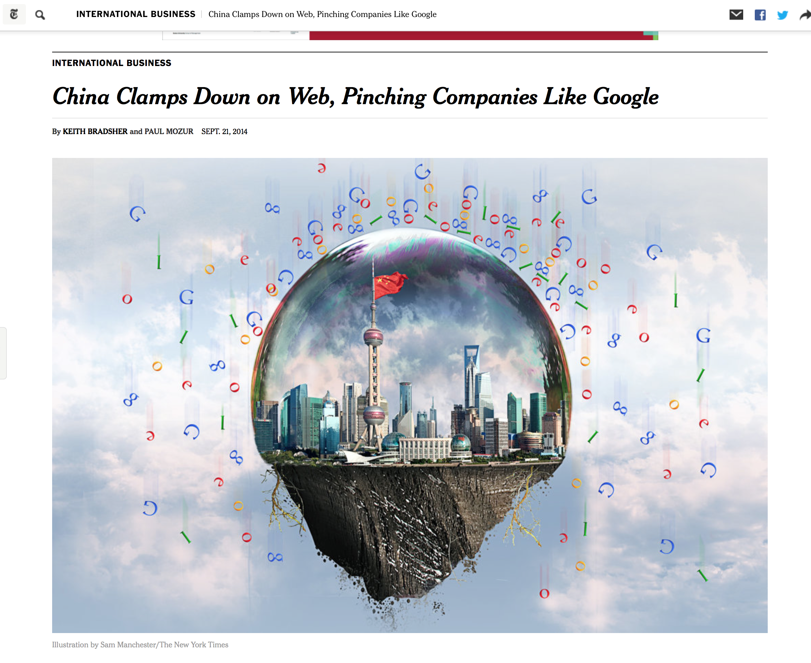
Within China this form of DNS filtering is commonplace

Slide 21
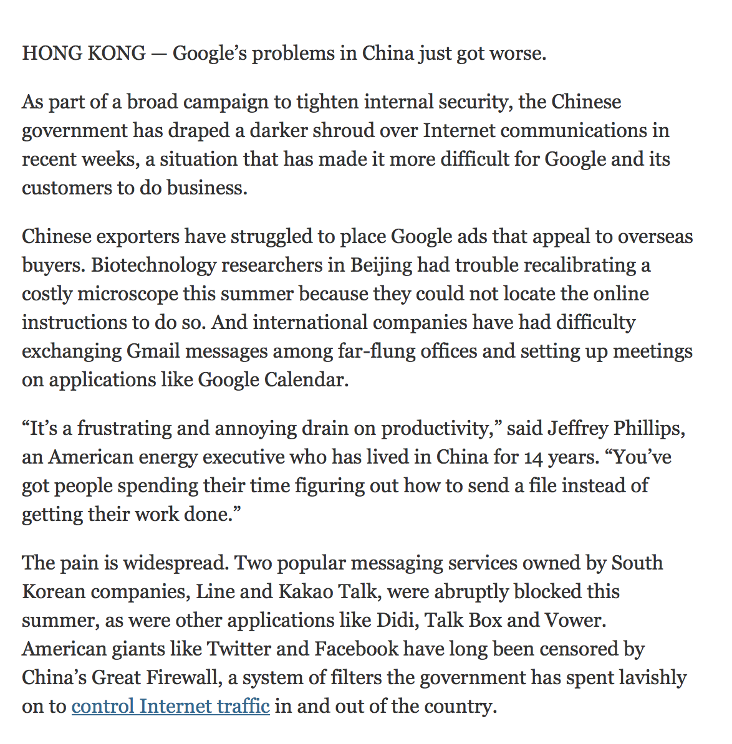
Within China this form of DNS filtering is commonplace

Slide 22
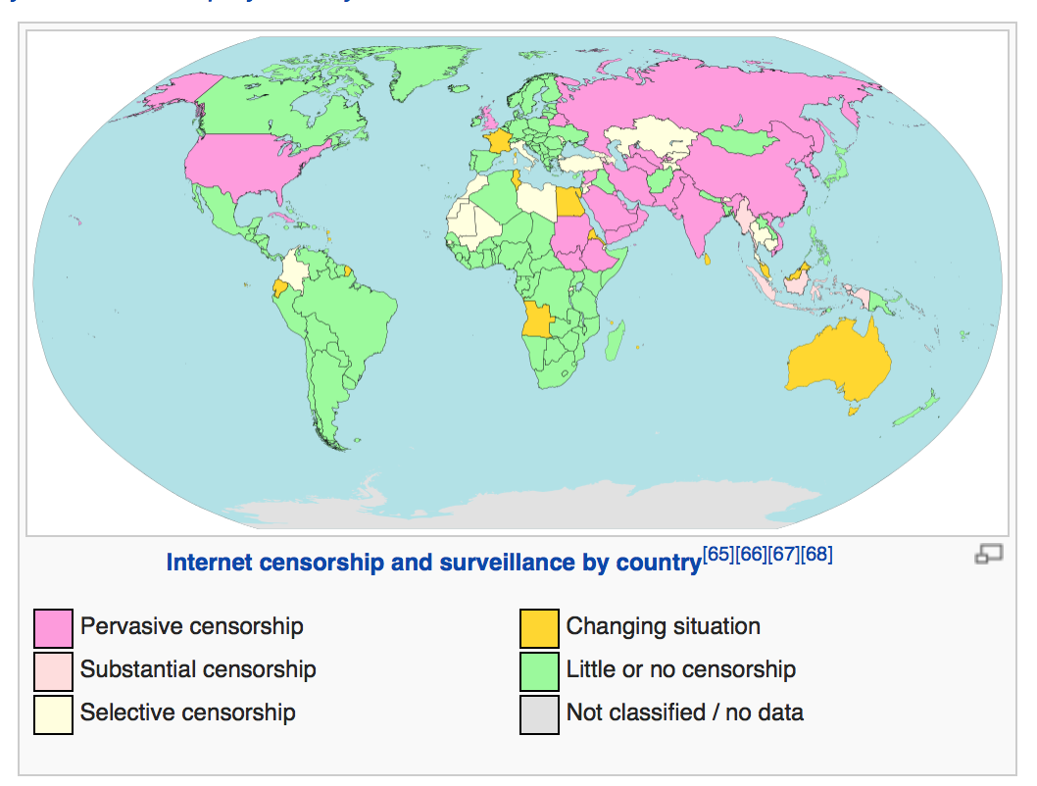
But it’s not just China
http://en.wikipedia.org/wiki/Internet_censorship

Slide 23
Selective DNS “fragmentation” is widespread
The DNS is easy to intercept
Its easy to intercede and synthesize false answers to incoming DNS queries
It’s often easier to intercept the DNS than it is to intercept traffic on the wire
End user applications are too credulous
They will believe anything the DNS appears to tell them!

Slide 24
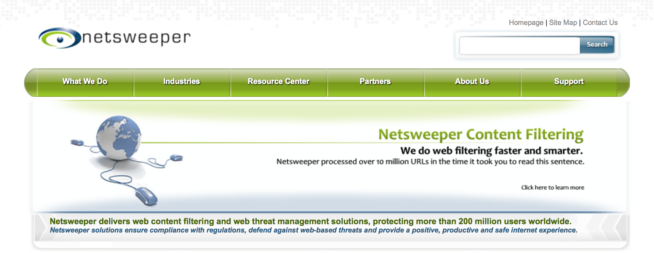
The business of content filtering through DNS manipulation
“Among the most popular filtering software programs is SmartFilter by Secure Computing in California, which was bought by McAfee in 2008. SmartFilter has been used by Tunisia, Saudi Arabia, Sudan, the UAE, Kuwait, Bahrain, Iran, and Oman, as well as the United States and the UK. Myanmar and Yemen have used filtering software from Websense. The Canadian-made commercial filter Netsweeper is used in Qatar, the UAE, and Yemen.”
http://en.wikipedia.org/wiki/Internet_censorship

Slide 25
So this is “bad” – right?
“bad” in the sense that it doesn’t really pose a barrier that can’t be solved by any user equipped with a decent search engine and a few minutes to install a workaround, so its “bad” in the sense that it’s a relatively meaningless imposition of an inefficiency within the network

Slide 26
So this is “bad” – right?
Well, not always.
What if your business is all about speed?

Slide 28
The workings of a CDN
The DNS provides a different answer depending on where the CDN thinks that the user is located
In other words different users will get different DNS responses from the same query
Is this “fragmentation”?
Well, yes. Different users see different DNS outcomes
Is this aiding users and content publishers?
Yes! Bringing content closer to users aids significantly in network efficiency

Slide 29
The workings of a CDN-DNS

Slide 30
So this is “good” – right?
Well, not always.
Because lying in the DNS is still a lie. And accepting lies introduces a new set of security vulnerabilities

Slide 31
User A User B
$ dig +short www.mybank.example.com
203.10.60.10
$ dig +short www.mybank.example.com
23.10.60.10
Which one is genuine?

Slide 32
Telling Good from Bad
What we use today to disambiguate “good” from “bad” when we see such variance is domain name certificates
The conventional response is that user can weed out “bad” DNS responses in a secure (TLS) context by validating the offered key
Essentially an “out of band” way of saying that a certain named service is secured with a crypto key value which is only known to the domain name holder
And if the name is NOT used in a TLS context?
You lose! You can’t tell which is the genuine response.

Slide 33
Security to the rescue?
Will our current name security tools allow users to identify attempts to misdirect the user through synthetic name responses?
Is this distributed system of trust adequately secure?

Slide 35
Enough said?

Slide 36
No?

Slide 37
Multiple hacker tools on the servers
Online Certification Authority
Server Compromise
Specialized PKI scripts
Incomplete audit trails
Fake certificate issued for *.google.com
Iran users of gmail are compromised by a mitm attack
Fake certificate private key published

Slide 38
Fake certificate issued for *.google.com
Fake certificate private key published
=
+
Any attacker-in-the-middle can intercept a connection request for mail.google.com, and initiate a “secure” connection using the fake certificate, and
your browser would be fooled into believing that this was the genuine server!

Slide 39
Two problems:
1. I may not have landed up where I wanted to be:
DNS cache poisoning
DNS resolver compromise
Local host compromise
Routing compromise
2. The domain name certificate may be fake
The combination of the two implies that I, and the browser I use, may not even notice that we have been mislead. This is bad.

Slide 40
This is broken economics!
Domain Name certification should use trust and integrity of operation as a differentiator
If you pay more money you would expect to use a service that operates with greater levels of care and data protection of your data and users of your service would be “more secure” – right?
But a compromised CA can issue a domain name certificate for ANY domain name
If you trust this compromised CA then you are going to trust its products
The entire Domain Name CA operation is only as good as the worst CA!
It does not matter what CA service you use, because any compromised CA can compromise users of your service

Slide 41
So what can we do about it?

Slide 42
User A User B
$ dig +dnssec www.mybank.example.com
203.10.60.10
$ dig +dnssec www.mybank.example.com
SERVFAIL
One possible response to inconsistency in DNS responses is to place digital
signatures into the DNS – by using DNSSEC
Synthetic DNS responses can be rejected because of the lack of a valid digital signature path

Slide 43
So DNSSEC helps here?
Yes
If we are looking for ways we can identify if the name space is being tampered with by third parties, then DNSSEC can help in identifying when the DNS response is synthetic
But
It does not help with the other purpose of a domain Name Certificate, namely to convey a public key to be used as part of a TLS (secure transport) session
For that we also need “DANE”

Slide 44
DANE
DNS-Based Authentication of Named Entities
How to represent and authenticate “named entities” in the DNS, using DNSSEC
Web Sites
Email addresses
Jabber IDs

Slide 45
Valid CERTs and/or CAs are stored in the the DNS
If DANE provides the CA’s identity, then DANE offers the protection that you are looking at a valid Certificate issued by the CA that performed the EV validation checks in the first place
CA compromise then has limited liability to those certificates issued by the compromised CA
i.e. your service is compromised only if your chosen CA is compromised!

Slide 46
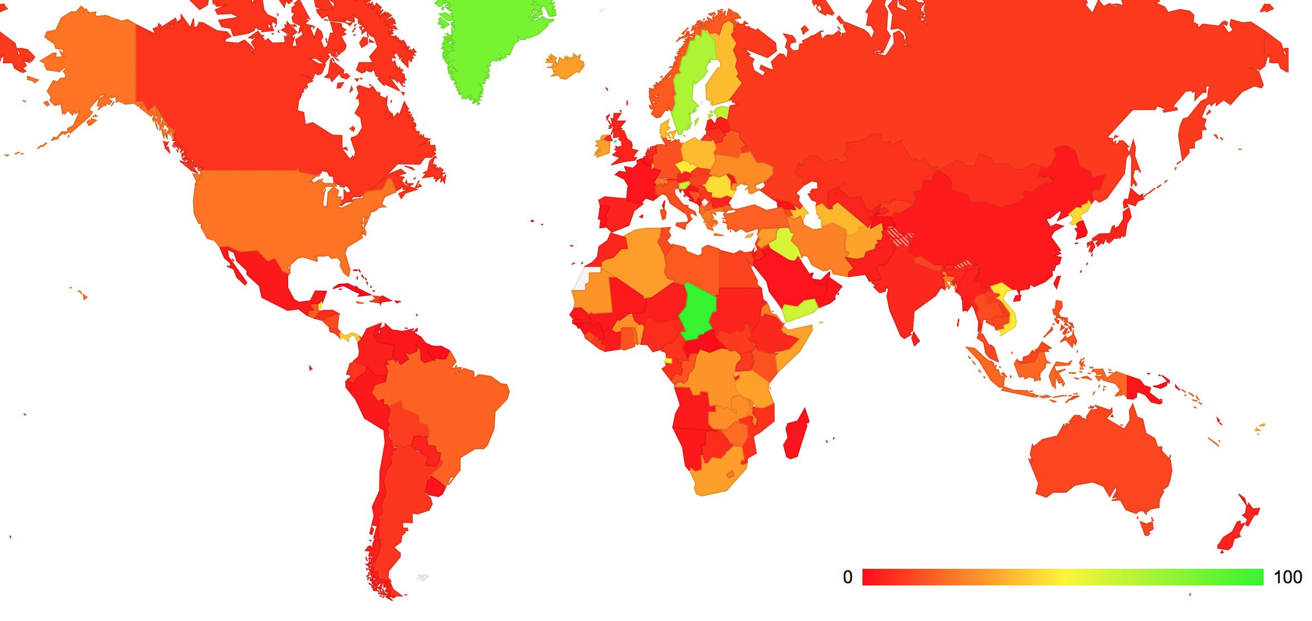
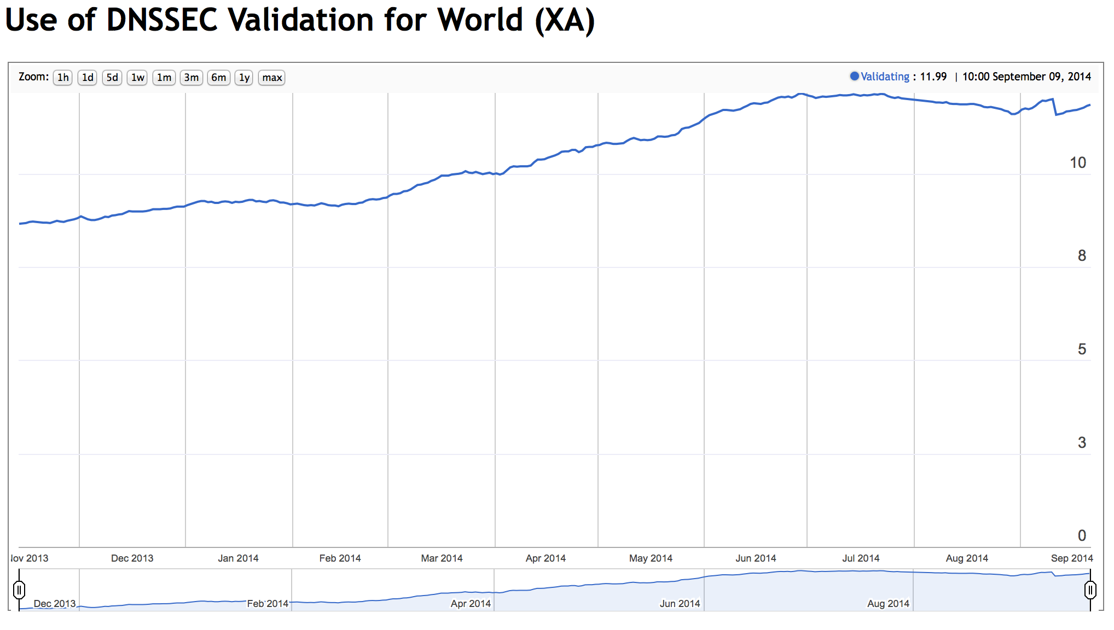
How are we going with DNSSEC?..
High levels of DNSSEC
Use seen in Africa,
Eastern and Northern
Europe
11% of users send their DNS queries to DNSSEC-validating resolvers

Slide 47
What needs to happen?
The local name management infrastructure should support the use of DNSSEC in all aspects of name management
ISPs should add DNSSEC validation to their forwarding resolvers
We should be measuring and reporting on the level of support for DNSSEC validating in both DNS resolvers and DNS names

Slide 48
Name “Fragmentation”
When a DNS name is resolved into different results it becomes a challenge to distinguish between what’s genuine and what’s a malicious fake
Adding more trust points to the mix makes the issue worse, not better
One approach is to use a hierarchical security framework to create an interlocking chain of dependency - DNSSEC
On the upside it locks out third party attempts to synthesize fake responses at the edge – the DNS lie cannot be prevented, but it can be exposed
On the downside it makes the apex of the name system even more critical, and imposes a common crypto model across the entire Internet

Slide 49
What about Addresses?
If we see continuing pressure for fragmentation and differential behaviours in the Internet’s name space, then why don’t we see the same fragmentation pressures in the address system?

Slide 50
Addresses are already losing coherence!
In some ways we’ve already lost that struggle for coherence in addresses – most of the client side of the Internet is addressed behind NATs, and increasing numbers of services are shared on a common platform. Individual IP addresses no longer have a strong association with individual network endpoints.
Addresses these days are just ephemeral conversation tokens without longer term significance
(Aside: Given that we’ve pushed the Internet into this space where addresses are just ephemeral transaction tokens and the name is the critical point, then will we ever roll back this step with IPv6?)

Slide 51
Where is this heading?
Are we heading back to the fragmented environment of the 1980s, which a set of islands of networks bridged by arbitrary application level gateways?
I don’t believe so – most of the talk of fragmentation remains in the realm of political sabre rattling, and the efforts to restrict, block and redirect end up creating and sustaining novel markets for services that counter such measures, such as retail VPN services, for example

Slide 52
Where is this heading?
Or is this a more subtle form of fragmentation that operates at the level of discrimination of content delivery system
By leveraging differential responses in the DNS, there is now a specialised market for replicated data delivery services:
Akamai, Limelight, Cloudflare, Amazon, Netflix, Google, Apple, Microsoft, DYN, …

Slide 53
Where is this heading?
Is “Fragmentation” an expression of frustration with the current framework of control of critical infrastructure for the Internet?
Rather than fragmentation, are we witnessing a much grander and far more widespread form of aggregation within the Internet space?

Slide 54
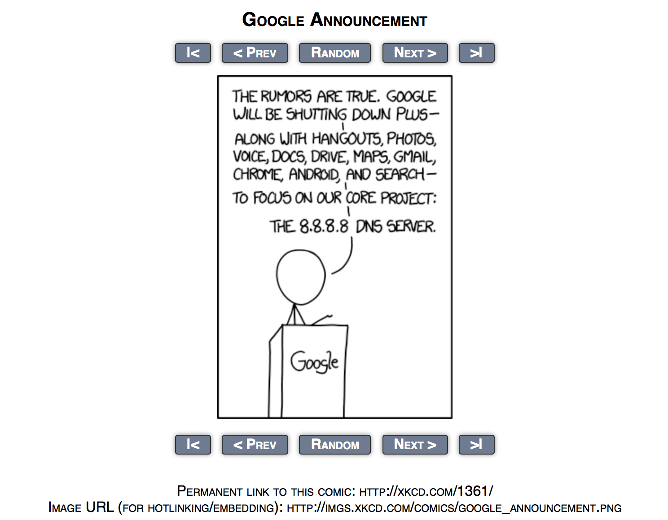

Slide 55
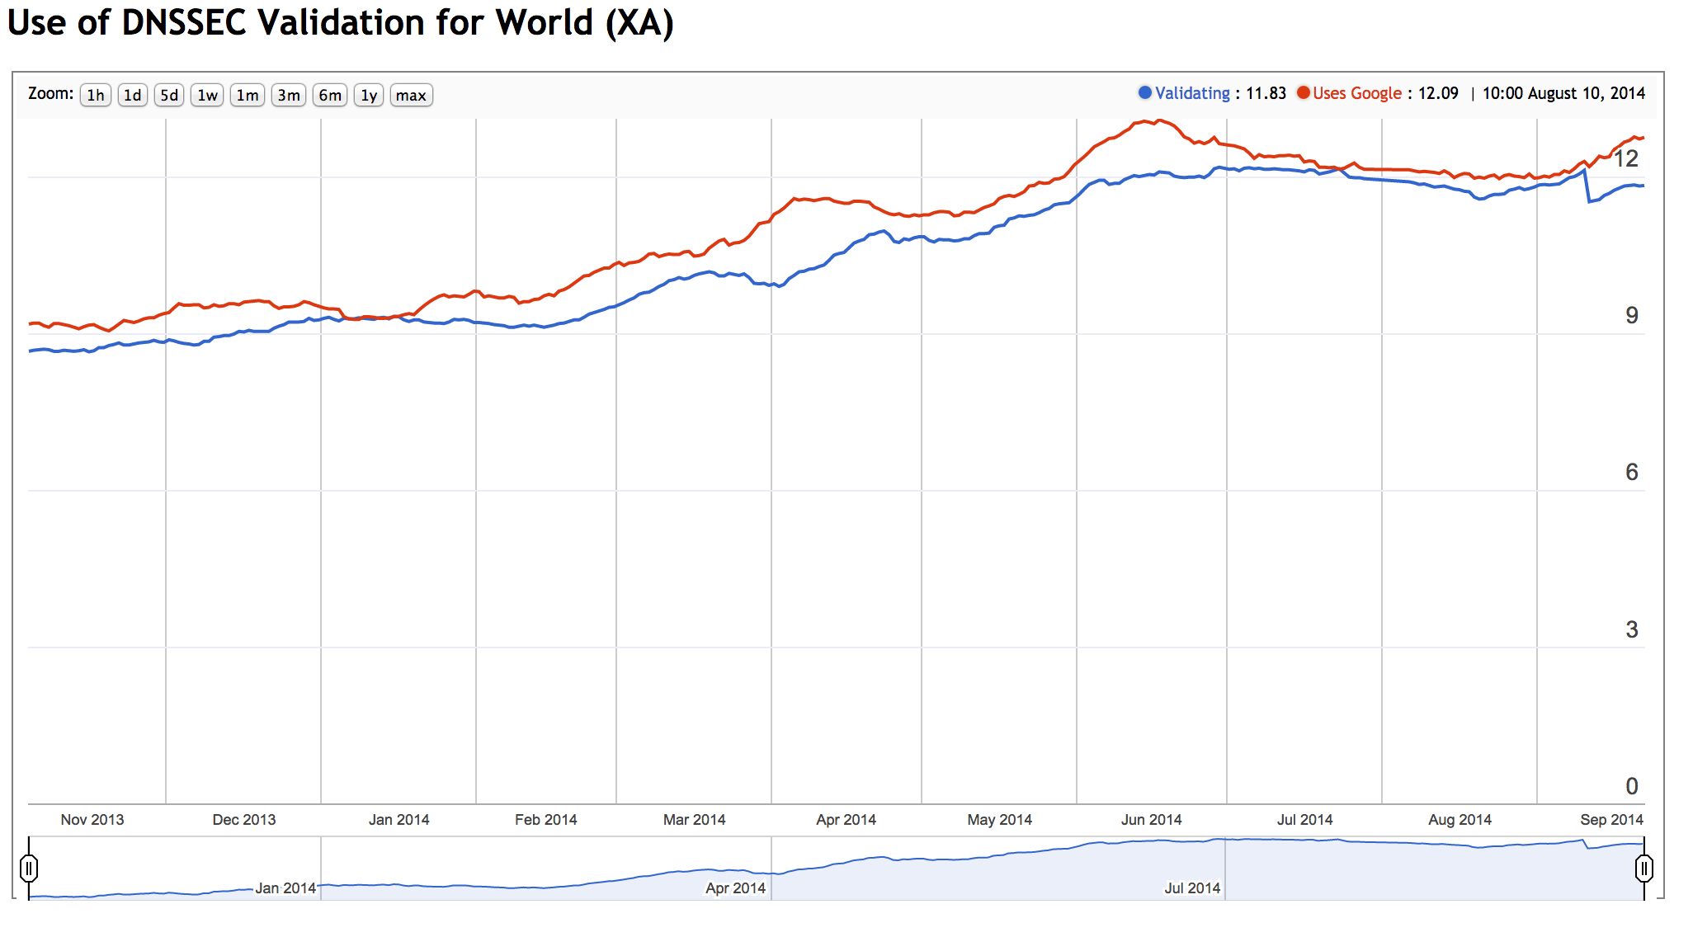
Internet-wide Market Share for Google’s Public DNS Service
1 in every 8 users of the Internet send
all their DNS queries to Google

Slide 56
That’s it!

