Slide 1
Large (UDP) Packets in IPv6
Geoff Huston
APNIC

Slide 2
What’s the problem?

Slide 3
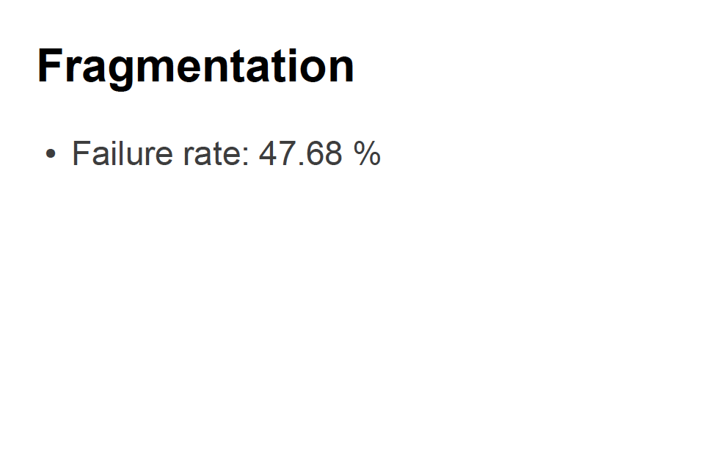
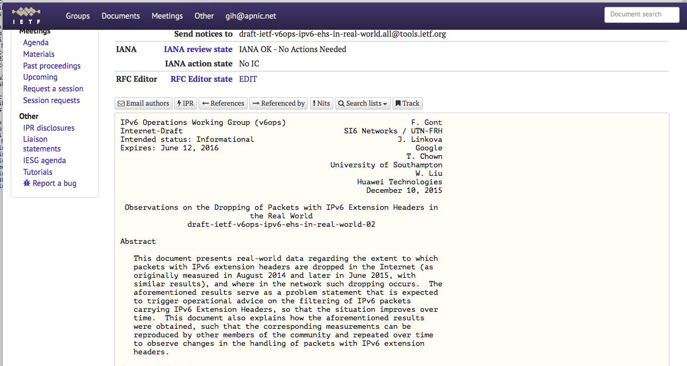
What’s the problem?
IEPG presentation – November 2013

Slide 4
So what?

Slide 5
Packet Networks like variable packet sizes
The range of packet sizes supported in a network represents a set of engineering trade-offs:
Bit error rate of the underlying media
Desired carriage efficiency
Transmission speed vs packet switching speed

Slide 6
IPv4 Packet Design
FORWARD fragmentation
If a router cannot forward a packet on its next hop due to a packet size mismatch then it is permitted to fragment the packet, preserving the original IP header in each of the fragments

Slide 7
IPv4 and the “Don’t Fragment” bit
If Fragmentation is not permitted by the source, then the router discards the packet. The router may send an ICMP to the packet source with an Unreacahble code (Type 3, Code 4)
Later IPv4 implementations added a MTU size to this ICMP message
BUT: ICMP messages are extensively filtered in the Internet so applications should not count on receiving these messages!

Slide 8
Trouble at the Packet Mill
Lost frags require a resend of the entire packet – this is far less efficient than repairing a lost packet
Fragments represent a security vulnerability as they are easily spoofed
Fragments represent a problem to firewalls – without the transport headers it is unclear whether frags should be admitted or denied
Packet reassembly consumes resources at the destination

Slide 9
The thinking at the time…
Fragmentation was a Bad Idea!
Kent, C. and J. Mogul, "Fragmentation Considered Harmful", Proc. SIGCOMM '87 Workshop on Frontiers in Computer Communications Technology, August 1987

Slide 10
IPv6 Packet Design
Attempt to repair the problem by effectively jamming the DON’T FRAGMENT bit to always ON
IPv6 uses BACKWARD signalling
When a packet is too big for the next hop a router should send an ICMP6 TYPE 2 (Packet Too Big) message to the source address and include the MTU of the next hop.

Slide 11
IPv6 Source Fragmentation

Slide 12
What changed? What’s the same?
Both protocols may fragment a packet at the source
Both protocols support a Packet Too Big signal from the interior of the network to the source
Only IPv4 routers may generate fragments on-the-fly
IPv6 relies on support for Extension Headers to support its implementation of IP packet fragmentation
But that has its own set of implications (See slide 3)!

Slide 13
What does “Packet Too Big” mean anyway?
errrrr

Slide 14
It’s a Layering Problem
Fragmentation was seen as an IP level problem
It was meant to be agnostic with respect to the upper level (transport) protocol
But we don’t treat it like that
And we expect different transport protocols to react to fragmentation notification in different ways

Slide 15
What does “Packet Too Big” mean anyway?
For TCP it means that the active session referred to in the ICMP payload* should drop its session MSS to match the MTU **
In an ideal network you should never see IPv6 fragments in TCP!
* assuming that the payload contains the original end-to-end IP header
** assuming that the ICMP is genuine

Slide 16
What does “Packet Too Big” mean anyway?
For UDP its not clear:
The offending packet has gone away!
Some IP implementations appear to ignore it
Others add a host entry to the local IP Forwarding table that records the MTU
Others perform a rudimentary form of MTU reduction in a local MTU cache

Slide 17
Problems
ICMP is readily spoofed
ICMP messages can consume host resources
An attacker may spoof a high volume stream of ICMP PTB messages with random IPv6 source addresses
An attacker may spoof ICMP PTB messages with very low MTU values

Slide 18
Problems
ICMP is widely filtered
leading to black holes in TCP sessions
GET is a small HTTP packet
The response can be arbitrarily large, and if there is a path MTU mismatch the response can wedge
Get
Response

Slide 19
Problems
Leading to ambiguity in UDP
Is this lack of a response due to network congestion, routing & addressing issues, or MTU mismatch?
Should the receiver just give up, resend the trigger query, or revert to TCP? (assuming that it can)

Slide 20
What did IPv6 do differently?
IPv6 defined a minimum unfragmented packet size of 1,280 bytes:
IPv6 Specification: RFC2460

Slide 21
What did IPv6 do differently?
IPv6 defined a minimum unfragmented packet size of 1,280 bytes:
I’ve been told that 1280 is 1024 + 256!
Which seems like a pretty specious line of reasoning to me!
It represented a compromise about non-reassembling tunneling and has resulted in a fractured IPv6 network.
1500 would’ve been a more robust outcome in my view.
IPv6 Specification: RFC2460

Slide 22
Bewteen 1280 and 1500
What should an IPv6 host use as a local MTU value?
If you set it at 1280 then you invite fragmentation if you need to send larger packets, which will risk EH loss on fragmented packets
If you set it at 1500 then you may encounter risks with MTU mismatch and PTB notification loss when talking with a host with a smaller MTU and encounter MTU Black Holes
1280
1500

Slide 23
Lets look
So if the issue is the combination of IPv6, UDP and larger packets then perhaps we can experiment with this
It’s called “the DNS” !
So we set up an experiment…
Response 1 : 131 octets
Response 2: 1400 octets
Response 3: 1700 octets
And set up a name server reachable only on IPv6 and only on UDP

Slide 24
What we expect to see
Size Fetched Failed Reason
Small (150 octets) 99% 1% Noise
1160 octets 99% 1% Noise
1400 octets ? ? PTB
1700 octets <52% >48% EH Loss,
Frag loss,
PTB

Slide 25
What we saw
Tested Always Fetched Both Always Missed
150 11,719 8,792 (75.02%) 377 (3.22%) 2,550 (21.76%)
1,160 2,004 1,353 (67.51%) 5 (0.25%) 646 (32.24%)
1,400 9,789 7,374 (75.33%) 385 (3.93%) 2,030 (20.74%)
1,425 1,977 1,313 (66.41%) 7 (0.35%) 657 (33.23%)
1,453 1,987 1,298 (65.32%) 9 (0.45%) 680 (34.22%)
1,700 11,170 5,859 (52.45%) 172 (1.54%) 5,139 (46.01%)
1280
1500

Slide 26
What we saw
Tested Always Fetched Both Always Missed
150 11,719 8,792 (75.02%) 377 (3.22%) 2,550 (21.76%)
1,160 2,004 1,353 (67.51%) 5 (0.25%) 646 (32.24%)
1,400 9,789 7,374 (75.33%) 385 (3.93%) 2,030 (20.74%)
1,425 1,977 1,313 (66.41%) 7 (0.35%) 657 (33.23%)
1,453 1,987 1,298 (65.32%) 9 (0.45%) 680 (34.22%)
1,700 11,170 5,859 (52.45%) 172 (1.54%) 5,139 (46.01%)
??
1280
1500
There is quite some noise in this data – the small-size response shows a 21%
loss rate, which is likely to be due to a combination of:
DNS multi-slave query engine farms
IPv6 Link Layer address manipulation
ICMPv6 Address unreachable
DNS timeouts

Slide 27
Unreachables
Dual Stack configurations hide a multitude of sins
And one of these is the use of unreachable IPv6 addresses for DNS resolvers
11,077 distinct unreachable IPv6 addresses !
Out of 22,000 distinct IPv6 /128 addresses
Which is not quite as bad as it looks – a number of resolvers are “aggressive” in their use of /64 interface identifiers

Slide 28
Filtering the results
Join individual resolver /128 addresses into common /64’s
Only look at resolver /64’s that fetch either of the two low-size controls
Which means that the IPv6 address is reachable
And the resolver will successfully resolve a glueless delegation

Slide 29
What we saw:
Size Tested Always Fetched Both Always Missed
150 5,433 5,290 (97%) 143 (3%) 0
1,160 654 651 (99%) 3 (1%) 0
1400 4,658 4,495 (96%) 133 (3%) 30 (1%)
1425 636 619 (97%) 5 (1%) 12 (2%)
1453 638 609 (95%) 6 (1%) 23 (4%)
1700 4,686 3,464 (74%) 79 (1%) 1,143 (25%)
1280
1500

Slide 30
What we saw:
Size Tested Always Fetched Both Always Missed
150 5,433 5,290 (97%) 143 (3%) 0
1,160 654 651 (99%) 3 (1%) 0
1400 4,658 4,495 (96%) 133 (3%) 30 (1%)
1425 636 619 (97%) 5 (1%) 12 (2%)
1453 638 609 (95%) 6 (1%) 23 (4%)
1700 4,686 3,464 (74%) 79 (1%) 1,143 (25%)
1280
1500
Between 1280 and 1500 the failure rate rises as the packet size rises.

Slide 31
PTB MTU size distribution
1500
1480
1492
1460
1280

Slide 32
What we saw:
Size Tested Always Fetched Both Always Missed
150 5,433 5,290 (97%) 143 (3%) 0
1,160 654 651 (99%) 3 (1%) 0
1400 4,658 4,495 (96%) 133 (3%) 30 (1%)
1425 636 619 (97%) 5 (1%) 12 (2%)
1453 638 609 (95%) 6 (1%) 23 (4%)
1700 4,686 3,464 (74%) 79 (1%) 1,143 (25%)
1280
1500
There is a visible signal here for packets > 1500 octets.
It is not a 48% drop rate, but it is certainly more than 20% over and above the other packet sizes. There is a definite problem here with large IPv6 packets.

Slide 33
EH drop? Or something more mundane?
1,143 IPv6 /64s consistently cannot fetch a 1,700 octet UDP response
331 /64’s generated ICMP Fragmentation reassembly ICMP messages
Firewall front end discarding trailing fragments
61 /64’s generated Packet Too Big messages
751 failing /64’s generated no ICMP messages
i.e. EH packet drop was a maximum of 16% in this experiment

Slide 34
What we saw with a 1280 MTU:
Size Tested Always Fetched Both Always Missed
150 4,777 4,600 (96%) 177 (4%) 0
1400 4,662 3,695 (79%) 80 (2%) 887 (19%)
1700 4,635 3,429 (74%) 95 (2%) 1,111 (24%)
1280
1500
Dropping the local MTU pushes a further 18% fragmentation drop into the 1,400 Byte packet

Slide 35
What are we seeing?
Whether its EH drop of frag filtering, there is something deeply concerning in these numbers:
A protocol that suffers a ~20% packet drop rate on fragmented packets presents a problem!
Hosts should use the largest locally supported MTU for UDP (and use a 1,220 MSS for TCP)
Applications should assume that large IPv6 fragmented packets may silently die in transit. They should be prepared to perform a rapid cutover to TCP in the event of suspected packet loss in UDP
Should we revive draft-bonica-6man-frag-deprecate?

Slide 36
Thanks!

