Slide 1
More Specific Announcements in BGP
Geoff Huston
APNIC

Slide 2
What’s a more specific?
A prefix advertisement that refines a “covering” advertisement
10.0.0.0/8
10.1.0.0/16

Slide 3
Why advertise a more specific?
I: To redirect packets to a different network: “hole punching prefixes”
10.0.0.0/8
AS 65530
Different Origin AS
10.1.0.0/16 AS 138000

Slide 4
Example: Type I
Network Path
>* 72.249.184.0/21 4777 2497 3356 36024
>* 72.249.184.0/24 4777 2497 2914 40824 394094

Slide 5
Why advertise a more specific?
II: To redirect incoming traffic to different network paths: “traffic engineering prefixes”
10.0.0.0/8
AS 65530
10.128.0.0/9 AS 65530
10.0.0.0/9 AS 65530
Same Origin AS, different AS Path
AS 65536
AS 65537

Slide 6
Example: Type II
Network Path
*> 1.37.0.0/16 4608 1221 4637 4775 i
*> 1.37.27.0/24 4608 1221 4637 4837 4775 i
*> 1.37.237.0/24 4608 1221 4637 4837 4775 i

Slide 7
Why advertise a more specific?
III: To mitigate more specific prefix hijacking: “more specific overlays”
10.0.0.0/22 AS 65530
10.0.0.0/24 AS 65530
Same Origin AS, same AS Path
10.0.1.0/24 AS 65530
10.0.2.0/24 AS 65530
10.0.3.0/24 AS 65530

Slide 8
Example: Type III
Network Path
*> 1.0.4.0/22 4608 4826 38803 56203 i
*> 1.0.4.0/24 4608 4826 38803 56203 i
*> 1.0.5.0/24 4608 4826 38803 56203 i
*> 1.0.6.0/24 4608 4826 38803 56203 i
*> 1.0.7.0/24 4608 4826 38803 56203 i

Slide 9
How many eBGP route advertisements are more specifics?
AS 131072 – 13 October 2017
Routes Advertised Address Span
BGP Routes: 685,895 2.86B /32s
More Specifics: 365,022 (53%) 1.04B /32s (36%)

Slide 10
How many eBGP route advertisements are more specifics?
AS 131072 – 13 October 2017
Routes Advertised Address Span
BGP Routes: 685,895 2.86B /32s
More Specifics: 365,022 (53%) 1.04B /32s (36%)
Over one half of the BGP routing table does not announce reachability to “new” destinations, but attempts to refine the way in which existing destinations can be reached

Slide 11
Has this changed over time?
IPv4

Slide 12
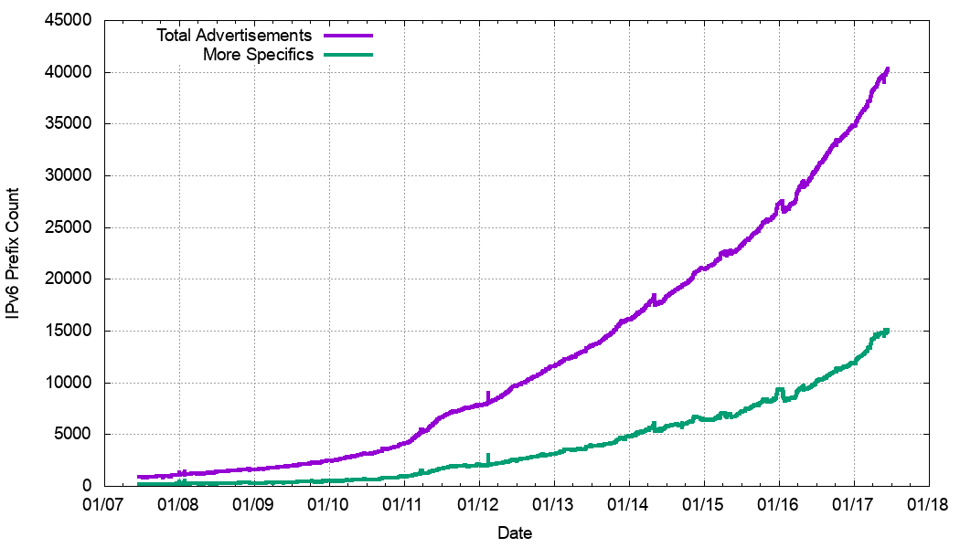
Has this changed over time?
IPv4
IPv6

Slide 13
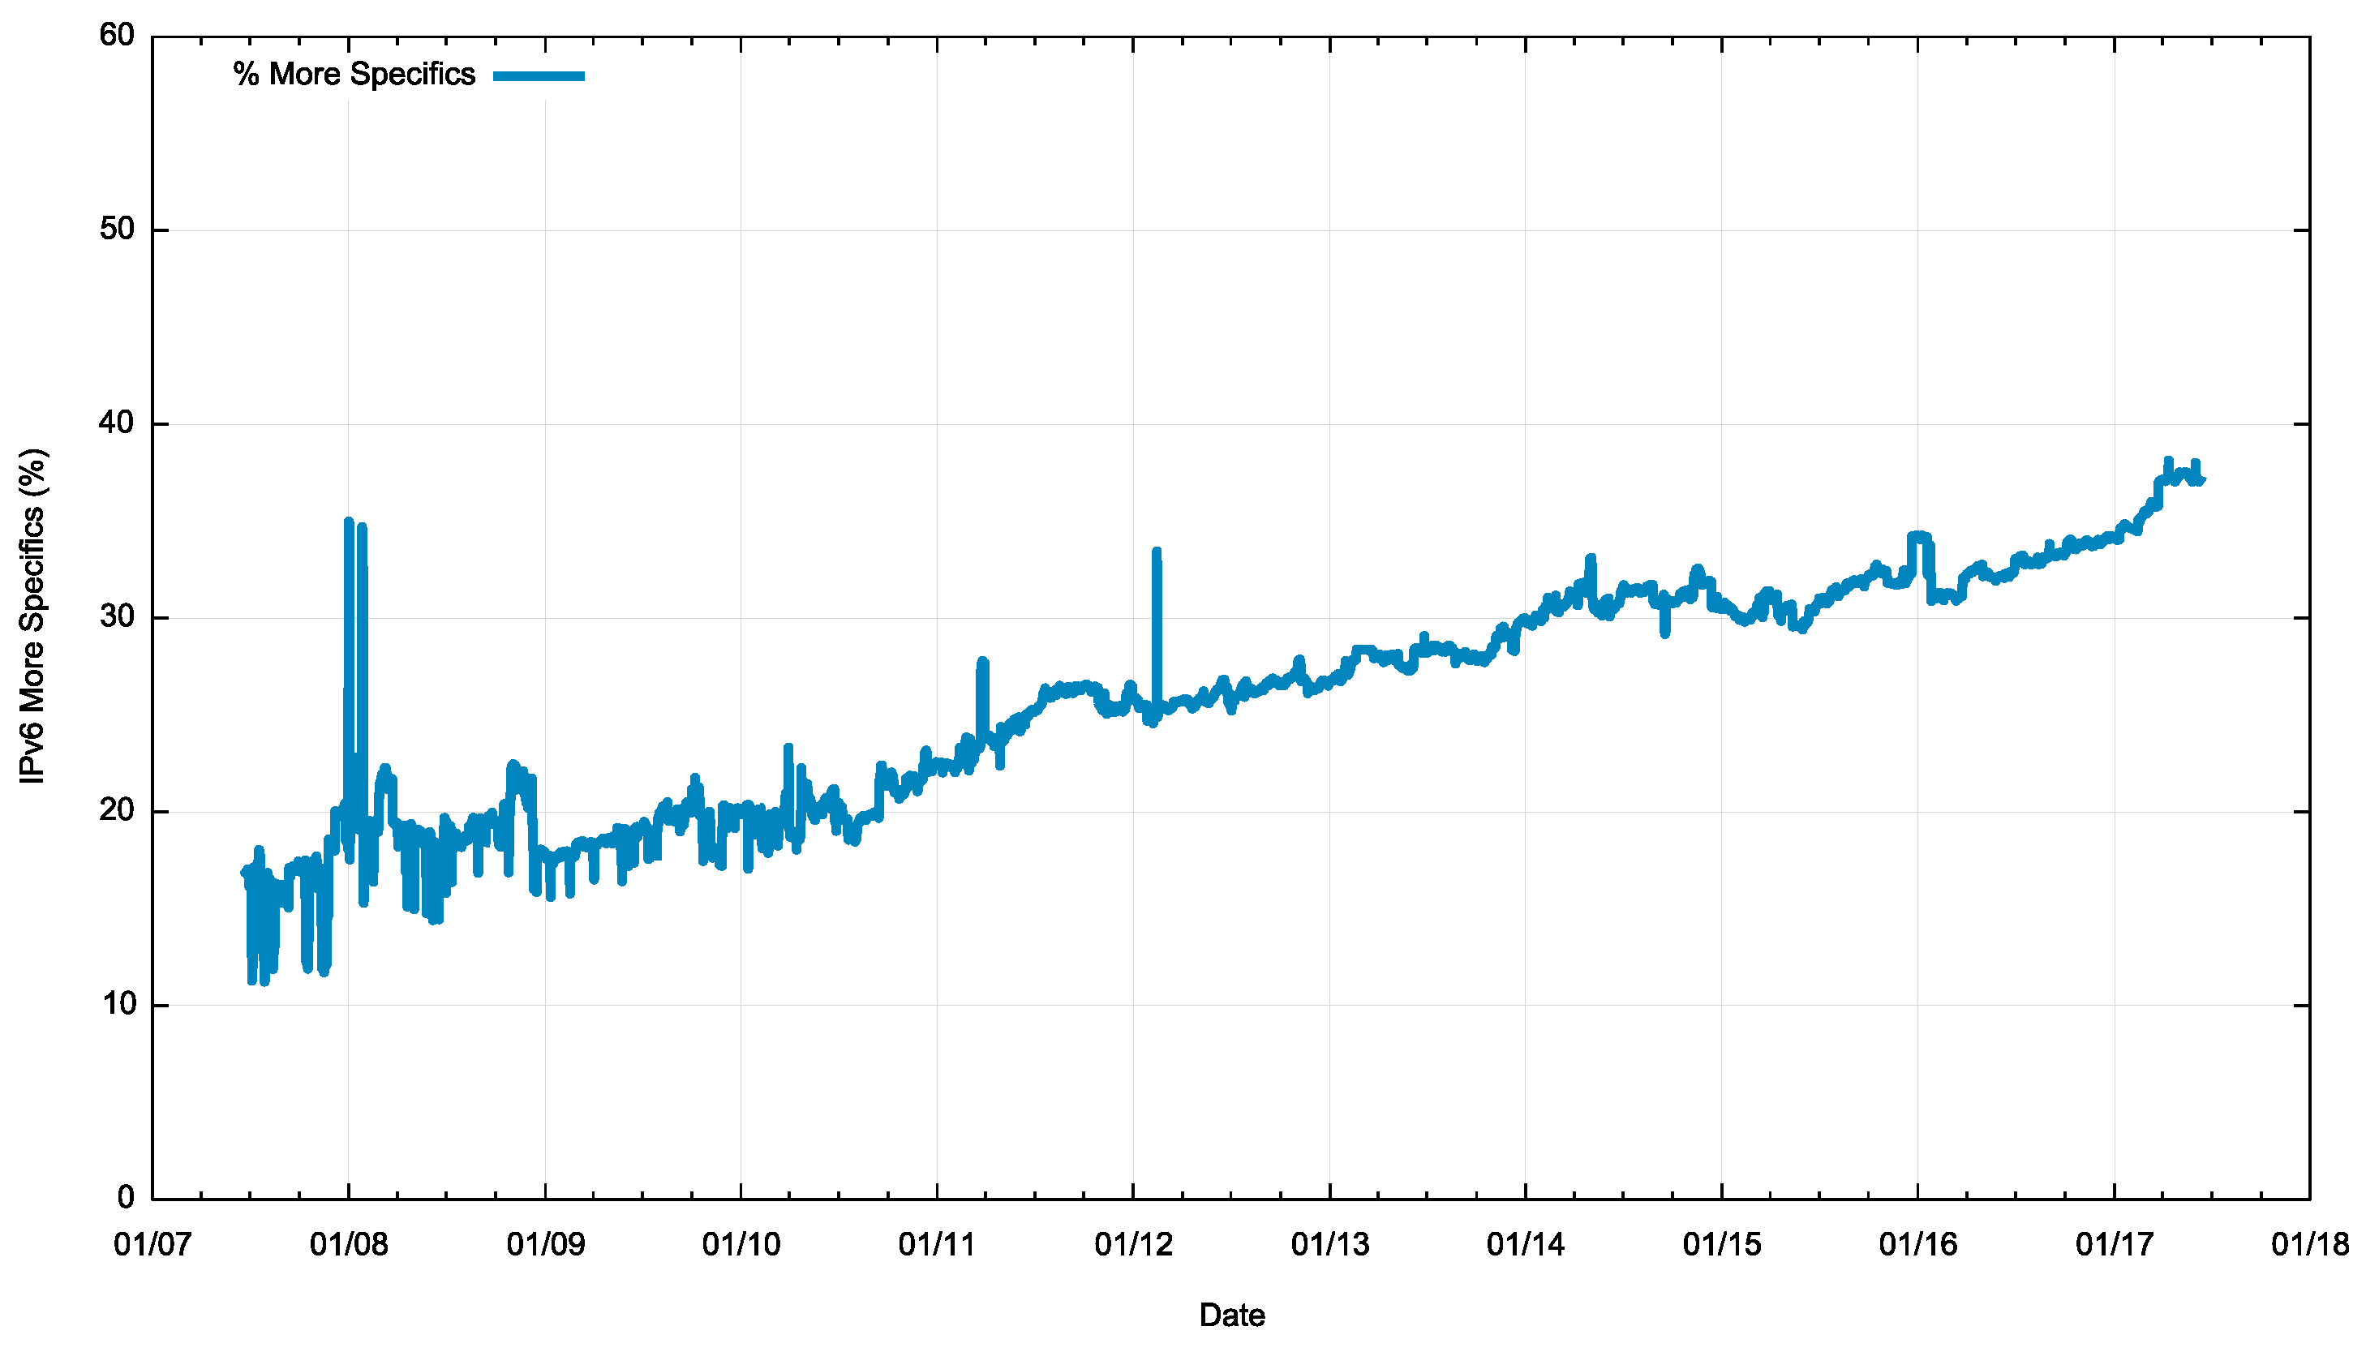
Has this changed over time?
Lets use the ratio of More-Specifics to the total route set
IPv4
IPv6

Slide 14
Has this changed over time?
Oddly stable at 50%
Still growing
2007
now
2007
now
IPv4
IPv6

Slide 15
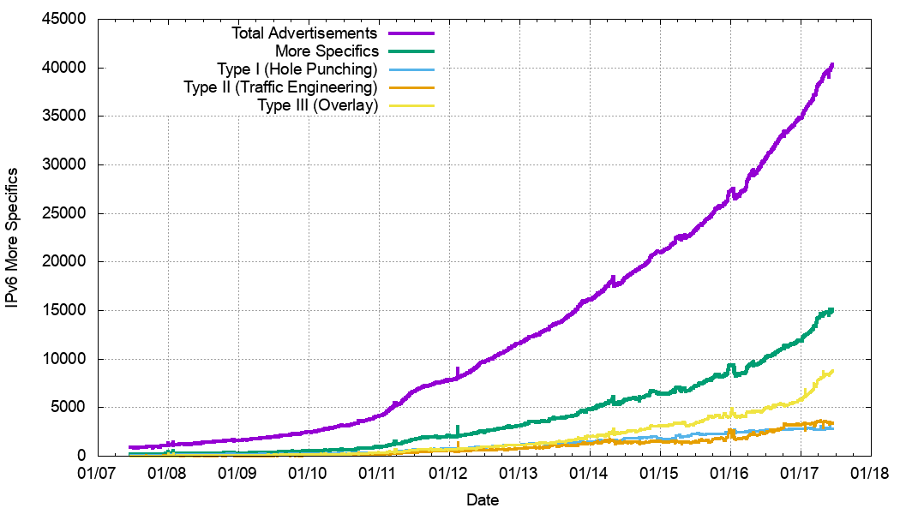
More Specific Types – Prefix Counts
IPv4
IPv6

Slide 16
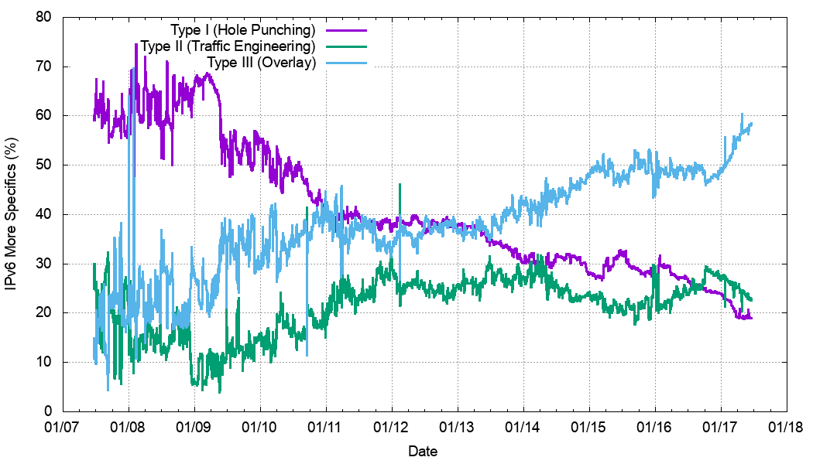
More Specific Types – Relative Counts
IPv4
IPv6

Slide 17
More Specific Types – Relative Counts
Overlay
IPv4
Hole Punching
IPv6

Slide 18
More Specific Types
In both IPv4 and IPv6:
Type I prefixes (”hole punching”) are declining over time (relatively)
Type II prefixes (“traffic engineering”) have been relatively constant at some 30% of more specifics
Type III prefixes (“overlays”) have risen (relatively) and are now the more prevalent form of advertised more specifics

Slide 19
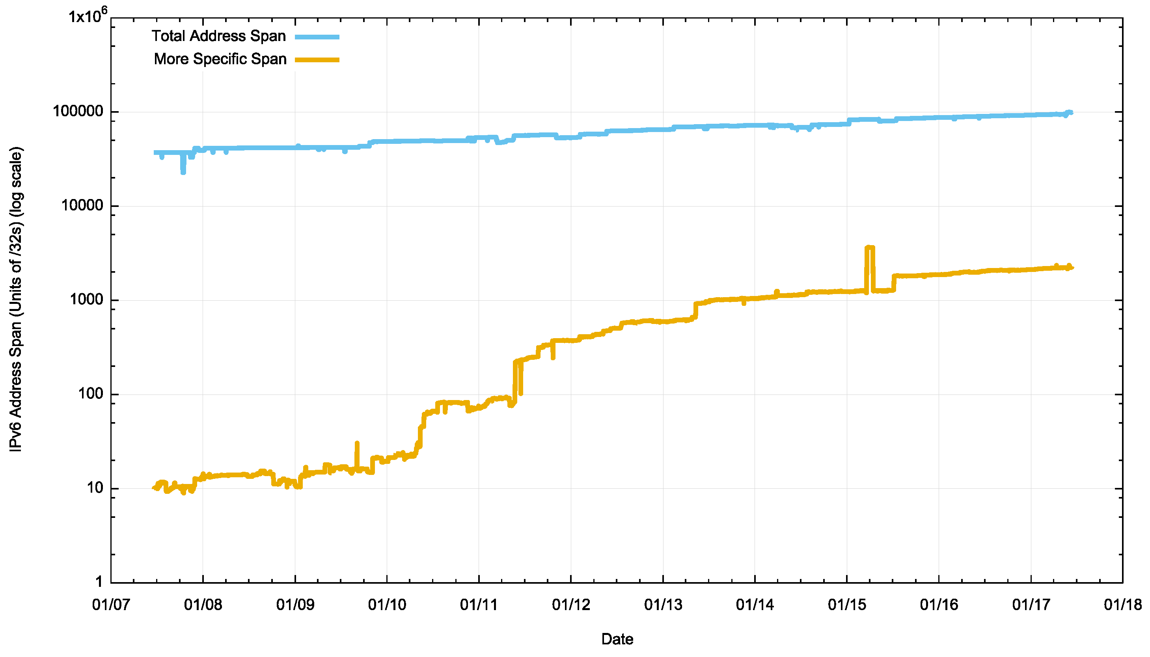
What about Address Spans covered by more specifics?
Yes, this is a LOG scale
IPv4
IPv6

Slide 20
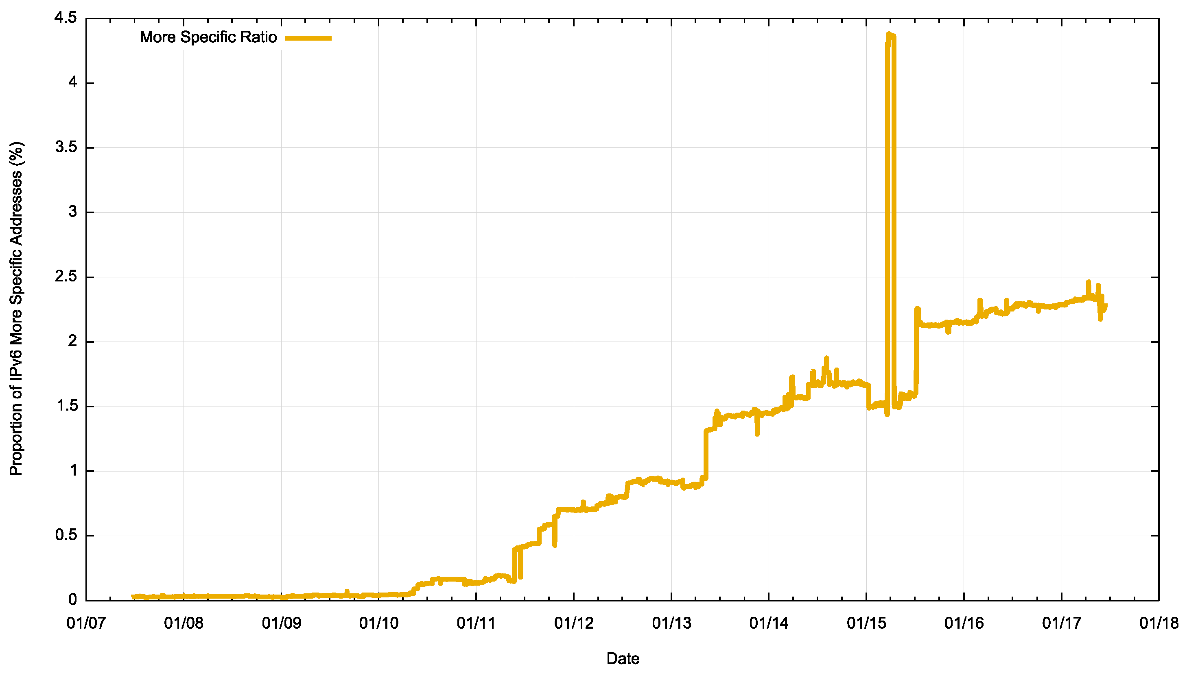
What about Address Spans covered by more specifics?
Lets use the ratio of More-Specifics to the total address span
IPv4
IPv6

Slide 21
What about Address Spans covered by more specifics?
Lets use the ratio of More-Specifics to the total address span
2%
27%
IPv4
IPv6

Slide 22
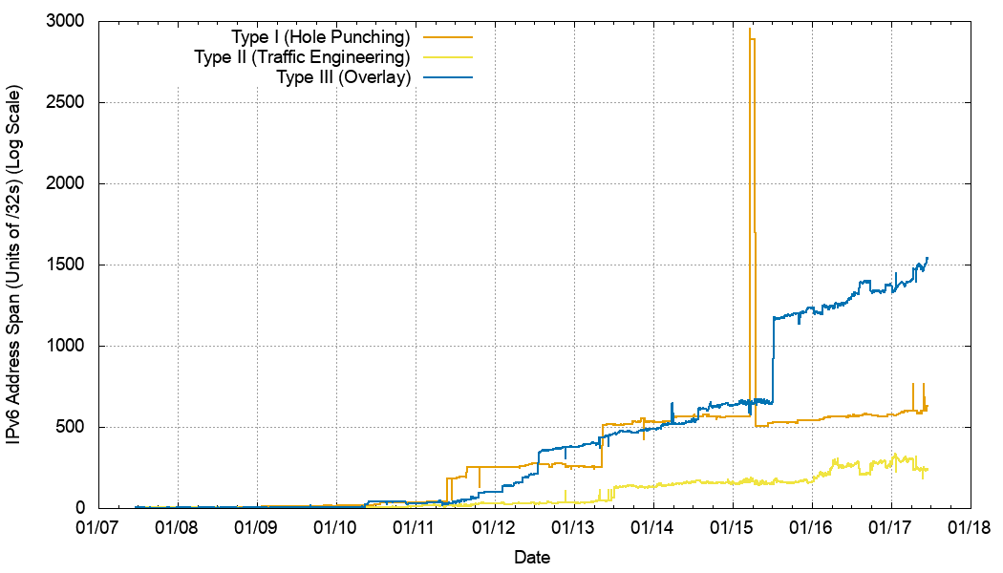
Address Span: Breakdown into Types
IPv4
IPv6

Slide 23
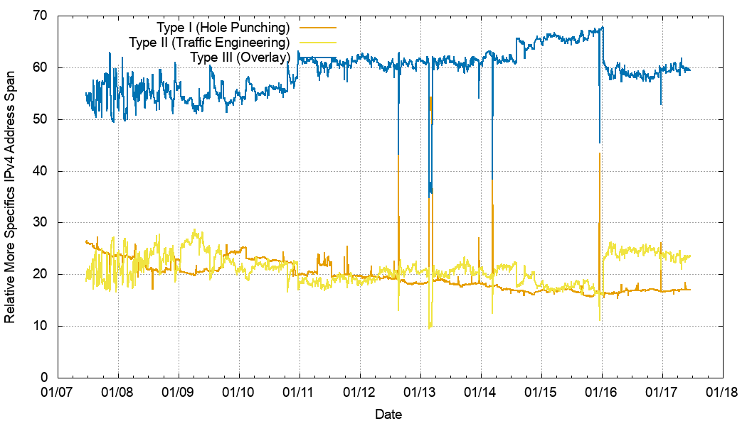
% of Total Span: Breakdown into Types
It’s mostly overlays!
IPv4
IPv6

Slide 24
Overlays are the majority of More Specifics
The initial IPv6 network had little in the way of overlays and had a high proportion of Type I (Hole Punching) more specifics. This has changed over time and the recent profile is similar to IPv4
In both protocols the largest block of more specific announcements in terms of address span are “overlays” where the AS Path of the enclosing aggregate and the more specific are identical

Slide 25
Overlays are the majority of More Specifics
Are Overlays “polluting” the BGP Space?
Overlays do not change routing, but do these more specifics add to the routing load?

Slide 26
Updates
Let’s look at “routing load” by looking at BGP updates
Our questions are:
Are more specifics “noisier” than aggregates?
and
Are overlays more active in terms of BGP Updates than other prefixes?

Slide 27
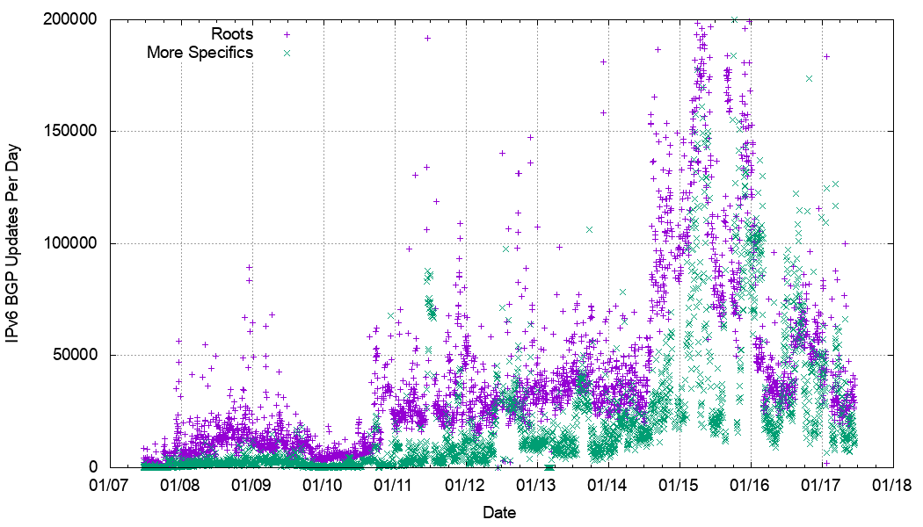
Update count by Prefix Type
IPv4
IPv6

Slide 28
Update count by Prefix Type
IPv4
IPv6

Slide 29
Update Count
In IPv4 the update count for more specific prefixes is greater than the comparable count for root prefixes, while the opposite is the case in IPv6.
But the relative count of more specifics is lower in IPv6
Let’s “normalise” this by dividing the update count by the number of prefixes to get the average update count per prefix of each type

Slide 30
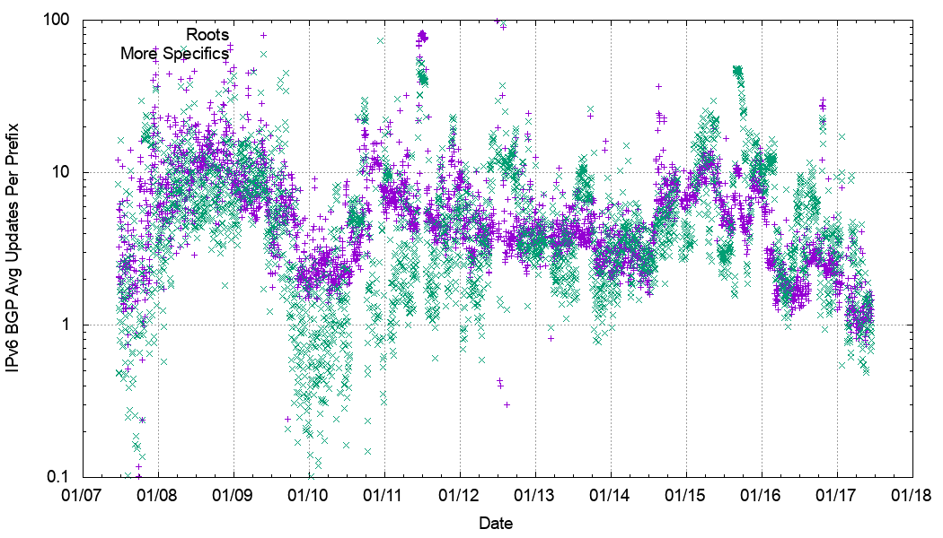
Relative Update count by Prefix Type
IPv4
IPv6

Slide 31
Relative Updates
On average, in IPv4 More Specifics are slightly noisier than IPv4 Roots, while in IPv6 roots and more specifics are equally likely to be the subject of BGP updates
Are different types of more specifics more or less stable in BGP terms?

Slide 32
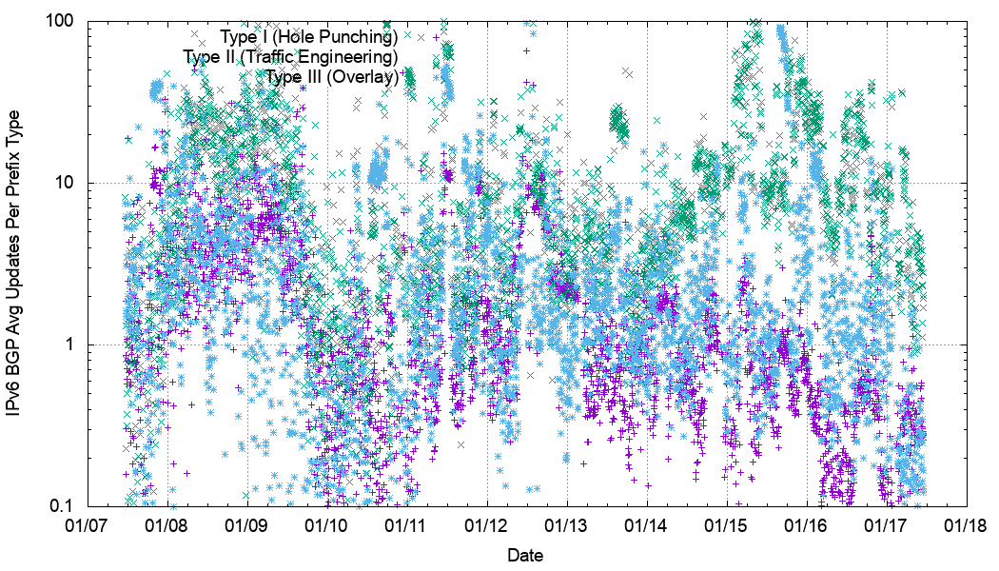
Average Number of Updates Per More Specific Prefix Type
IPv4
IPv6

Slide 33
Average Number of Updates Per More Specific Prefix Type
In IPv4 Type II Traffic Engineering Prefixes show a slightly higher level of BGP instability on average over Type I Hole Punching Prefixes, while Type III Overlay Prefixes show the highest levels of stability of more specifics
In IPv6 this has only been apparent in the past three years which Type II Traffic Engineering Prefixes showing the greatest levels of BGP instability , and Type I Hole Punching more specifics showing the highest levels of relative stability

Slide 34
BGP Instability is heavily skewed
IPv4
IPv6

Slide 35
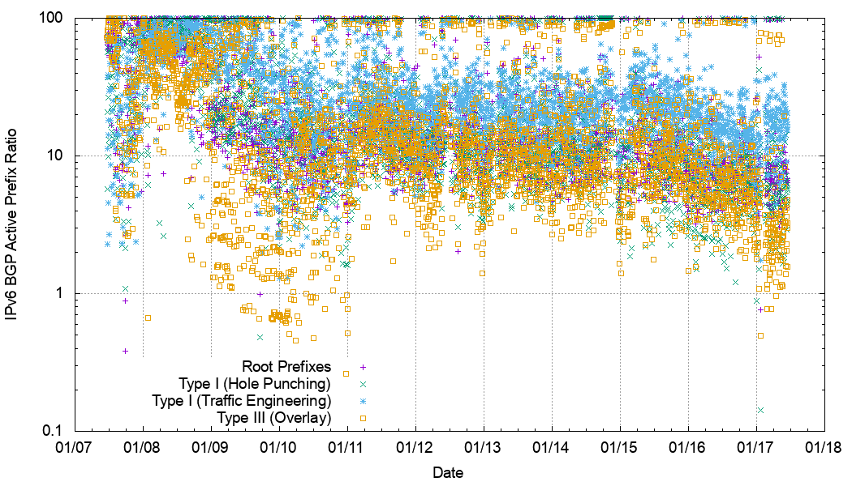
What Type of Prefixes are more Unstable?
IPv4
IPv6

Slide 36
What Type of Prefixes are more Unstable?
Type II More Specific Prefixes (Traffic Engineering) are approximately twice as likely to be unstable than either root prefixes or other types of More Specifics in both IPv4 and IPv6
This matches a rough intuition about the nature of more specifics, where overlays and hole punching would be expected to be as stable as root announcements

Slide 37
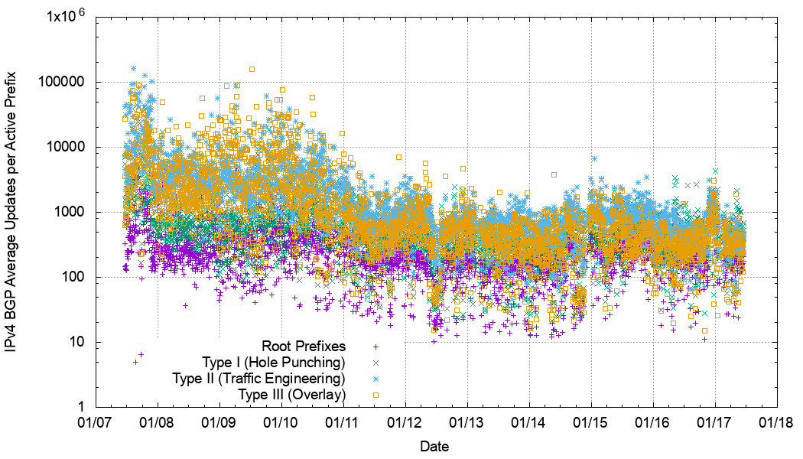
Average Number of Updates per Active Prefix Type
IPv4
IPv6

Slide 38
Average Number of Updates per Active Prefix Type
In IPv4 Type II Traffic Engineering Prefixes have a greater average number of updates than other prefix types
In IPv6 Root Prefixes tend to have a lower average number of updates than other prefix types
Perhaps the significant message here is that IPv6 has a higher inherent level of instability – unstable prefixes in IPv6 have 100x more instability events per unstable prefix on average than unstable prefixes in IPv4

Slide 39
What if…
All Overlay more specific prefixes were removed from the routing table?

Slide 40
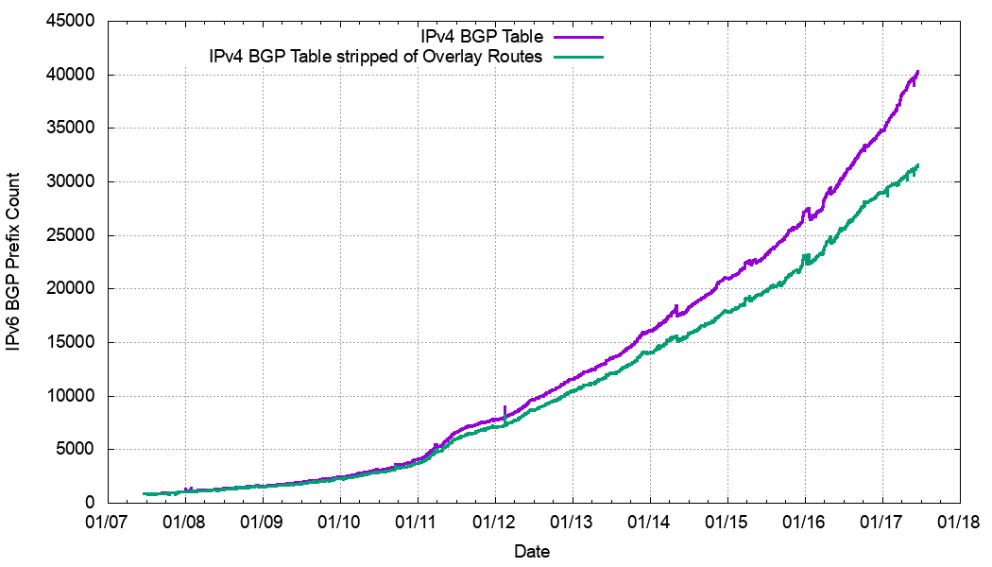
Table Size Implications
-150,000
-10,000
IPv4
IPv6

Slide 41
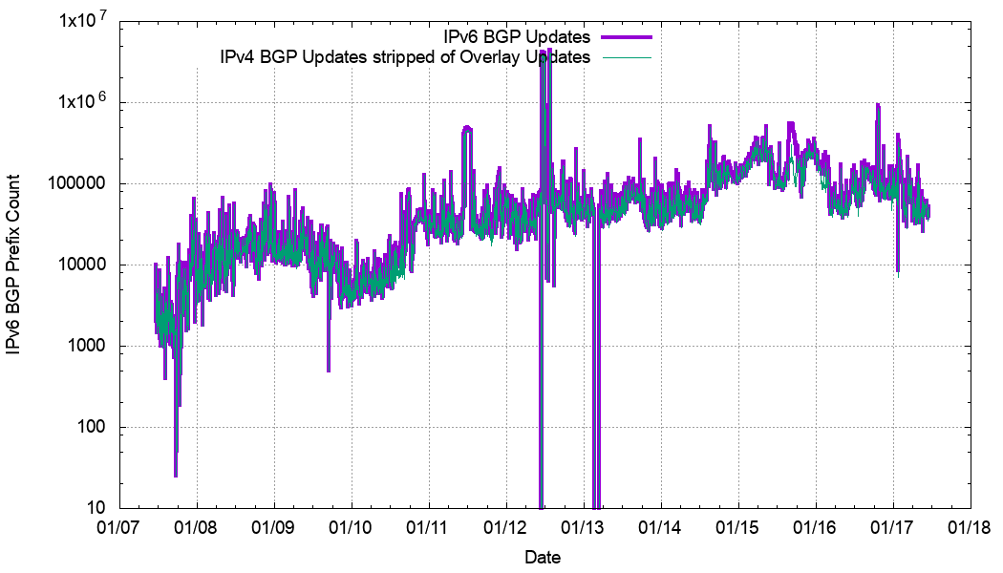
Update Count Implications
IPv4
IPv6

Slide 42
What if…
All Overlay more specific prefixes were removed from the routing table?
Both IPv4 and IPv6 routing tables would drop in size by approximately 30%, as Overlay more specifics are now the predominate type of more specifics in the routing tables
The rate of dynamic instability in BGP would not change by any significant amount, as overly more specifics are relatively stable prefixes

Slide 43
Summary of Findings
More specifics add to both the size and the update load of BGP
However BGP itself is both a reachability and a traffic engineering tool, and more specifics are often used to qualify reachability by traffic engineering. We have no other viable internet-wide traffic engineering tools, so this particular use of BGP really has no alternative
Recent years have seen the decline of hole punching as more providers tend to treat their address blocks as integral units.
Overlays are becoming more prevalent. While this has implications in terms of total table size it has no significant impact on BGP update rates.

Slide 44
Summary of Findings
There is the question of total instability in IPv6 being far greater than IPv4, but this is not intrinsically an issue with more specifics, but a more general issue of BGP routing instability in IPv6
More investigation called for!

Slide 45
Thanks!

