Slide 1
That KSK Roll
Geoff Huston
APNIC Labs

Slide 2
The DNS may look simple

Slide 3
But with the DNS, looks are very deceiving

Slide 4
So lets talk DNSSEC
DNSSEC introduces digital signatures into the DNS
It allows a DNS resolver to validate the information it receives to ensure that however it got to learn it, the information is:
  Valid
  Up to Date
It can prevent various forms of attack on the DNS
But more importantly it can allow us to publish information in the DNS and have clients authenticate that the information has not been tampered with in any way

Slide 5
Why DNSSEC?
To improve the robustness of the DNS
  Because we can inject false information into the DNS and mislead users
We could improve the robustness of a secured web
  Because authentic information in the DNS can help in propping up the WebPKI model with CA pinning information
To improve access to robust security
  Because we’d like to make some progress towards an environment where accessible, robust security in accessing services can be provided

Slide 6
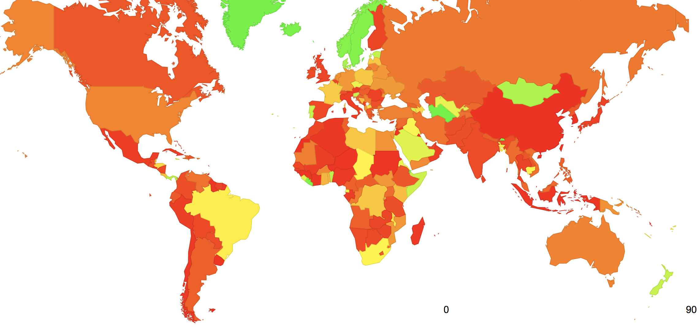
Who uses DNSSEC?
Today around 1 in 7 users will not resolve a DNSSEC-signed domain name if the signature cannot be validated
% of users in each country who
perform DNSSEC validation

Slide 7
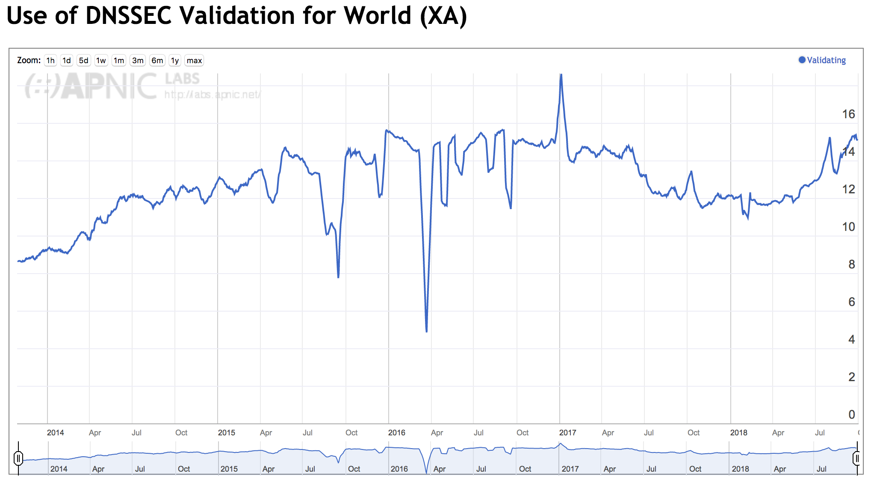
Who uses DNSSEC?
Today around 1 in 7 users will not resolve a DNSSEC-signed domain name if the signature cannot be validated

Slide 8
Trust in DNSSEC
DNSSEC uses a single point of trust – the Key Signing Key of the root zone
  The DNSKEY for the root zone is signed by the KSK for the root zone
  This key signs a DNSKEY entry that includes a Zone Signing Key – ZSK - that is used to sign every entry in the root zone
  The zone includes a DS entry signed by the root zone ZSK for the .net delegation that is the hash of the KSK for .net
    The DNSKEY for .net is signed by the KSK for .net
    The DNSKEY entry for .net includes a ZSK used to sign every entry in the .net zone
    The zone includes a DS entry signed by the .net zone ZSK for the potaroo.net delegation that is the hash of the KSK for .potaroo.net
      The DNSKEY for potaroo.net is signed by the KSK for potaroo.net
      The DNSKEY entry for potaroo .net includes a ZSK used to sign every entry in the potaroo.net zone
      The entry for www.potaroo.net is signed by the ZSK for potaroo.net

Slide 9
Rolling keys in DNSSEC
Rolling a key can be easy in DNSSEC for most keys:
  Tell your ”parent” about the new key
    - wait -
  Sign the products with the new key
    - wait -
  Withdraw the old key

Slide 10
Rolling keys in DNSSEC
Rolling a key can be easy in DNSSEC for most keys:
  Tell your ”parent” about the new key
    - wait -
  Sign the products with the new key
    - wait -
  Withdraw the old key
But the Root Zone has no parent, so this approach doesn’t work for the KSK

Slide 11
Rolling Keys
No key is eternal:
  Digital cryptography is based on difficult problems, not impossible problems! As computing capabilities change, what is unfeasible to solve changes
  The best crafted plans can fail – key compromise is always a possibility
  Key storage systems can fail – inability to access the key makes the key useless
If we need to instil a discipline of changing keys in relying party systems then we need to change the key from time to time
Is it better to gain experience in regularly scheduled key rolls than react with ad hoc measures when it’s forced upon us?

Slide 12
The Mechanics of Rolling the KSK
”Introduce” the new KSK to the world
Use the Root Zone DNSKEY record to publish a new KSK
    wait -
Sign the Root Zone DNSKEY record with the new KSK
Remove the old KSK from the Root Zone DNSKEY record
    - wait -
Revoke the old KSK in the Root Zone DNSKEY record
See RFC 5011 – wait for at least 30 days

Slide 13

The Mechanics of Rolling the KSK
”Introduce” the new KSK to the world
Use the Root Zone DNSKEY record to publish a new KSK
    wait -
Sign the Root Zone DNSKEY record with the new KSK
Remove the old KSK from the Root Zone DNSKEY record
    - wait -
Revoke the old KSK in the Root Zone DNSKEY record
We are here
October 11

Slide 14
Will this work?
We don’t really know!
    If everyone built code strictly according to current specs
    And
    All specs were clear, unambiguous and functional
    And
    We could build robust accurate code
    And
    The Internet worked all of the time
    And
    The stars are aligned in our favour
  Then everything will be fine!

Slide 15
But
We really don’t know!
Is there a way we might peek into the DNS and see just how ready we are for a KSK roll?

Slide 16
Measuring Resolvers via RFC8145 Signaling
Getting resolvers to report on their local trusted key state
  A change to resolver behavior that requires deployment of new resolver code
  Resolvers that support the RFC 8145 signal mechanism periodically include the key tag of their locally trusted keys into a query directed towards the root servers

Slide 17
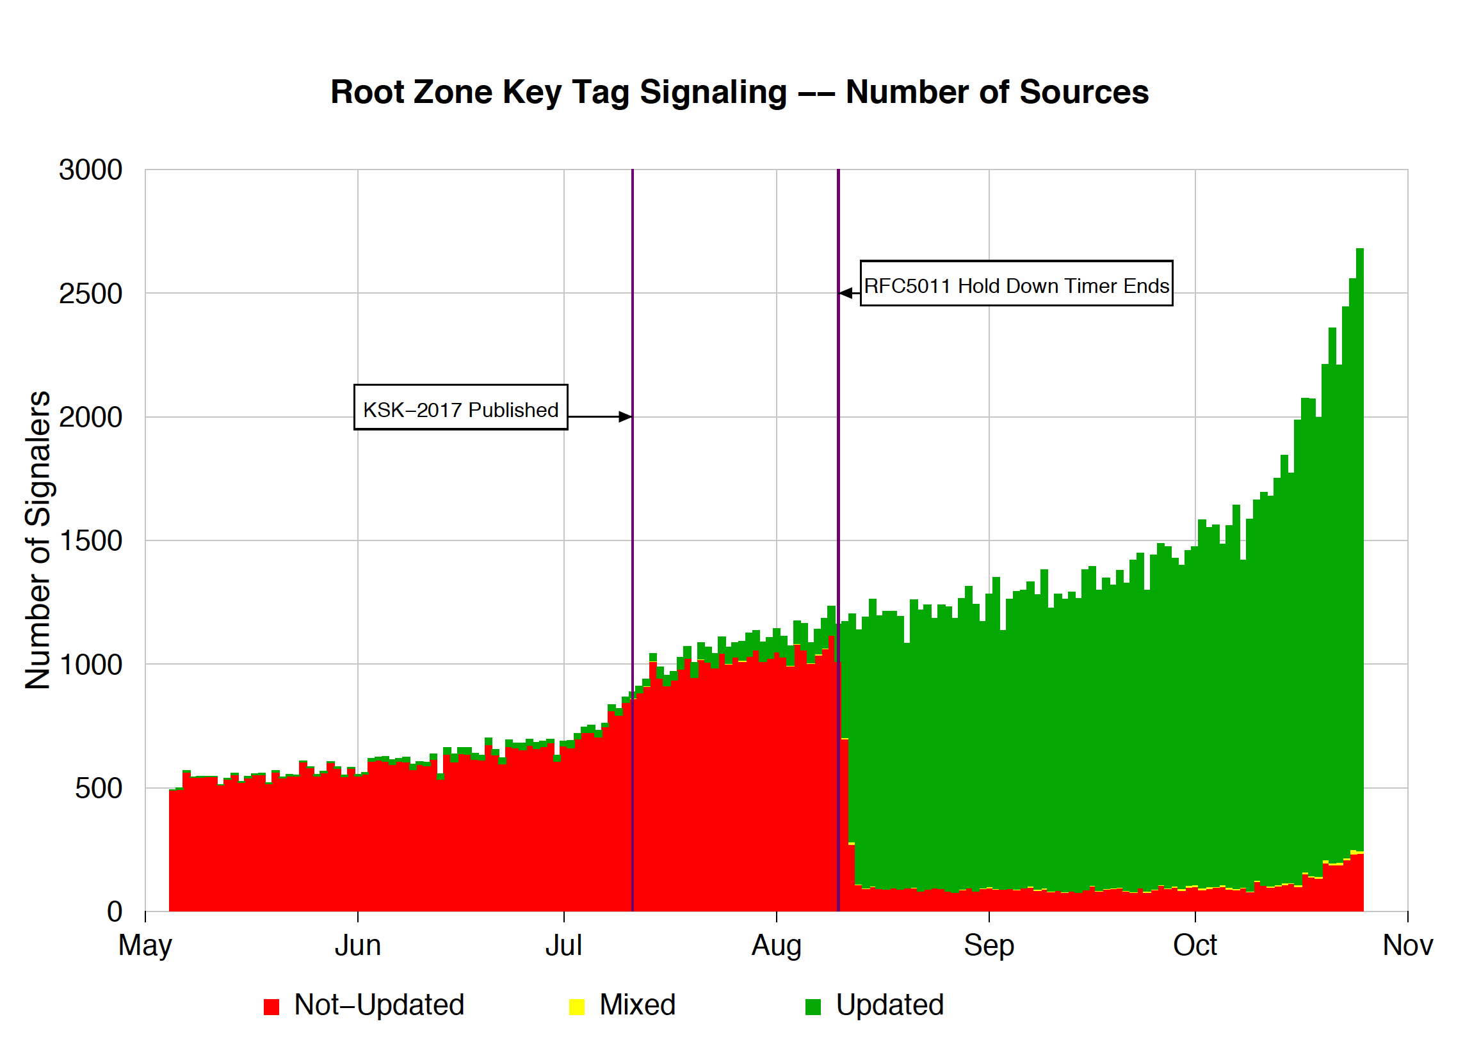
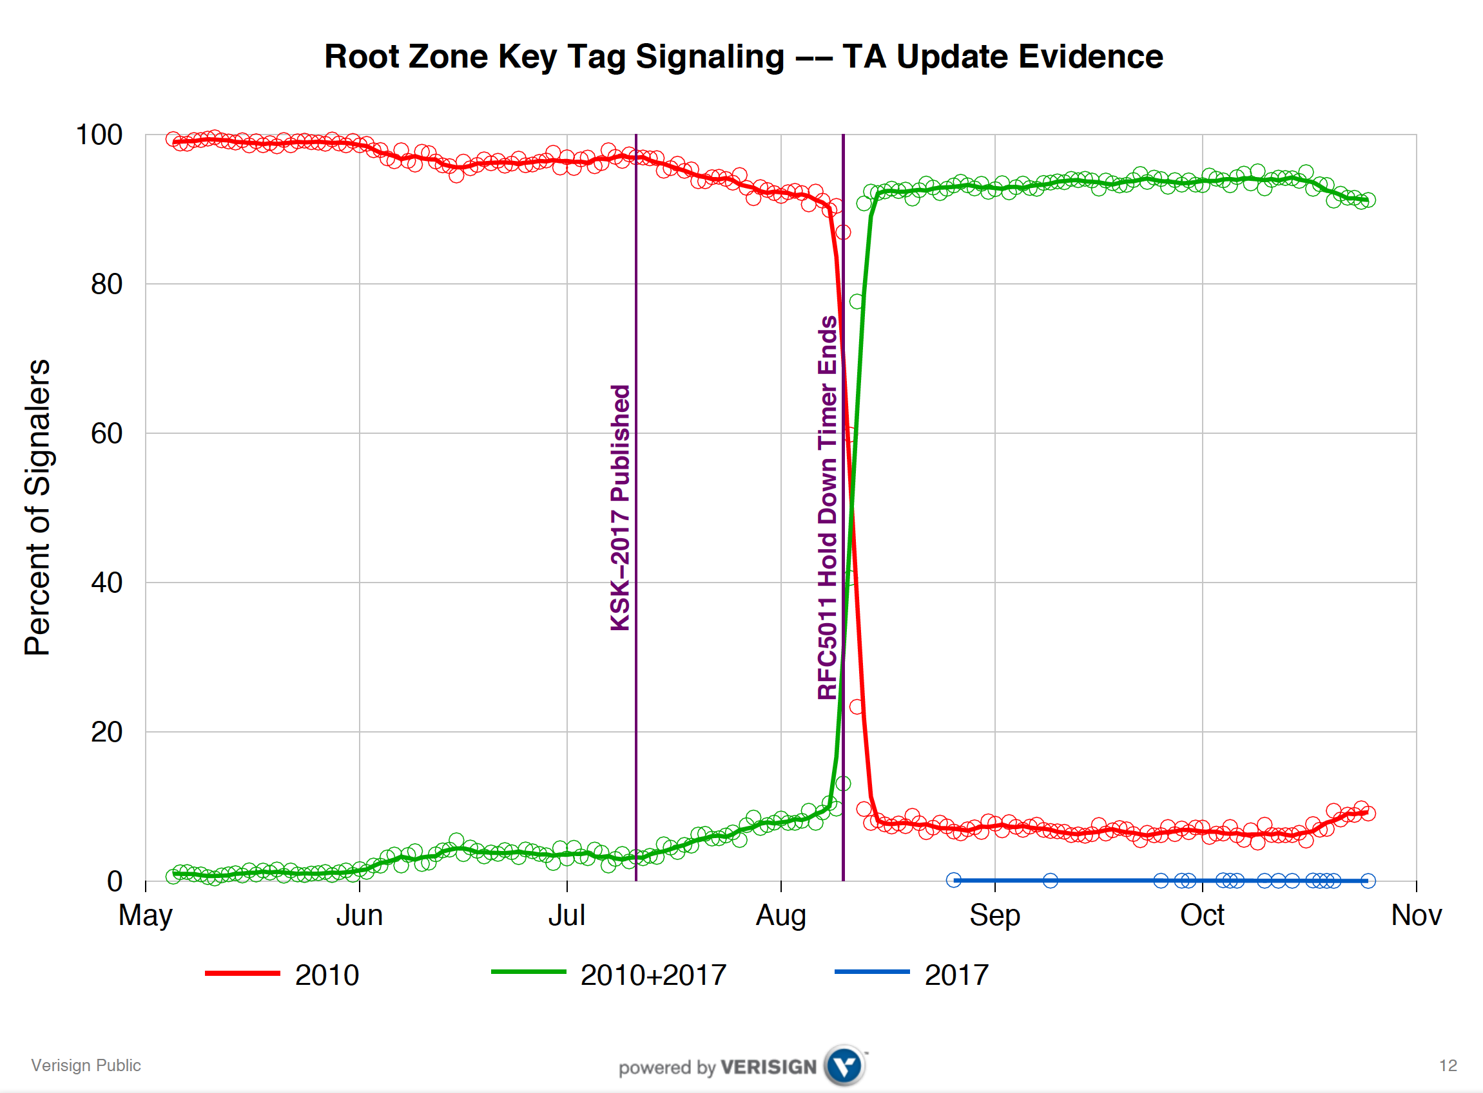
What did we see at (some) roots?
Duane Wessels VeriSign RFC 8145 Signaling Trust Anchor Knowledge In DNS Security Extensions
Presentation to DNSSEC Workshop @ ICANN 60 – 1 Nov 2017
https://schd.ws/hosted_files/icann60abudhabi2017/ea/Duane%20Wessels-VeriSign-RFC%208145-Signaling%20Trust%20Anchor%20Knowledge%20in%20DNS%20Security%20Extensions.pdf

Slide 18
What is RFC 8145 saying?
Its clear that there is some residual set of resolvers that are signalling that they have not yet learned to trust the new KSK key
But it’s not all that helpful as a signal
  Is this is an accurate signal about the state of this resolver?
  Is this is an accurate signal about the identity of this resolver?
  How many users sit ‘behind’ this resolver?
  Whether these uses rely solely on this resolver, or if they also have alternate resolvers that they can use?
  What proportion of all users are affected?

Slide 19
Why?
Because the DNS does not do tracequery
  Forwarding a query onward in the DNS contains no ‘sticky’ information about the original query
  At no time is the user exposed in the referred query
Because caching
  If A and B both forward their queries via C, then it may be that one or both of these queries may be answered from C’s cache
  In this case the signal is being suppressed
Because its actually measuring a cause, not the outcome
  Its measuring resolvers’ uptake of the new KSK, but is not able to measure the user impact of this

Slide 20
User-Side Measurement
Can we devise a DNS query that could reveal the state of the trusted keys of the resolvers back to the user?
  Not within the current parameters of DNSSEC and/or resolver behaviour

Slide 21
User-Side Measurement
Can we devise a DNS query that could reveal the state of the trusted keys of the resolvers back to the user?
  What if we could change resolver behaviour?

Slide 22
User-Side Measurement
Can we devise a DNS query that could reveal the state of the trusted keys of the resolvers back to the user?
  What about a change to the resolver’s reporting of validation outcome depending on the resolver’s local trusted key state?
    If a query contains the label “root-key-sentinel-is-ta-<key-tag>” then a validating resolver will report validation failure if the key is NOT in the local trusted key store
    If a query contains the label “root-key-sentinel-not-ta-<key-tag>” then a validating resolver will report validation failure if the key IS in the local trusted key store

Slide 23
User-Side Resolver Measurement
Three DNS queries:
  root-key-sentinel-is-ta-20326.<unique-label>.<some.signed.domain>
  root-key-sentinel-not-ta-20236.<unique-label>.<some.signed.domain>
  <badly-signed>. <unique-label>.<some.signed.domain>
Analysis:
Resolver Behaviour Type
Loaded KSK-2017
NOT Loaded KSK-2017
Mechanism not supported
Not validating
Query 1 Query 2 Query 3
A SERVFAIL SERVFAIL
SERVFAIL A SERVFAIL
A A SERVFAIL
A A A

Slide 24
Measuring User Impact
Load these DNS tests into an online ad campaign and use the ad to perform this measurement with at least hundred million users across the Internet before the key rolls

Slide 25
Are we ready?
The KSK rolls on 11 October 2018
And we’ve been measuring for the past week

Slide 26
Results so far
16% of users use DNSSEC-validating resolvers
15% of users do not report
their KSK trust-state
0.5% of users report KSK-2017
loaded
0.005% of users report KSK-2017
NOT loaded

Slide 27
Possibly Affected Users
Between 0.1% to 0.2% of users are reporting that their resolvers have not loaded KSK-2017 as a trust anchor
The measurement has many uncertainties and many sources of noise so this is an upper bound of the pool of users who may encounter DNS failure due to to the KSK roll

Slide 28
There is still uncertainty in this measurement
This is a recent change to resolver behaviour – only a few resolvers respond to the key test queries!
Not all resolvers will pre-provision KSK-2017 using RFC 5011 automated trust mechanisms – they may elect to load the new trust anchor at the time of the roll
  And we cannot measure the difference between a resolver that has a broken implementation of RFC5011 and a resolver that is being managed manually
We cannot readily measure the properties of individual resolvers
  We can derive an estimate of users that may be impacted, but it’s not so easy to figure out which resolvers are responsible

Slide 29
What to expect with the KSK roll
To the extent that the DNS is able to be measured, it appears that most users will be unaffected by the planned roll of the KSK on October 11
But your helpdesk should be aware that we a user reports that their Internet is dead in the 48 hours after October 11 then a DNSSEC trusted key failure for the user is a possible cause.

Slide 30
Thanks!

