Slide 1
Measuring the End User
Geoff Huston
APNIC Labs

Slide 2
How to measure “the Internet”
What do we mean when we say
“we’re measuring the Internet?”

Slide 3
Measurement Self-Selection
When we first looked at measuring in the Internet, it was all about the network, and the distinction between network management and network measurement was not very clear
We ended up measuring what’s easy to measure and often missed measuring what’s useful to understand

Slide 4
User experience
Responsiveness
Sustained Throughput
Application performance quality
Consistency
Availability
Network Behaviour
Routing Stability
Path characteristics
Element Behaviour
Subnet characteristics
Switch element behaviour
Switch resource consumption
Network availability
Element availability
Transmission path availability
Transmission element BER
Network path availability
Path characteristics
Latency
Jitter characteristics
Loss characteristics
Protocol behaviour
Transport protocol behaviour
IPv6 penetration levels
Failover behaviour
Connection failures
And so on...

Slide 5
What are you trying to measure?
User experience
Responsiveness
Sustained Throughput
Application performance quality
Consistency
Availability
Network Behaviour
Routing Stability
Path characteristics
Element Behaviour
Subnet characteristics
Switch element behaviour
Switch resource consumption
Network availability
Element availability
Transmission path availability
Transmission element BER
Network path availability
Path characteristics
Latency
Jitter characteristics
Loss characteristics
Protocol behaviour
Transport protocol behaviour
IPv6 penetration levels
Failover behaviour
Connection failures
And so on...

Slide 6
Network Measurement Approaches
PING and related probe techniques
Send an ICMP echo request to a target device and measure the time to respond
Often used to interpret some indication of delay, loss and jitter
BUT has little relationship to application performance, as the probe measurement is heavily impacted by the behaviour of the probe and the echo point
i.e. beyond being a remote device availability beacon, its of little practical use

Slide 7
Network Measurement Approaches
SNMP and device polling
Per-element probe to poll various aspects of an element’s current status
Of little practical value in determining end-to-end network performance, as there is a distinct gap between end-to-end path performance and periodic polling of network element state

Slide 8
Network Measurement Approaches
Active Test Traffic
Perform a particular network transaction in a periodic fashion and correlate application performance across invocations
Often measures the performance limitations of the test gear and the target rather than the network
Tests only a small number of network transit paths
Provides only a weak correlation between measurement results and actual end-user experiences of application performance

Slide 9
What, Where and Why?
Using a combination of active and passive measurement techniques there is a massive set of possible aspects of network behaviour that can be measured
Few network measurements have any real bearing on the performance characteristics of applications that include some form of network interaction
i.e. there’s a difference between measuring any old thing and measuring something relevant and useful
If you are going to measure something…
Know why you are measuring it
Understand the limitations of the measurement technique
Understand the limitations of any interpretation of the measurement
Understand who is the consumer of the measurement

Slide 10
IP Performance
The end-to-end architectural principle of IP:
The network should not duplicate or mimic functionality that can or should be provided through end-to-end transport-level signalling
Wired IP networks can be seen as lossy queue-controlled passive switching devices connected through fixed delay channels
Wireless IP networks are worse!
IP parameters:
Delay
Delay stability
Jitter
Loss rate
Loss burstiness
In general the smaller the numbers the better, but ...

Slide 11
TCP Performance
TCP performance is the interaction of concurrent end-to-end transport sessions performing a role of mutually enforced resource sharing
The network is not a mediator or controller of an application’s resource requirements
Its a lot like fluid dynamics:
Each network transport flow behaves in a fair greedy fashion, consuming as much of the network’s resources as other concurrent network transport applications will permit

Slide 12
Observations
Most networks are a collection of elephants and rats
And the elephants are uncontrollable
And the rats breed like crazy
If all the traffic is long-held TCP and buffers are “right”-sized then the traffic should drive a network to oscillate around the point of packet loss
If all the traffic is inelastic then congestion events can become catastrophic

Slide 13
Approaches to Measurement...
Measure the network
And claim that perfection is in the eye of the network management system
And everything else is a user problem!
This approach has its weaknesses of course

Slide 14
Maybe asking how to measure “network performance” is the wrong question
How well your car operates is an interaction between the functions and characteristics of the car, the behavior of other cars, and the characteristics of the road
How well an application operates across a network is also an interaction between the application and the local host and the interaction by its remote counterparts and their hosts as well as the interaction between the application’s transport drivers and other concurrent applications that occur within the network

Slide 15
The Internet is all about users and use!

Slide 16
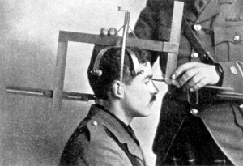
Measuring the End User

Slide 17
The Challenge:
How can we undertake meaningful public measurements that:
quantify aspects of users’ experiences
drawn from across the entire Internet
that don’t rely on access to private data?

Slide 18
For example… IPv6
It would be good to know how we are going with the transition to IPv6
And it would be good everyone to know how everyone else is going with the transition to IPv6

Slide 19
For example… IPv6
What can we measure?
IPv6 in the DNS – AAAA records in the Alexa top N
IPv6 in routing – IPv6 routing table
IPv6 traffic exchanges – traffic graphs
What should we measure?
How many connected devices on today’s Internet are capable of making IPv6 connections?

Slide 20
Approaches to Measurement...
From the inside looking out
Set up a measurement station
Ping, traceroute and fetch routines
Measure the absolute outcomes and the variance
Its not really a user metric
It’s not that bad
But its not that useful either

Slide 21
Approaches to Measurement...
From the outside looking in:
Set up a measurement station
Enrol end users to send traffic to it
Measure the absolute outcomes and the variance
Or instrument your web server
Its not a bad metric
But its a small sample set that is often nerd heavy
And nerds are “special”

Slide 22
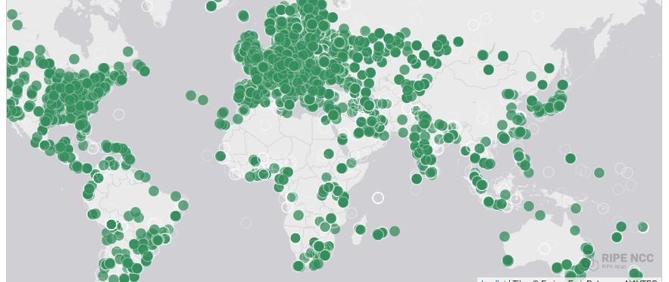
Approaches to Measurement...
From the inside looking out
RIPE Altas
Many thousands of end points installed in end user networks
Ping and traceroute to a small set of destinations
And report back
Analysing the data to produce relevant outcomes is a challenge

Slide 23
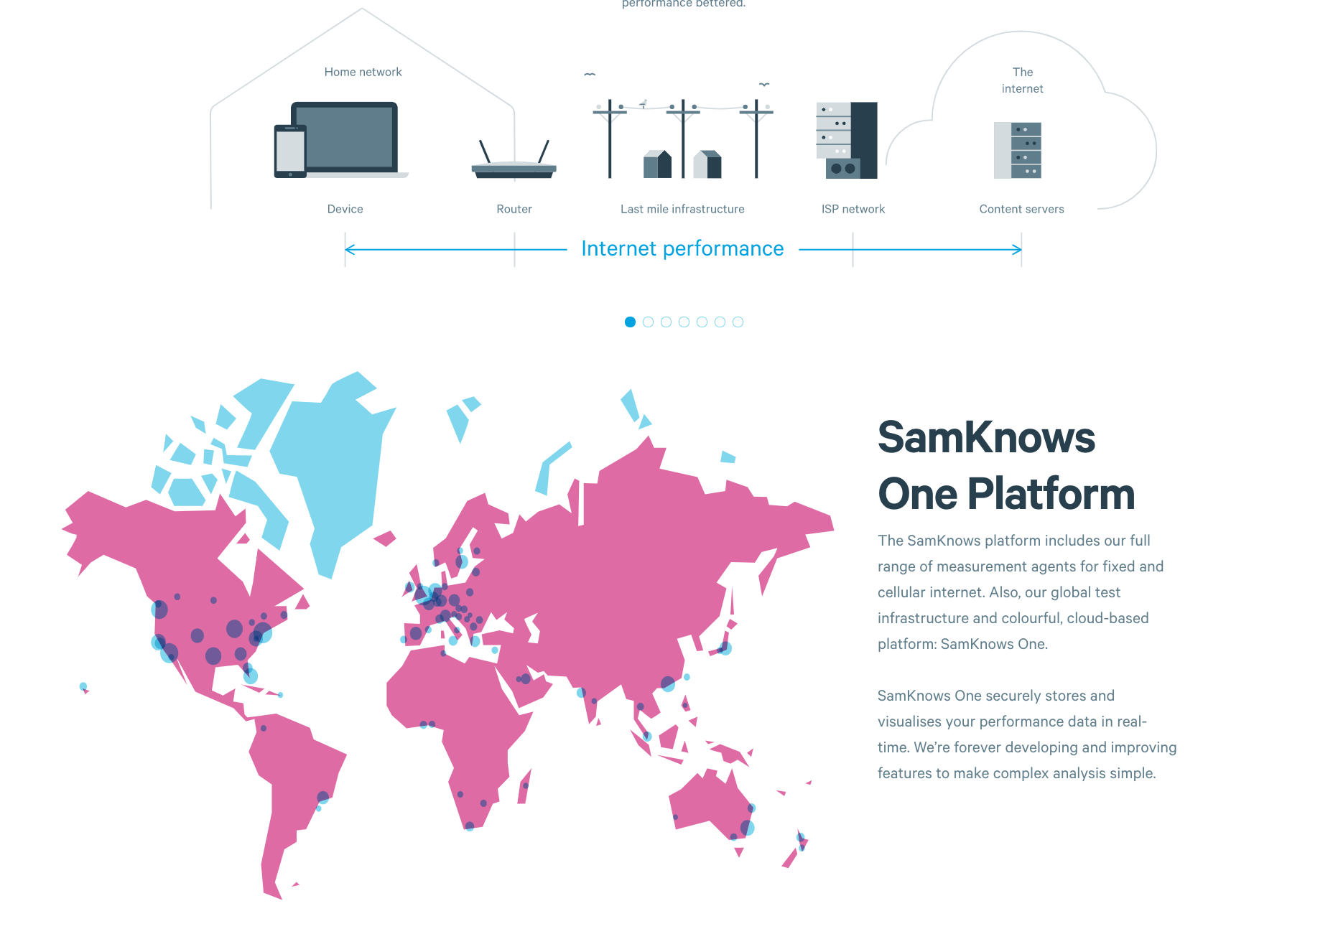
Approaches to Measurement...
From the inside looking out
The “Sam Knows” approach
“be the user”
Use a known common platform (Open WRT DSL modem)
Use a common set of tests (short and large data transfer)
Take over the user’s connection and perform the tests at regular intervals
Report results
Originally developed to test DSL claims in the UK
Used by the FCC and ISPs in the US
Underway in Singapore and in Europe

Slide 24
Observations
IP performance measurement is not a well understood activity with mature tools and a coherent understanding of how to interpret various metrics that may be pulled out from hosts and networks
The complex interaction of applications, host systems, protocols, network switches and transmission systems is at best only weakly understood
But there’s a lot of slideware out there claiming to provide The Answer!

Slide 25
How to measure millions of end devices for their IPv6 capability?

Slide 26
How to measure millions of end devices for their IPv6 capability?
a) Be

Slide 27
How to measure millions of end devices for their IPv6 capability?
OR
Have your measurement code run on a million end devices

Slide 28
Approaches to Measurement
A case study: APNIC’s approach
we wanted to measure IPv6 deployment as seen by end users
We wanted to say something about ALL users
So we were looking at a way to sample end users in a random but statistically significant fashion
We stumbled across the advertising networks...

Slide 29
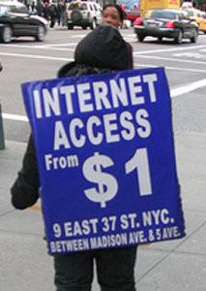
…buy the user!

Slide 30
Ads are ubiquitous

Slide 31
Ads are ubiquitous

Slide 33
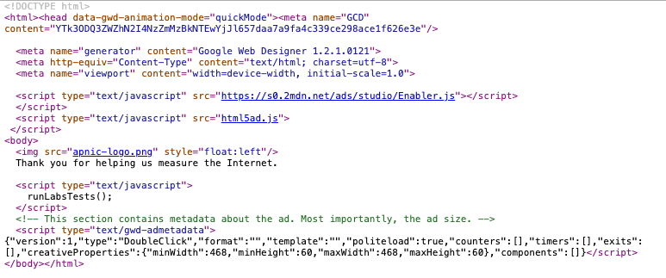

Slide 34
The Ad Measurement Technique
Ad Server
Authoritative Name Server
End user
Web Server

Slide 35
The Ad Measurement Technique
1. Ad Impression
Ad Server
Authoritative Name Server
End user
Web Server

Slide 36
The Ad Measurement Technique
Ad Server
2. DNS resolution
DNS Resolvers
Authoritative Name Server
End user
Web Server

Slide 37
The Ad Measurement Technique
Ad Server
Authoritative Name Server
End user
Web Server
3. Web Fetch

Slide 38
The Ad Measurement Technique
Ad Server
Authoritative Name Server
End user
Web Server
4. Result Web Fetch

Slide 39
What can be scripted
Not much:
http.FetchImg()
i.e. attempt to retrieve a URL
But that’s enough!
It’s EXACTLY what users do!
A URL consists of a DNS question and an HTML question
What if we point both the DNS and the HTML to servers we run?
As long as each Ad execution uses unique names we can push the user query back to our servers

Slide 40
Tests
Think of a URL name as a microcoded instruction set directed to programmable DNS and HTTP servers …
http://06s-u69c5b052-c13-s1579128735-icb0a3c4c-0.ap.dotnxdomain.net/v61x1.png
Valid DNS
IPv6 access only
Valid DNSSEC signature available
User is located in Country 13 (Australia)
Time is 16 January 2020 9:52am
User’s IPv4 address is 203.10.60.76

Slide 41
Ad Placement
At low CPM, the advertising network needs to present unique, new eyeballs to harvest impressions and take your money.
Therefore, a ‘good’ advertising network provides fresh crop of unique clients per day

Slide 42
Unique IPS?
Collect list of unique IP addresses seen
Per day
Since inception
Plot to see behaviours of system
Do we see ‘same eyeballs’ all the time?

Slide 43
Lots of Unique IP’S
Unique IPs via Ads
Unique IPs via Web Sites

Slide 44
Ad Presentation Volumes

Slide 45
Ad Presentations: Countries

Slide 46
Bias Compensation
The ad presentation is NOT uniform across the Internet’s user population
The ad machinery ‘over-presents’ in some countries:

Slide 47
Bias Compensation
The ad presentation is NOT uniform across the Internet’s user population
The ad machinery ‘under-presents’ in some countries:

Slide 48
Bias Compensation
Use ITU data on Internet users per country as the reference set, and weight the ad results to compensate for ad placement bias

Slide 49
Dealing with the data
Unified web logs, dns query logs, packet capture
Map individual DNS and HTML transactions using a common experiment identifier
For example:
DNSSEC validation implies:
DNS queries include EDNS(0) DNSSEC OK flag set
See DNS queries for DNSSEC signature records (DNSKEY / DS)
User fetches URL corresponding to a validly signed DNS name
User does not fetch URL corresponding to a in validly signed DNS name

Slide 50
What are we measuring?
IPv6 adoption
IPv6 performance
IPv6 Extension header fragility
IPv4 and IPv4 Packet fragmentation resilience
DNS resolver centrality
DNS performance
DNSSEC validation
DNS over TCP
DNS NSEC caching

Slide 51
What are we seeing?

Slide 52
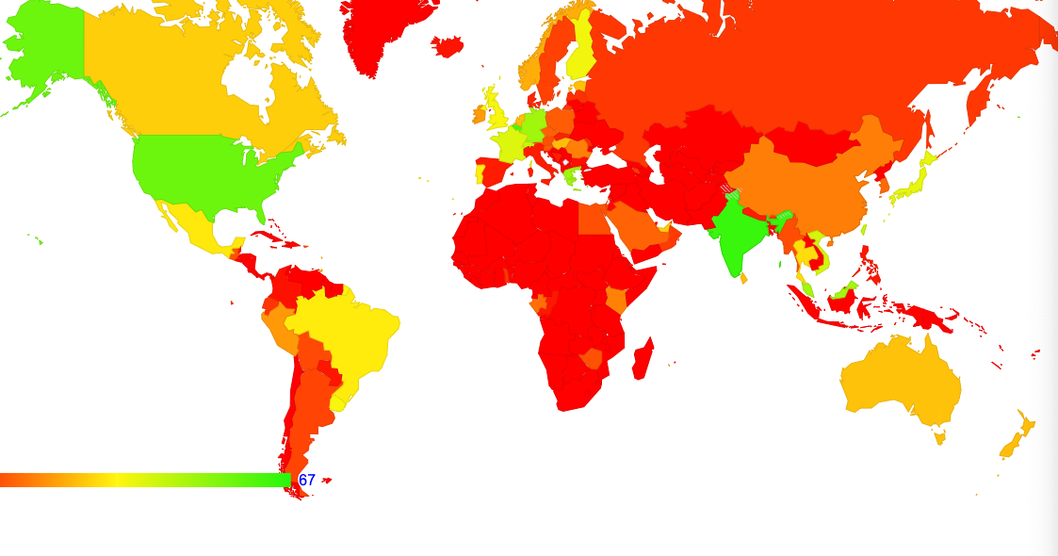
IPv6 Adoption by Country

Slide 53
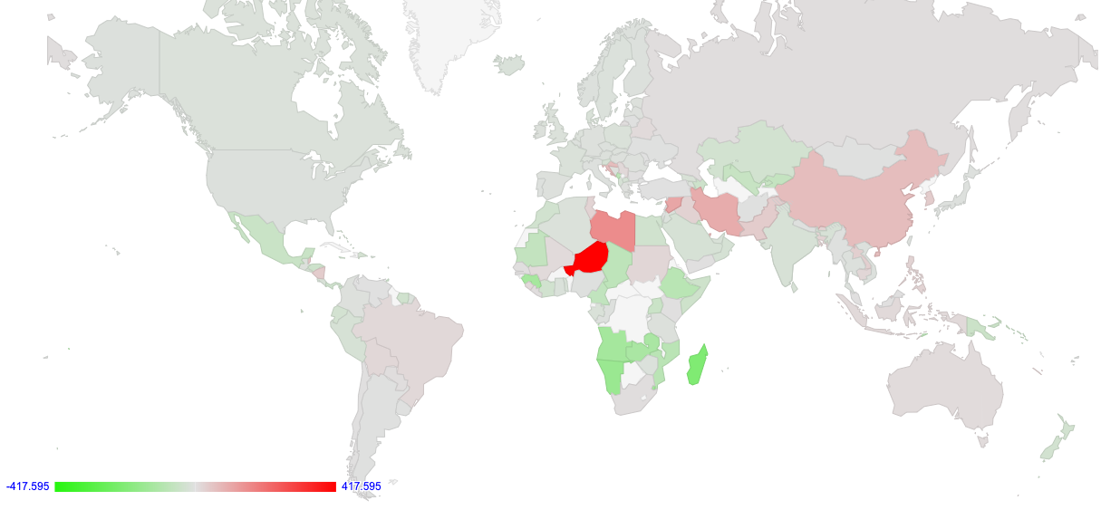
IPv6 Performance

Slide 54
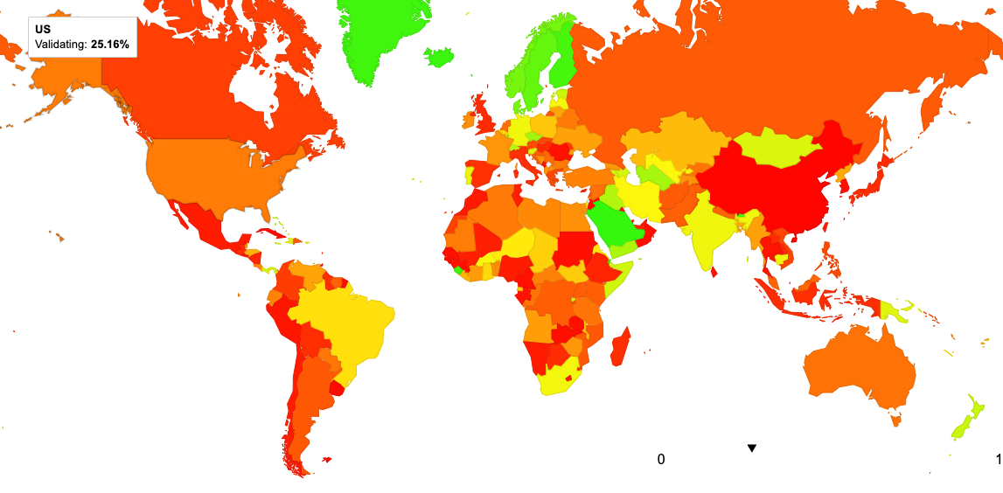
DNSSEC validation by Country

Slide 55
Users per Network

Slide 56
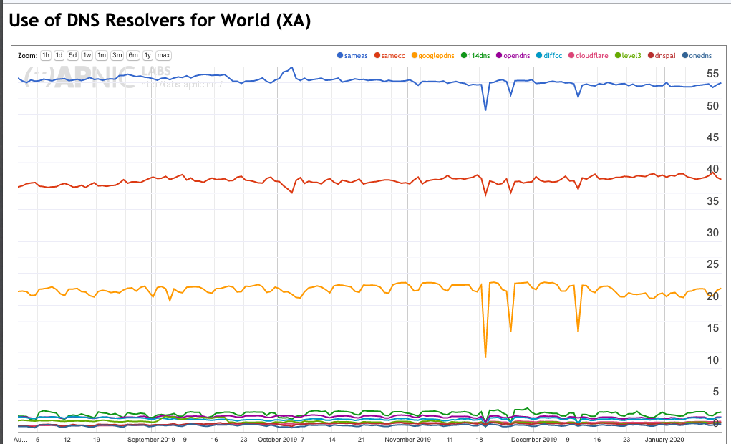
DNS Resolver Centrality

Slide 57
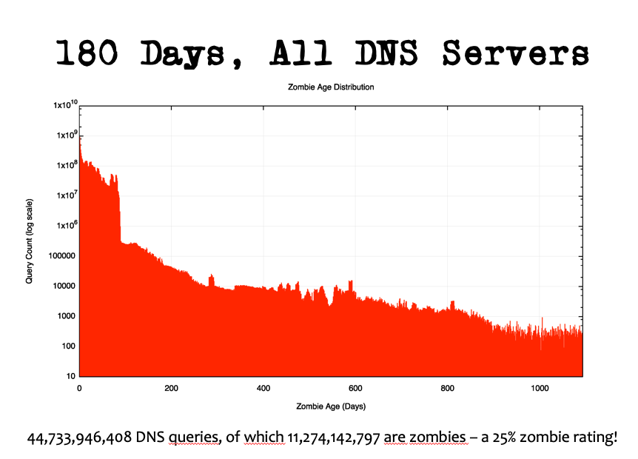
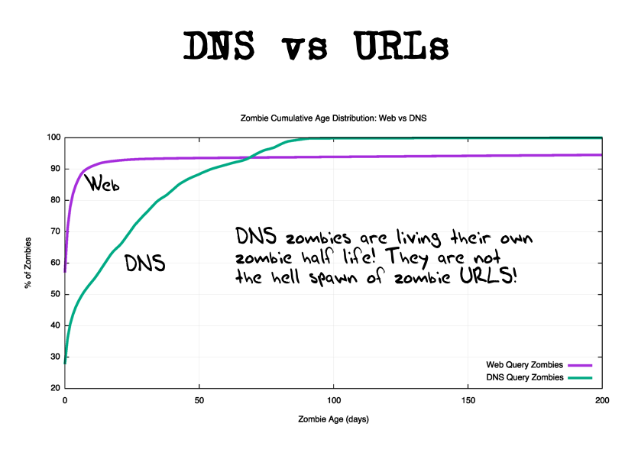
Zombies
Remember the use of the current time in the URL?
We can distinguish between “current” and “old” DNS and HTML queries

Slide 58
But…
It’s not a general purpose compute platform, so it can’t do many things
Ping, traceroute, etc
Send data to any destination
Pull data from any destination
Use different protocols
This is a “many-to-one” styled setup where the server instrumentation provides insight on the inferred behaviour of the edges

Slide 59
Measurement Ethics
There is no user consent
And cookies (even “don’t measurement me!” cookies) are progressively being frowned upon
Don’t generate large data volumes
Don’t publish PII
Don’t use ‘compromising’ URL names

Slide 60
In Summary…
Measuring what happens at the user level by measuring some artifact or behaviour in the infrastructure and inferring some form of user behaviour is always going to be a guess of some form
If you really want to measure user behaviour then its useful to trigger the user to behave in the way you want to study or measure
The technique of embedding simple test code behind ads is one way of achieving this objective
for certain kinds of behaviours relating to the DNS and to URL fetching

Slide 61
Thank You
Discussion?
labs

