Slide 1
IPv6 Transition: Why is this taking SO LONG!
Geoff Huston AM
Chief Scientist, APNIC

Slide 2
What’s the problem? Up and to the right, yes?
IPv6 Adoption Rates
2015
2017
2019
2021
2023

Slide 3
Oops!
What’s the problem? Up and to the right, yes?
30%
20%
10%
IPv6 Adoption Rates
2015
2017
2019
2021
2023

Slide 4
It’s been around a decade…
Since the RIRs handed out their last substantial IPv4 address blocks
We’ve been in a state of IPv4 “address exhaustion” for more than a decade
And yet the global uptake rate of IPv6 is a little over one third of the Internet’s user base
This is completely unexpected!

Slide 5
Projecting this Forward
2045

Slide 6
Projecting this Forward
Another 20 years of transition?
Seriously??
2045

Slide 7
What’s gone wrong here?

Slide 8
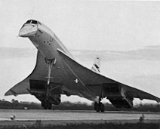
We had this plan …
IPv6 Deployment
Size of the
Internet
IPv6 Transition using Dual Stack
IPv4 Pool
Size
Time

Slide 9
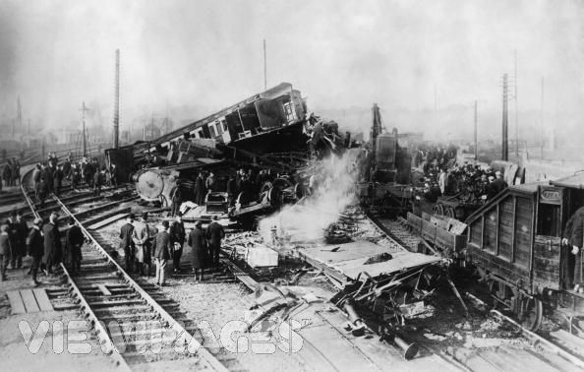
Dual Stack Transition Assumptions
That we could drive the entire transition to IPv6 while there were still ample IPv4 addresses to sustain the entire network and its growth
Transition would be driven by individual local decisions to deploy dual stack support
The entire transition would complete before the IPv4 unallocated pool was exhausted!

Slide 10
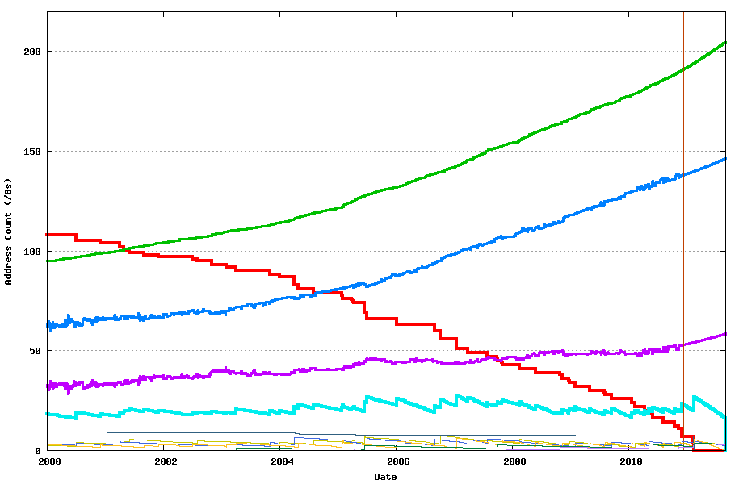
We strayed off-plan!
IPv4 Allocated Addresses
IPv4 Advertised Addresses
IANA Free Pool
IANA Exhaustion February 2011
First RIR Exhaustion July 2011

Slide 11
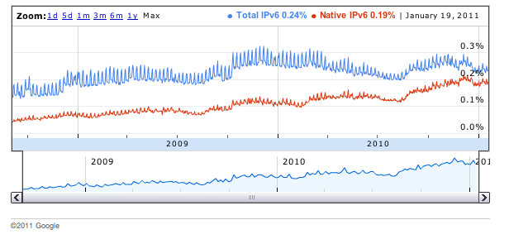
Where were we with IPv6 deployment?
http://www.google.com/intl/en/ipv6/statistics/

Slide 12
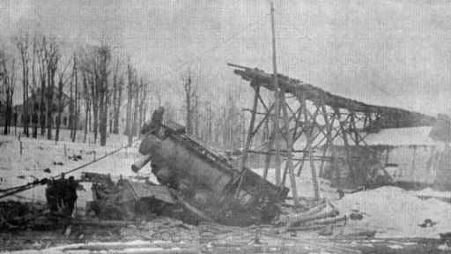
The 2012 IPv6 Transition Plan
IPv4 Pool Size
Size of the Internet
?
IPv6 Transition – Dual Stack
IPv6 Deployment
2004
2006
2008
2010
2012
Date

Slide 13
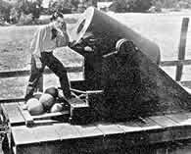
What next?
Despite the whinging from IETF purists over the compromise of a pristine end-to-end model there really was no other option:
The answer was NATs!

Slide 14
NATs
This low friction response to IPv4 address depletion had been used for more than a decade in client/server network architectures
Clients initiate a service transaction and only need an external address/port binding for the duration of the transaction
Servers sit in central data centres and share platform IP addresses using name-based distinguishers

Slide 15
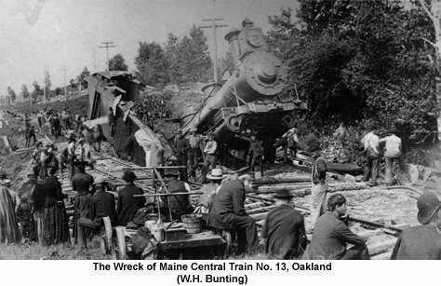
Making IPv4 Last Longer with NATs
For how long?
For what cumulative address demand?
For what level of fairness of access?
At what cost?
For whom?
To what end?
What if we actually achieve something different?
How would the Law of Unintended Consequences apply here?
Would this negate the entire “IPv6 is the solution” philosophy?

Slide 16
Because it wasn’t just an IPv4 to IPv6 transition
Follow the money…

Slide 17
The “Classical” Internet
IP was a network protocol that provided services to attached devices
It was the role of Network Providers to allow clients to consume content and access services
The costs of operating the network dominated the entire cost of the Internet
In networking distance dominates all cost models
In the Internet the role of transit providers were paramount
We used to spend all our time talking about peering and transit
ISPs were the brokers of rationing the scarce resource of distance capacity
apps
transport
$$$
network
media

Slide 18
What’s driving change today?
From scarcity to abundance!
For many years the demand for communications services outstripped available capacity
We used price as distribution function to moderate demand to match available capacity
But this is no longer the case – available capacity in the communications domain far outpaces demand

Slide 19
Abundant Capacity
Fibre cables continue to deliver massive capacity increases within relatively constant unit cost of deployment
https://www.ncbi.nlm.nih.gov/
(That 2022 number is probably low – at the end of 2022 we can pull 2.2T per lambda with a 190Gbd signal rate, giving a fibre capacity of 105T)

Slide 20
Abundant Compute Power
By Max Roser, Hannah Ritchie - https://ourworldindata.org/uploads/2020/11/Transistor-Count-over-time.png, CC BY 4.0, https://commons.wikimedia.org/w/index.php?curid=98219918

Slide 21
Abundant Storage
http://aiimpacts.org/wp-content/uploads/2015/07/storage_memory_prices_large-_hblok.net_.png

Slide 22
How can we use this abundance?
By changing the communications provisioning model from on demand to just in case
Instead of using the network to respond to users by delivering services on demand we’ve changed the service model to provision services close to the edge just in case the user requests the service
With this change we’ve been able to eliminate the factors of distance from the network and most network transactions occur over shorter network spans
What does a shorter network enable?

Slide 23
Bigger
Increasing transmission capacity by using photonic amplifiers, wavelength multiplexing and phase/amplitude/polarisation modulation for fibre cables
Serving content and service transactions by distributing the load across many individual platforms through server and content aggregation
The rise of high-capacity mobile edge networks and mobile platforms add massive volumes to content delivery
To manage this massive load shift we’ve stopped pushing content and transactions across the network and instead we serve from the edge

Slide 24
Faster
Reduce latency - stop pushing content and transactions across the network and instead serve from the edge
The rise of CDNs serve (almost) all Internet content and services from massively scaled distributed delivery systems.
The “Packet Miles” to deliver content to users has shrunk - that’s faster!
The development of high frequency cellular data systems (4G/5G) has resulted in a highly capable last mile access network with Gigabit capacity
Applications are being re-engineered to meet faster response criteria
Compressed interactions across shorter distances using higher capacity circuitry results in a much faster Internet

Slide 25
Better
If “better” means “more trustworthy” and “more privacy” then we are making progress at last!
Encryption is close to ubiquitous in the world of web services
TLS 1.3 is moving to seal up the last open TLS porthole, the SNI field
QUIC is sealing up the transport controls from the networks
Oblivious DNS and Oblivious HTTP is moving to isolate knowledge of the querier from the name being queried
The content, application, and platform sectors have all taken the privacy agenda up with enthusiasm, to the extent that whether networks are trustable or not doesn’t matter any more – all network infrastructure is uniformly treated as untrustable!

Slide 26
Cheaper
We are living in a world of abundant comms and computing capacity
And working in an industry when there are significant economies of scale
And its being largely funded by capitalising a collective asset that is infeasible to capitalise individually – the advertisement market
The result is that a former luxury service accessible to just a few has been transformed into an affordable mass-market commodity service available to all

Slide 27
And in all this, the money moved up the stack!
apps
$$$
apps
transport
$$$
network
Internal
Transport +
session security
transport
media
network
media

Slide 28
So, who needs to pay?
Networks need to make an investment to switch to a dual stack mode that includes IPv6
But neither the user base not the content world really care
And they are certainly not going to pay a premium to the network operator for IPv6 support
And in the application service world, IP addresses are not the critical resource

Slide 29
IPv4 Scarcity?
2024 IPv4 market
price is stable!

Slide 30
A Network of Names
Today’s public Internet is largely a service delivery network using CDNs to pull content and service as close to the user as possible
The multiplexing of multiple services onto underlying service platforms is an application-level function tied largely to TLS and service selection using SNI
The DNS is now used to perform “closest match” service platform selection, supplanting the role of routing
Most large CDNs run a BGP routing table with an average AS Path Length that is intended to converge to 1!

Slide 31
A new Internet Architecture
We’ve moved from end-to-end peer networks to client/server asymmetric networks
We’ve replaced single platform servers-plus-network to replicated servers-minus-network with CDNs
Clients aren’t identified with a unique public IP address – clients are inside NATs are uniquely identified only in a local context
Individual services aren’t identified with a unique public IP address – services are identified in the DNS

Slide 32
A new Internet Architecture
We’ve moved from end-to-end peer networks to client/server asymmetric networks
We’ve replaced single platform servers-plus-network to replicated servers-minus-network with CDNs
Clients aren’t identified with a unique public IP address – clients are inside NATs are uniquely identified only in a local context
Individual services aren’t identified with a unique public IP address – services are identified in the DNS
We’ve moved from address-based networks to name-based services

Slide 33
What am I saying?
We’ve been able to take a 1980’s address-based architecture and scale it more than a billion-fold by altering the core reliance on distinguisher tokens from addresses to names
There was no real lasting benefit in trying to leap across to just another 1980’s address-based architecture (with only a few annoyingly stupid differences, apart from longer addresses!)

Slide 34
Today’s Internet:
Names Matter
The DNS Matters

Slide 35
Today’s Internet:
Names Matter
The DNS Matters
Addresses not so much
Address-based Routing not so much

Slide 36
Longer Term Trends?
Pushing EVERYTHING out of the network and over to applications
Transmission infrastructure is becoming an abundant commodity
Network sharing technology (multiplexing) is decreasingly relevant
We have so much network and computing that we no longer have to bring consumers to service delivery points - instead, we are bringing services towards consumers and using the content frameworks to replicate servers and services
With so much computing and storage the application is becoming the service, rather than just a window to a remotely operated service

Slide 37
Do Networks matter any more?
We have increasingly stripped out network-centric functionality in our search for lower cost, higher speed, and better agility
We are pushing functions out to the edge and ultimately off “the network” altogether and what is left is just dumb pipes
What defines “the public Internet”?
A common shared transmission fabric, a common suite of protocols and a common protocol address pool?
or
A disparate collection of services that share common referential mechanisms using a common name space?

Slide 38
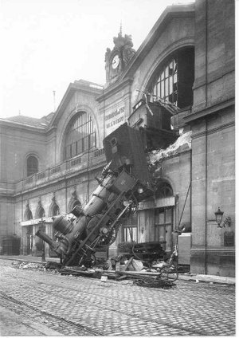
Thank You!

