Slide 1
What happened to IP Addresses in 2024?
Geoff Huston AM
Chief Scientist, APNIC

Slide 2
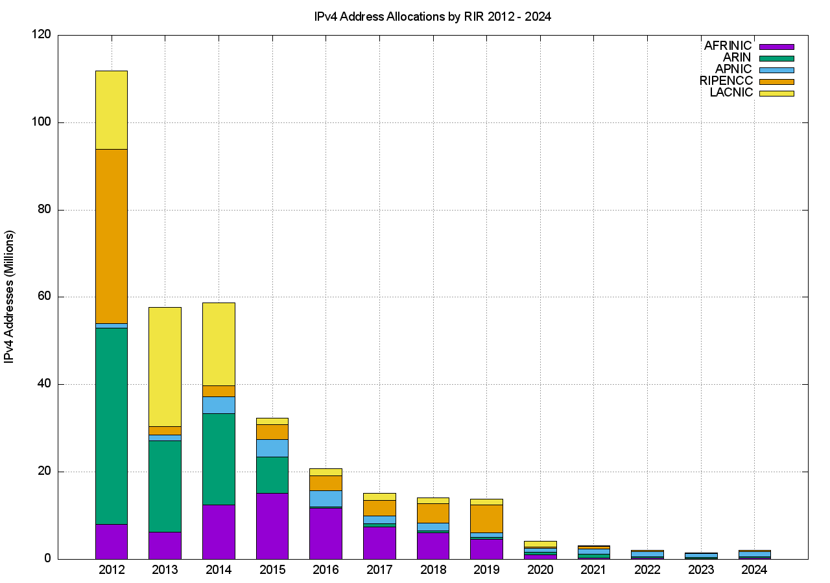
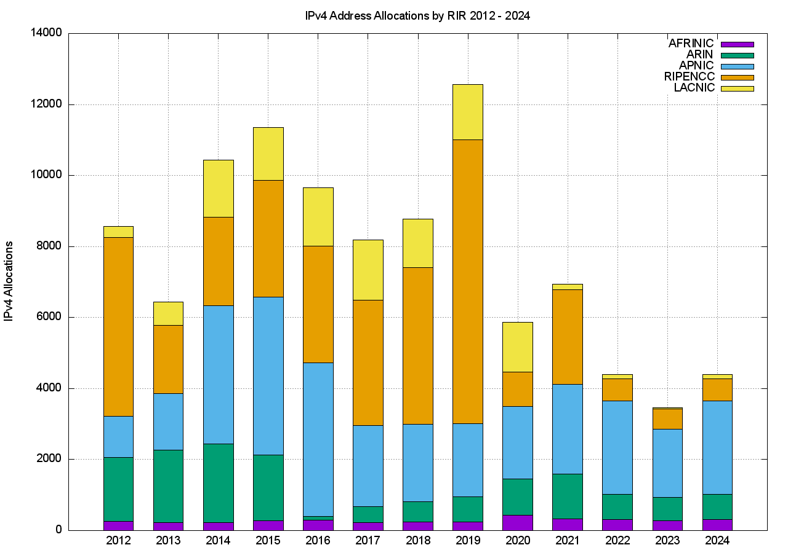
IPv4 Address Allocations
Addresses
Allocation Transactions
4,200 allocations
1.2M addresses

Slide 3
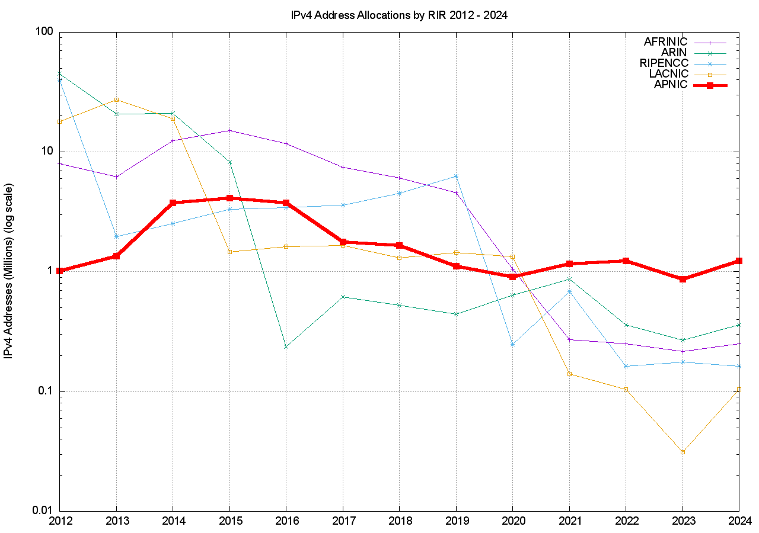
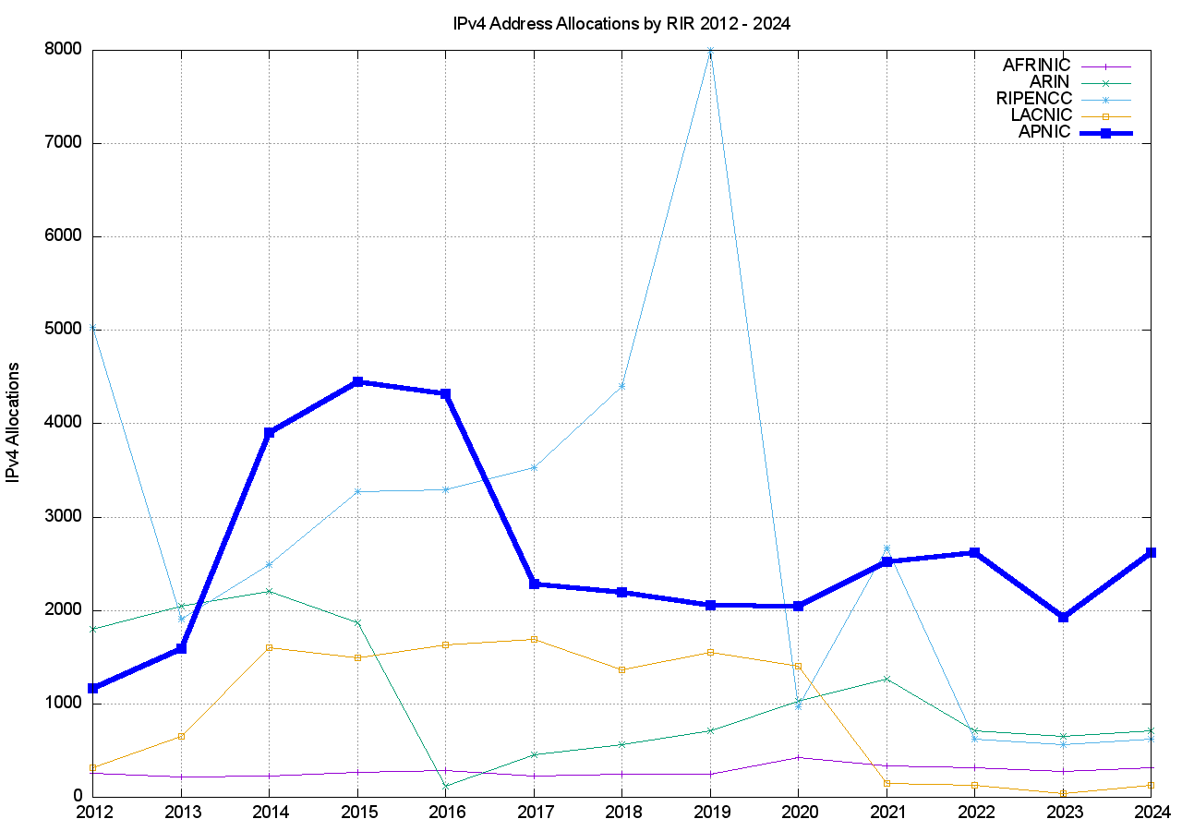
IPv4 Address Allocations
Addresses
Allocation Transactions
Notes:
APNIC had sustained a higher IPv4 address allocation rate, both in addresses and allocation transactions compared to the other RIRs over 2022

Slide 4
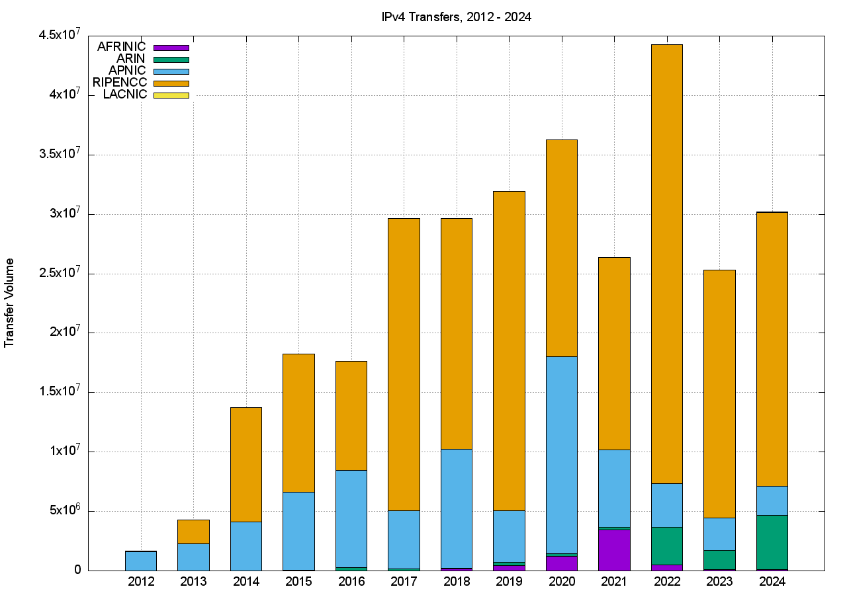
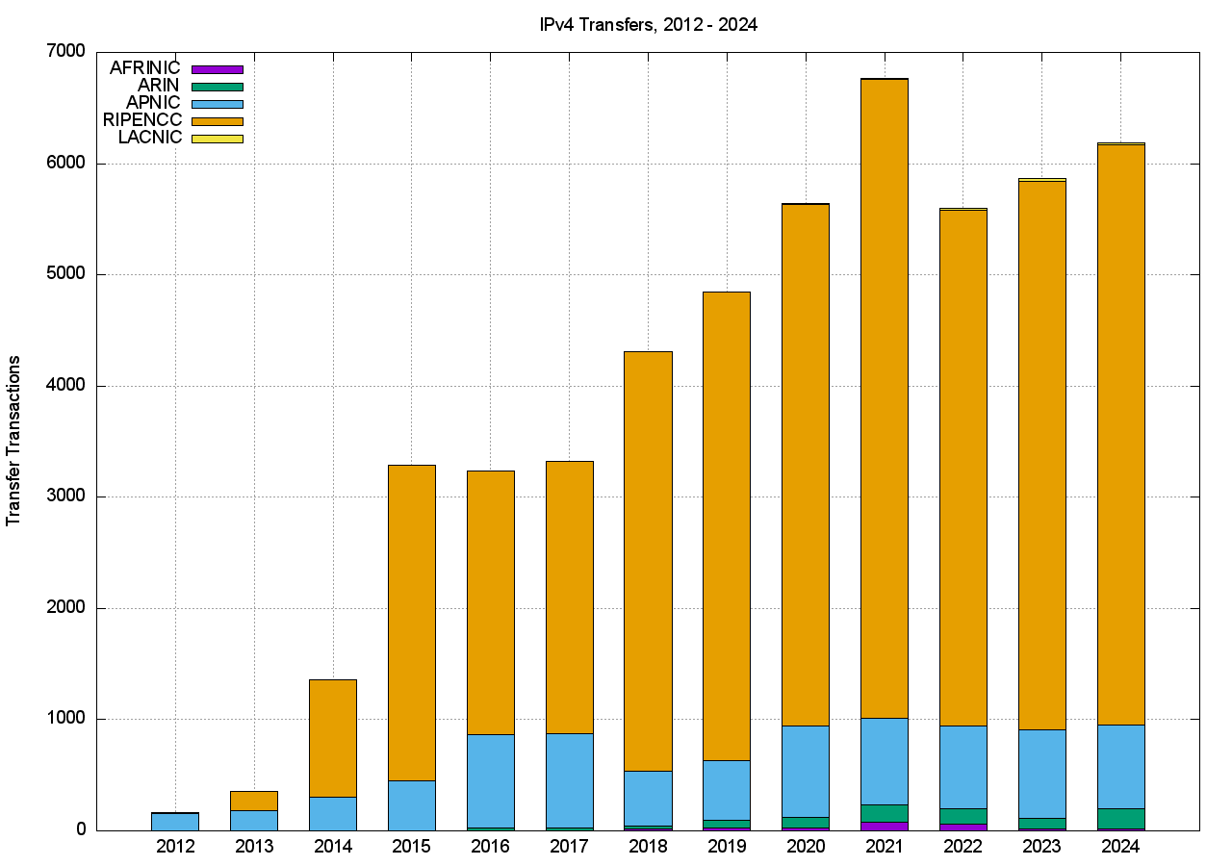
IPv4 Address Transfers
Addresses
Transfer Transactions
6,184 transactions
30M addresses

Slide 5
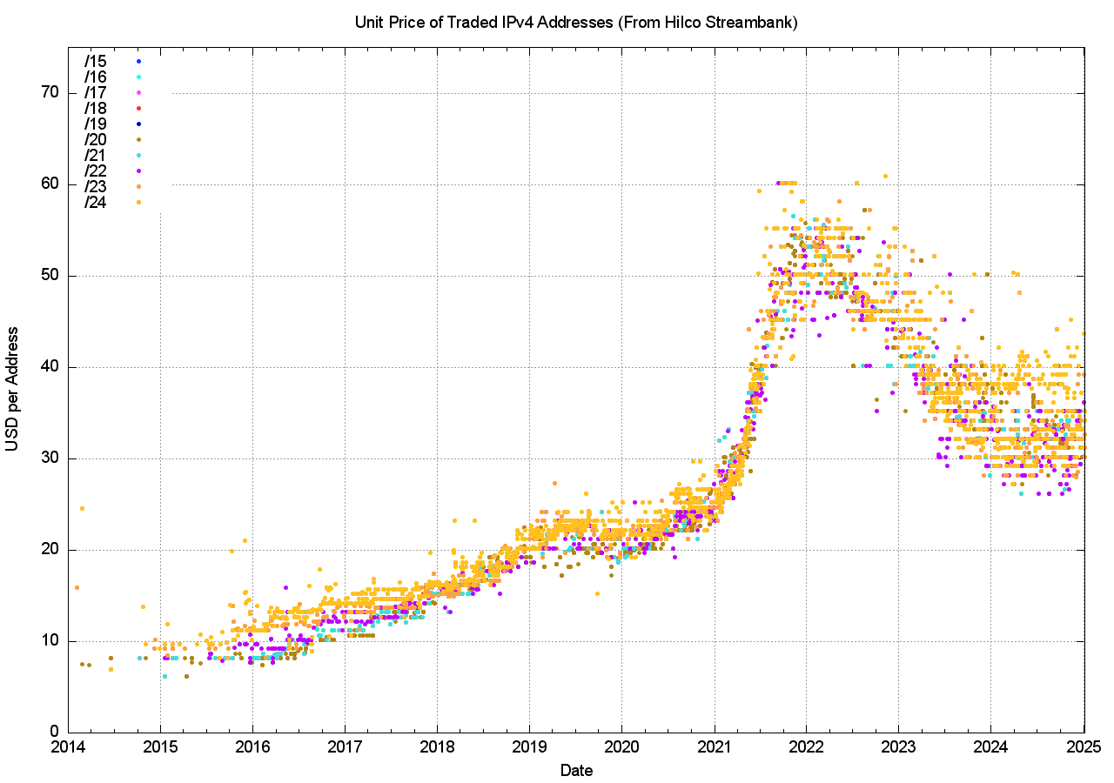
Transfer Pricing
The market price per address doubled across 2021 to peak at the start of 2022
The average price dropped by 35% since the 2022 peak
The variance in prices has increased significantly since 2021

Slide 6
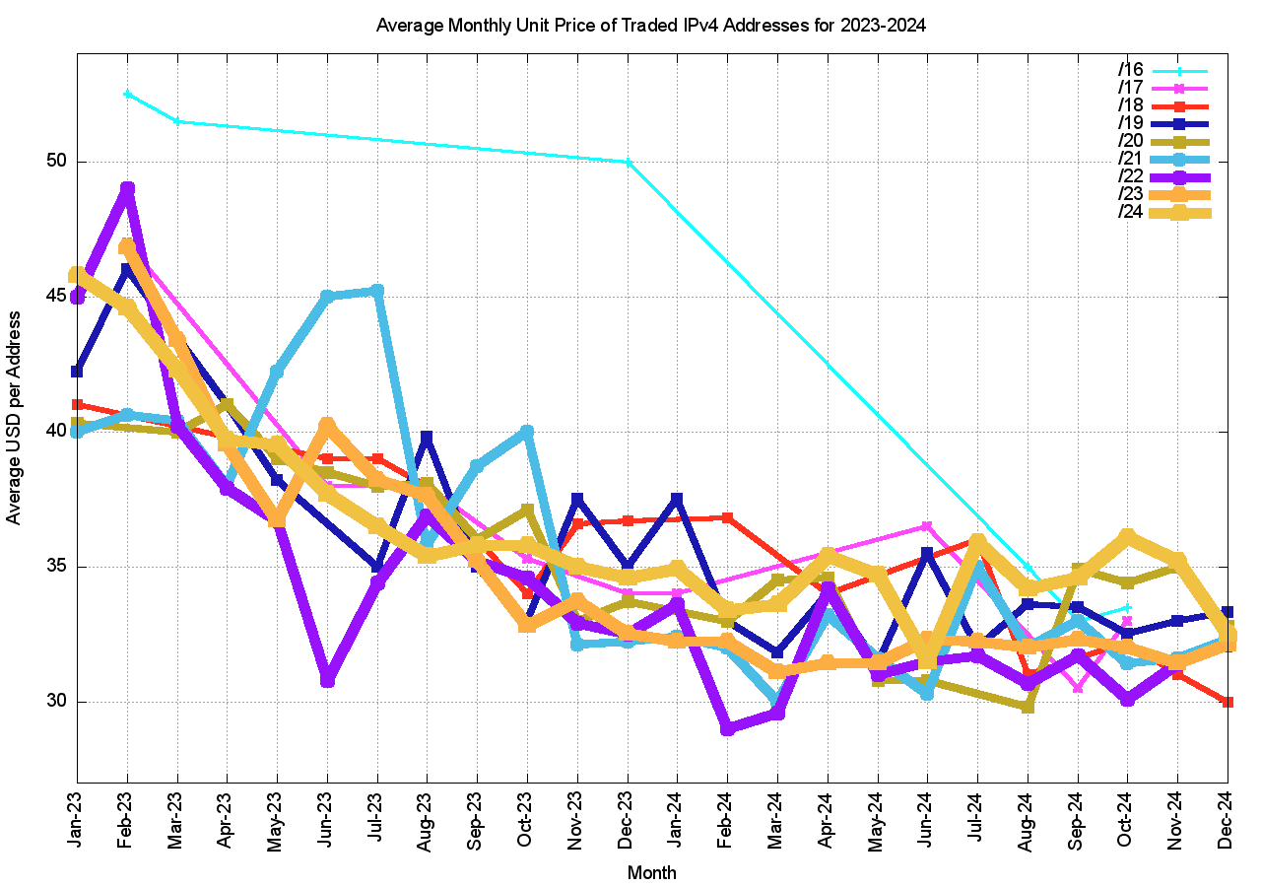
Transfer Pricing
Average prices month-by-month have been relatively stable for the past 24 months
The trend was falling over 2023 and stable over 2024
Price variation appears to reflect a preference for trading in-region – buyers appear to prefer to trade in-region even if there is a slight price premium

Slide 7
Who’s Selling and Who’s Buying
Selling
Buying

Slide 8
Imports and Exports

Slide 9
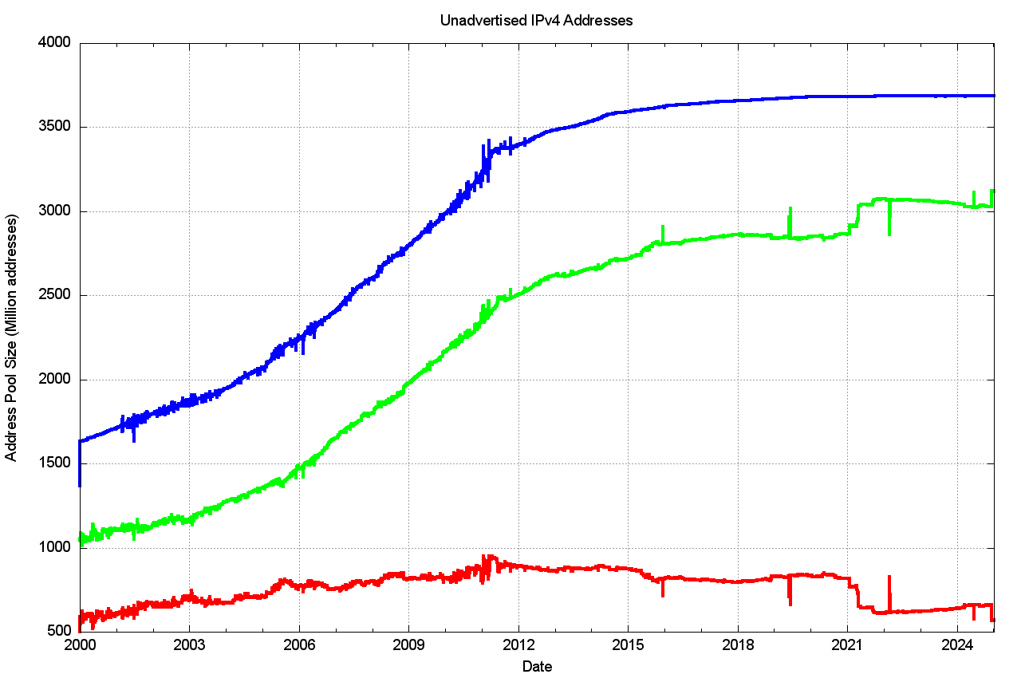
Are Transfers recovering unused addresses?
Allocated Address Pool
Advertised Address Pool
Unadvertised Address Pool

Slide 10
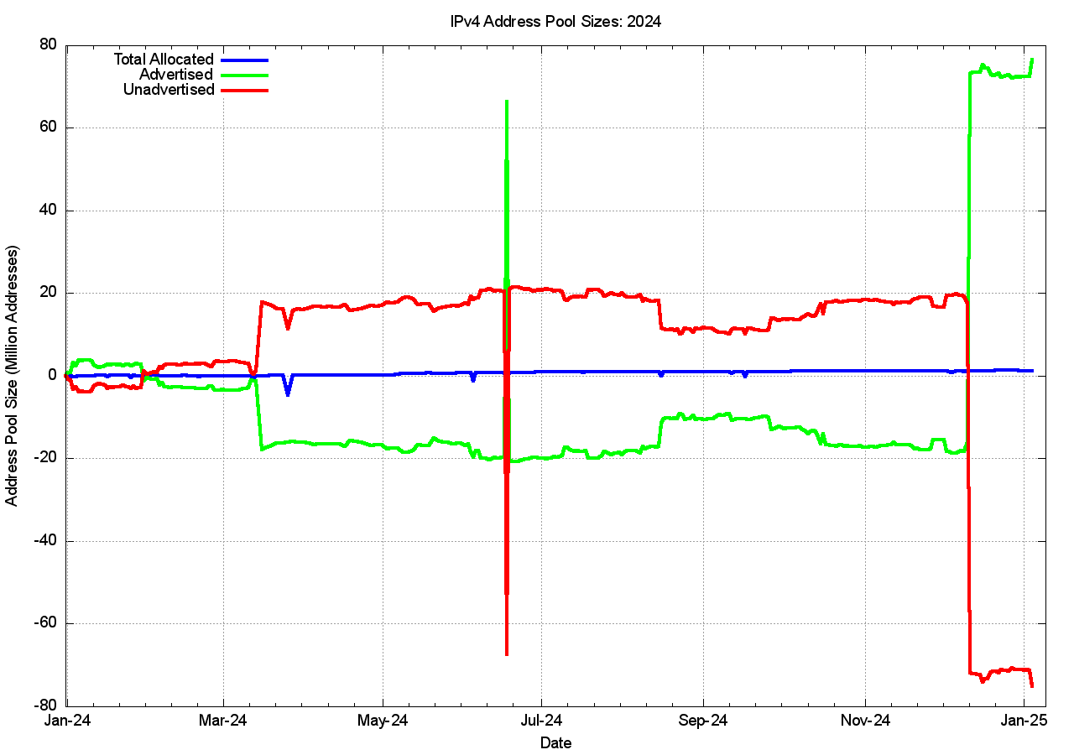
Are Transfers recovering unused addresses?
Advertised Address Pool
+78M addresses
Amazon Advertisement
Allocated Address Pool
+1.2 M addresses
Unadvertised Address Pool
-78M addresses

Slide 11
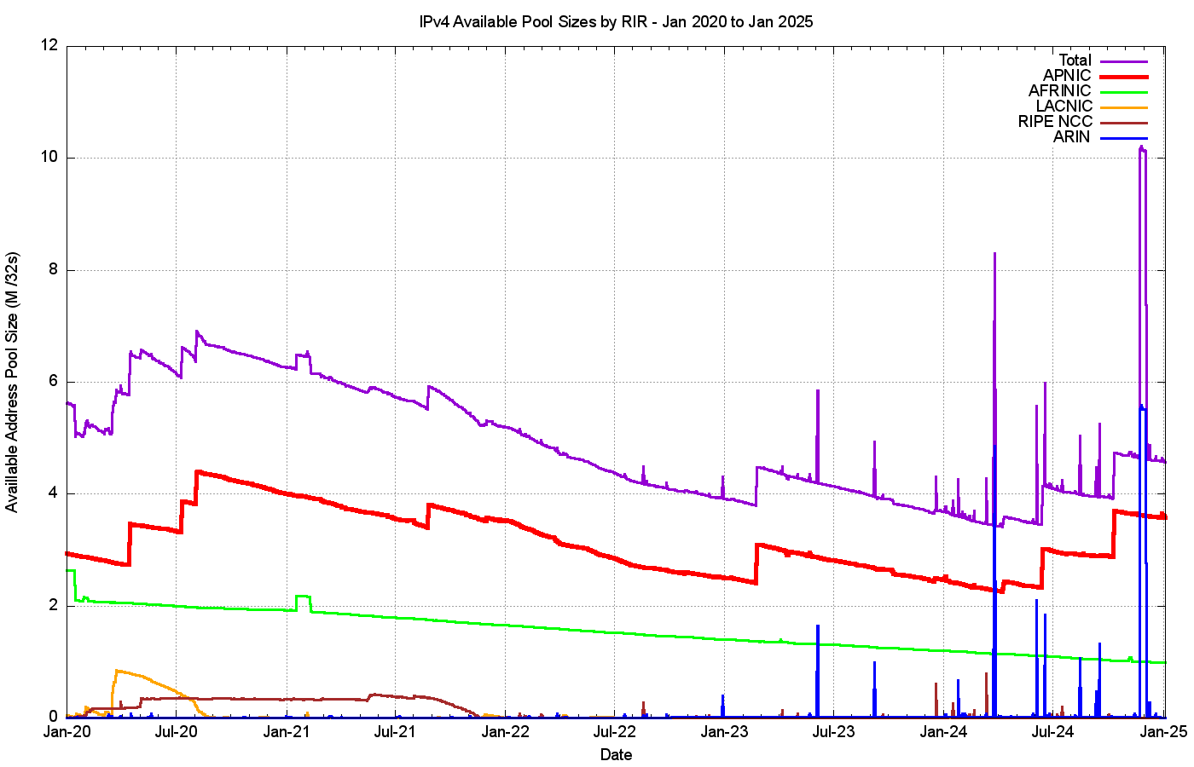
RIR “Available” Address Pools
Only APNIC and AfriNIC have residual available address pools
TOTAL
APNIC
AFRINIC
ARIN
LACNIC
RIPE NCC

Slide 12
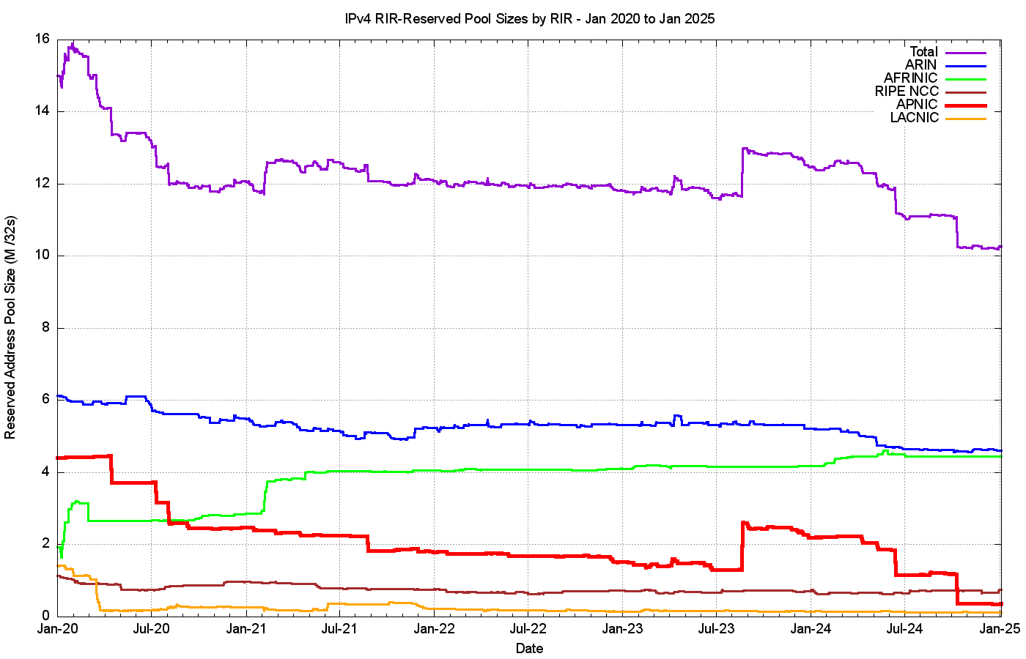
RIR “Reserved” Address Pools
ARIN
AFRINIC
RIPE NCC
APNIC
LACNIC

Slide 13
IPv4 in 2024
IPv4 scarcity pressure continues to fall across 2024:
  Signs of market saturation in many mature Internet markets
  More IPv6-accessible service deployments relieving IPv4 NAT pressures for ISPs
  Stable market prices for IPv4 addresses
  Lower pressure to release unadvertised addresses through the transfer market

Slide 14
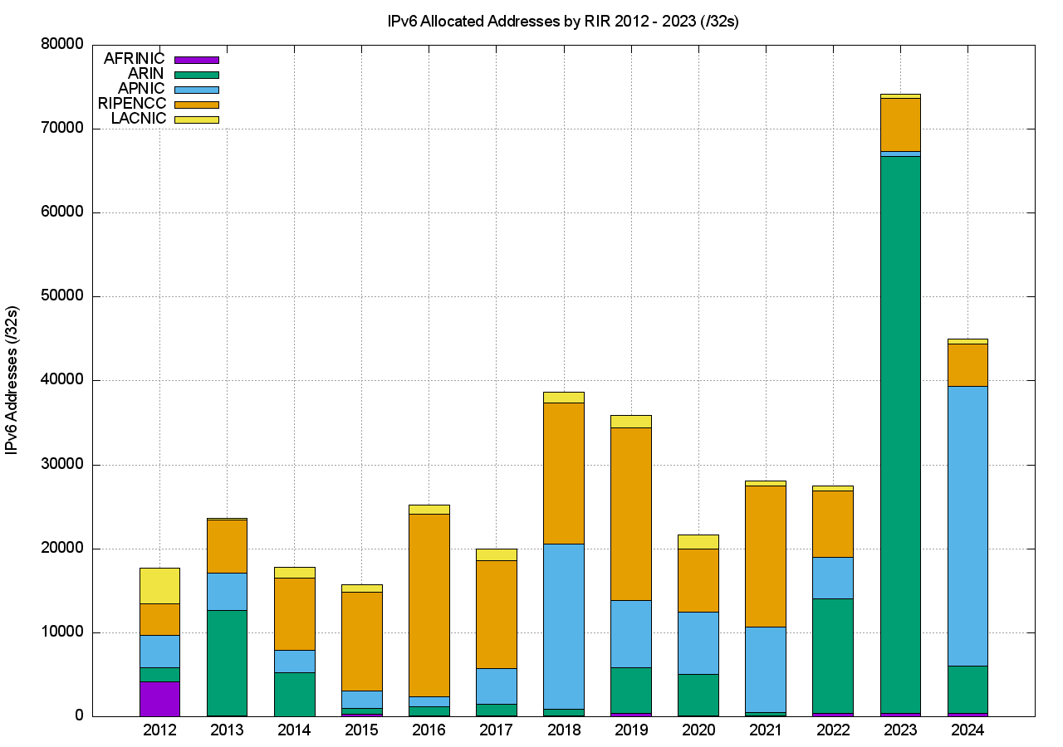
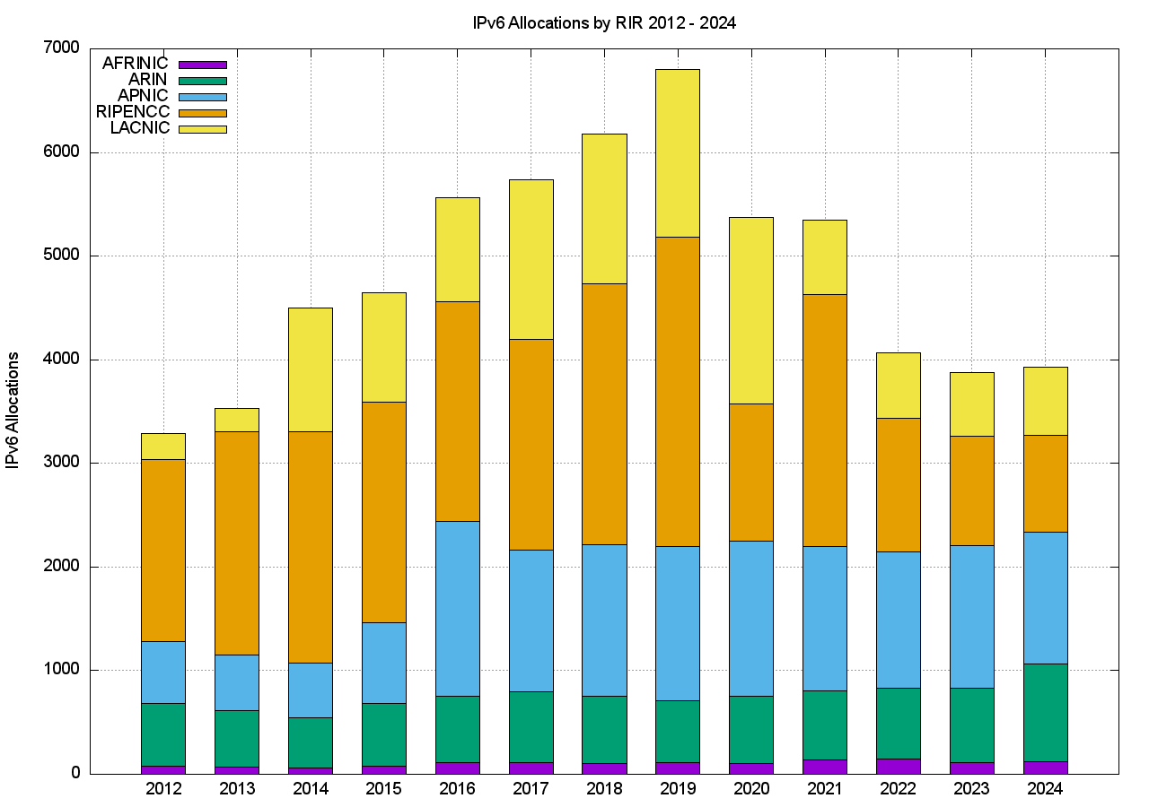
IPv6 Address Allocations
Addresses
Allocation Transactions
3,900 allocations
45,000 /32 addresses

Slide 15
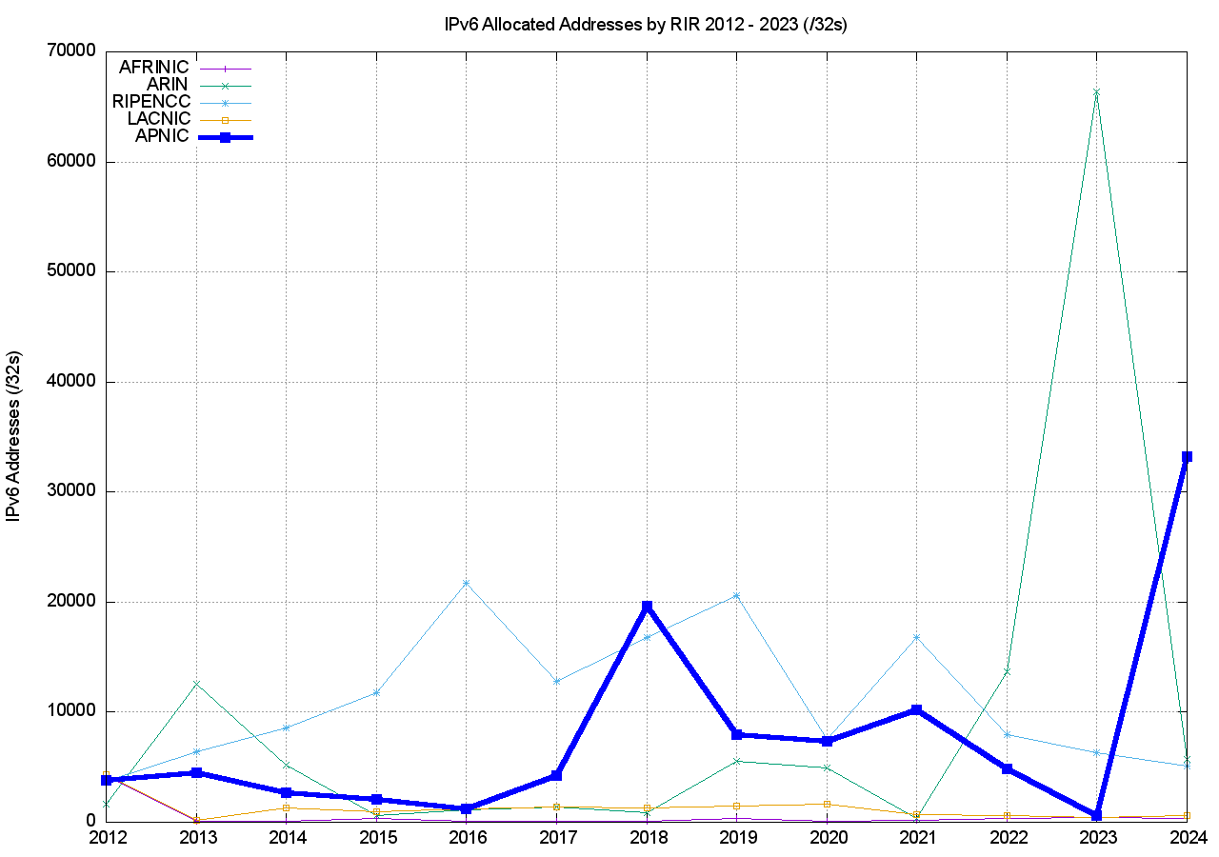
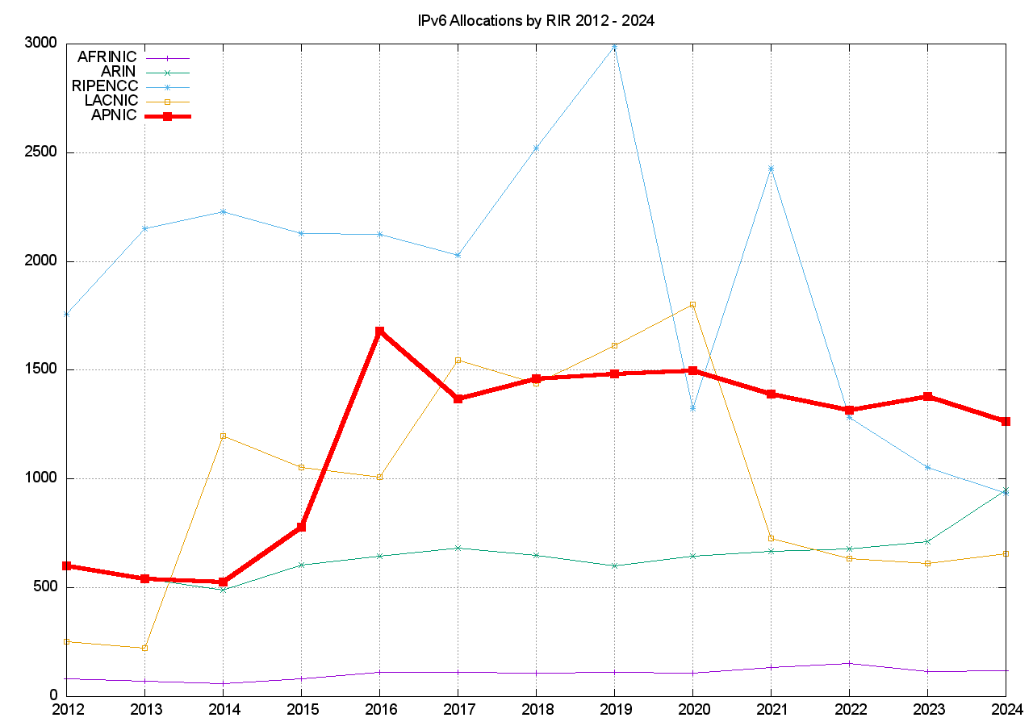
IPv6 Address Allocations
Addresses
Allocation Transactions

Slide 16
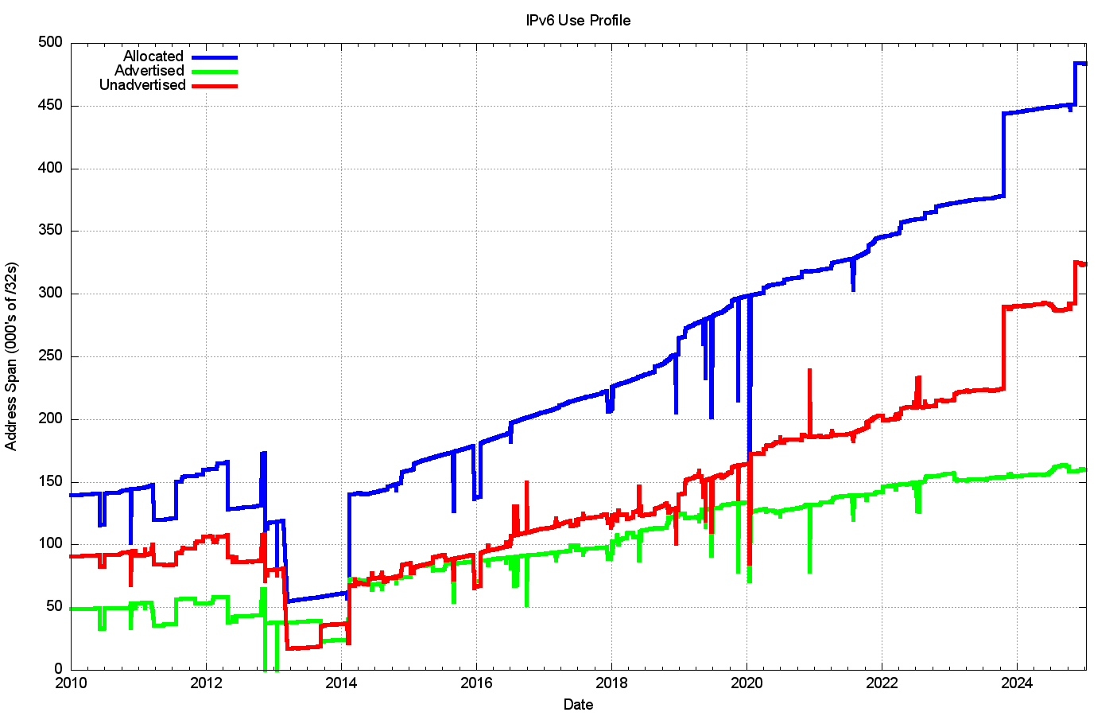
IPv6 Address Pools
Allocated Address Pool
Unadvertised Address Pool
Advertised Address Pool

Slide 17
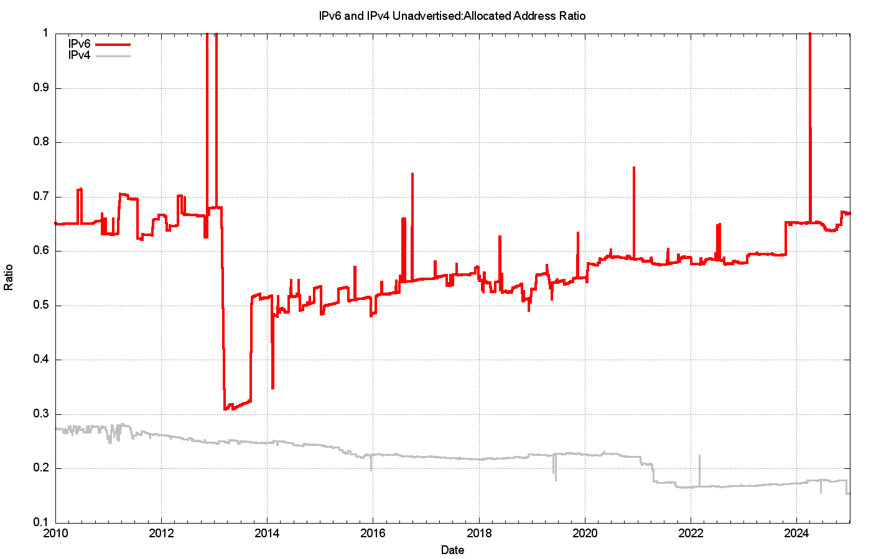
Unadvertised : Advertised Ratio
IPv6
IPv4

Slide 18
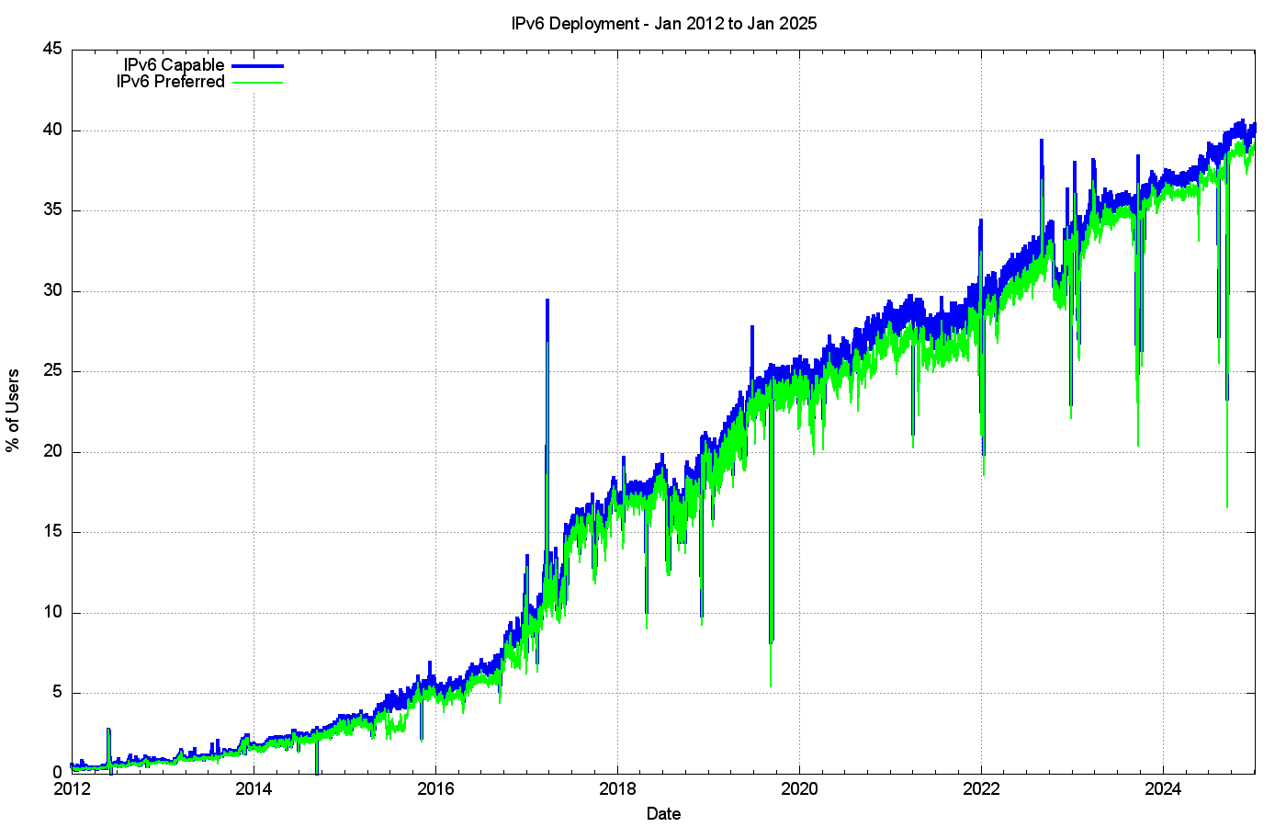
IPv6 Deployment

Slide 19
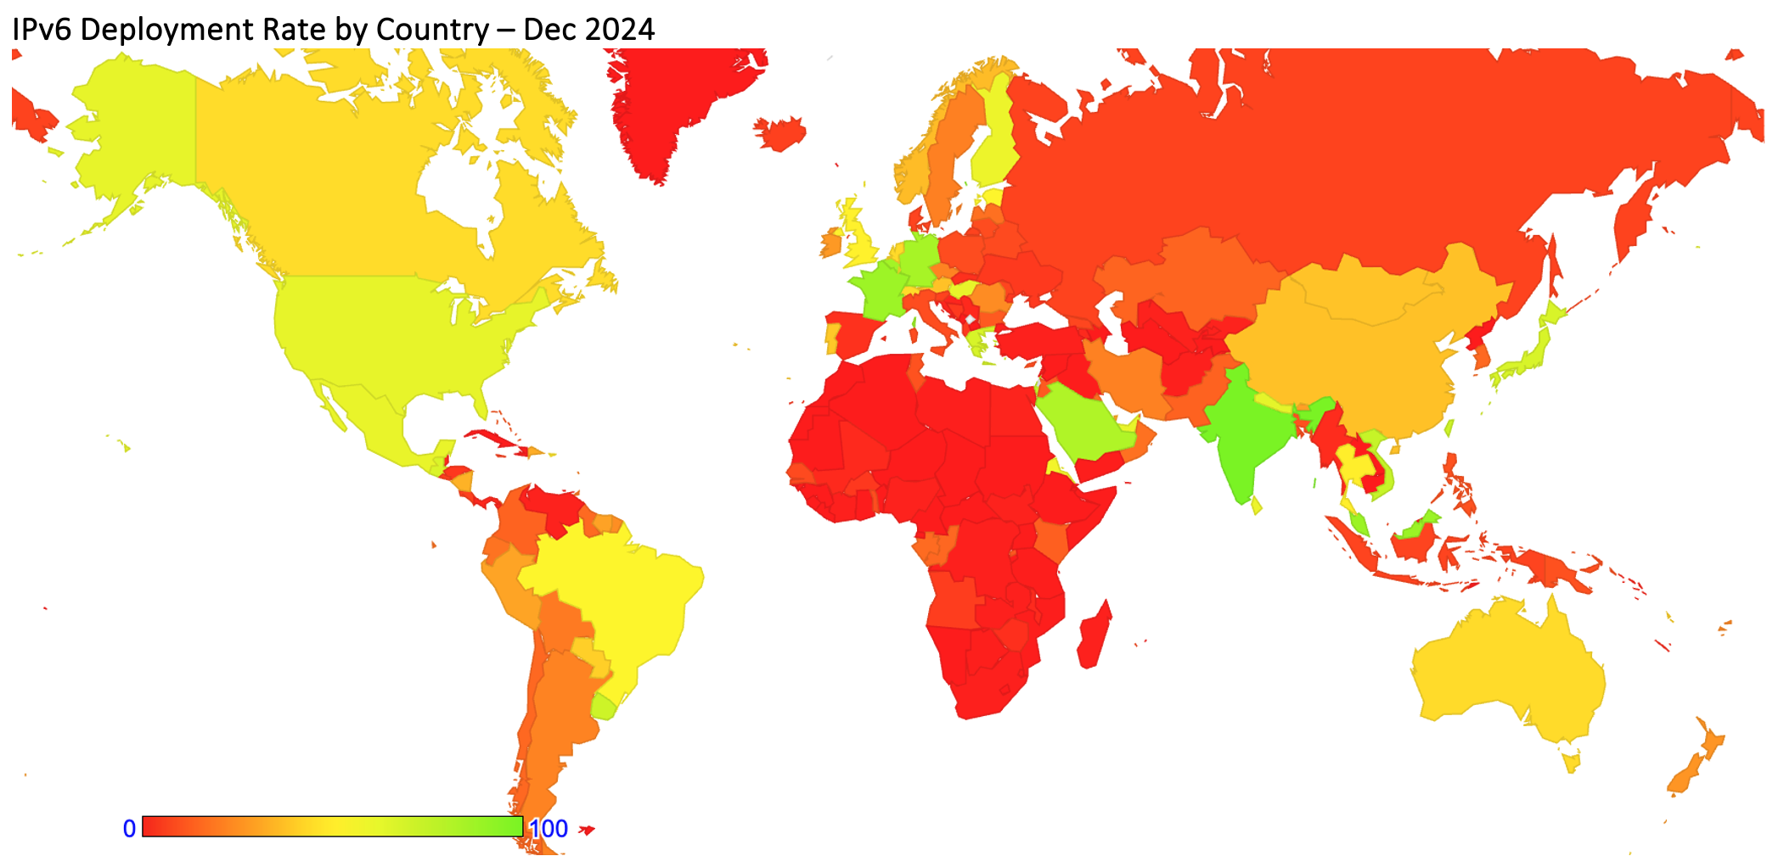
IPv6 Deployment

Slide 20
IPv6 in 2024
Steady IPv6 deployment in access networks is allowing more services to operate in dual stack mode - this is relieving pressure on the IPv4 address pools
Large address allocations in IPv6 mean that there is no pressure to deploy IPv6 using highly efficient deployments
IPv6 address consumption rates are tapering off – are we reaching a market saturation point?

Slide 21
Thanks!

