Slide 1
What’s going on with IPv6?
Geoff Huston AM
Chief Scientist, APNIC

Slide 2
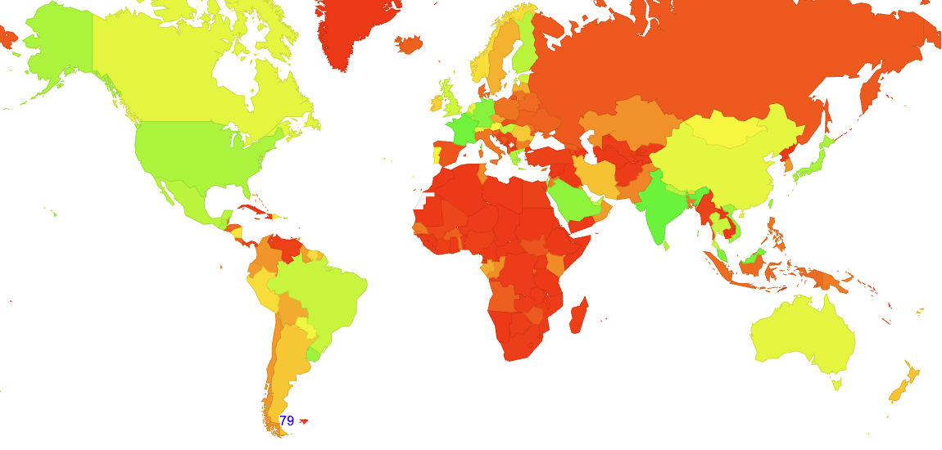
IPv6 Today
0%
80%
Per-Economy IPv6 Deployment Measurement - % of Users with IPv6

Slide 3
IPv6 Today

Slide 4
Projecting IPv6 Adoption
We are here
% of the Internet’s User Base with IPv6
IPv6 Adoption over the past decade
2045!
Year

Slide 5
This is unexpected
Back in the early nineties when the Internet was just picking up momentum NOBODY could conceive that a transition to IPv6 would take longer than five years - tops!
A total timeframe to complete this transition from start to finish of fifty years was unthinkable!
But that is where we are
Why?

Slide 6
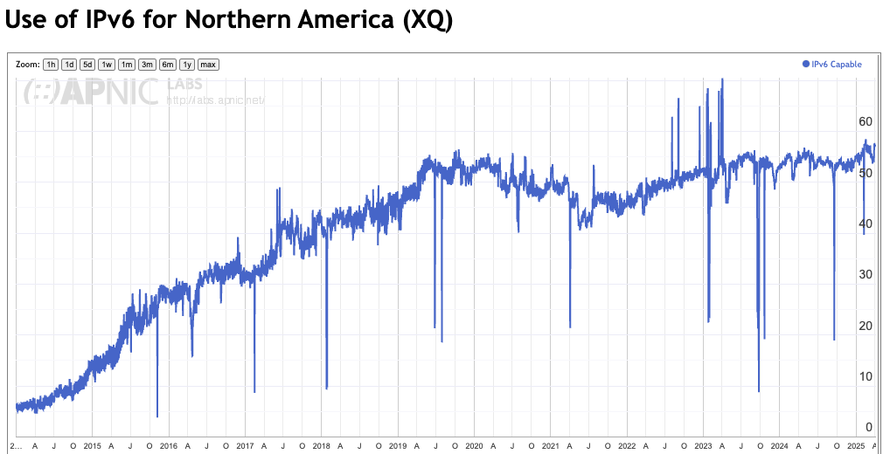
Not everyone is feeling the pressure to adopt IPv6
Is this now a steady state?
% of Users
2020
2022
2024
https://stats.labs.apnic.net/ipv6/XQ

Slide 7
Networks are different from each other
Small to medium scale networks with low growth probably feel little pressure to introduce IPv6 dual stack
Existing customer requirements are being met with IPv4
Low growth means little pressure to increase the address pools beyond current levels
Any expenditure to introduce dual stack becomes a cost without any increased revenue to offset this cost

Slide 8
Networks are different from each other
Large scale networks with continued growth will see this differently
The way to alleviate the IPv4 scarcity pressure is to use Dual Stack and rely on end client preference to prefer to use IPv6 (Happy Eyeballs)
And place pressure on service provider platforms to adopt IPv6

Slide 9
What does “success” look like?
It’s likely that IPv4 will persist for many decades to come
There is no significant functional difference between the two protocols
Established IPv4 networks do not feel under any pressure to change to Dual Stack if their network is providing an acceptable level of service and functionality to their users
And that means that a target of 100% IPv6 adoption is not likely in every economy in the near to medium term
In which case do we need to revise our definition of “success” for IPv6 adoption?
Maybe 100% adoption is just too ambitious in this timeframe – Perhaps we need to rethink what ”success” means

Slide 10
India – Success?
77%

Slide 11
Saudi Arabia – Success?
65%

Slide 12
Finland – Success?
55%

Slide 13
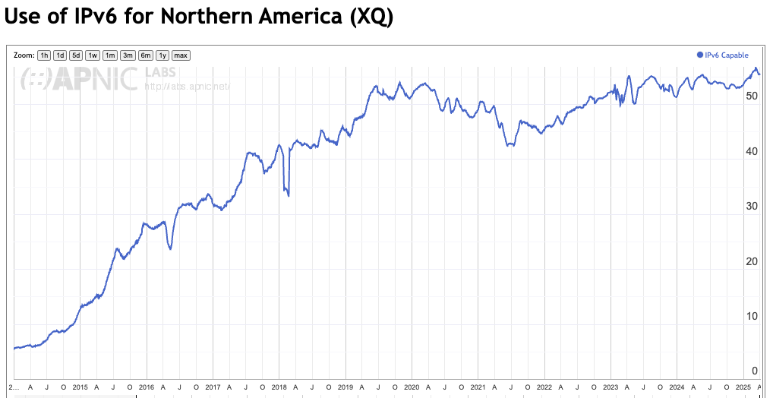
North America – Success?
55%

Slide 14
Taiwan – Success?
60%

Slide 15
China – more to come?
45%

Slide 16
When can we declare “success”?
Clearly, across all of Africa, much of the Middle East, Western Asia and Southern Europe, the Internet infrastructure in incapable of sustaining further growth without some effort to support integration of dual stack platforms. In these geographies IPv6 adoption still demands further attention.
But in many other economies it may be that we have already achieved “success” in this effort, and there is little more to be gained by pushing the IPv6 adoption message in these areas.

Slide 17
Why has the Transition effort fragmented?
We’ve been used to talking about “the Internet” as it it was a single entity, where users and network service providers both operate within the constraints of similar pressures and opportunities
This is obviously not the case these days
Network service providers are feeling increased pressure to commoditize their service offerings
Because the internal economy of the Internet is changing…

Slide 18
The network economy is changing
Value has moved up the protocol stack from carriage to content and service
apps
$$$
apps
transport
$$$
network
Internal
Transport +
session security
transport
media
network
media

Slide 19
So, who pays for the IPv6 transition?
Networks need to make the investment to switch to a dual stack mode that includes IPv6
But neither the user base nor the content distribution world really care
And they are certainly not going to pay a premium to the network operator for IPv6
And in the application service world, IP addresses are not the critical resource any more
We’ve changed the “currency” of networks!

Slide 20
What does this mean?
We no longer operate within a strict address-based network architecture
Clients no longer use a permanent unique public IP address to communicate with servers
Servers no longer use a permanent unique public IP address to communicate with clients
Address scarcity takes on a different dimension when you don’t need public addresses to uniquely number every host and service

Slide 21
A Network of Names
Today’s public Internet is largely a service delivery network using CDNs to push content and service as close to the user as possible
The multiplexing of multiple services onto underlying service platforms is an application-level function tied largely to TLS and service selection using SNI
The DNS is now used to perform “closest match” service platform selection, supplanting the role of routing
Most large CDNs run a BGP routing table with an average AS Path Length that is intended to converge to 1!

Slide 22
A new Internet Architecture
We’ve moved from end-to-end peer networks to client/server asymmetric networks
We’ve replaced single platform servers-plus-network to replicated servers-minus-network with CDNs
Clients aren’t identified with a unique public IP address – clients are inside NATs are uniquely identified only in a local context
Individual services aren’t identified with a unique public IP address – services are identified in the DNS

Slide 23
A new Internet Architecture
We’ve moved from end-to-end peer networks to client/server asymmetric networks
We’ve replaced single platform servers-plus-network to replicated servers-minus-network with CDNs
Clients aren’t identified with a unique public IP address – clients are inside NATs are uniquely identified only in a local context
Individual services aren’t identified with a unique public IP address – services are identified in the DNS
We’ve moved from address-based networks to name-based services

Slide 24
What am I saying?
The slow uptake of IPv6 is not because this industry is chronically stupid or short sighted
There is something else going on here…
In our efforts to deliver bigger, faster, cheaper services we’ve moved our attention away from the IP level of the protocol stack and today the concentrated effort lies in services and applications
In many economies network providers have now done what they can with IPv6, and its now about user devices and their lifecycles. There is adequate momentum to continue IPv6 deployment through coming years!

Slide 25
Thank You!

